Slide 1
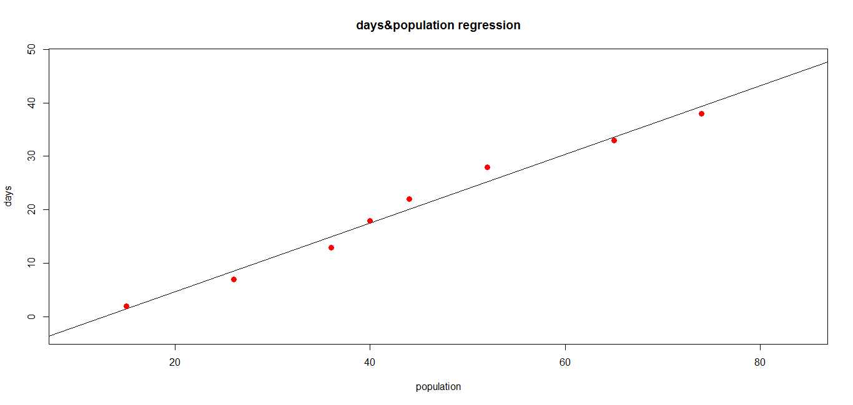
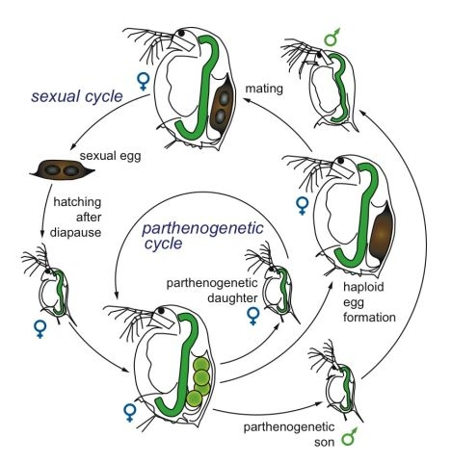
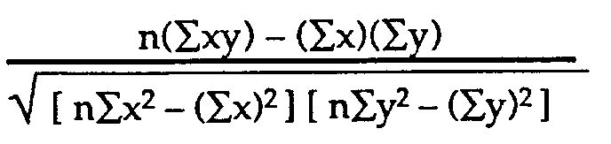
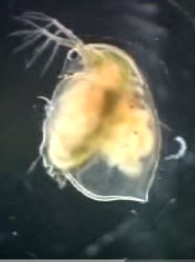
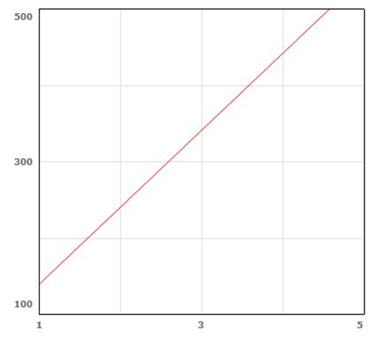
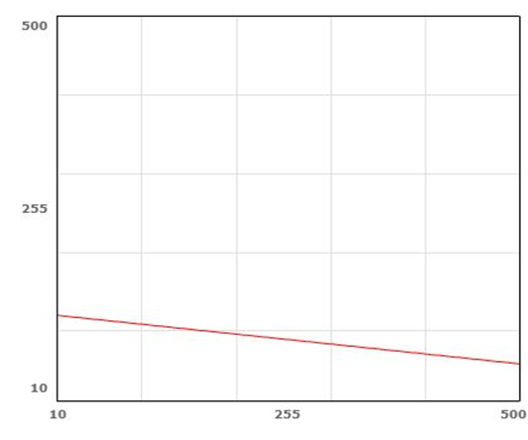
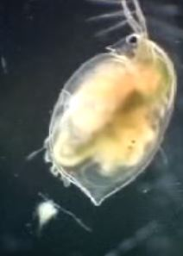
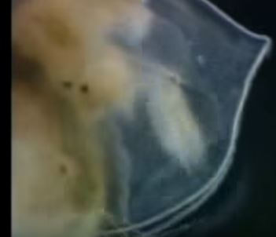
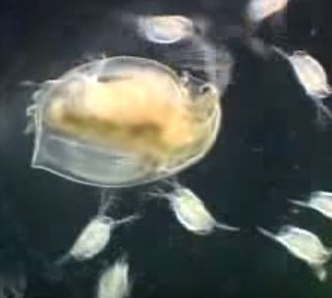

Establishment of Daphnia culture for studying population modelling and drug testing .
Hemant Singh, Sumit Kumar
Cluster Innovation Centre
University of Delhi, Delhi-110002, India.
Hemant.singh404@gmail.com, sumitjangid05aug@gmail.com
INTRODUCTION
One of the most common crustaceans to be found in lakes, ponds and quiet streams is the 'water flea', Daphnia. These tiny animals are usually less than 3mm in size, so you could put dozens of them on a single fingernail. They're not really fleas – in fact they're not insects at all, but rather crustaceans, more closely related to crabs and shrimp. Daphnia has a transparent body and thus its heartbeat can be observed easily , the heartbeat of daphnia responds to environmental stress in different manners and is very useful to detect the toxicity or change in the environment.
EXPERIMENTAL DETAILS
OBSERVATIONS
Initial population was taken as 10 individuals
Daphnia was cultured using milk (1mg) and its population model was constructed over the time interval of 40 days using its exponential and logistic growth.
The population overtime was studied and predicted for the future by linear regression method.
Two drugs which contain alcohol and caffeine was tested.
The heart rate of daphnia was studied under exposure to these chemicals.
Based on the observations correlation coefficient was calculated which described how a drug is affecting the heart rate of Daphnia.
The population model
Exponential equation:
P(t) = 10$e^{1.053t}$
Logistic equation:
P(t) = $\frac{p_{0}R}{ {p_{0}+e}^{−kt}\left(R−p_{0}\right)}$ = $\frac{(10)(1000)}{ {10+e}^{−1.053t}\left(1000−10\right)}$
Linear regression equation: y = 1.533x+13.145
Correlation coefficient calculation formula
R =
Effect of caffeine effect of alcohol
Life Cycle of Daphnia
RESULTS
Population prediction for 40-45 days = 79
Population prediction for 45-50 days= 85
Correlation coefficient for caffeine and heartbeat=1.03
Correlation coefficient for alcohol and heartbeat= -0.11
REFERENCES
CONCLUSION
http://www.frostburg.edu/fsu/assets/File/clife/mscenter/FinalPapers/2015Daphnia.pdf
http://www.academia.edu/9032468/Does_caffeine_affect_the_heart_rate_of_Daphnia_
http://abacus.bates.edu/~ganderso/biology/resources/writing/HTWtablefigs.html
http://www.slideshare.net/robswatski/biol-101-chp-53-population-ecology
http://www.scielo.br/scielo.php?script=sci_arttext&pid=S1519-69842008000200020
The experimental results shows that with increasing concentration of caffeine, daphnia’s heart rate increases and with the increasing concentration of alcohol, daphnia’s heart rate decreases.

