Slide 1
AGRITECH
BY :
Deadline Tech Team

Slide 2
Introduction:-
Each and every sector in this digital world is undergoing a dramatic change due to the influence of IT field . The agricultural sector needs more support for its development in developing countries like India.
Nowadays , the main problems of the farmers are
1.Dealing with middlemen and traders:-Farmers who are unaware of market prices , sell their outputs to traders with negligible profit .
2.Less Infrastructure and use of Technology:-Mostly farmers are having
Smartphones with Internet connectivity , but they don’t know the
proper usage of technology.

Slide 3
Our Approach:
Our approach is to benefit the farmers in the financial way. They should know the actual price of the crop in the market.
Process:
1.Farmers have to capture the image of crop.
2.To upload the image the farmers have to click on the upload button given in the website.
3.Select the required image and upload.
4.By giving the information needed regarding the climate , temp, month it will predict the cost of the crop.

Slide 4
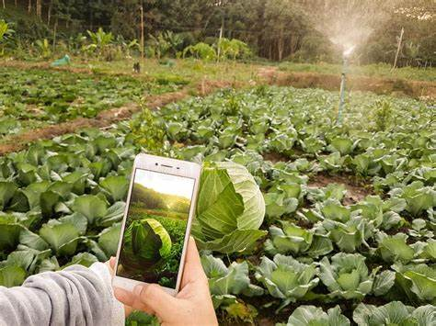
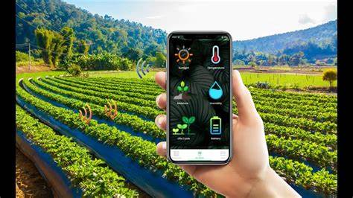

IMPLEMENTATION:

Slide 5
Algorithm used:
Image Classification:
The Image Classification is done by using CNN algorithm .
CNN:
1) The CNN will divide the image into parts and it classify the each
image based on the features.
2)The CNN works mainly on the large data.
Price Prediction:
Recurrent neural network(RNN)or XGBoost are the most commonly
used ML algorithm for price Prediction.

Slide 6
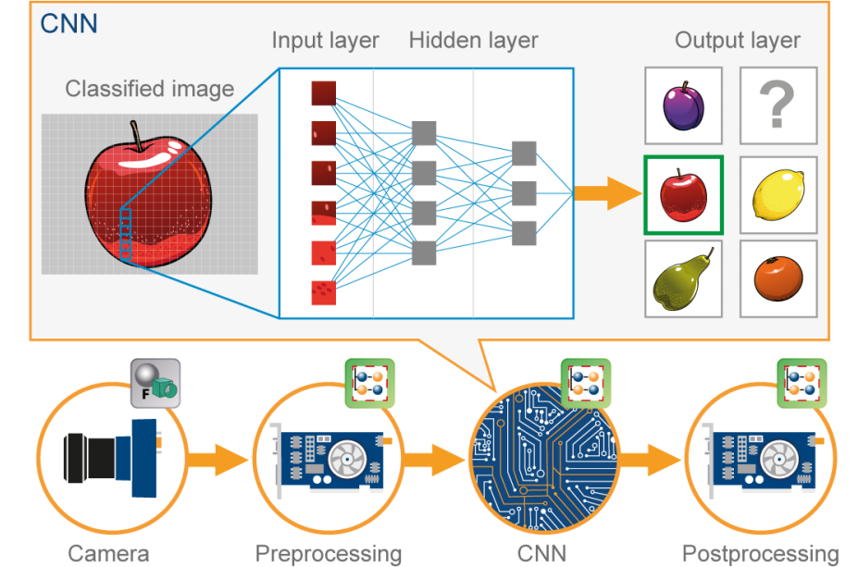

Slide 7
Conclusion:
We conclude that ,by using our website farmers can easily predict the prices for the crops .
THANK YOU

