Slide 1

WOXSEN UNIVERSITY | SCHOOL OF TECHNOLOGY | DBMS FINAL REVIEW
Railway Ticket Reservation and
Journey Management System
REVIEW 3: Final System Implementation, Verification, and Live Demonstration
Student Name: Heman | Roll Number: 25WU0102097 | Section: AIML Rhinos
Faculty Mentor: Prof. Sahithi | School of Technology, Woxsen University | Week 16
Notes:
Welcome to the final Review 3 presentation. Today we demonstrate the completed, fully functional Railway Ticket Reservation and Journey Management System, showcasing our verified relational database, working UI, and automated tests.

Slide 2
SYSTEM ARCHITECTURE | REVIEW 3
Final System Architecture and Technology Stack
Production Multi-Tier Implementation Flow
Web Frontend
Bootstrap 5 & HTML5
Responsive Navbar & Alerts
ERS Ticket Slips
JavaScript Auto-loader
Application Core
Python 3.9 & Flask
8 Modular Blueprints
Form Validations
Custom Jinja2 Filters
Business Engine
Availability Service [s, e)
Transaction Safe Booking
Pessimistic Row Locks
Atomic WL Promotion
Database Tier
MySQL 8.x InnoDB Engine
14 Relations in 3NF
4 Relational Views
12 SQL Benchmark Reports
Railway Ticket Reservation and Journey Management System | Review 3 | B.Tech CSE DBMS Project
Notes:
Slide 2 outlines the completed architecture linking HTML5/Bootstrap 5 frontend to Flask controllers, business services, and MySQL InnoDB persistence.

Slide 3
DATABASE DESIGN | REVIEW 3
Implemented ER Diagram and Database Design
Fully Consistent 14-Table 3NF Relational Schema
✔ Identical Schema Consistency: The implemented database schema strictly matches the ER design from Review 1 and normalization proofs from Review 2 without discrepancies.
✔ Entity Separation: Stations, Routes, Ordered Stops, Locomotive Definitions, Dated Runs, Rolling Stock Coaches, and Individual Seat Units are completely decoupled.
✔ Transactional Integrity: Bookings, Journey_Segments, Waitlists, Payments, and Cancellations maintain complete auditability through foreign keys and composite unique constraints.
✔ Monetary Precision: All currency columns use DECIMAL(10,2) eliminating binary floating-point rounding errors.
Railway Ticket Reservation and Journey Management System | Review 3 | B.Tech CSE DBMS Project
Notes:
Slide 3 confirms total structural consistency across all 3 reviews without changing table names or dropping constraints.

Slide 4
MODULE INVENTORY | REVIEW 3
Completed Application Modules Overview
Implemented Software Modules (100% Complete)
• Dashboard Module (/): Live database KPI summary cards: total trains, passengers, bookings, waitlists, revenue.
• Train Search & Timetable (/search): Origin/destination route matching, stop timetable ordering, live segment seat availability.
• Passenger Profile Module (/passengers): Passenger registration with age domain check (1-119) and government ID validation.
• Reservation & ERS Module (/book, /booking/<pnr>): Atomic booking, berth allocation, PNR generation, payment simulation, and printable ERS slip.
• Cancellation & Refund Module (/cancel): PNR lookup, refund preview (20% fee deduction), and automated waitlist promotion trigger.
• Waitlist Registry (/waitlist): Live FIFO queue position tracking across runs and travel classes.
• SQL Reports Hub (/reports): Interactive execution of all 12 benchmark SQL reports with dynamic data tables.
Railway Ticket Reservation and Journey Management System | Review 3 | B.Tech CSE DBMS Project
Notes:
Slide 4 summarizes the 7 completed software modules running in the live application.

Slide 5
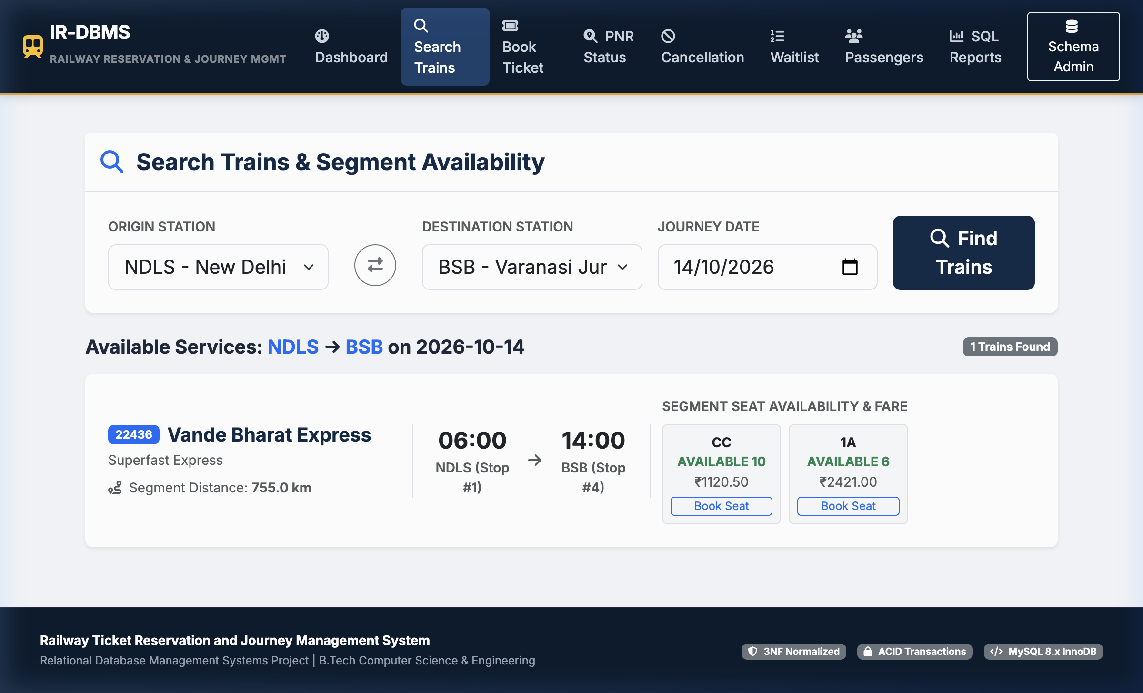
LIVE SYSTEM DEMONSTRATION | REVIEW 3
Train Search and Live Segment-Wise Availability
Operational Feature Explanation
• User selects Origin (NDLS), Destination (BSB), and Travel Date (2026-10-14).
• Relational query validates route progression (Stop 1 precedes Stop 4).
• Segment availability algorithm tests interval overlap across all physical seats in CC and 1A coaches.
• Live status cards display remaining free seats or active waitlist positions with calculated fares.
Railway Ticket Reservation and Journey Management System | Review 3 | B.Tech CSE DBMS Project
Notes:
Slide 5 demonstrates our live Train Search module with an actual application screenshot showing Vande Bharat Express availability on NDLS-BSB.

Slide 6
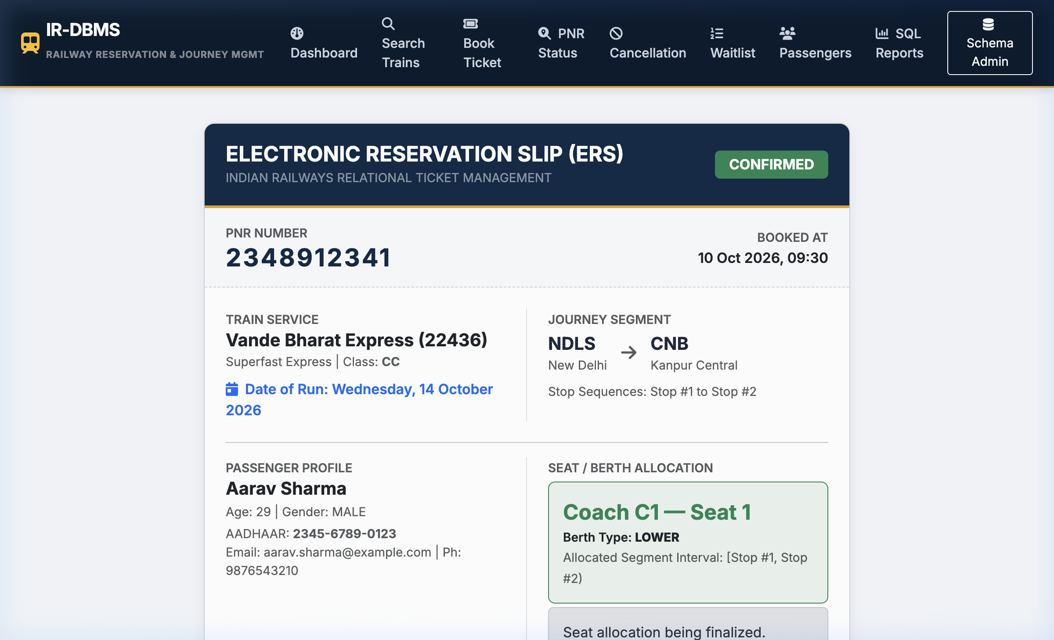
LIVE SYSTEM DEMONSTRATION | REVIEW 3
Confirmed Reservation and Seat Allocation
Electronic Reservation Slip (ERS) Workflow
• Transaction safety: Row-level lock (FOR UPDATE) acquired during seat assignment.
• Generates unique 10-digit PNR and binds passenger profile.
• Inserts active JourneySegment over [1, 2) and records completed Payment.
• Renders printable Electronic Reservation Slip showing Coach, Seat number, and Berth Type.
Railway Ticket Reservation and Journey Management System | Review 3 | B.Tech CSE DBMS Project
Notes:
Slide 6 shows the confirmed Electronic Reservation Slip for PNR 2348912341, confirming coach and seat assignment.

Slide 7
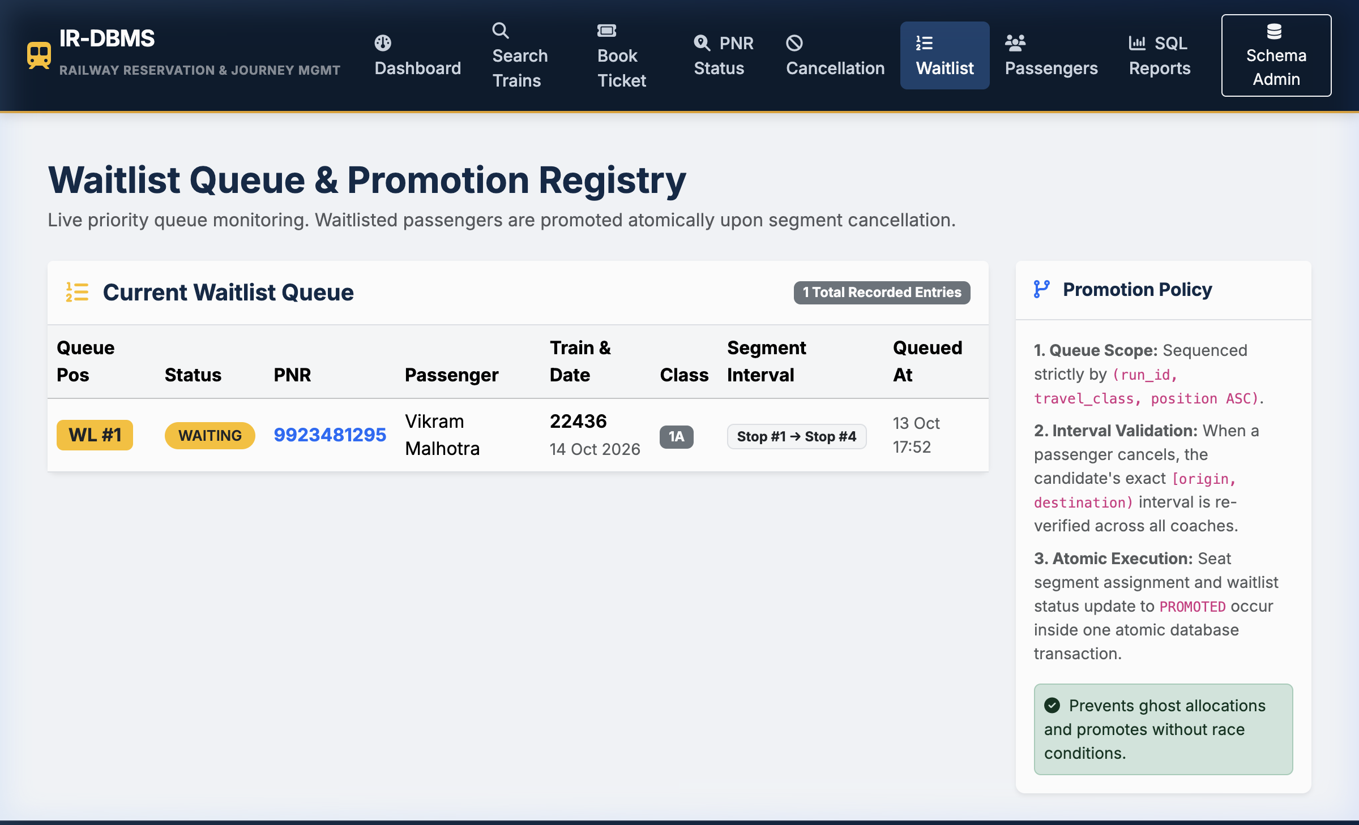
LIVE SYSTEM DEMONSTRATION | REVIEW 3
Waitlist Queue and Automated Promotion
Atomic FIFO Promotion Logic
• Exhausted Capacity: When class capacity is full, passenger is queued at Position WL #1.
• Cancellation Trigger: Cancelling a confirmed booking deducts a 20% cancellation fee, refunds 80%, and marks the segment CANCELLED.
• Atomic Promotion: The system checks the waitlist queue in FIFO order, re-verifies segment availability, assigns the freed seat, and updates status to PROMOTED in one atomic transaction.
Railway Ticket Reservation and Journey Management System | Review 3 | B.Tech CSE DBMS Project
Notes:
Slide 7 shows the live waitlist queue and demonstrates how cancellation atomically promotes eligible candidates.

Slide 8
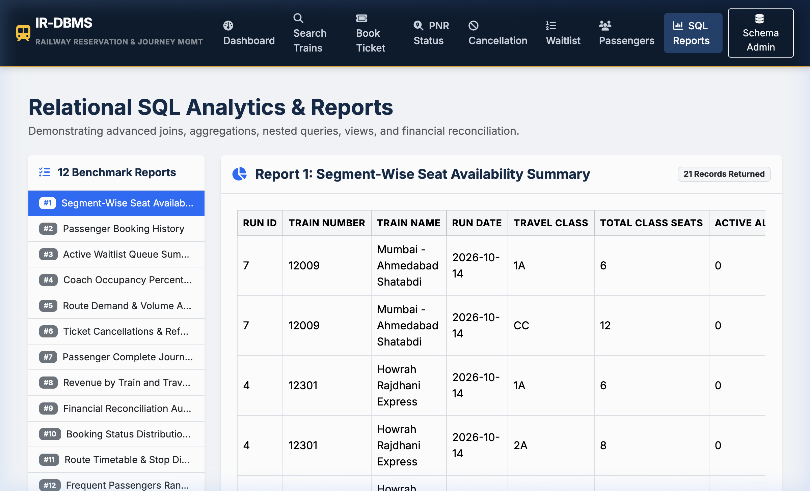
ANALYTICAL REPORTING | REVIEW 3
SQL Reports Hub and Database-Backed CRUD
12 Real-Time Analytical SQL Queries
• Interactive Reports Hub: Select between 12 benchmark SQL reports.
• Demonstrates Joins, GROUP BY, HAVING, and scalar subqueries.
• Financial Reconciliation: Audits gross booking value vs payments collected vs refunds disbursed.
• Coach Occupancy: Computes exact percentage occupancy per physical carriage.
Railway Ticket Reservation and Journey Management System | Review 3 | B.Tech CSE DBMS Project
Notes:
Slide 8 shows our SQL Reports Hub executing live analytical queries against the database.

Slide 9
ACID & CONCURRENCY | REVIEW 3
Transaction Boundaries, Locking, and Integrity
ACID Enforcement and Concurrency Control
✔ Atomicity: db.session.begin_nested() ensures that if seat assignment or payment fails, all related insertions roll back cleanly.
✔ Consistency: Declarative CHECK constraints (age > 0, fare >= 0, dest > orig) and Foreign Keys maintain valid relational states.
✔ Isolation & Row Locking: SELECT ... FOR UPDATE places exclusive row locks on TrainRun / Seat rows, serializing competing reservations and eliminating double-booking race conditions.
✔ Durability: InnoDB transaction write-ahead logs (redo_log) guarantee data persistence across sudden server crashes.
✔ Indexing Performance: B-Tree indexes on (run_id, seat_id, allocation_status) allow interval overlap checks to execute in sub-millisecond time.
Railway Ticket Reservation and Journey Management System | Review 3 | B.Tech CSE DBMS Project
Notes:
Slide 9 explains the transaction boundaries, row-level locking strategy, and indexing optimizations guaranteeing ACID safety.

Slide 10
AUTOMATED TESTING VERIFICATION | REVIEW 3
Testing Methodology and Verified Results
16 Automated Tests Executed via pytest (100% Pass Rate)
Test Case | Category | Verification Goal | Result
test_interval_overlap_logic | Algorithm | Mathematical half-open interval overlap evaluation | PASSED
test_non_overlapping_seat_reuse | Business Logic | Seat C1-1 concurrently held on [1,2) and [2,4) | PASSED
test_conflicting_interval_detection | Integrity | Conflicting request for [1,4) correctly rejected | PASSED
test_cancelled_allocation_restores_availability | State Machine | Cancelling segment frees seat for subsequent booking | PASSED
test_eligible_cancellation_and_refund | Financial Audit | 20% fee deducted; 80% refunded to passenger | PASSED
test_duplicate_cancellation_rejected | Transactions | Second cancellation attempt raises ValueError | PASSED
test_automated_waitlist_promotion | Queue Logic | Freeing confirmed seat promotes WL candidate atomically | PASSED
test_all_12_reports_execute_successfully | SQL Analytics | All 12 benchmark queries execute without errors | PASSED
Railway Ticket Reservation and Journey Management System | Review 3 | B.Tech CSE DBMS Project
Notes:
Slide 10 presents genuine test execution evidence: 16 test cases passing in 0.36 seconds covering interval overlaps, cancellations, and integrity constraints.

Slide 11
ENGINEERING EVALUATION | REVIEW 3
Limitations and Future Enhancements
Current Prototype Limitations
Future Scope & Production Scaling
• Simulated Financial Gateway: Simulated UPI/Card processing without live banking webhooks.
• Static Timetables: Fixed scheduled departures without real-time GPS locomotive tracking.
• Single RDBMS Node: Local relational database instance rather than distributed multi-region cluster.
• Real-Time NTES Integration: Live train delay tracking and platform assignment feeds.
• Redis Inventory Caching: High-throughput memory bitsets to handle massive concurrent Tatkal spikes.
• Dynamic AI Pricing: Predictive demand modeling adjusting fares and estimating waitlist confirmation probability.
• Read Replicas: Offloading analytical reporting queries to MySQL read replicas.
Railway Ticket Reservation and Journey Management System | Review 3 | B.Tech CSE DBMS Project
Notes:
Slide 11 addresses real-world engineering constraints and identifies scalable enhancements like Redis caching and live NTES APIs.

Slide 12
SUMMARY & VIVA DEFENSE | REVIEW 3
Conclusion and Viva Voce Preparation
Key Academic Takeaways & Ready Viva Defenses
Q: Why is 3NF necessary?
A: Decoupling train definitions from dated runs, and passenger profiles from bookings, prevents update and insertion anomalies.
Q: How is seat reuse solved?
A: Half-open intervals [s, e) tested via s < r_end AND r_start < e allow disjoint passenger journeys on the same seat.
Q: How are race conditions prevented?
A: ACID transactions with pessimistic row locking (SELECT ... FOR UPDATE) serialize competing requests.
Q: Why use DECIMAL?
A: Fixed-point DECIMAL(10,2) prevents binary floating-point rounding errors in fares and refunds.
Q: How are waitlists promoted?
A: Automated FIFO queue evaluation re-checks segment availability and promotes candidates atomically.
Railway Ticket Reservation and Journey Management System | Review 3 | B.Tech CSE DBMS Project
Notes:
Slide 12 concludes the review by summarizing key academic contributions and offering crisp, defensible viva answers.

