Slide 1
RAINFALL PREDICTION PROJECT
Assignment Stage 1 and Stage 2
Data Science for Innovation
Presented to:
Dr. Ali Anaissi
Presented by:
Hemang Sharma (24695785)
Jyoti Khurana (14075648)
Mahjabeen Mohiuddin (24610507)
Suyash Santosh Tapase (24678207)

Slide 2
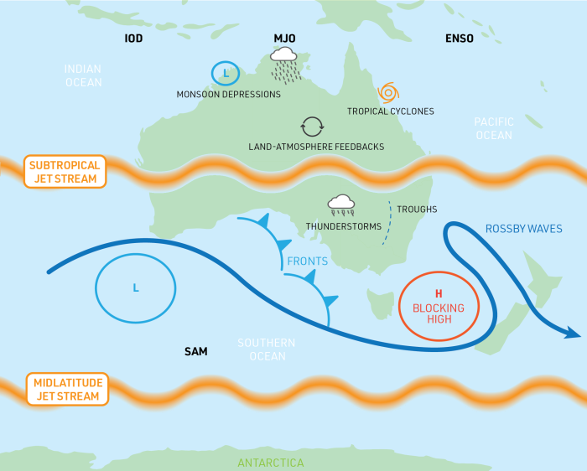
RAINFALL IN AUSTRALIA:
Australia experiences significant variations in rainfall across the country and throughout the seasons.
The tropical north of Australia receives the majority of its rainfall during the summer monsoon, while winters are typically dry in this region.
Many parts of southern Australia receive more rainfall in winter than in summer.
Southern Australia's rainfall is influenced by extratropical cyclones, fronts, troughs, and thunderstorms.
In Southern Australia, rainfall is influenced by extratropical cyclones, fronts, troughs, and thunderstorms.
Figure 1: Key processes influencing Australian rainfall

Slide 3
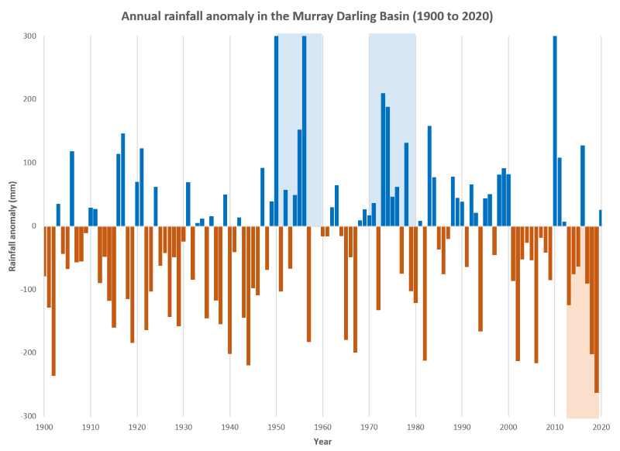
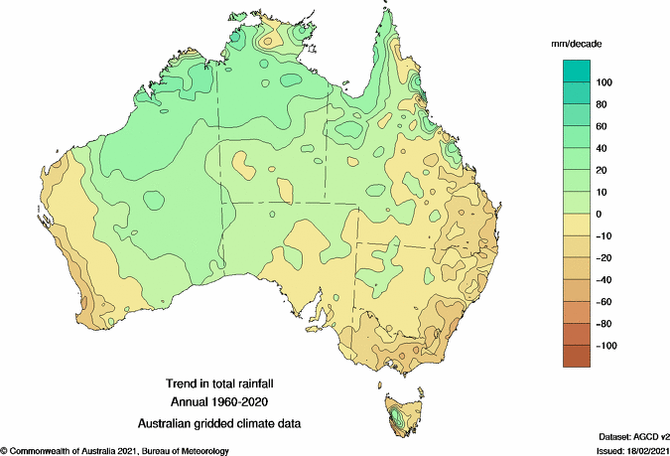
PROBLEM STATEMENT:
Australia has a history of experiencing extreme rainfall and drought events.
Australia's geographical location exposes it to the climate systems of the Pacific, Indian, and Southern oceans, making it vulnerable to their effects.
Variability in Australia, particularly affecting the crop growing season in the eastern and northern regions.
The El Niño-Southern Oscillation (ENSO) is a significant factor influencing rainfall variability in Australia.
Understanding how climate change will affect Australia's future rainfall patterns is crucial for making informed decisions regarding sustainable water management and agriculture.

Slide 4
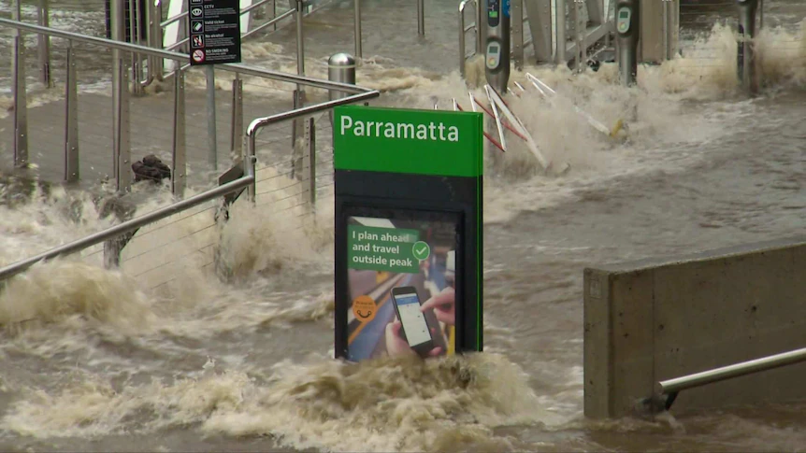
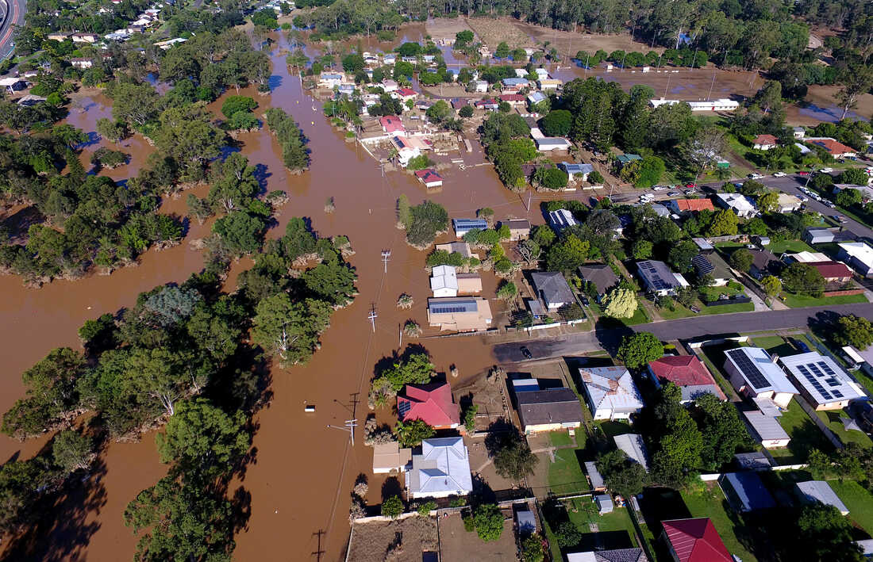
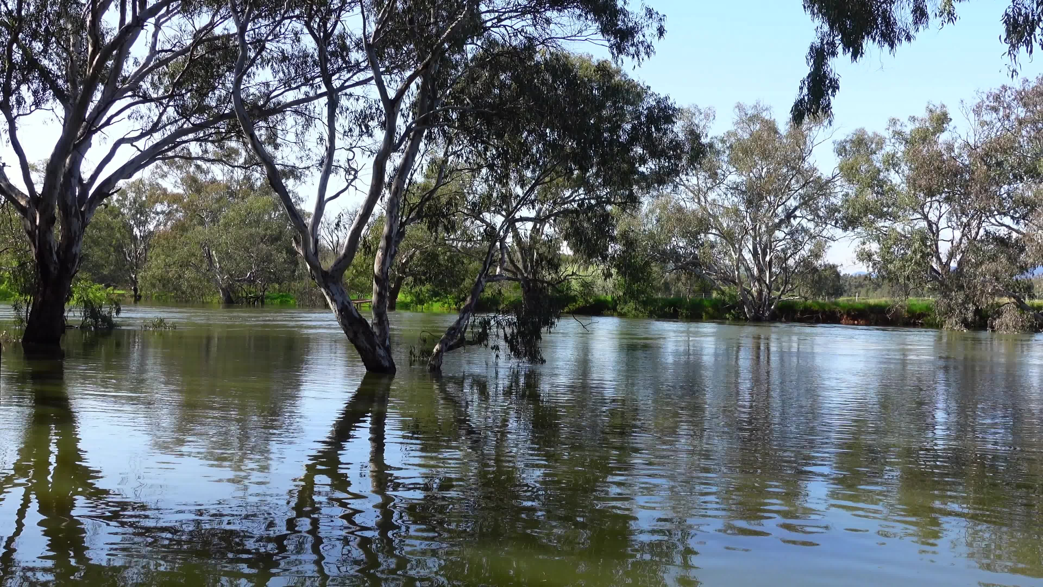
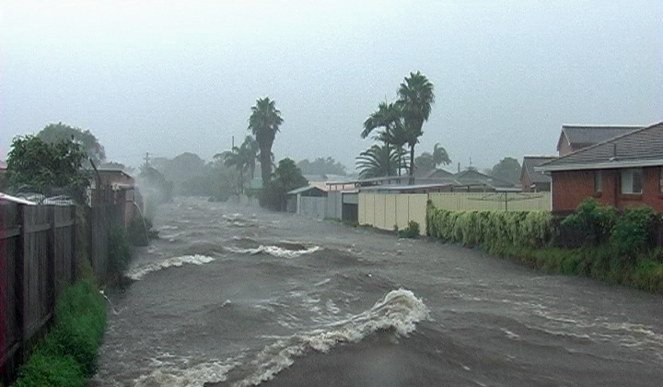
HIGHLIGHTS OF RAINFALL IN AUSTRALIA:
Within two years Sydney has experienced major flood due to heavy rainfall.
Albury had heaviest rainfall in 160 years, Weatherzone article published on 30th January 2023
Heavy flood in Wollongong in August 2018, with rainfall of 316mm in 24 hours
Image1 & 2: Flood in Sydney
Image 3: Flooded Murray River, Albury 2022
Image 3: Wollongong Flood, Aug 2018
RESEARCH QUESTIONS:
As the rainfall in Australia can vary dramatically, the project was aimed to answer the following questions:
How likely it is to have a rainfall tomorrow?
Based on today’s values, tomorrow how heavy the rainfall could be?

Slide 5
LITERATURE REVIEW FOR STAGE 1 REPORT:
Within two years Sydney has experienced major flood due to heavy rainfall.
Albury had heaviest rainfall in 160 years, Weatherzone article published on 30th January 2023
Heavy flood in Wollongong in August 2018, with rainfall of 316mm in 24 hours
1
1
1

Slide 6
DATA AND APPROACH:
For this project we surfed through many websites, and we finalized a dataset which was on Kaggle
The dataset was from Bureau of Meteorology, with 10 years of daily observations of weather across Australia.
After carefully analyzing the unpredictable and devastating impact of rainfall we tried to predict the likely hood of rainfall in future and the intensity of rainfall.
Based on the historical data of rainfall, classification model was selected to predict the outcomes.
Based on the dataset there can be two outcomes, i.e. it will rain or it will not rain, and falls under binary classification.
The classifier needs training dataset and after the classifier is trained accurately it can predict the outcome of the results, whether it will rain or not.

Slide 7
DATA PREPARATION:
Data preparation is an essential stage in data analysis where data is cleaned, transformed, and preprocessed to ensure its readiness for analysis.
Dropped the rows which had too many missing values values.
Calculated percentage of missing values for every columns and dropped the columns which had more than 40% of missing values.
Transformed column from Object to Boolean column using ‘map()’ function.
Calculated the number of missing values for remaining columns and filled those values with median

Slide 8





EXPLORATORY DATA ANALYSIS:
Exploratory data analysis (EDA) is a technique used to examine and explore datasets, aiming to understand their key attributes and patterns. EDA often involves the use of data visualization techniques to summarize and present the main characteristics of the data.
In the Project, Python packages i.e. Pandas, Numpy, Seaborn, Matplotlib, and Plotly was used for data exploration and visualization.
These packages provide a range of tools for data visualization and analysis, including statistical tests and models.
They enable the exploration of variable relationships and predictions by utilizing techniques such as histograms, scatterplots, and box plots to examine variable distributions.

Slide 9
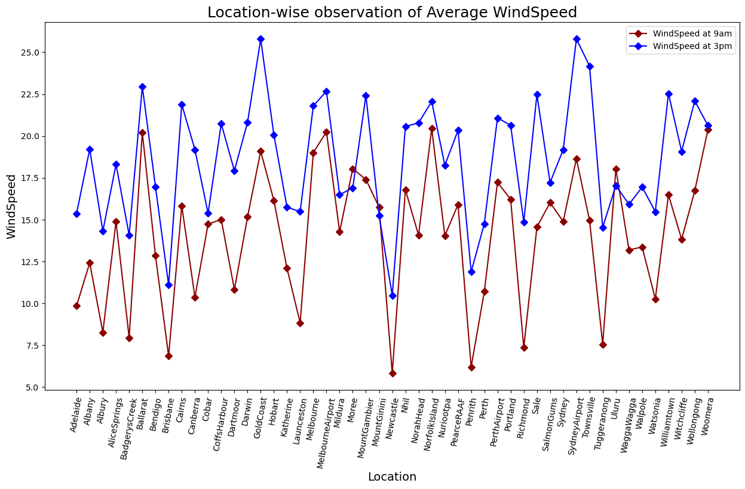
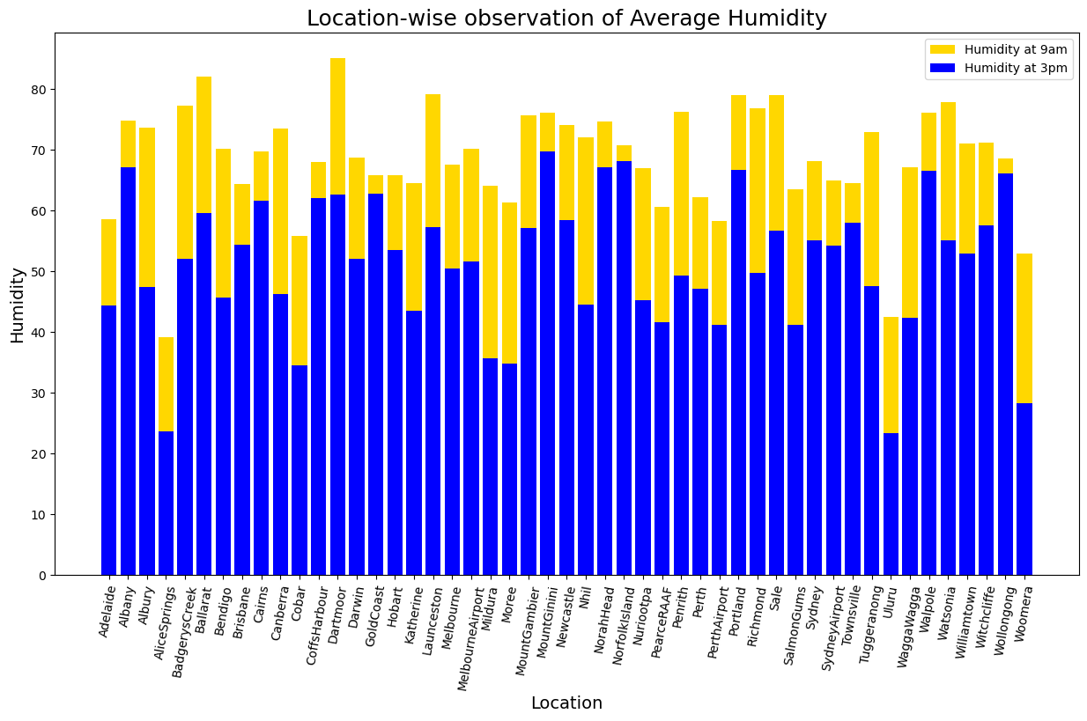
EXPLORATORY DATA ANALYSIS:
The graph shows average wind speed across various locations in Australia.
The average wind speed at 3:00pm was significantly more than the average wind speed at 9:00am.
The highest average wind speed was recorded at Gold Coast followed by Sydney Airport and Ballarat.
The graph shows average humidity across various locations in Australia.
The average humidity at 9:00am was significantly more than the average wind speed at 6:00pm.
The highest average humidity was recorded 9:00am at Gold Coast followed by Sydney Airport and Ballarat.

Slide 10
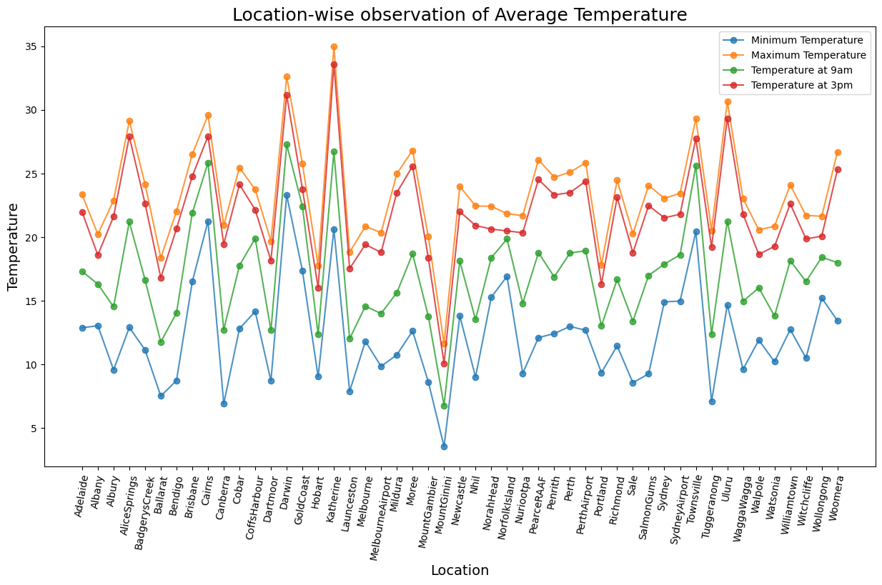
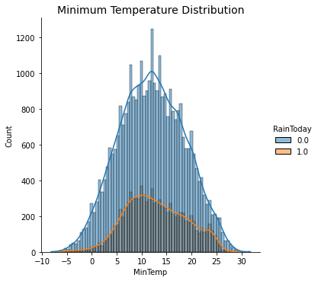
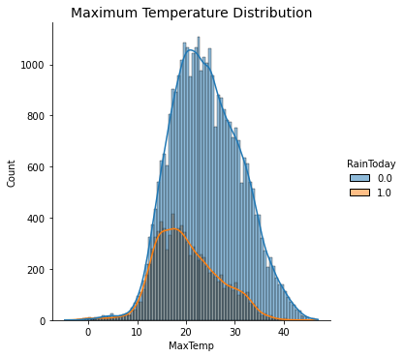
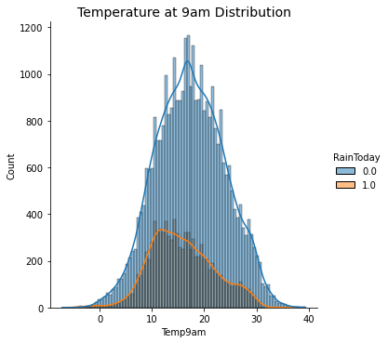
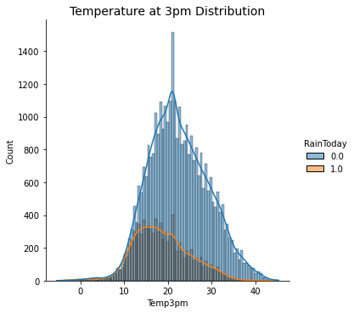
EXPLORATORY DATA ANALYSIS:
The graph shows location wise average temperature.
The average temperature at 3:00pm was significantly more than the average temperature at 9:00am.
The highest average maximum temperature was recorded at Katherine (around 35°C)and lowest average minimum temperature was recorded at Mount Ginini (around 5°C).

Slide 11
ASSIGNMENT STAGE 2:
Research Questions and Hypothesis:
What is the likelihood of rainfall in Australia tomorrow?
Null hypothesis: No significant difference between predicted chance of rainfall and a random guess.
Alternative hypothesis: Difference in predicted forecast of rainfall tomorrow and a random guess.
What is the accuracy of machine learning models in predicting rainfall?
Null hypothesis: No significant difference between the accuracy of machine learning models and random guessing in predicting rainfall.
Alternative hypothesis: Significant difference between predicted accuracy and random guessing in predicting rainfall.

Slide 12
HYPOTHESIS TESTING:
Mean and standard deviation values of the features for ANOVA test are not suitable for Hypothesis Testing.
All the features have different Standard Deviation values.
It was decided to perform Kruskal wallis Test.
For Kruskal wallis test
Computation Result was 29549.87439836076 and p-value was 0.0
Therefore, Null Hypothesis was rejected.

Slide 13
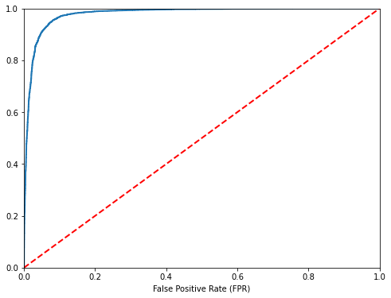
CLASSIFICATION MODEL:
The predictive model was a supervised ML classification model. The target variable had categorical values, i.e. Yes and No.
Three classifiers were used to train the model, Random Forest, Gradient Boost, Dummy Classifier.
Randomized Search Cross Validation and Receiver Operating Characteristic (ROC) used for hyperparameter tuning.
Figure: ROC Curve

Slide 14
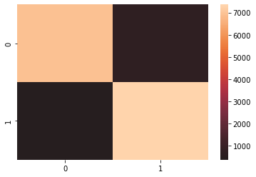

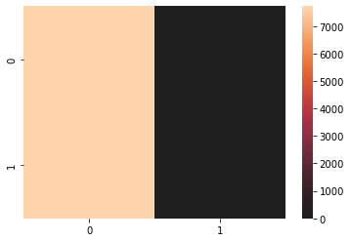
RESULTS:
Random Forest Classifier:
Training Score: 0.9804006278711425
Testing Score: 0.9274235355106273
Accuracy Score: 0.9274235355106273
F1 Scores: 0.9274235355106273
Gradient Booting Classifier:
Training Score: 0.9900923085785055
Testing Score: 0.9331907724209435
Accuracy Score: 0.9331907724209435
F1 Scores: 0.93528340970435
Dummy Classifier:
Testing Score: 0.49954639709694143
Figure: Confusion matrix for Random Forest Classifier
Figure: Confusion matrix for Random Forest Classifier
Figure: The confusion matrix for Gradient Boosting Classifier

Slide 15
Conclusion:
After analyzing the performance of different predictive models, we have determined that the model has successfully learned all the data patterns and accurately predicted the absence of rainfall for the next day.
We have saved the trained model, which allows us to make precise predictions about future weather conditions without the need to train the model repeatedly or execute the entire code again.
This saved model will serve as a reliable tool for accurately forecasting weather conditions for the next day at any given time in the future.

