Slide 1
Dataprem – Assignment#1
Prepared by
Shanmugam MANOHARAN
AIEWS

Slide 2
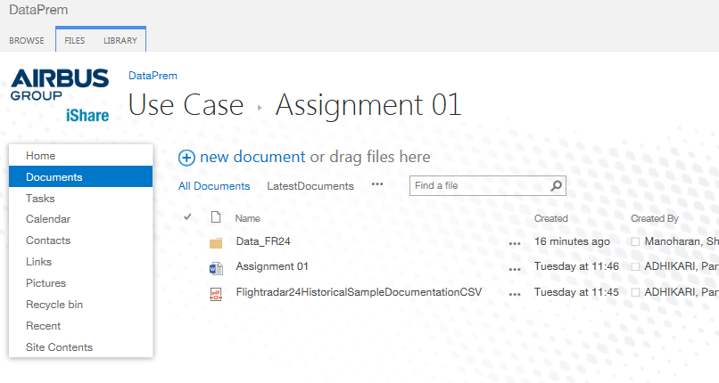
Data location for Assignment 01 in iShare
iShare_Assignment_01_Link

Slide 3
Description of File: 1 of 2
First file 20140131_flights.csv lists all relevant flights information for the day 31Jan2014 Few lines are below:
flight_id,aircraft_id,reg,equip,callsign,flight,schd_from,schd_to,real_to,reserved
44073370,4577652,OY-VKT,A321,VKG9665,DK9665,ARN,,,
44106201,0,,GLF5,GLF5,,,,,
44105885,4976657,SHRL4,GRND,SHRL4,,IST,,,
Description of each field is as follows:
flight_id : unique decimal identifier for the flight leg
aircraft_id : modeS address in hexadecimal
reg : unique aircraft text identifier
Equip : equipment, e.g. B733
Callsign : e.g. NAX11S
Flight : flight number, e.g. DY311
schd_from : departure airport’s IATA code, e.g. KKN
schd_to : arrival airport’s IATA code
Reserved : unused
For each line (flight) in this file, there is a corresponding file in the zip file FR24_20000files_20140131_positions available in the iShare

Slide 4
Description of File: 2 of 2
Second file (20140131_44073370.csv) is available in the zip file for first flight 44073370.
Top Few lines from the file, mentioned in previous slide
snapshot_id,altitude,heading,latitude,longitude,radar_id,speed,squawk
1391090595,32025,309,29.37470,32.46940,8512,0,0
1391090693,32025,308,29.48320,32.31110,8512,385,0
1391144854,800,189,59.64670,17.91690,201,169,608
1391144860,1275,190,59.64200,17.91510,201,173,608
1391144867,1650,191,59.63690,17.91300,201,177,608
Description of parameters:
snapshot_id : time of sample in seconds since 1 Jan 1970 00:00:00 UTC
Altitude : in feet
Heading : 0 – 359 degrees
Latitude : floating point
Longitude : floating point
radar_id : unique identifier of ground receiver
Squawk : code broadcast by airplane

Slide 5
ddmmyyhhmmss calculation for each flight recording
To deduce the instant time of the flight:
Sample data from file 2:
snapshot_id,altitude,heading,latitude,longitude,radar_id,speed,squawk
1391090595,32025,309,29.37470,32.46940,8512,0,0
snapshot_id : time of sample in seconds since 1 Jan 1970 00:00:00 UTC
The value 1391090595 is the no of seconds passed since 1 Jan 1970 00:00:00
Hence this has to be converted to the actual date based on value of seconds

Slide 6
Tips for the exercise
Q1: Read file 1 and save the information for all flights regarding ACTAIL, ACTYPE, Departure airport and arrival airport etc.
Q2: use the data from file 1
Q3: Use the information in slide 4 to develop the logic
Q4: For the shortlisted flights from Q2, use file (s) 2 from zip folder.
Q5: use the information from Q2 and Q3 to arrive at the results

Slide 7
© Airbus Group India Private Limited. All rights reserved. Confidential and proprietary document. This document and all information contained herein is the sole property of Airbus Group India Private Limited. No intellectual property rights are granted by the delivery of this document or the disclosure of its content. This document shall not be reproduced or disclosed to a third party without the express written consent of Airbus Group India Private Limited.. This document and its content shall not be used for any purpose other than that for which it is supplied. The statements made herein do not constitute an offer. They are based on the mentioned assumptions and are expressed in good faith. Where the supporting grounds for these statements are not shown, Airbus Group India Private Limited will be pleased to explain the basis thereof. AIRBUS, its logo, A300, A310, A318, A319, A320, A321, A330, A340, A350, A380, A400M are registered trademarks.

