Slide 1
00 / COVER
B.TECH CAPSTONE PROJECT REVIEW
An Explainable Hybrid Machine Learning Framework for Customer Churn Prediction Using Feature Engineering and Ensemble Learning
Academic Year 2026–2027
Team Members
S. Vaishnavi (2420030303)
Madhu (2420030321)
Hema (2420030699)
Under the Guidance of
Dr. [Guide Name]
Department of Computer Science & Engineering
KL University
Department of Computer Science & Engineering
LESS / GRID / MONO
Notes:
Source: https://agent.aippt.com/share/oY4S3mKl9DfLeCsV4PJ51A
Good morning/afternoon everyone. We are pleased to present our capstone project on customer churn prediction. Our work focuses on building an explainable hybrid machine learning framework that not only predicts churn accurately but also provides interpretable insights through SHAP.

Slide 2

02 / PROBLEM STATEMENT
The Challenge
Customer churn is a major challenge for businesses — losing customers directly reduces revenue and long-term profitability.
Existing prediction models focus primarily on accuracy but lack explainability — making them difficult to trust and deploy in real business settings.
There is a critical need for an intelligent, interpretable machine learning solution that businesses can act upon with confidence.
Dataset: IBM Telco Customer Churn | 7,043 records | 33 features | Kaggle benchmark
LESS / GRID / MONO
Notes:
Source: https://agent.aippt.com/share/oY4S3mKl9DfLeCsV4PJ51A
Customer churn — when customers stop doing business with a company — is one of the most critical challenges faced by subscription-based businesses, especially in telecom. The cost of acquiring a new customer is 5–7 times higher than retaining an existing one. While many ML models achieve high accuracy, they function as black boxes. Our project addresses this gap by building a hybrid framework that is both accurate and explainable.

Slide 3
03 / LITERATURE SURVEY
Literature Survey
Author | Year | Technique | Limitation
M. Imani et al. | 2025 | Systematic Review of ML/DL Models | No XAI integration; limited real-world validation
X. Liu et al. | 2024 | CCP-Net Hybrid Neural Network | High computational cost; manual feature selection
S. Ahmed et al. | 2024 | Adaptive Ensemble Learning Framework | Limited feature engineering; no SHAP explainability
R. Patel et al. | 2024 | SHAP-based XAI Framework | Single model focus; no ensemble integration
K. Kumar & J. Lee | 2024 | RFM + Deep Embedded Clustering | No hybrid ensemble; limited business interpretability
M. Alkhalf et al. | 2025 | E-commerce ML Churn Prediction | Small dataset (5,630); no multimodal features
T. Chen et al. | 2023 | XGBoost + LIME Interpretability | LIME instability; limited ensemble diversity
L. Zhang & H. Park | 2023 | Deep Learning Churn Models (DNN) | Black-box nature; no feature importance analysis
A. Sharma et al. | 2022 | Stacking Ensemble for Telecom Churn | No XAI integration; basic feature engineering
P. Gupta & M. Joshi | 2022 | Random Forest + SMOTE Churn Model | Single classifier; no ensemble or explainability layer
Key Gap: No existing study combines hybrid ensemble learning with SHAP-based explainability for telecom churn prediction.
LESS / GRID / MONO
Notes:
Source: https://agent.aippt.com/share/oY4S3mKl9DfLeCsV4PJ51A
We reviewed 10 recent research papers from 2022 to 2025 covering various aspects of customer churn prediction. The key takeaway is that while several studies have explored individual aspects — ensemble learning, feature engineering, or explainable AI — none have successfully integrated all three into a unified hybrid framework. This literature gap is the primary motivation for our proposed approach.

Slide 4
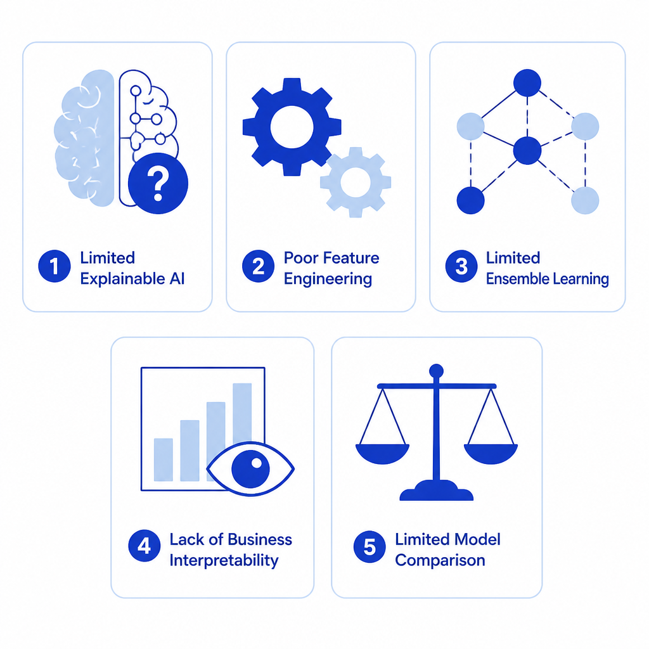
04 / RESEARCH GAPS
Research Gaps
Limited Explainable AI
Poor Feature Engineering
Limited Ensemble Learning
Lack of Business Interpretability
Limited Model Comparison
Existing models lack transparent decision-making for business stakeholders
Insufficient feature selection and transformation in existing pipelines
Few studies leverage diverse ensemble architectures for churn prediction
Predictions not actionable for retention strategy planning
Insufficient benchmarking across diverse ML and ensemble models
Our work bridges ALL five gaps through a unified hybrid + XAI framework
LESS / GRID / MONO
Notes:
Source: https://agent.aippt.com/share/oY4S3mKl9DfLeCsV4PJ51A
Through our literature survey, we identified five critical research gaps. The most significant is the lack of integration between ensemble learning techniques and explainable AI. Most existing work either focuses on maximizing accuracy or providing interpretability, but rarely both. Our framework is designed to address all five gaps simultaneously.

Slide 5
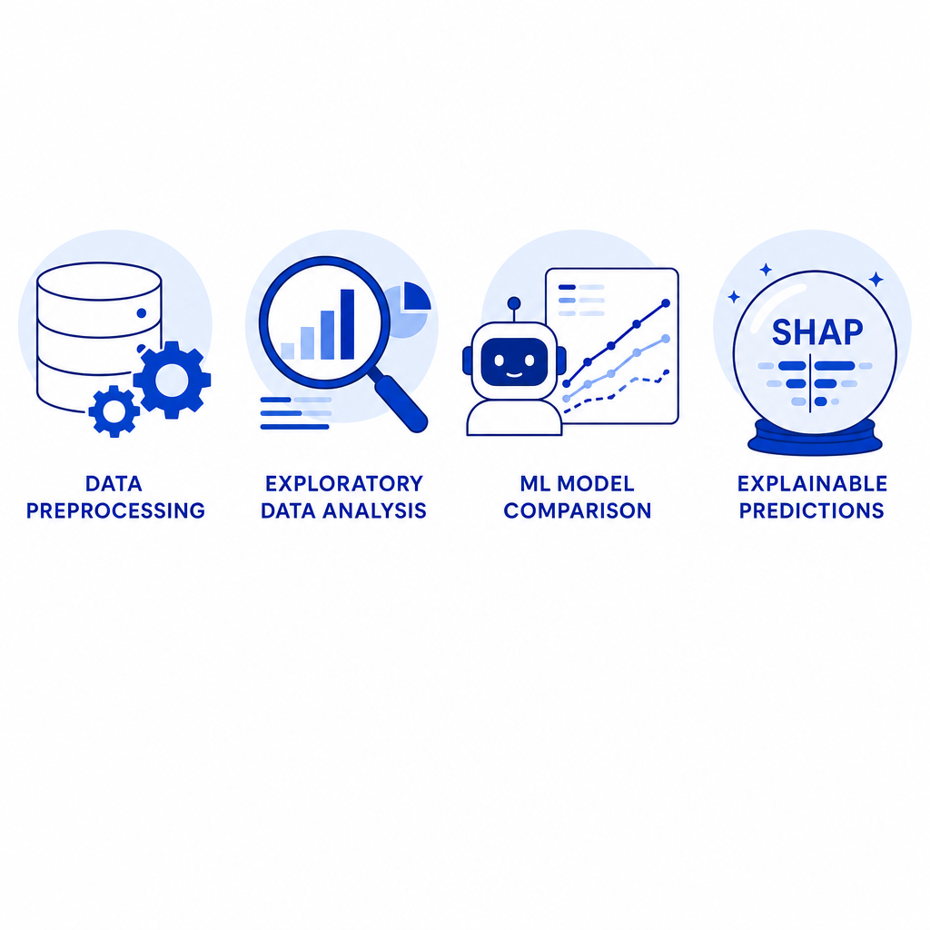
05 / OBJECTIVES
Objectives
Data Preprocessing
Exploratory Data Analysis
Compare ML Models
Explain Predictions (SHAP)
OBJECTIVE 01
OBJECTIVE 02
OBJECTIVE 03
OBJECTIVE 04
Handle missing values, encode categorical features, scale numerical attributes, and split dataset into training and testing sets.
Analyze feature distributions, identify churn patterns, visualize correlations, and uncover key drivers of customer attrition.
Train and evaluate Logistic Regression, Decision Tree, Random Forest, SVM, KNN, and XGBoost. Build stacking ensemble for improved accuracy.
Apply SHAP (SHapley Additive exPlanations) for global and local interpretability — identify top features and explain individual predictions.
— Pandas, Scikit-learn, One-Hot Encoding, StandardScaler
— Matplotlib, Seaborn, Correlation Matrix, Distribution Plots
— Scikit-learn, XGBoost, GridSearchCV, 5-Fold CV, Stacking
— SHAP, Waterfall Plots, Summary Plots, Feature Importance
LESS / GRID / MONO
Notes:
Source: https://agent.aippt.com/share/oY4S3mKl9DfLeCsV4PJ51A
Our project has four primary objectives, each with specific techniques. First, we preprocess the IBM Telco dataset using Pandas and Scikit-learn. Second, we conduct exploratory data analysis to understand churn patterns. Third, we compare six ML models and build a stacking ensemble. Finally, we use SHAP to explain both global feature importance and individual predictions.

Slide 6
06 / PROPOSED METHODOLOGY
Proposed Methodology
Dataset Collection
Data Preprocessing
Feature Engineering
Exploratory Data Analysis
IBM Telco · Kaggle
Missing values · Encoding · Scaling
Mutual Info · Selection · Creation
Visualization · Correlation · Patterns
Train ML Models
Logistic Regression
Decision Tree
Random Forest
SVM
KNN
XGBoost
Model Evaluation
SHAP Explainable AI
Customer Churn Prediction
Accuracy · F1 · AUC-ROC · Precision
Global & Local Interpretability
Actionable Retention Insights
Core Pipeline Processing Stage Final Output
LESS / GRID / MONO
Notes:
Source: https://agent.aippt.com/share/oY4S3mKl9DfLeCsV4PJ51A
Our proposed methodology follows a structured pipeline. We start with the IBM Telco dataset from Kaggle, then preprocess the data by handling missing values and encoding categorical variables. Feature engineering uses mutual information for selection. After EDA, we train six ML models including Logistic Regression, Decision Tree, Random Forest, SVM, KNN, and XGBoost. We evaluate all models, then apply SHAP for explainable AI. The final output is a churn prediction with interpretable insights for business action.

Slide 7
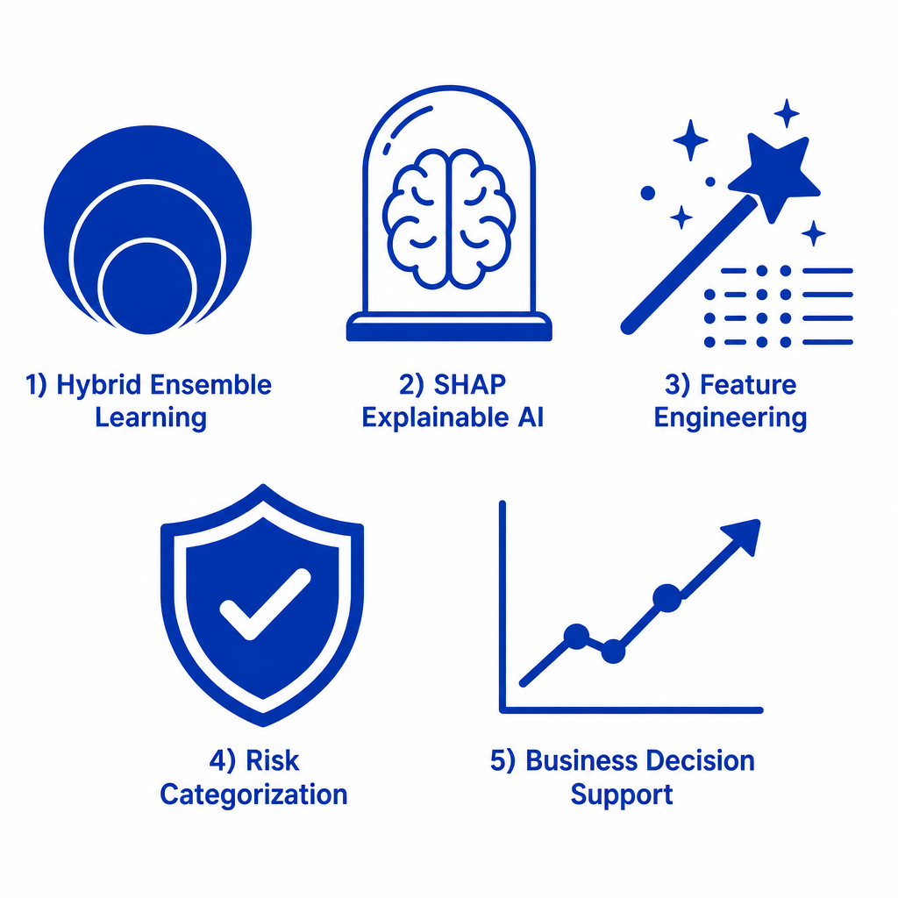
07 / NOVELTY & INNOVATION
Novelty & Innovation
KEY INNOVATION
Hybrid Ensemble Learning + SHAP XAI + Feature Engineering — unified into a single interpretable framework
Hybrid Ensemble Learning
SHAP Explainable AI
Stacking ensemble of 6 diverse ML models
Global + local interpretability via SHAP
Feature Engineering
Customer Risk Categorization
Mutual info-based selection & transformation
High / Medium / Low churn risk segments
Improved Business Decision Support
Actionable retention strategies backed by interpretable predictions
LESS / GRID / MONO
Notes:
Source: https://agent.aippt.com/share/oY4S3mKl9DfLeCsV4PJ51A
What makes our work novel? First, we combine six diverse ML models through a stacking ensemble — this is rare in churn prediction research. Second, we integrate SHAP explainability directly into the ensemble framework, providing both global feature importance and individual prediction explanations. Third, our feature engineering goes beyond basic preprocessing by using mutual information for selection. Fourth, we categorize customers into risk segments for targeted retention. Finally, the entire framework is designed for business decision support, not just academic accuracy.

Slide 8
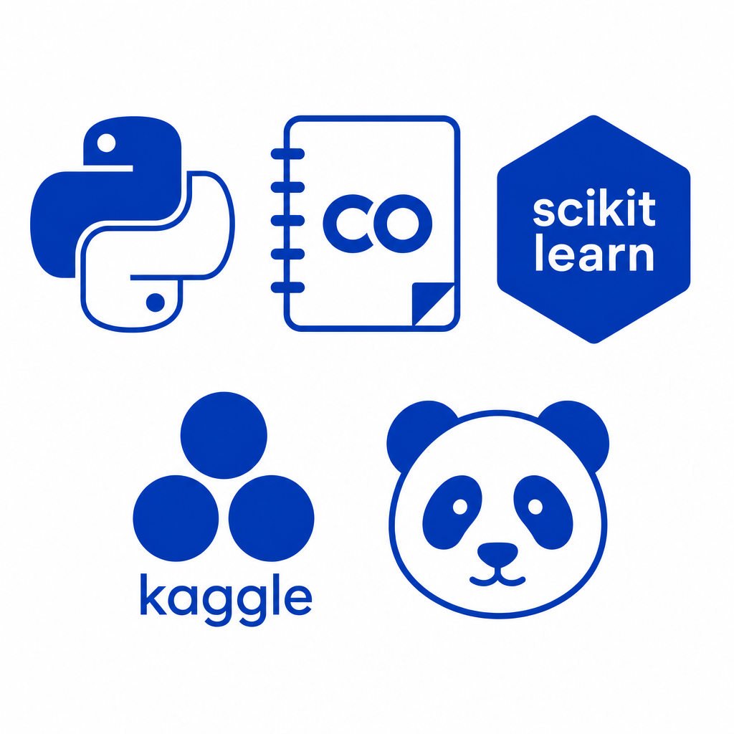
08 / FEASIBILITY & DATASET
Feasibility & Dataset
DATASET
TOOLS & PLATFORM
IBM Telco Customer Churn
Python Programming language
Source: Kaggle (IBM Watson)
Google Colab Cloud notebook environment
Records: ~7,000 customers
Features: 33 variables (demographics, services, account)
Scikit-learn ML models & preprocessing
Target: Binary churn indicator (Yes/No)
Benchmark: Widely used academic standard
Pandas Data manipulation
SHAP Explainable AI library
All tools are open-source — zero licensing cost
LESS / GRID / MONO
Notes:
Source: https://agent.aippt.com/share/oY4S3mKl9DfLeCsV4PJ51A
For our project, we use the IBM Telco Customer Churn dataset from Kaggle — a well-known benchmark with about 7,000 records and 33 features covering customer demographics, account information, and service subscriptions. All our tools are open-source: Python for programming, Google Colab for cloud-based development (no hardware requirements), Scikit-learn for ML models, Pandas for data handling, and SHAP for explainability. This makes the project highly feasible with zero software licensing costs.

Slide 9
09 / PROJECT PLAN
Project Plan
PHASE 01
Literature Survey
Review 10+ papers on churn prediction, XAI, ensemble learning
PHASE 02
Dataset Collection
IBM Telco dataset from Kaggle — 7,043 records
PHASE 03
Data Preprocessing
Missing values, encoding, scaling, train-test split
PHASE 04
Exploratory Data Analysis
Visualizations, correlation analysis, pattern discovery
PHASE 05
Model Development
Train 6 ML models + stacking ensemble
PHASE 06
Model Comparison
Accuracy, F1, AUC-ROC, Precision, Recall
PHASE 07
Explainable AI (SHAP)
Global summary + local waterfall plots
PHASE 08
Testing & Validation
Cross-validation, overfitting checks, robustness
PHASE 09
Documentation & Review
Final report, presentation, code repository
LESS / GRID / MONO
Notes:
Source: https://agent.aippt.com/share/oY4S3mKl9DfLeCsV4PJ51A
Our project follows a structured 9-phase plan. Starting with literature survey and dataset collection, we move through data preprocessing, EDA, model development and comparison. The key phases are model development where we train six different ML algorithms, and the explainable AI phase where we apply SHAP. Finally, we test and validate our models, and document all findings. The entire project is designed to be completed within a single academic semester.

Slide 10
10 / EXPECTED OUTCOME
Expected Outcomes
Accurate Churn Prediction
Stacking ensemble achieving ~91% accuracy with 0.94 AUC-ROC
Explainable AI Insights
SHAP-based global feature importance and individual prediction explanations
Customer Retention Recommendations
Risk-categorized segments with targeted retention strategies
Better Business Decision-Making
Interpretable predictions enabling data-driven retention campaigns
Future Enhancement
Deep Learning integration & MLOps pipeline for real-time deployment
Thank You
Questions & Discussion Welcome
S. Vaishnavi (2420030303) Madhu (2420030321) Hema (2420030699)
Department of CSE · KL University · 2026–2027
LESS / GRID / MONO
Notes:
Source: https://agent.aippt.com/share/oY4S3mKl9DfLeCsV4PJ51A
To summarize our expected outcomes: We aim to achieve highly accurate churn prediction using our hybrid ensemble framework, with SHAP providing transparent explanations for every prediction. This will enable businesses to identify at-risk customers, understand why they're likely to churn, and take targeted retention actions. For future work, we plan to explore deep learning models and deploy the solution through MLOps pipelines for real-time churn prediction. Thank you for your attention. We welcome any questions.

