Slide 1



Vidyavardhini’s College of Engineering & Technology
Department of Artificial Intelligence & Data Science
Rise of Online Education: Transforming Learning through Web-based Platforms
By:
Hemani Ramakant Maurya
Department of Artificial Intelligence and data Science
Vidyavardhini’s College of Engineering and Technology

Slide 2

What is ONLINE EDUCATION?
“Online education, also known as
e-learning, is a mode of learning that leverages digital technologies and the internet to deliver educational content, instruction, and assessments to students remotely. It offers flexibility, accessibility, and the ability to learn from anywhere with an internet connection, making it a popular choice for both formal and informal learning.”

Slide 3
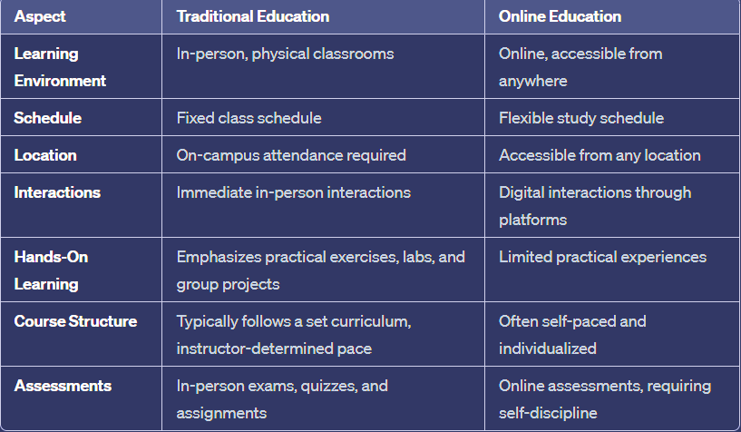
Traditional v/s online education

Slide 4

Technical advancements in online education
Learning Management Systems (LMS): LMS platforms like Moodle and Canvas have features for content delivery, assessments, and learner tracking.
Interactive Multimedia: Integration of multimedia elements: videos, simulations and virtual reality.
AI and Machine Learning: Algorithms provide personalized learning paths, automated grading, and data-driven insights for educators.
Cloud Computing: Cloud-based infrastructure ensures scalability, accessibility, and secure data storage.
Mobile Learning: Mobile apps and responsive design enable learning on smartphones and tablets, increasing accessibility.
EdTech Tools: A proliferation of educational technology tools for various purposes, from collaborative platforms to gamification.
Artificial Intelligence (AI) Chatbots: AI-driven chatbots offer immediate support and guidance to learners.
Augmented and Virtual Reality (AR/VR): AR and VR technologies enhance immersive learning experiences.

Slide 5

Advantages of online learning
Flexibility: Tailored schedules.
Accessibility: Learn from anywhere.
Diverse Courses: Wide subject range.
Self-Paced: Learn at your speed.
Cost-Efficient: Reduced expenses.
Personalization: Adaptive content.
Global Networking: Connect globally.
Digital Skills: Tech proficiency.
No Commute: Time and eco-friendly.
Comfortable: Personalized environment.
Continuous Learning: Lifelong education.
Immediate Resources: Quick access to materials.

Slide 6
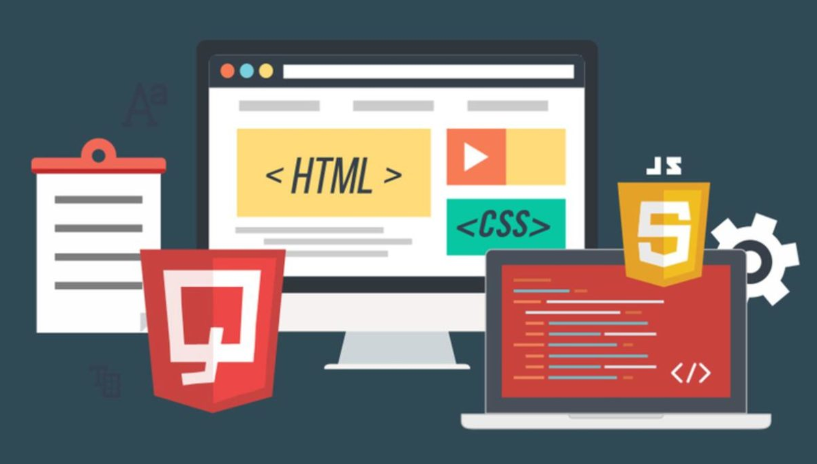

Architectural Aspects of Web-based Platforms
Front-end (UI/UX): User interface and experience design. It's developed using web technologies like HTML, CSS, and JavaScript.
Back-end (Server-Side): Server, database, and application logic. It's often built using programming languages like Python, Java, PHP, or JavaScript (Node.js).
Database Management: Storage and retrieval of user data and content. Common types include relational databases (e.g., MySQL, PostgreSQL) and NoSQL databases (e.g., MongoDB).
APIs (Application Programming Interfaces): Interfacing with other applications.
Content Management System (CMS): Organizing and managing educational content.
Security: Protecting user data and ensuring privacy.
Mobile Optimization: Adaptation for various devices.

Slide 7
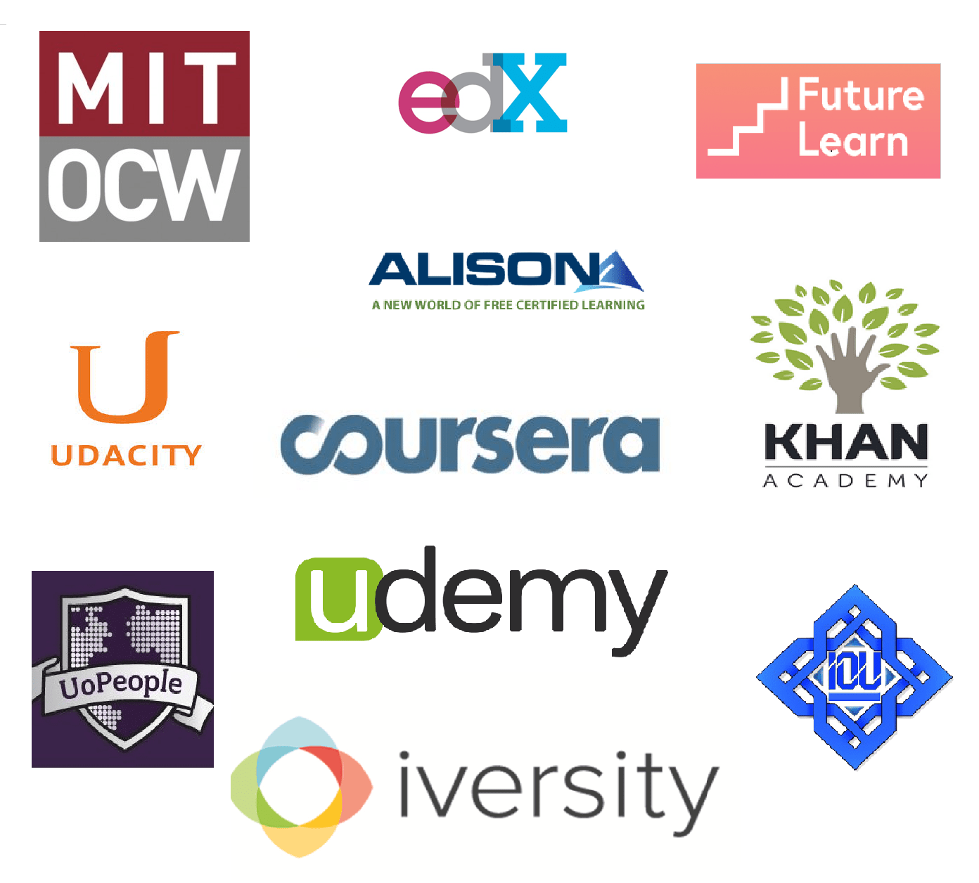
TOP Platforms and Websites very useful for students !!
www.wolframalpha.com : to find solution of science, mathematics or any other problems and neumericals.
scholar.google.com : helpful in English and other projects.
www.docsity.com : can download PYQs, sample paper, practice papers, mock papers.
resoomer.com : helpful to make longer answers short and simple, helpful for sst.
witeboard.com : virtual whiteboard for group studies.
Coursera : academic courses.
Skillshare : platform for creative students.
Udemy: wide range of programs and high quality courses.
edX : high quality courses created by Harvard University.
Linkedin learning : thounsands of programs, education while building profile.

Slide 8
conclusion
In conclusion, online education's ascent has transformed learning via web-based platforms. It enhances accessibility, offers flexibility, and leverages technology for personalized and engaging learning experiences. The future promises continued innovation, making education more adaptable and accessible to learners worldwide. Online education is a pivotal tool for lifelong learning and professional development in our digital age.

Slide 9
Thank you !!!

