Slide 1


LETS PLAY FIFA!
Project Created by:
Kuldeep Prasad Rohit Raj Hemani Shah Navya Sri Kalli

Slide 2

CONTENTS
Analysis to find:
Part A
Who is the best player in the world according to your analysis?
Predicting the rank of FIFA 2020 players by training model on the 2019 players dataset using their skill statistics as predictors.
Can a professional defender become a forward?
Predict the position of the player in the FIFA 20 dataset by training the model on all
players from FIFA 19 using their skill statistics.
The best staff always help their players grow, can you identify that using historical data?
Calculate the rank of the clubs using data from 2015 to 2020 according to best
increase in player statistics and value.
Part B
Part C

Slide 3
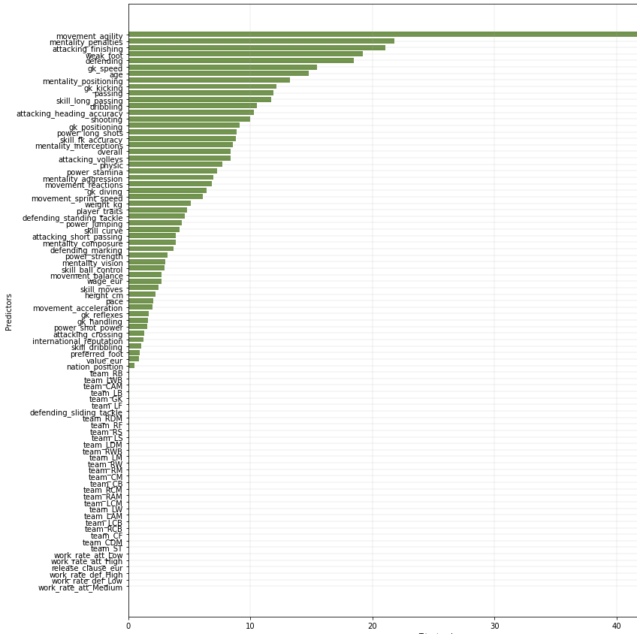
INTRODUCTION
PART - A
Who is the best player in the world according to your analysis?
Predicting the rank of FIFA 2020 players by training model on the 2019 players dataset using their skill statistics as predictors.
Model Used:
Multiple linear regression
Neural networks has 4 hidden layers, uses Adam optimizer and was trained for 50 epochs on a dataset of 86 columns.

Slide 4
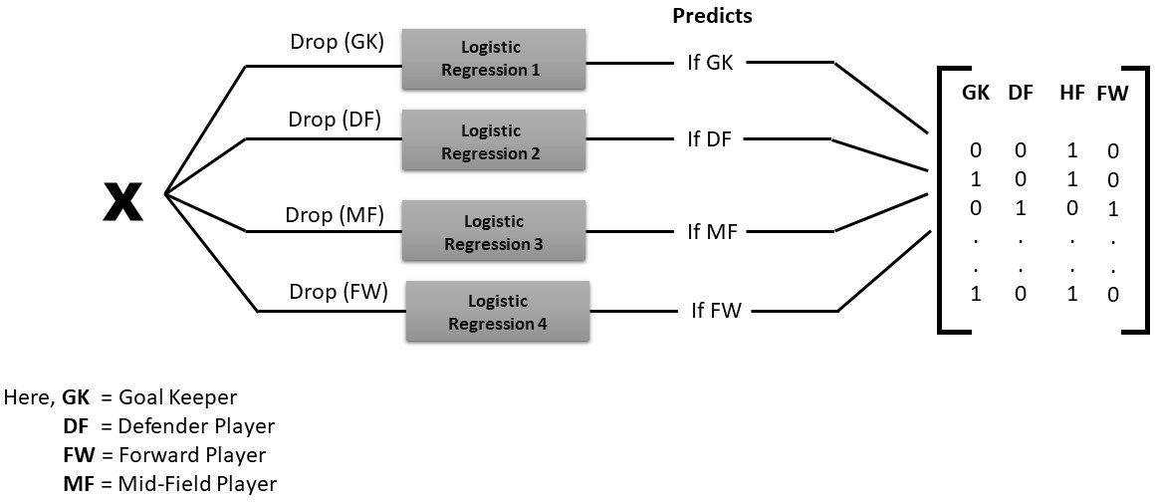
INTRODUCTION
PART - B
Can a professional defender become a forward?
Predict the position of the player in the FIFA 20 dataset by training the model on all players from FIFA 19 using their skill statistics.
Model Used:

Slide 5
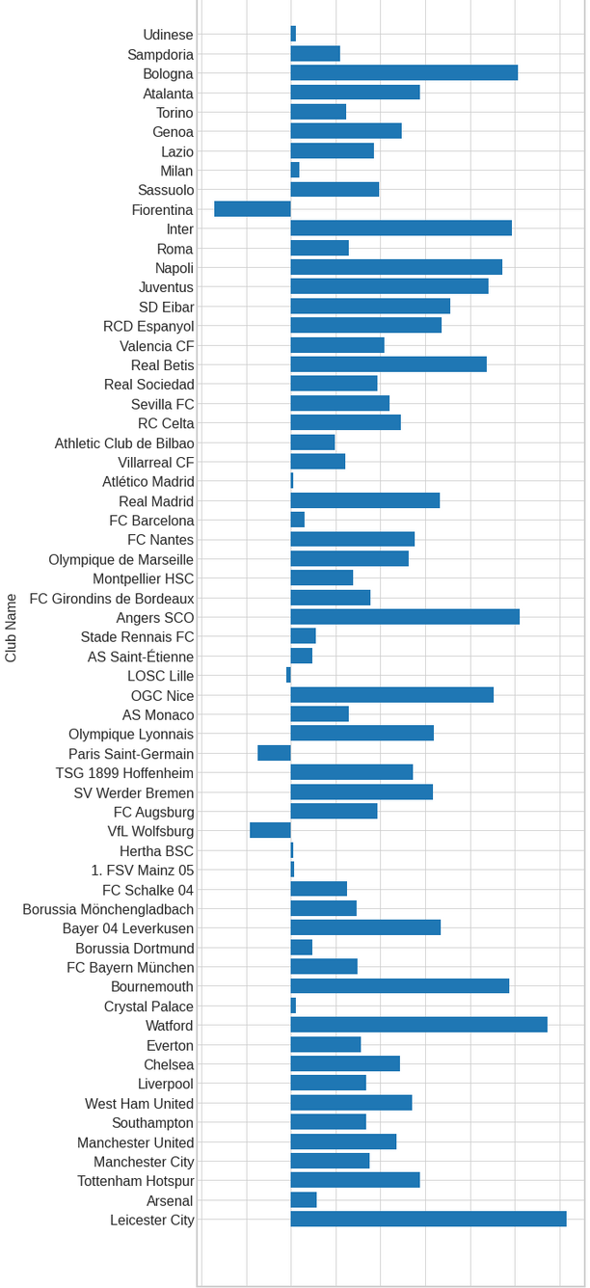
INTRODUCTION
PART – C
The best staff always help their players grow, can you identify that using historical data?
Calculate the rank of the clubs using data from 2015 to 2020 according to best increase in player statistics and value.
Model Used:
Linear Regression

Slide 6


METH0DOLOGY
EXPLAINING THE PREPROCESSING FUNCTION
Dropped the columns that don’t affect the model
Players without a team position are out of race. Preferred foot was encoded
Replaced nation position with 0’s and 1’s
Filling missing values in position specific columns
Replaced the expressions after evaluating them (eval() was helpful) Replacing values of player traits with the count of traits a player has One hot encoding for team positions and work rate
Work rate has two values one for attacking and the other for defending

Slide 7


A
PART – A:
Hypothesis testing and correlation matrix are implemented to
drop insignificant columns in Linear Regression
Notable libraries are Linear Regression, r2 score, tf, keras, layers, and matplotlib.
Data is fed to neural networks after scaling and a linear activation function is used.
B
C
PART – B:
Player position is not dropped unlike earlier and feature scaling
is implemented before training the model
Important libraries are Logistic Regression, Standard scaler, and accuracy score
METHODOLOGY
PART – C:
The overall score is the only column considered along with
clubs in this section
Libraries utilized are Linear Regression, pandas, numpy, and matplotlib

Slide 8
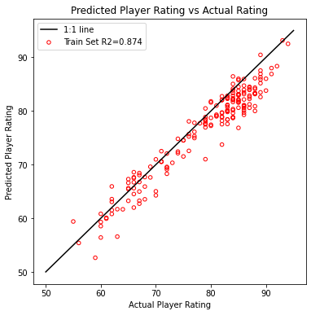
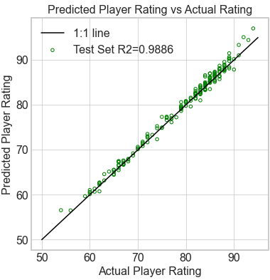
RESULTS
PART A:
The best player is Cristiano Ronaldo score - 93
The best player is L.Messi score - 95.86

Slide 9
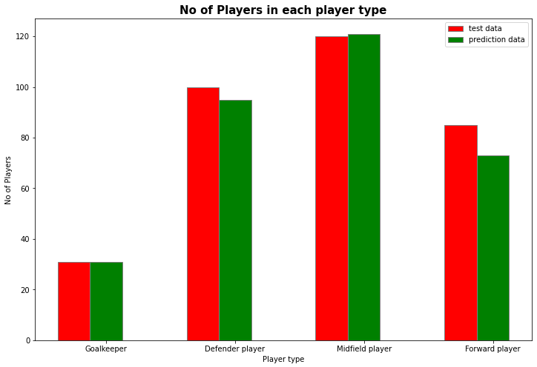
RESULTS
PART - B
Absolute metric accuracy for test data: 0.80 Relative metric accuracy for test data: 1.00
Can a professional defender become a forward?
Yes, a defender can become a forward player. Although, the probability is very low.
As we can see in the cell above only 18 Defenders have been able to become Forwards in the time period: 2015 to 2020

Slide 10
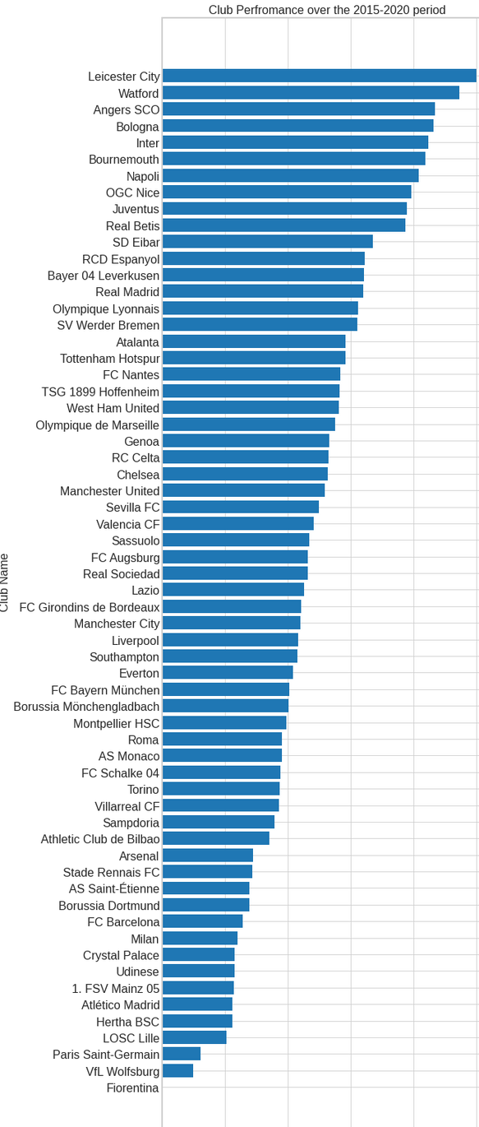
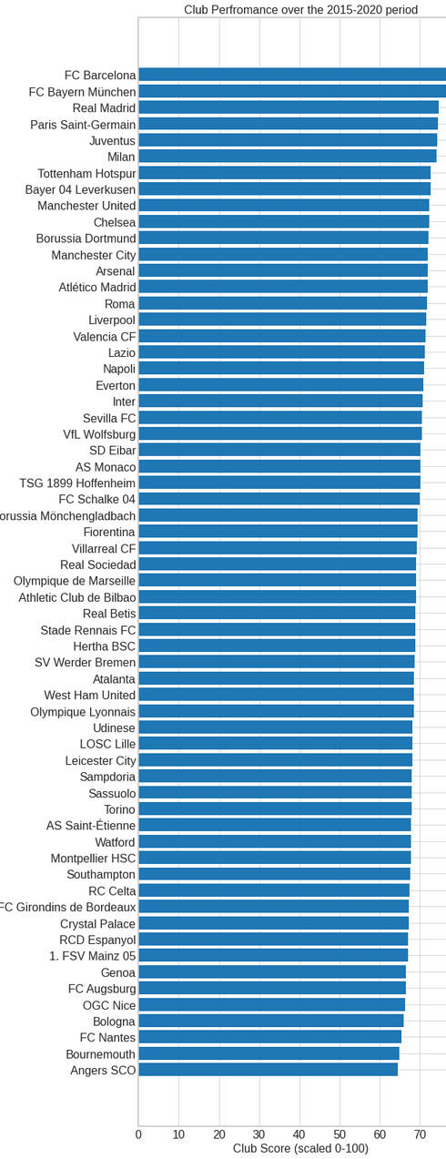
RESULTS
PART C:
Prioritizing only positive change vs considering the initial average values as well as the increase in the performance of the club.

Slide 11
CONCLUSION
LEARNINGS:
How to deal with real world problems Many Data Preprocessing techniques Importance of visualization
How to draw inferences
IMPROVEMENTS:
Can implement Regularization in Part – B Logistic regression
Can try neural networks in Part – B to predict multiple outputs at a time

