Slide 1

RMSC5102 Final Review
Leung Man Fung, Heman
Spring, 2020

Slide 2
Agenda
Review
Monte Carlo Method
Random Variable Generation
Variance Reduction Technique
Simulation in Action
Q&A

Slide 3
Monte Carlo Method

Slide 4
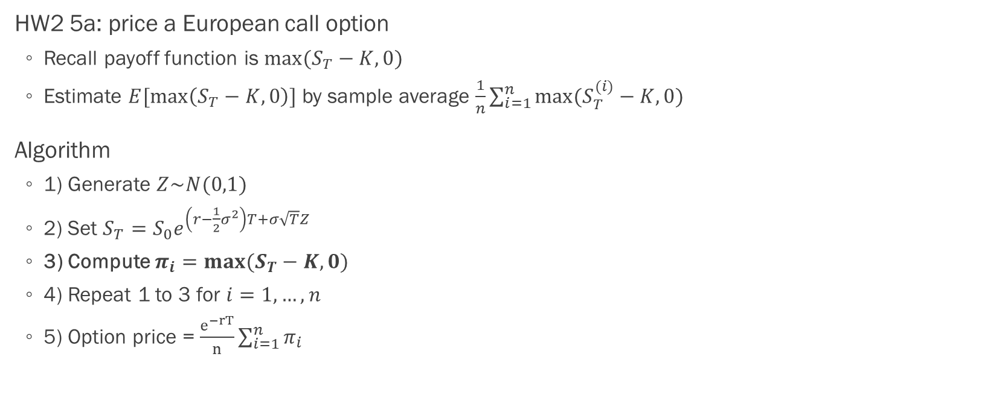
Standard Monte Carlo
HW2 5a: price a European call option
Recall payoff function is $max⁡(S_{T}−K,0)$
Estimate $E[\max\left(S_{T}−K,0\right)]$ by sample average $\frac{1}{n}\sum_{i=1}^{n}{max⁡(S_{T}^{(i)}−K,0) }$
Algorithm
1) Generate $Z\sim N(0,1)$
2) Set $S_{T}=S_{0}e^{\left(r−\frac{1}{2}σ^{2}\right)T+σ\sqrt{T}Z}$
3) Compute $π_{i}=max⁡(S_{T}−K,0)$
4) Repeat 1 to 3 for $i=1,…,n$
5) Option price = $\frac{e^{−rT}}{n}\sum_{i=1}^{n}{π_{i}}$

Slide 5
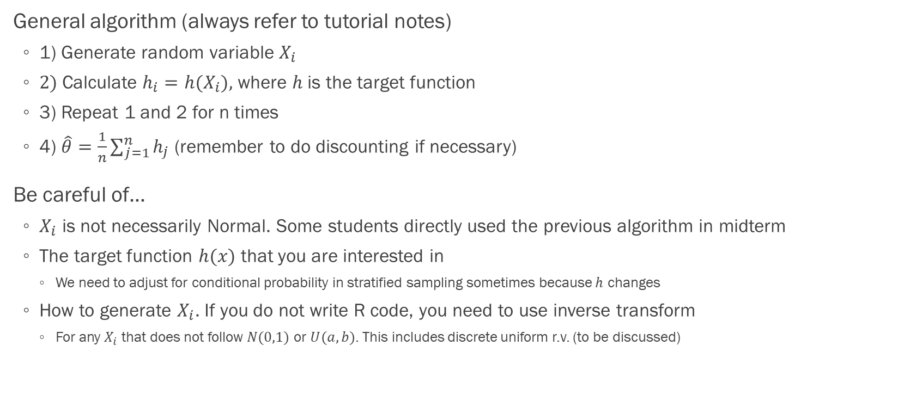
Things to Note
General algorithm (always refer to tutorial notes)
1) Generate random variable $X_{i}$
2) Calculate $h_{i}=h(X_{i})$, where $h$ is the target function
3) Repeat 1 and 2 for n times
4) $\hat{θ}=\frac{1}{n}\sum_{j=1}^{n}{h_{j}}$ (remember to do discounting if necessary)
Be careful of…
$X_{i}$ is not necessarily Normal. Some students directly used the previous algorithm in midterm
The target function $h(x)$ that you are interested in
We need to adjust for conditional probability in stratified sampling sometimes because $h$ changes
How to generate $X_{i}$. If you do not write R code, you need to use inverse transform
For any $X_{i}$ that does not follow $N(0,1)$ or $U(a,b)$. This includes discrete uniform r.v. (to be discussed)

Slide 6
Random Variable Generation

Slide 7
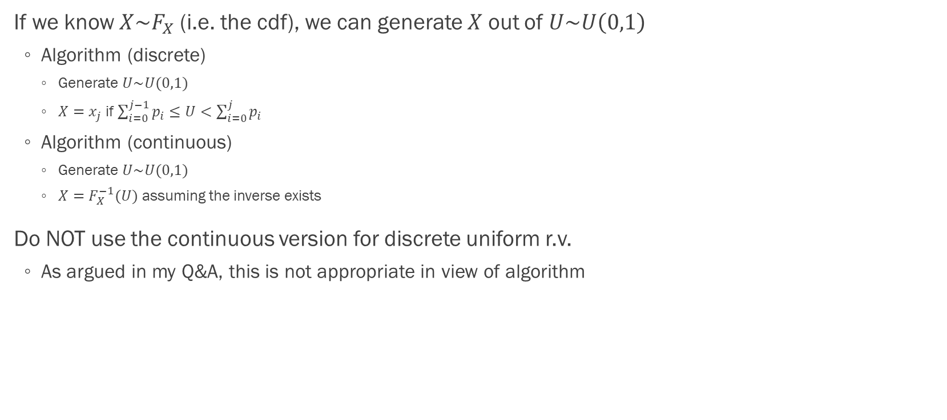
Inverse Transform
If we know $X\sim F_{X}$ (i.e. the cdf), we can generate $X$ out of $U\sim U\left(0,1\right)$
Algorithm (discrete)
Generate $U\sim U(0,1)$
$X=x_{j}$ if $\sum_{i=0}^{j−1}{p_{i}}≤U<\sum_{i=0}^{j}{p_{i}}$
Algorithm (continuous)
Generate $U\sim U(0,1)$
$X=F_{X}^{−1}(U)$ assuming the inverse exists
Do NOT use the continuous version for discrete uniform r.v.
As argued in my Q&A, this is not appropriate in view of algorithm

Slide 8
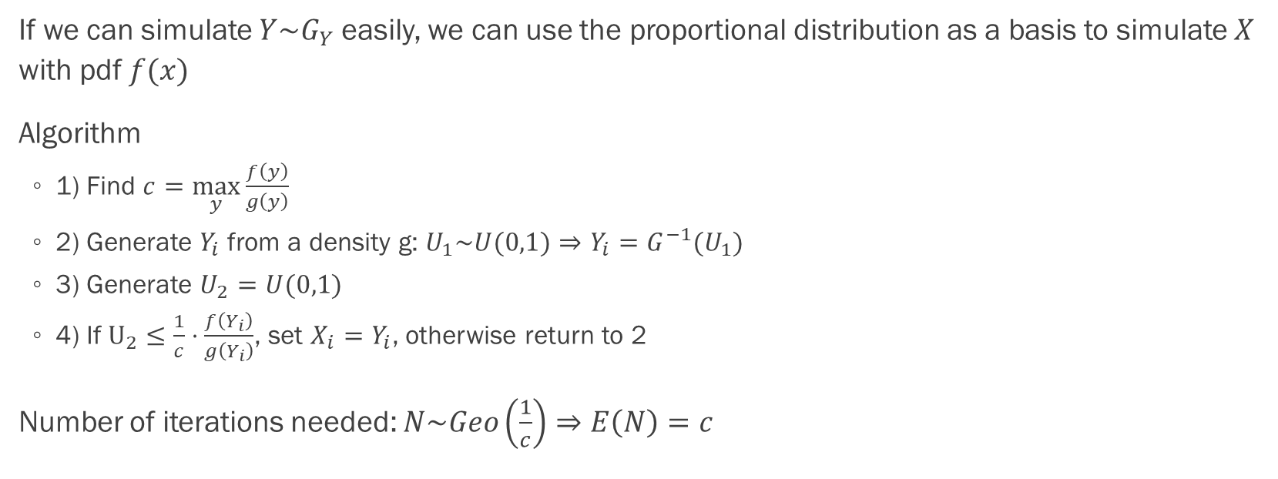
Rejection Sampling
If we can simulate $Y\sim G_{Y}$ easily, we can use the proportional distribution as a basis to simulate $X$ with pdf $f(x)$
Algorithm
1) Find $c=\max_{y}{\frac{f\left(y\right)}{g\left(y\right)}}$
2) Generate $Y_{i}$ from a density g: $U_{1}\sim U(0,1)⇒Y_{i}=G^{−1}(U_{1})$
3) Generate $U_{2}=U(0,1)$
4) If $U_{2}≤\frac{1}{c}⋅\frac{f\left(Y_{i}\right)}{g\left(Y_{i}\right)}$, set $X_{i}=Y_{i}$, otherwise return to 2
Number of iterations needed: $N\sim Geo\left(\frac{1}{c}\right)⇒E\left(N\right)=c$

Slide 9
Variance Reduction Technique

Slide 10
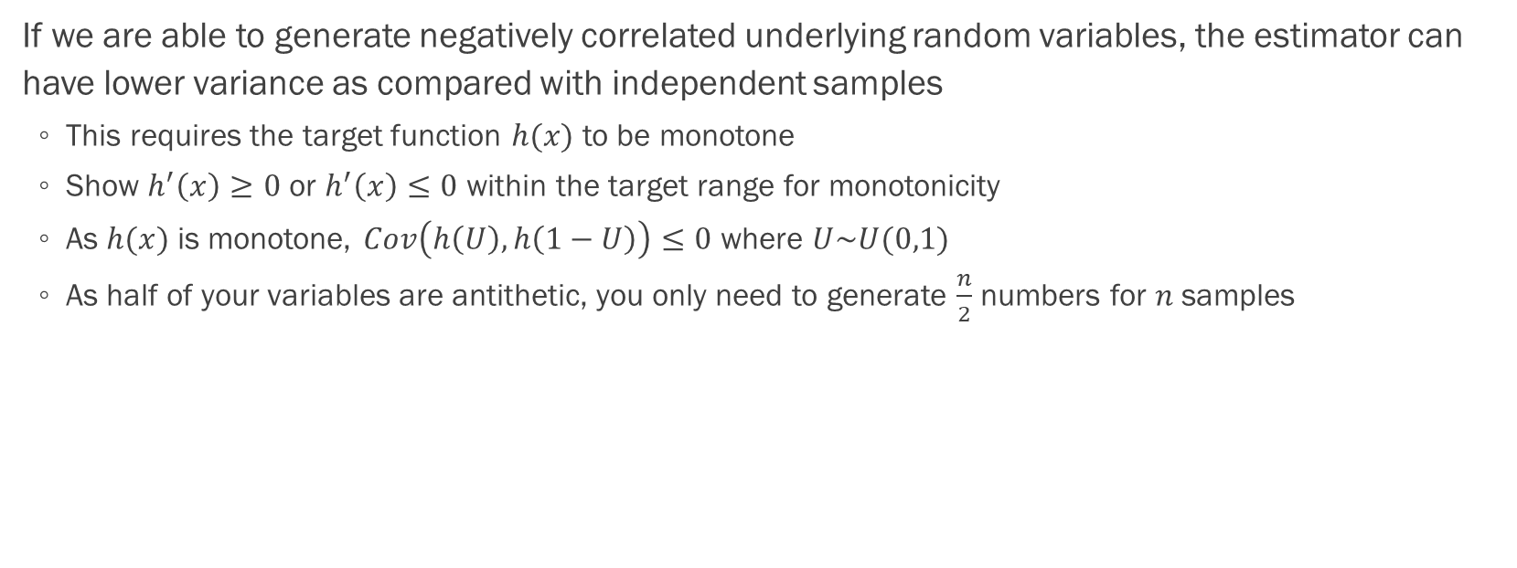
Antithetic Variables
If we are able to generate negatively correlated underlying random variables, the estimator can have lower variance as compared with independent samples
This requires the target function $h(x)$ to be monotone
Show $h^{′}\left(x\right)≥0$ or $h^{′}\left(x\right)≤0$ within the target range for monotonicity
As $h(x)$ is monotone, $Cov\left(h\left(U\right), h\left(1−U\right)\right)≤0$ where $U\sim U(0,1)$
As half of your variables are antithetic, you only need to generate $\frac{n}{2}$ numbers for $n$ samples

Slide 11
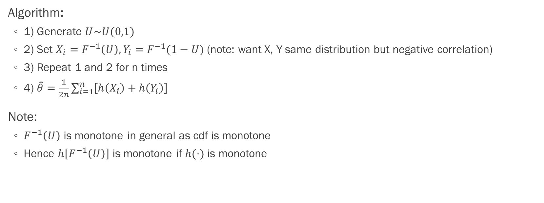
Antithetic Variables
Algorithm:
1) Generate $U\sim U(0,1)$
2) Set $X_{i}=F^{−1}\left(U\right), Y_{i}=F^{−1}(1−U)$ (note: want X, Y same distribution but negative correlation)
3) Repeat 1 and 2 for n times
4) $\hat{θ}=\frac{1}{2n}\sum_{i=1}^{n}{\left[h\left(X_{i}\right)+h\left(Y_{i}\right)\right]}$
Note:
$F^{−1}\left(U\right)$ is monotone in general as cdf is monotone
Hence $h\left[F^{−1}\left(U\right)\right]$ is monotone if $h(⋅)$ is monotone

Slide 12
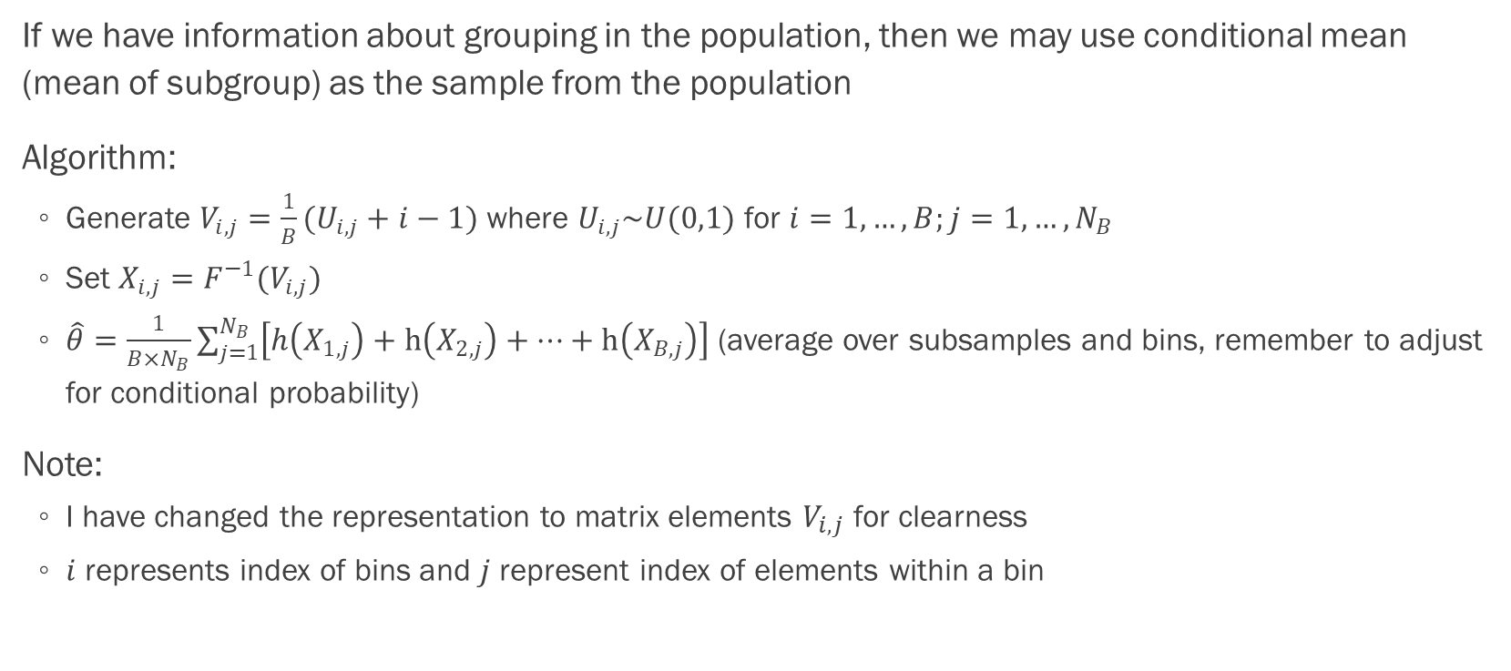
Stratified Sampling
If we have information about grouping in the population, then we may use conditional mean (mean of subgroup) as the sample from the population
Algorithm:
Generate $V_{i,j}=\frac{1}{B}(U_{i,j}+i−1)$ where $U_{i,j}\sim U(0,1)$ for $i=1,…,B;j=1,…,N_{B}$
Set $X_{i,j}=F^{−1}(V_{i,j})$
$\hat{θ}=\frac{1}{B×N_{B}}\sum_{j=1}^{N_{B}}{\left[h\left(X_{1,j}\right)+h\left(X_{2,j}\right)+…+h\left(X_{B,j}\right)\right]}$ (average over subsamples and bins, remember to adjust for conditional probability)
Note:
I have changed the representation to matrix elements $V_{i,j}$ for clearness
$i$ represents index of bins and $j$ represent index of elements within a bin

Slide 13
Stratified Sampling
When to adjust for conditional probability?
Try to write out the expectation you are trying to approximate (e.g. Ch6 p.43)
Usually you need to when there is an indicator or you have restricted the support
If you have time, you can try to simulate and compare with standard Monte Carlo
If the estimates differ a lot, probably you need to
Do ALL questions first

Slide 14
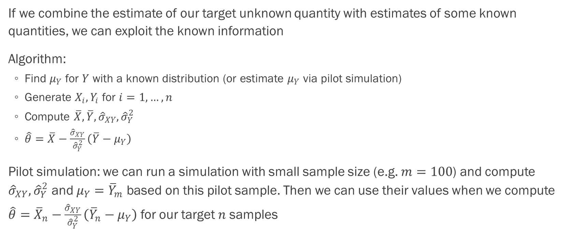
Control Variate
If we combine the estimate of our target unknown quantity with estimates of some known quantities, we can exploit the known information
Algorithm:
Find $μ_{Y}$ for $Y$ with a known distribution (or estimate $μ_{Y}$ via pilot simulation)
Generate $X_{i}, Y_{i}$ for $i=1,…,n$
Compute $\overline{X}, \overline{Y}, {\hat{σ}}_{XY}, {\hat{σ}}_{Y}^{2}$
$\hat{θ}=\overline{X}−\frac{{\hat{σ}}_{XY}}{{\hat{σ}}_{Y}^{2}}\left(\overline{Y}−μ_{Y}\right)$
Pilot simulation: we can run a simulation with small sample size (e.g. $m=100$) and compute ${\hat{σ}}_{XY}, {\hat{σ}}_{Y}^{2}$ and $μ_{Y}={\overline{Y}}_{m}$ based on this pilot sample. Then we can use their values when we compute $\hat{θ}={\overline{X}}_{n}−\frac{{\hat{σ}}_{XY}}{{\hat{σ}}_{Y}^{2}}\left({\overline{Y}}_{n}−μ_{Y}\right)$ for our target $n$ samples

Slide 15
Control Variate
Properties of effective control: evaluable from simulation data, known mean and high correlation with the simulation variable. Possible candidates are underlying random variable (e.g. uniform when we use inverse transform) and martingale transform (will not be tested)
Note:
The algorithm in last slide is one-off, i.e. it does not affect each sample
So we should use control variate last if we were to combine the methods (e.g. HW4 Q3)

Slide 16
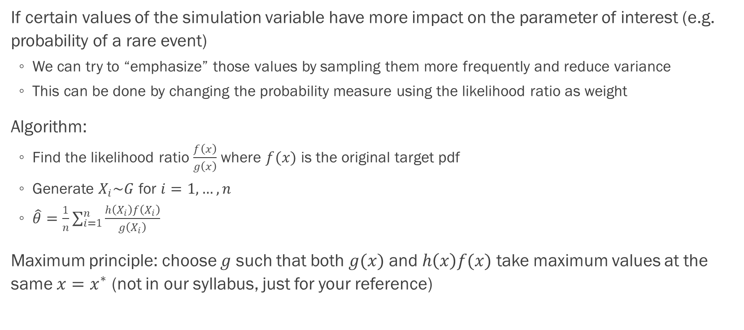
Importance Sampling
If certain values of the simulation variable have more impact on the parameter of interest (e.g. probability of a rare event)
We can try to “emphasize” those values by sampling them more frequently and reduce variance
This can be done by changing the probability measure using the likelihood ratio as weight
Algorithm:
Find the likelihood ratio $\frac{f\left(x\right)}{g\left(x\right)}$ where $f(x)$ is the original target pdf
Generate $X_{i}\sim G$ for $i=1,…,n$
$\hat{θ}=\frac{1}{n}\sum_{i=1}^{n}{\frac{h\left(X_{i}\right)f\left(X_{i}\right)}{g\left(X_{i}\right)}}$
Maximum principle: choose $g$ such that both $g(x)$ and $h\left(x\right)f(x)$ take maximum values at the same $x=x^{∗}$ (not in our syllabus, just for your reference)

Slide 17
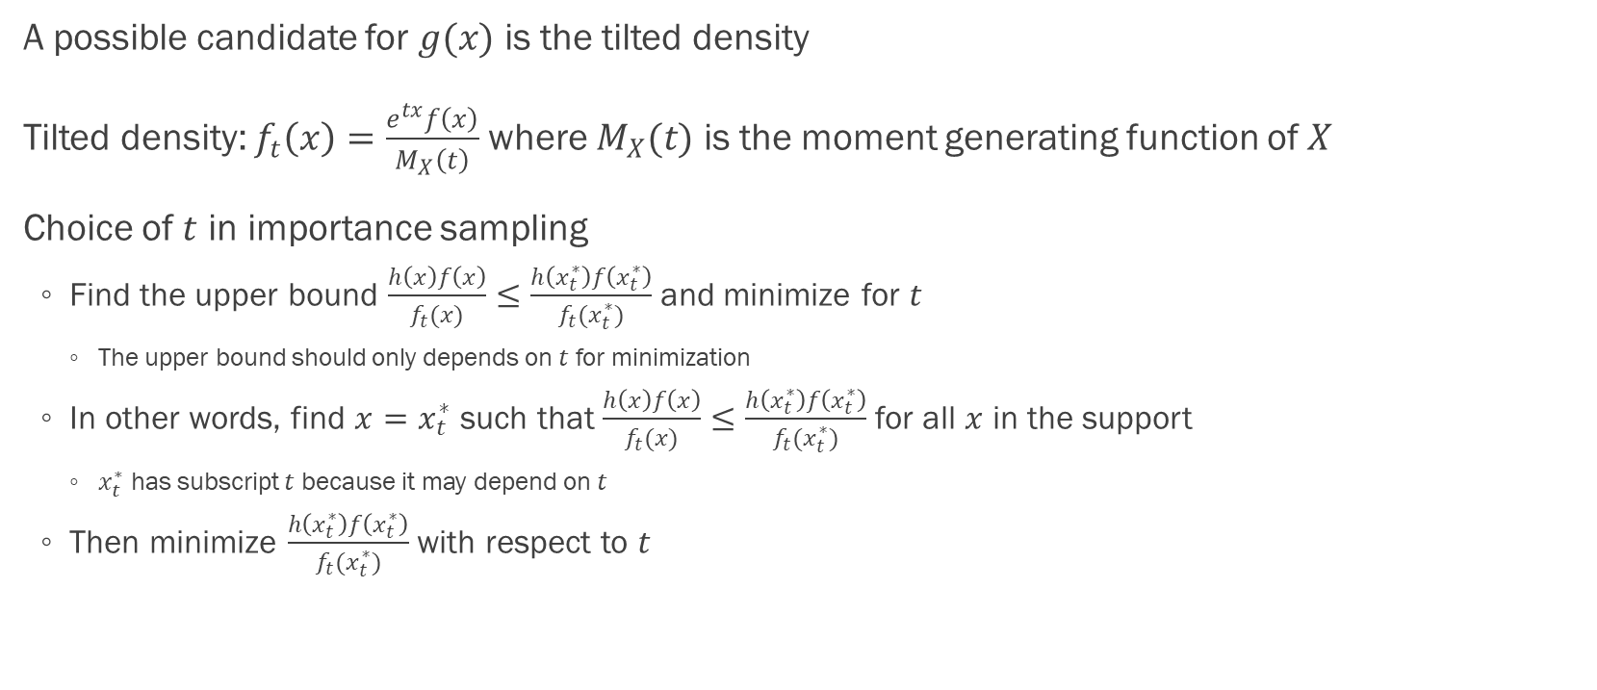
Importance Sampling
A possible candidate for $g(x)$ is the tilted density
Tilted density: $f_{t}\left(x\right)=\frac{e^{tx}f\left(x\right)}{M_{X}\left(t\right)}$ where $M_{X}(t)$ is the moment generating function of $X$
Choice of $t$ in importance sampling
Find the upper bound $\frac{h\left(x\right)f\left(x\right)}{f_{t}(x)}≤\frac{h\left(x_{t}^{∗}\right)f\left(x_{t}^{∗}\right)}{f_{t}(x_{t}^{∗})}$ and minimize for $t$
The upper bound should only depends on $t$ for minimization
In other words, find $x=x_{t}^{∗}$ such that $\frac{h\left(x\right)f\left(x\right)}{f_{t}(x)}≤\frac{h\left(x_{t}^{∗}\right)f\left(x_{t}^{∗}\right)}{f_{t}(x_{t}^{∗})}$ for all $x$ in the support
$x_{t}^{∗}$ has subscript $t$ because it may depend on $t$
Then minimize $\frac{h\left(x_{t}^{∗}\right)f\left(x_{t}^{∗}\right)}{f_{t}(x_{t}^{∗})}$ with respect to $t$

Slide 18
Simulation in Action

Slide 19
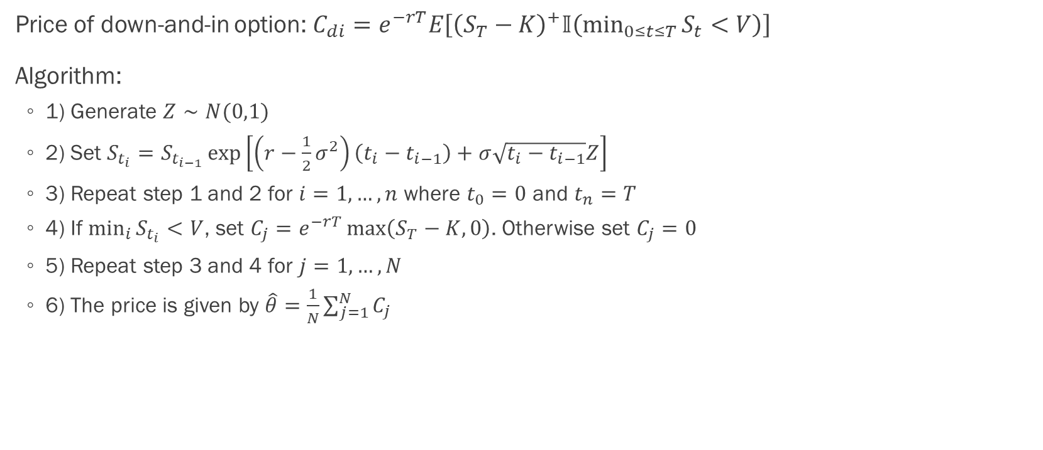
Down-and-in Call Option
Price of down-and-in option: $C_{di}=e^{−rT}E\left[{\left(S_{T}−K\right)}^{+}𝕀\left(\min_{0≤t≤T}{S_{t}}<V\right)\right]$
Algorithm:
1) Generate $Z∼N(0,1)$
2) Set $S_{t_{i}}=S_{t_{i−1}}\exp\left[\left(r−\frac{1}{2}σ^{2}\right)\left(t_{i}−t_{i−1}\right)+σ\sqrt{t_{i}−t_{i−1}}Z\right]$
3) Repeat step 1 and 2 for $i=1,…,n$ where $t_{0}=0$ and $t_{n}=T$
4) If $\min_{i}{S_{t_{i}}}<V$, set $C_{j}=e^{−rT}\max\left(S_{T}−K,0\right)$. Otherwise set $C_{j}=0$
5) Repeat step 3 and 4 for $j=1,…,N$
6) The price is given by $\hat{θ}=\frac{1}{N}\sum_{j=1}^{N}{C_{j}}$

Slide 20
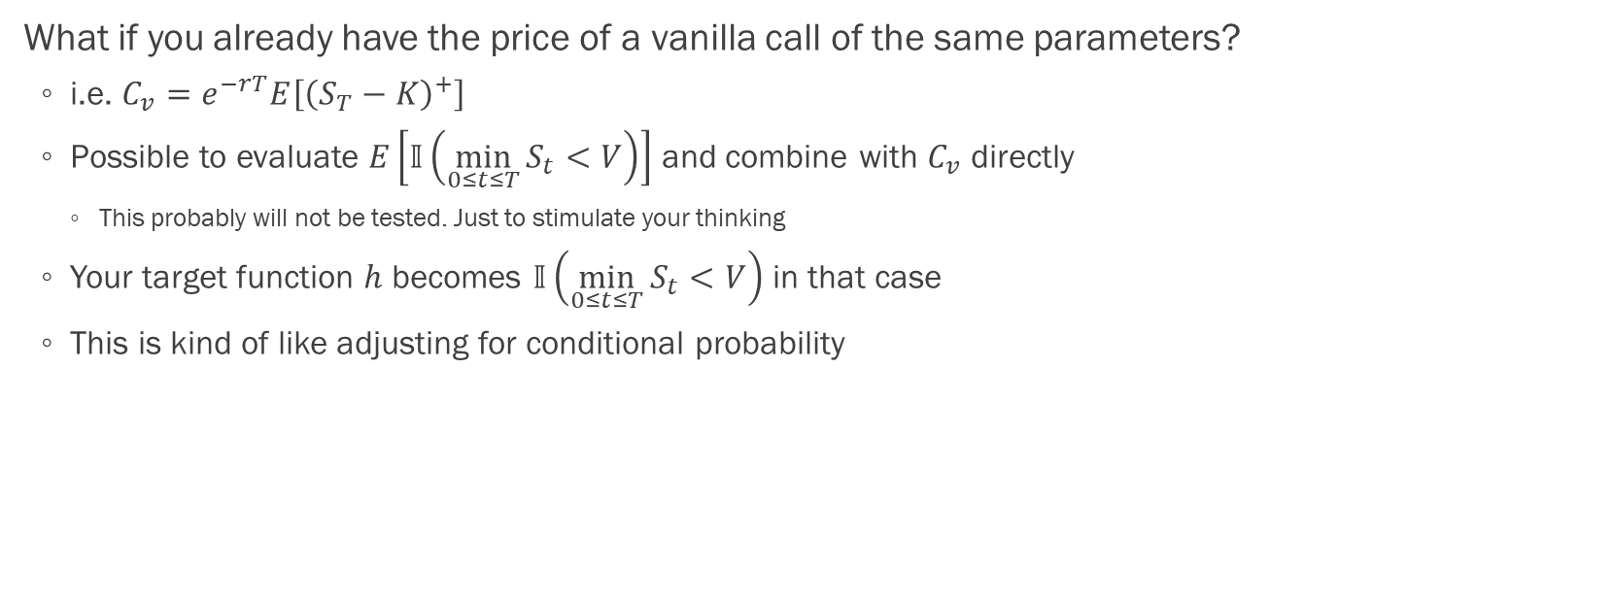
Down-and-in Call Option
What if you already have the price of a vanilla call of the same parameters?
i.e. $C_{v}=e^{−rT}E\left[{\left(S_{T}−K\right)}^{+}\right]$
Possible to evaluate $E\left[𝕀\left(\min_{0≤t≤T}{S_{t}}<V\right)\right]$ and combine with $C_{v}$ directly
This probably will not be tested. Just to stimulate your thinking
Your target function $h$ becomes $𝕀\left(\min_{0≤t≤T}{S_{t}}<V\right)$ in that case
This is kind of like adjusting for conditional probability

Slide 21
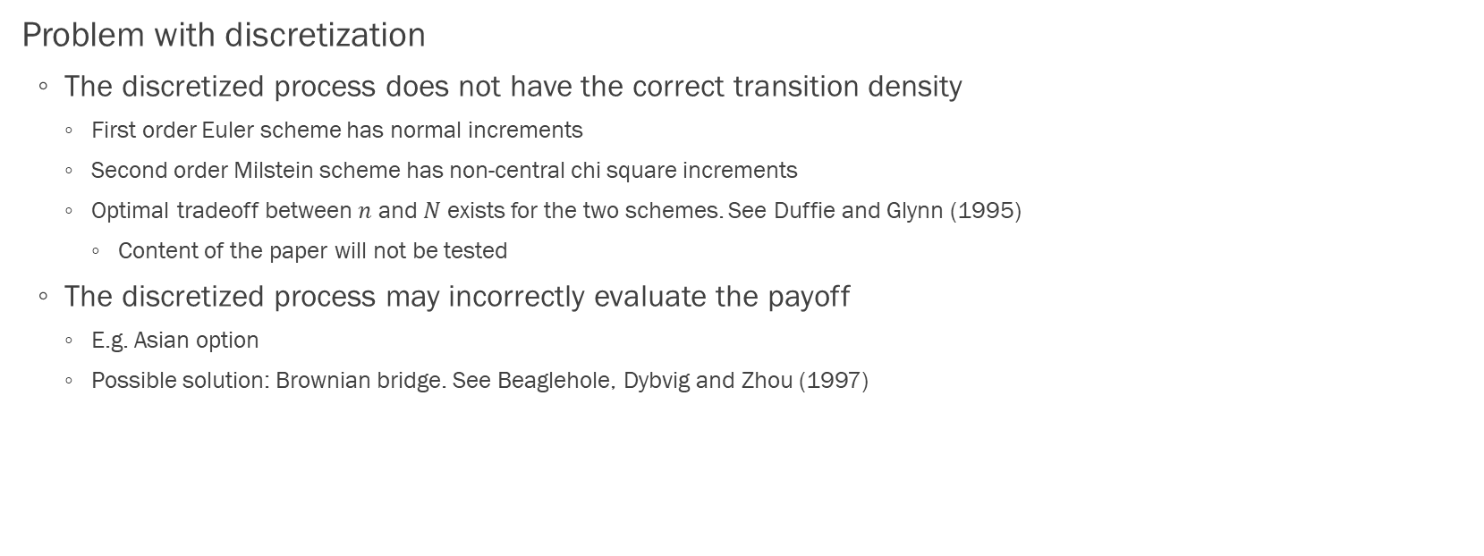
Path-dependent Option
Problem with discretization
The discretized process does not have the correct transition density
First order Euler scheme has normal increments
Second order Milstein scheme has non-central chi square increments
Optimal tradeoff between $n$ and $N$ exists for the two schemes. See Duffie and Glynn (1995)
Content of the paper will not be tested
The discretized process may incorrectly evaluate the payoff
E.g. Asian option
Possible solution: Brownian bridge. See Beaglehole, Dybvig and Zhou (1997)

Slide 22
Path-dependent Option
American option
Problem with branching paths
Possible solution: linear regression. See Longstaff and Schwartz (2001)
Just for your interest
Consider taking courses from Prof. Wong :P He taught us this in undergrad

Slide 23

Q&A
Thank you for taking RMSC5102! Write me (or department) an email if you like my tutorials :P
Let’s keep in touch :)

