Slide 1
RMSC5102 Midterm Review
Leung Man Fung, Heman
Spring, 2021

Slide 2
Agenda
Review
Basic Knowledge
The Black-Scholes World
Monte Carlo Method
Random Variable Generation
Variance Reduction Technique
Q&A

Slide 3
Basic Knowledge

Slide 4
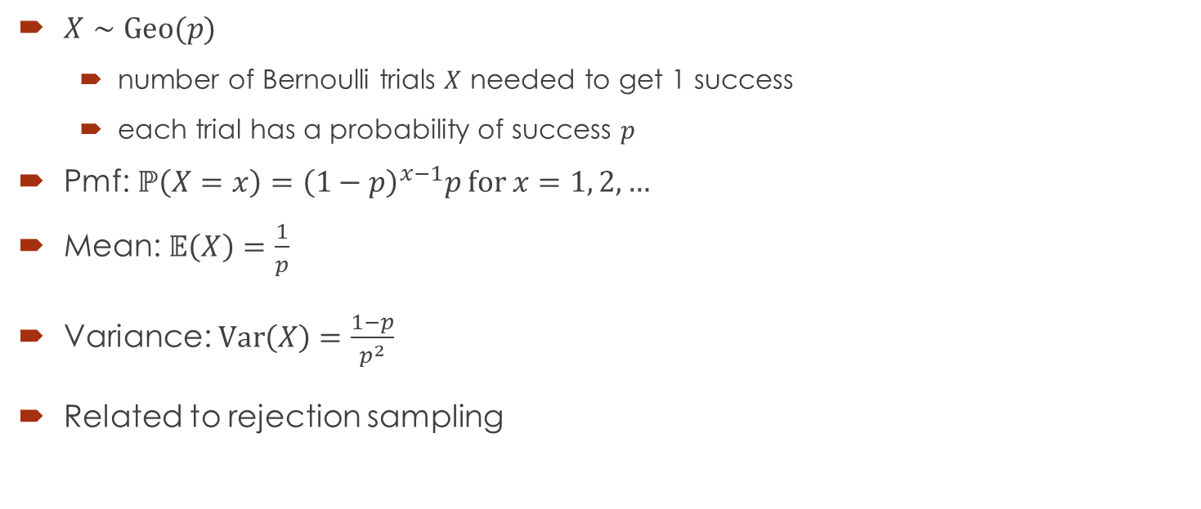
Geometric Distribution
$X∼Geo(p)$
number of Bernoulli trials $X$ needed to get 1 success
each trial has a probability of success $p$
Pmf: $ℙ\left(X=x\right)={\left(1−p\right)}^{x−1}p$ for $x=1, 2, …$
Mean: $𝔼\left(X\right)=\frac{1}{p}$
Variance: $\text{Var}\left(X\right)=\frac{1−p}{p^{2}}$
Related to rejection sampling

Slide 5
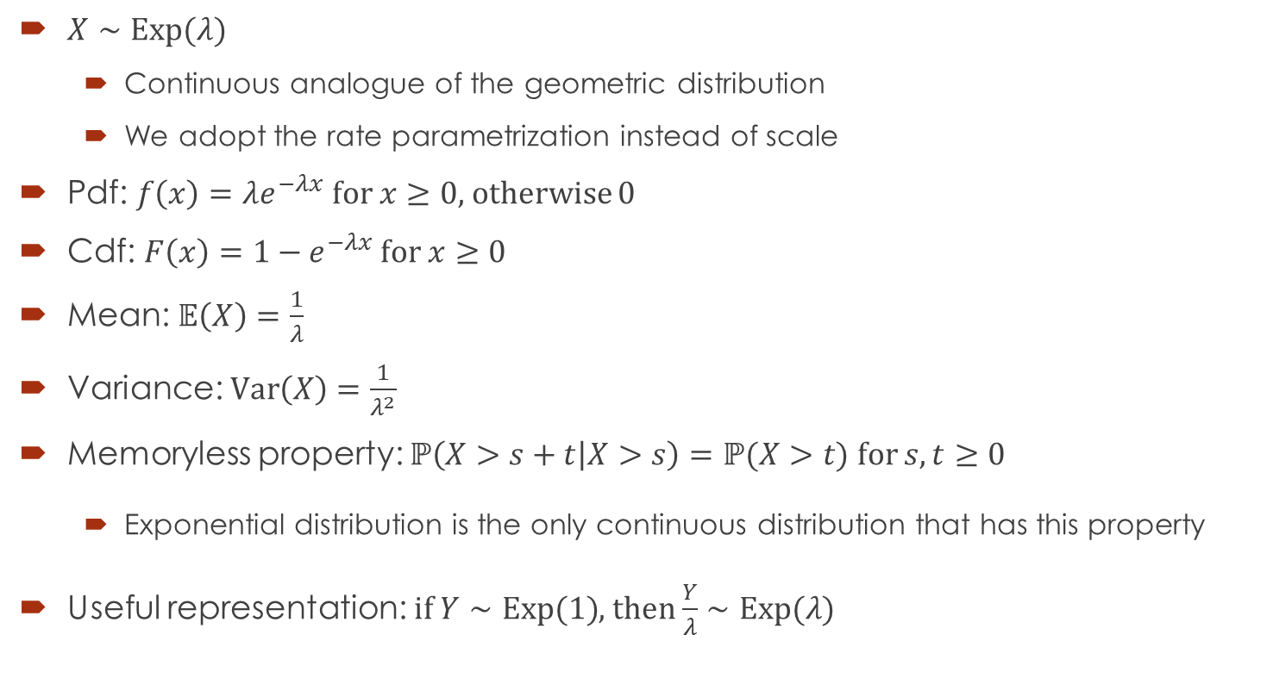
Exponential Distribution
$X∼Exp(λ)$
Continuous analogue of the geometric distribution
We adopt the rate parametrization instead of scale
Pdf: $f\left(x\right)=λe^{−λx}$ for $x≥0$, otherwise 0
Cdf: $F\left(x\right)=1−e^{−λx}$ for $x≥0$
Mean: $𝔼\left(X\right)=\frac{1}{λ}$
Variance: $\text{Var}\left(X\right)=\frac{1}{λ^{2}}$
Memoryless property: $ℙ\left(X>s+t | X>s\right)=ℙ(X>t)$ for $s,t≥0$
Exponential distribution is the only continuous distribution that has this property
Useful representation: if $Y∼Exp(1)$, then $\frac{Y}{λ}∼Exp(λ)$

Slide 6
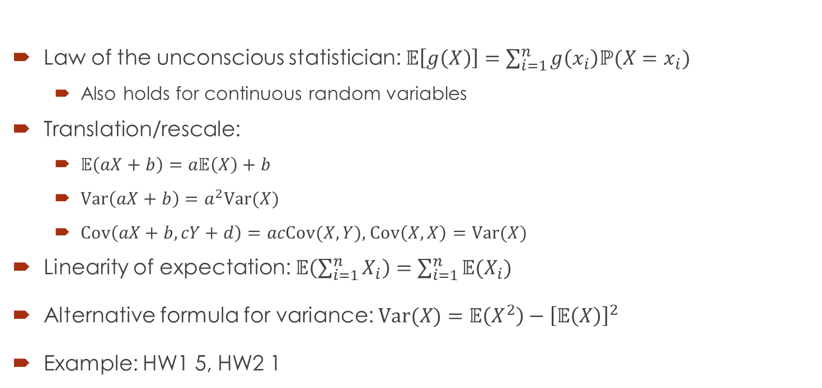
Some Properties of Expectation, Variance and Covariance
Law of the unconscious statistician: $𝔼\left[g\left(X\right)\right]=\sum_{i=1}^{n}{g\left(x_{i}\right)ℙ(X=x_{i})}$
Also holds for continuous random variables
Translation/rescale:
$𝔼\left(aX+b\right)=a𝔼\left(X\right)+b$
$\text{Var}\left(aX+b\right)=a^{2}\text{Var}(X)$
$Cov\left(aX+b,cY+d\right)=acCov(X,Y)$, $Cov\left(X,X\right)=Var(X)$
Linearity of expectation: $𝔼\left(\sum_{i=1}^{n}{X_{i}}\right)=\sum_{i=1}^{n}{𝔼(X_{i})}$
Alternative formula for variance: $\text{Var}(X)=𝔼\left(X^{2}\right)−{\left[𝔼\left(X\right)\right]}^{2}$
Example: HW1 5, HW2 1

Slide 7
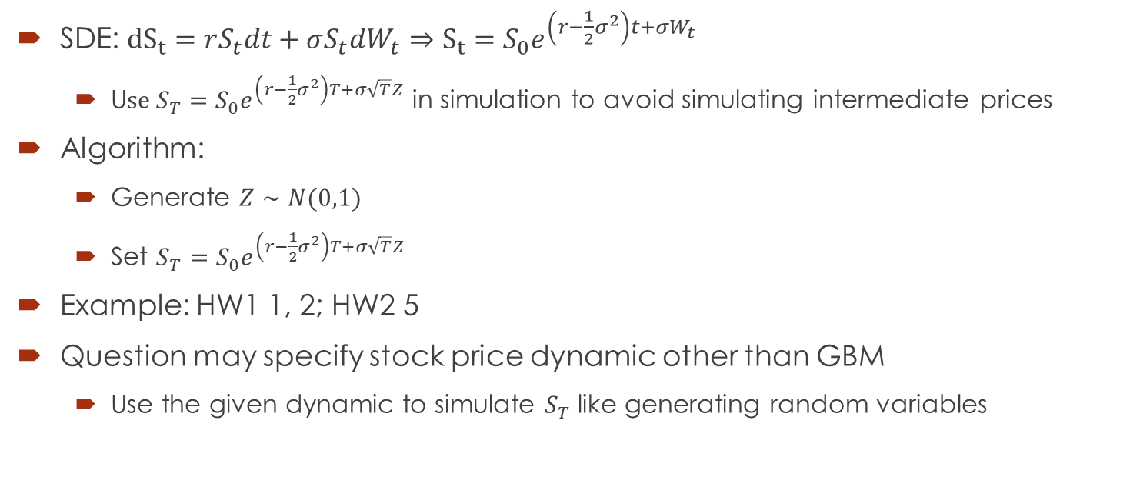
Geometric Brownian Motion
SDE: ${dS}_{t}=rS_{t}dt+σS_{t}dW_{t}⇒S_{t}=S_{0}e^{\left(r−\frac{1}{2}σ^{2}\right)t+σW_{t}}$
U$se S_{T}=S_{0}e^{\left(r−\frac{1}{2}σ^{2}\right)T+σ\sqrt{T}Z}$ in simulation to avoid simulating intermediate prices
Algorithm:
Generate $Z∼N(0,1)$
Set $S_{T}=S_{0}e^{\left(r−\frac{1}{2}σ^{2}\right)T+σ\sqrt{T}Z}$
Example: HW1 1, 2; HW2 5
Question may specify stock price dynamic other than GBM
Use the given dynamic to simulate $S_{T}$ like generating random variables

Slide 8
The Black-Scholes World

Slide 9
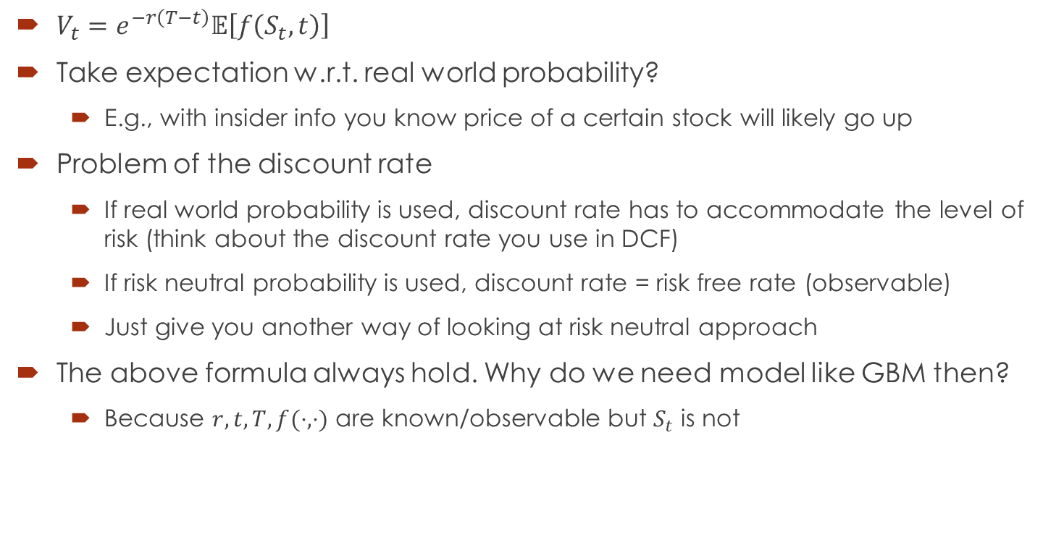
Risk Neutral Valuation
$V_{t}=e^{−r\left(T−t\right)}𝔼\left[f\left(S_{t},t\right)\right]$
Take expectation w.r.t. real world probability?
E.g., with insider info you know price of a certain stock will likely go up
Problem of the discount rate
If real world probability is used, discount rate has to accommodate the level of risk (think about the discount rate you use in DCF)
If risk neutral probability is used, discount rate = risk free rate (observable)
Just give you another way of looking at risk neutral approach
The above formula always hold. Why do we need model like GBM then?
Because $r,t,T,f(⋅,⋅)$ are known/observable but $S_{t}$ is not

Slide 10
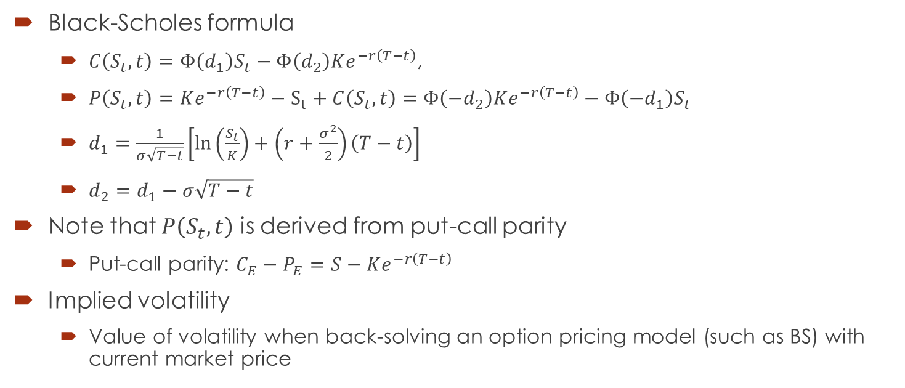
Black–Scholes–Merton Model
Black-Scholes formula
$C\left(S_{t},t\right)=Φ\left(d_{1}\right)S_{t}−Φ\left(d_{2}\right)Ke^{−r\left(T−t\right)}$,
$P\left(S_{t},t\right)=Ke^{−r\left(T−t\right)}−S_{t}+C\left(S_{t},t\right)=Φ\left(−d_{2}\right)Ke^{−r\left(T−t\right)}−Φ\left(−d_{1}\right)S_{t}$
$d_{1}=\frac{1}{σ\sqrt{T−t}}\left[\ln\left(\frac{S_{t}}{K}\right)+\left(r+\frac{σ^{2}}{2}\right)\left(T−t\right)\right]$
$d_{2}=d_{1}−σ\sqrt{T−t}$
Note that $P\left(S_{t},t\right)$ is derived from put-call parity
Put-call parity: $C_{E}−P_{E}=S−Ke^{−r\left(T−t\right)}$
Implied volatility
Value of volatility when back-solving an option pricing model (such as BS) with current market price

Slide 11
Monte Carlo Method

Slide 12


Key Idea
Use repeated random sampling to obtain numerical estimate
The estimate is usually average in our course
Example: estimate $π$ (picture credit: nicoguaro)

Slide 13
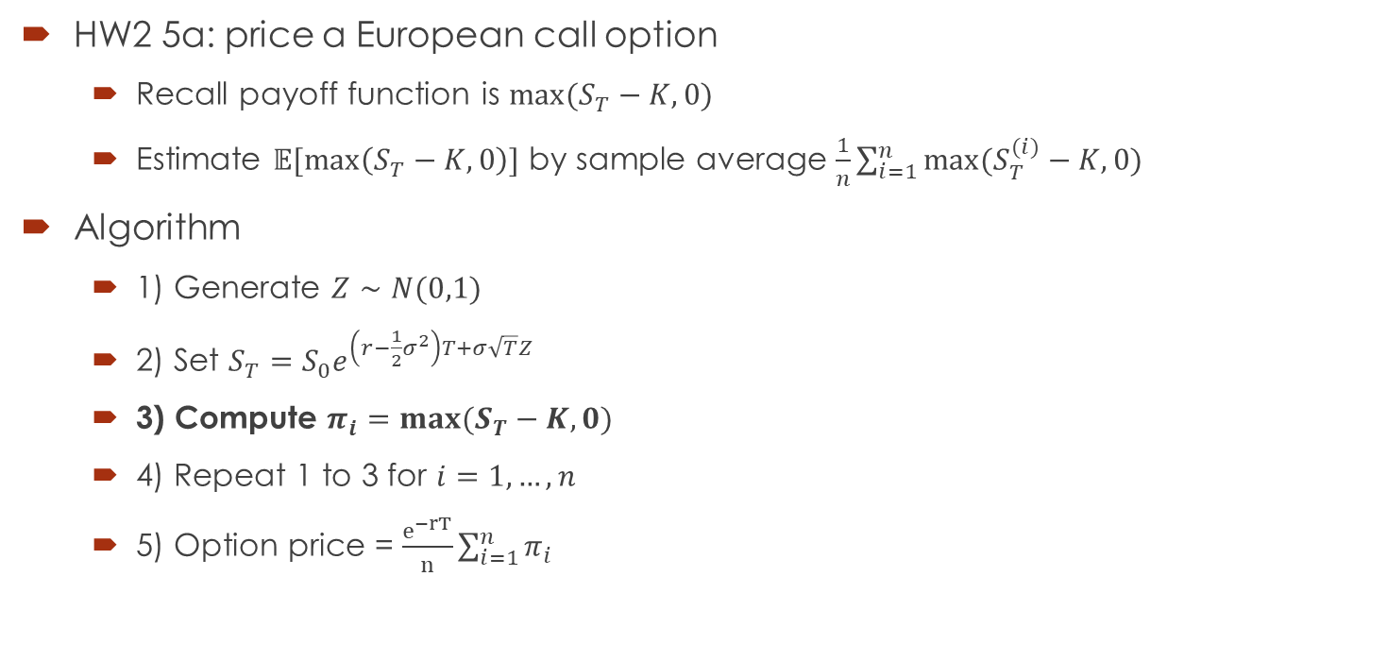
Standard Monte Carlo
HW2 5a: price a European call option
Recall payoff function is $max⁡(S_{T}−K,0)$
Estimate $𝔼[\max\left(S_{T}−K,0\right)]$ by sample average $\frac{1}{n}\sum_{i=1}^{n}{max⁡(S_{T}^{(i)}−K,0) }$
Algorithm
1) Generate $Z∼N(0,1)$
2) Set $S_{T}=S_{0}e^{\left(r−\frac{1}{2}σ^{2}\right)T+σ\sqrt{T}Z}$
3) Compute $π_{i}=max⁡(S_{T}−K,0)$
4) Repeat 1 to 3 for $i=1,…,n$
5) Option price = $\frac{e^{−rT}}{n}\sum_{i=1}^{n}{π_{i}}$

Slide 14
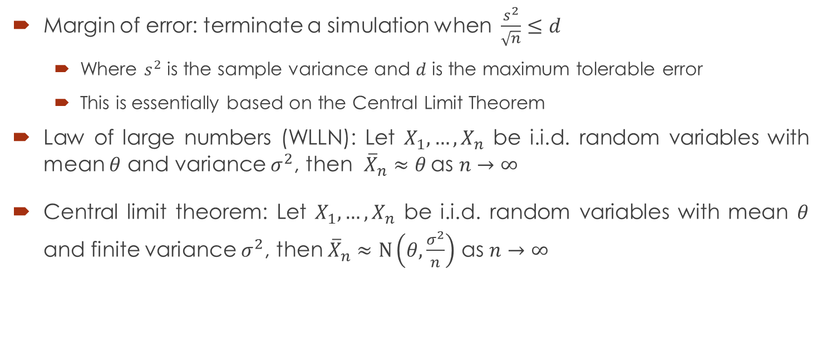
Stopping a Simulation
Margin of error: terminate a simulation when $\frac{s^{2}}{\sqrt{n}}≤d$
Where $s^{2}$ is the sample variance and $d$ is the maximum tolerable error
This is essentially based on the Central Limit Theorem
Law of large numbers (WLLN): Let $X_{1},…,X_{n}$ be i.i.d. random variables with mean $θ$ and variance $σ^{2}$, then ${\overline{X}}_{n}≈θ$ as $n→∞$
Central limit theorem: Let $X_{1},…,X_{n}$ be i.i.d. random variables with mean $θ$ and finite variance $σ^{2}$, then ${\overline{X}}_{n}≈\text{N}\left(θ,\frac{σ^{2}}{n}\right)$ as $n→∞$

Slide 15
Random Variable Generation

Slide 16
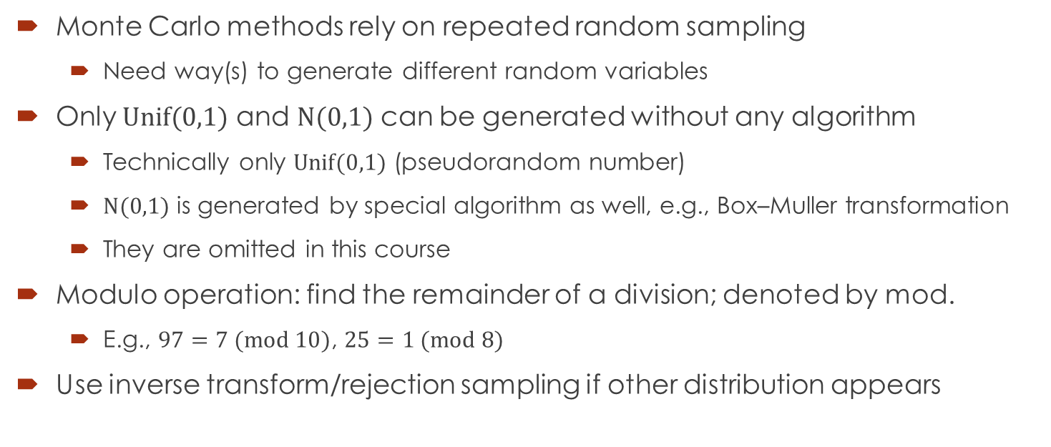
Key ideas
Monte Carlo methods rely on repeated random sampling
Need way(s) to generate different random variables
Only $Unif(0,1)$ and $N(0,1)$ can be generated without any algorithm
Technically only $Unif(0,1)$ (pseudorandom number)
$N(0,1)$ is generated by special algorithm as well, e.g., Box–Muller transformation
They are omitted in this course
Modulo operation: find the remainder of a division; denoted by mod.
E.g., $97=7 (mod 10)$, $25=1 (mod 8)$
Use inverse transform/rejection sampling if other distribution appears

Slide 17
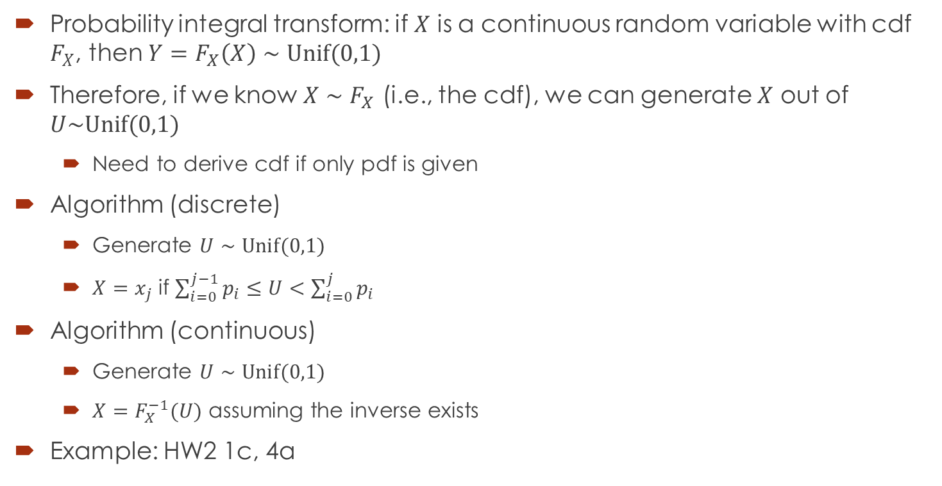
Inverse Transform
Probability integral transform: if $X$ is a continuous random variable with cdf $F_{X}$, then $Y=F_{X}\left(X\right)∼Unif(0,1)$
Therefore, if we know $X∼F_{X}$ (i.e., the cdf), we can generate $X$ out of $U\sim Unif(0,1)$
Need to derive cdf if only pdf is given
Algorithm (discrete)
Generate $U∼Unif(0,1)$
$X=x_{j}$ if $\sum_{i=0}^{j−1}{p_{i}}≤U<\sum_{i=0}^{j}{p_{i}}$
Algorithm (continuous)
Generate $U∼Unif(0,1)$
$X=F_{X}^{−1}(U)$ assuming the inverse exists
Example: HW2 1c, 4a

Slide 18
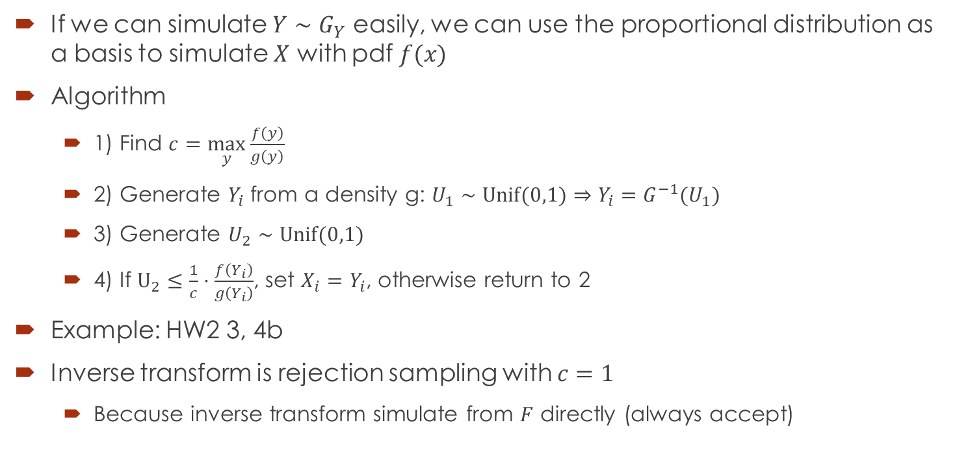
Rejection Sampling
If we can simulate $Y∼G_{Y}$ easily, we can use the proportional distribution as a basis to simulate $X$ with pdf $f(x)$
Algorithm
1) Find $c=\max_{y}{\frac{f\left(y\right)}{g\left(y\right)}}$
2) Generate $Y_{i}$ from a density g: $U_{1}∼Unif(0,1)⇒Y_{i}=G^{−1}(U_{1})$
3) Generate $U_{2}∼Unif(0,1)$
4) If $U_{2}≤\frac{1}{c}⋅\frac{f\left(Y_{i}\right)}{g\left(Y_{i}\right)}$, set $X_{i}=Y_{i}$, otherwise return to 2
Example: HW2 3, 4b
Inverse transform is rejection sampling with $c=1$
Because inverse transform simulate from $F$ directly (always accept)

Slide 19
Variance Reduction Technique

Slide 20
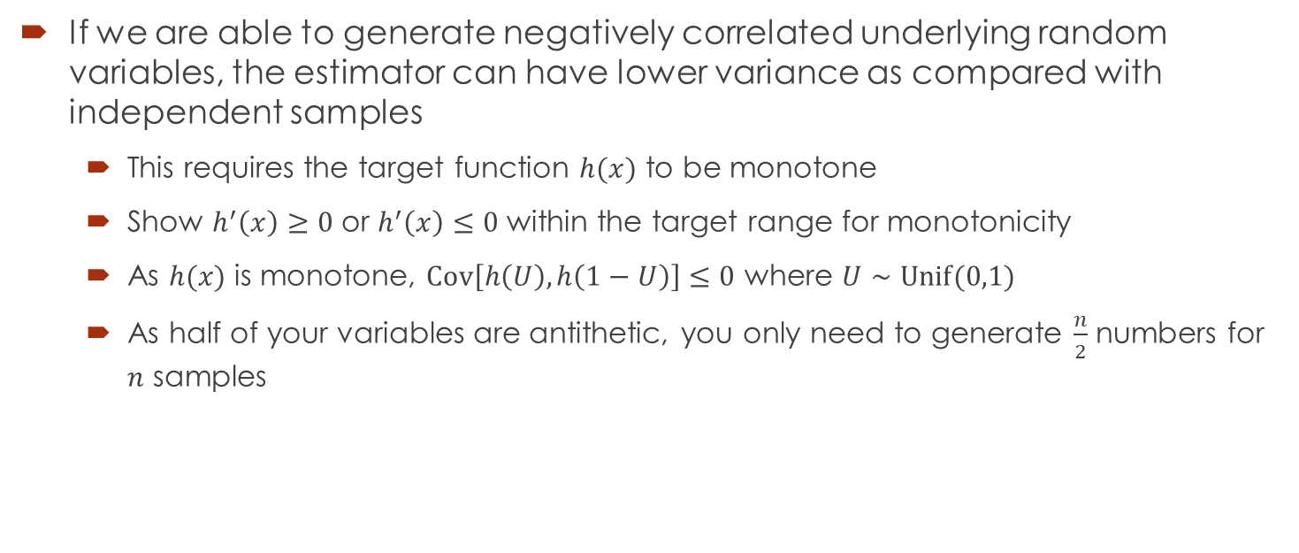
Antithetic Variables
If we are able to generate negatively correlated underlying random variables, the estimator can have lower variance as compared with independent samples
This requires the target function $h(x)$ to be monotone
Show $h^{′}\left(x\right)≥0$ or $h^{′}\left(x\right)≤0$ within the target range for monotonicity
As $h(x)$ is monotone, $Cov\left[h\left(U\right), h\left(1−U\right)\right]≤0$ where $U∼Unif(0,1)$
As half of your variables are antithetic, you only need to generate $\frac{n}{2}$ numbers for $n$ samples

Slide 21
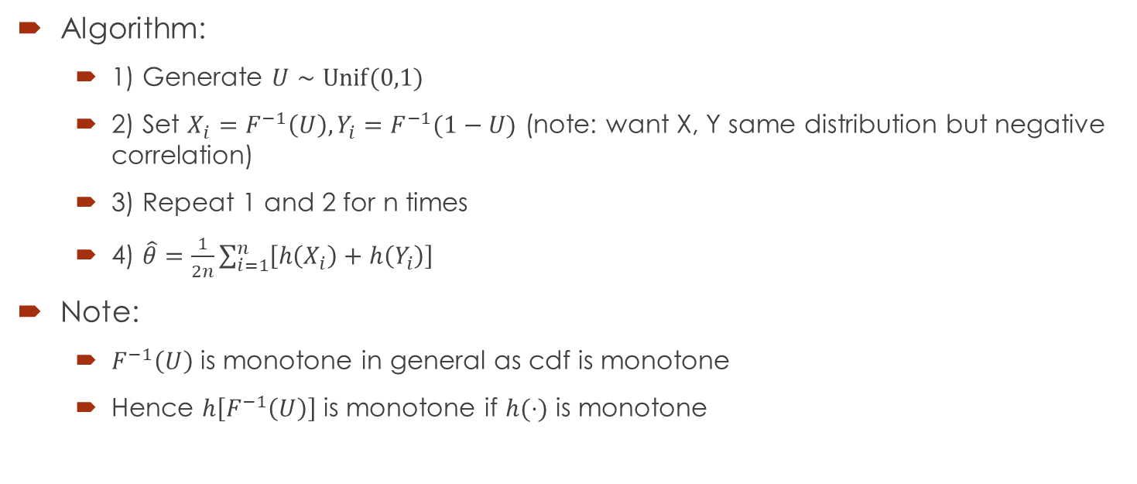
Antithetic Variables
Algorithm:
1) Generate $U∼Unif(0,1)$
2) Set $X_{i}=F^{−1}\left(U\right), Y_{i}=F^{−1}(1−U)$ (note: want X, Y same distribution but negative correlation)
3) Repeat 1 and 2 for n times
4) $\hat{θ}=\frac{1}{2n}\sum_{i=1}^{n}{\left[h\left(X_{i}\right)+h\left(Y_{i}\right)\right]}$
Note:
$F^{−1}\left(U\right)$ is monotone in general as cdf is monotone
Hence $h\left[F^{−1}\left(U\right)\right]$ is monotone if $h(⋅)$ is monotone

Slide 22

Q&A

