Slide 1

STAT1012 Post-midterm Review
LEUNG Man Fung, Heman
Spring, 2020

Slide 2
Topic so far…
Ch1 Descriptive Statistics
Ch2 Probability
Probability theory
Ch3 Discrete Probability Distributions
Ch4 Continuous Probability Distributions
Continuous random variables
Central tendency
Discrete random variables
Mean, mode, median
Dispersion
Quartile, percentile
Variance, SD
Range, IQR, skewness
Graphical methods
Bar graph, histogram
Stem-and-leaf, boxplot
Mutually exclusive
Independence
Conditional probability, relative risk
Total probability rule, exhaustive
Bayes’ theorem
Notation
Union, intersect, complement
DeMorgan’s laws
Expectation, variance
Total probability rule
Pmf, cdf
Binomial distribution
Poisson distribution
poisson approximation to binomial
Pdf, cdf
Expectation, variance
Uniform distribution
Total probability rule
Normal distribution
Standardization
Normal probability table
Normal approximation to binomial
Normal approximation to poisson

Slide 3
What is important…
Ch1 Descriptive Statistics
Ch2 Probability
Probability theory
Ch3 Discrete Probability Distributions
Ch4 Continuous Probability Distributions
Continuous random variables
Central tendency
Discrete random variables
Mean, mode, median
Dispersion
Quartile, percentile
Variance, SD
Range, IQR, skewness
Graphical methods
Bar graph, histogram
Stem-and-leaf, boxplot
Mutually exclusive
Independence
Conditional probability, relative risk
Total probability rule, exhaustive
Bayes’ theorem
Notation
Union, intersect, complement
DeMorgan’s laws
Expectation, variance
Total probability rule
Pmf, cdf
Binomial distribution
Poisson distribution
poisson approximation to binomial
Pdf, cdf
Expectation, variance
Uniform distribution
Total probability rule
Normal distribution
Standardization
Normal probability table
Normal approximation to binomial
Normal approximation to poisson
when to apply
when to apply

Slide 4
Agenda
Sample and population
Independence
Bayes’ theorem
Discrete random variables
Continuous random variables
Normal distribution
When to apply X distribution?
Q&A

Slide 5
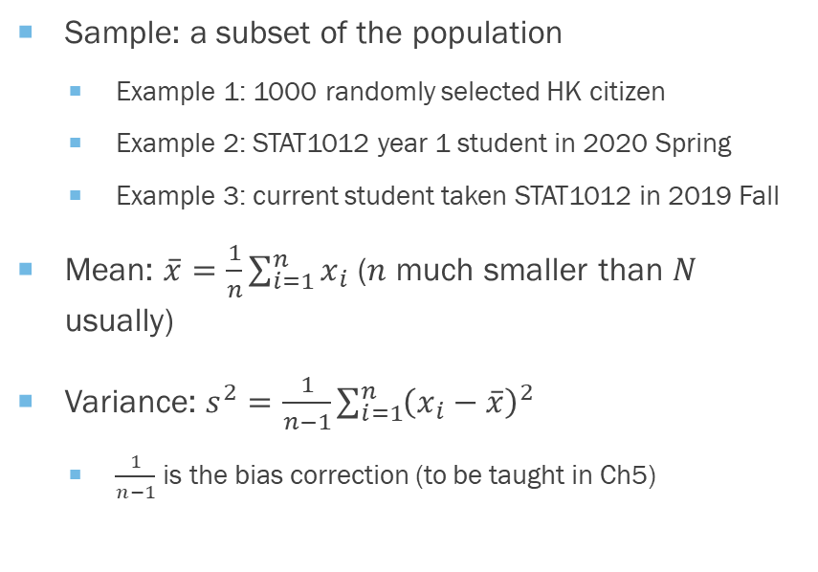
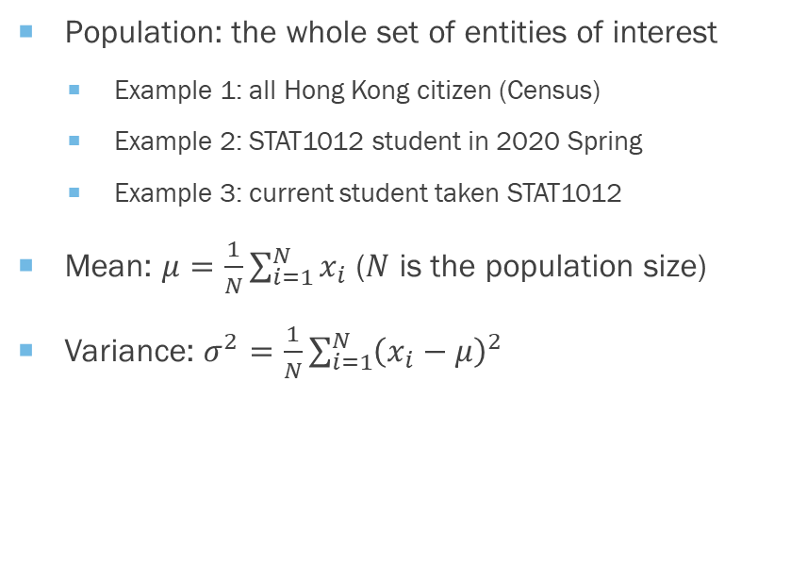
Sample and population
Population: the whole set of entities of interest
Example 1: all Hong Kong citizen (Census)
Example 2: STAT1012 student in 2020 Spring
Example 3: current student taken STAT1012
Mean: $μ=\frac{1}{N}\sum_{i=1}^{N}{x_{i}}$ ($N$ is the population size)
Variance: $σ^{2}=\frac{1}{N}\sum_{i=1}^{N}{{\left(x_{i}−μ\right)}^{2}}$
Sample: a subset of the population
Example 1: 1000 randomly selected HK citizen
Example 2: STAT1012 year 1 student in 2020 Spring
Example 3: current student taken STAT1012 in 2019 Fall
Mean: $\overline{x}=\frac{1}{n}\sum_{i=1}^{n}{x_{i}}$ ($n$ much smaller than $N$ usually)
Variance: $s^{2}=\frac{1}{n−1}\sum_{i=1}^{n}{{\left(x_{i}−\overline{x}\right)}^{2}}$
$\frac{1}{n−1}$ is the bias correction (to be taught in Ch5)

Slide 6
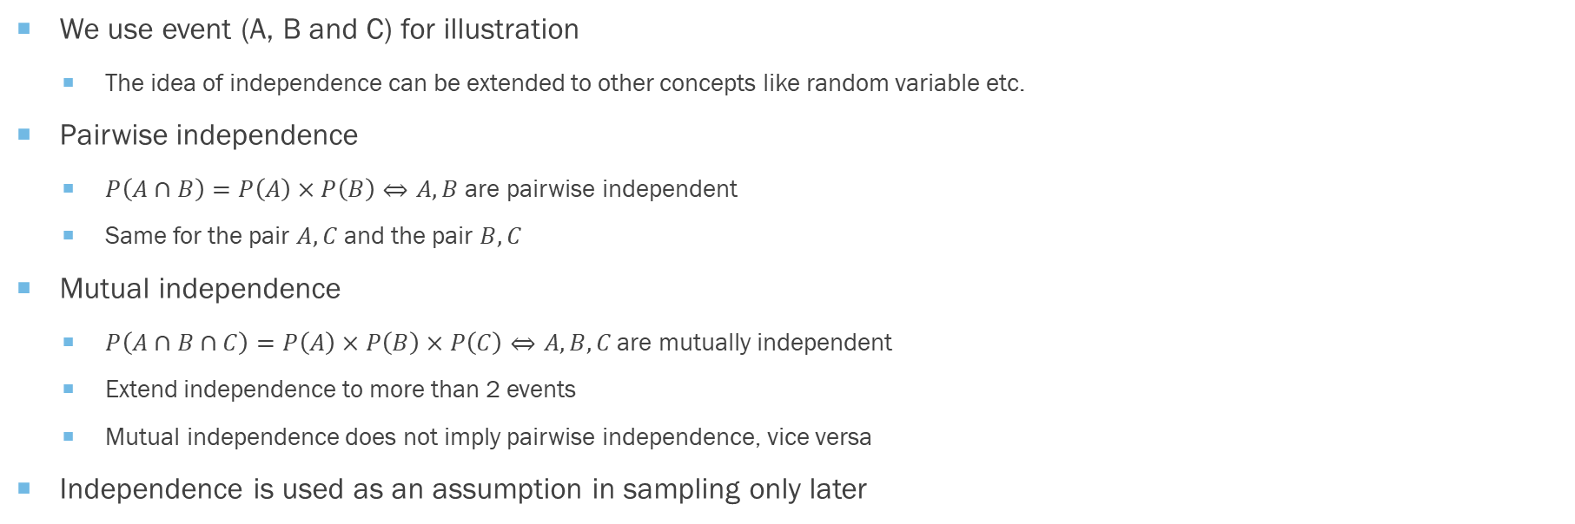
Independence
We use event (A, B and C) for illustration
The idea of independence can be extended to other concepts like random variable etc.
Pairwise independence
$P\left(A∩B\right)=P\left(A\right)×P\left(B\right)⇔A, B$ are pairwise independent
Same for the pair $A, C$ and the pair $B, C$
Mutual independence
$P\left(A∩B∩C\right)=P\left(A\right)×P\left(B\right)×P\left(C\right)⇔A, B, C \text{are} \text{mutually} \text{independent}$
Extend independence to more than 2 events
Mutual independence does not imply pairwise independence, vice versa
Independence is used as an assumption in sampling only later

Slide 7
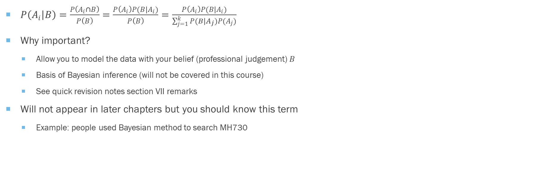
Bayes’ theorem
$P\left(A_{i} | B\right)=\frac{P\left(A_{i}∩B\right)}{P\left(B\right)}=\frac{P\left(A_{i}\right)P(B|A_{i})}{P\left(B\right)}=\frac{P\left(A_{i}\right)P(B|A_{i})}{\sum_{j=1}^{k}{P(B|A_{j})P(A_{j})}}$
Why important?
Allow you to model the data with your belief (professional judgement) $B$
Basis of Bayesian inference (will not be covered in this course)
See quick revision notes section VII remarks
Will not appear in later chapters but you should know this term
Example: people used Bayesian method to search MH730

Slide 8
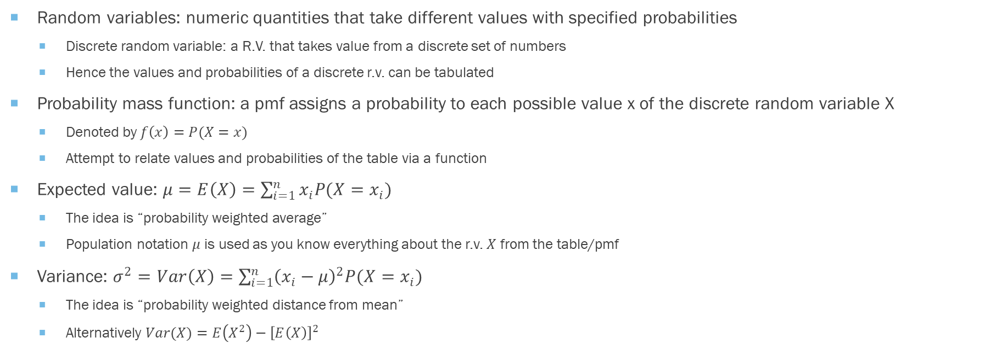
Discrete random variables
Random variables: numeric quantities that take different values with specified probabilities
Discrete random variable: a R.V. that takes value from a discrete set of numbers
Hence the values and probabilities of a discrete r.v. can be tabulated
Probability mass function: a pmf assigns a probability to each possible value x of the discrete random variable X
Denoted by $f\left(x\right)=P(X=x)$
Attempt to relate values and probabilities of the table via a function
Expected value: $μ=E\left(X\right)=\sum_{i=1}^{n}{x_{i}P(X=x_{i})}$
The idea is “probability weighted average”
Population notation $μ$ is used as you know everything about the r.v. $X$ from the table/pmf
Variance: $σ^{2}=Var\left(X\right)=\sum_{i=1}^{n}{{\left(x_{i}−μ\right)}^{2}P(X=x_{i})}$
The idea is “probability weighted distance from mean”
Alternatively $Var(X)=E\left(X^{2}\right)−{\left[E\left(X\right)\right]}^{2}$

Slide 9
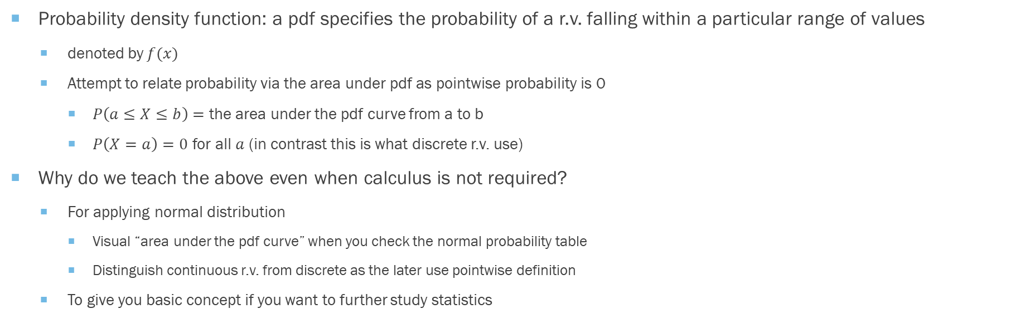
Continuous random variables
Probability density function: a pdf specifies the probability of a r.v. falling within a particular range of values
denoted by $f(x)$
Attempt to relate probability via the area under pdf as pointwise probability is 0
$P\left(a≤X≤b\right)=$ the area under the pdf curve from a to b
$P\left(X=a\right)=0$ for all $a$ (in contrast this is what discrete r.v. use)
Why do we teach the above even when calculus is not required?
For applying normal distribution
Visual “area under the pdf curve” when you check the normal probability table
Distinguish continuous r.v. from discrete as the later use pointwise definition
To give you basic concept if you want to further study statistics

Slide 10
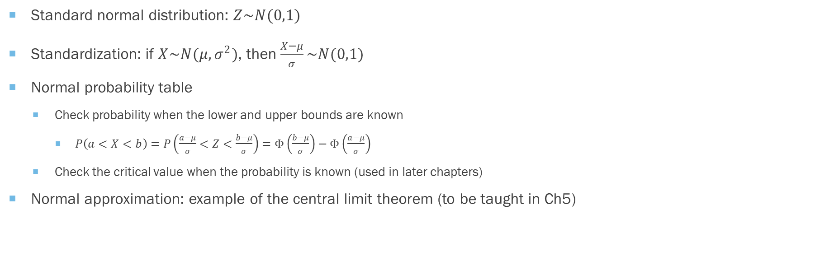
Normal distribution
Standard normal distribution: $Z\sim N(0,1)$
Standardization: if $X\sim N(μ,σ^{2})$, then $\frac{X−μ}{σ}\sim N(0,1)$
Normal probability table
Check probability when the lower and upper bounds are known
$P\left(a<X<b\right)=P\left(\frac{a−μ}{σ}<Z<\frac{b−μ}{σ}\right)=Φ\left(\frac{b−μ}{σ}\right)−Φ\left(\frac{a−μ}{σ}\right)$
Check the critical value when the probability is known (used in later chapters)
Normal approximation: example of the central limit theorem (to be taught in Ch5)

Slide 11
When to apply X distribution?
Binomial distribution
Number of success in a fixed number of independence trials (binary proportion)
Example: number of student answering yes in question 1 in a test (fixed total number of attendees)
Poisson distribution
Number of occurrence over a fixed time/space (rate)
Example: number of customer getting into a supermarket in an hour (fixed time as an hour and space as supermarket)
Uniform distribution
Fair outcome
Example: fair coin toss, fair dice thrown
Normal distribution
Statistical inference due to central limit theorem (to be taught in Ch5)

Slide 12
Q&A
All models are wrong, but some are useful

