Slide 1
RMSC5102 Midterm Review
Leung Man Fung, Heman
Spring, 2020

Slide 2
Agenda
Review
Stochastic Calculus
The Black-Scholes World
Monte Carlo Method
Random Variable Generation
Variance Reduction Technique
Q&A

Slide 3
Stochastic Calculus

Slide 4

Wiener Process
Stationary increment: $W_{t}−W_{s}\sim N\left(0,t−s\right)$
Independent increment: $W_{t_{4}}−W_{t_{3}}⊥W_{t_{2}}−W_{t_{1}}$
Starts at zero: $P\left(W_{t_{0}}=0\right)=1$

Slide 5

Finding SDE
Strategy
Define $f(x,t)$ and $dX_{t}$
Apply Ito’s lemma to $f(X_{t},t)$
Straight forward
Example: HW1 1a, 4b; Exercise 2.2

Slide 6
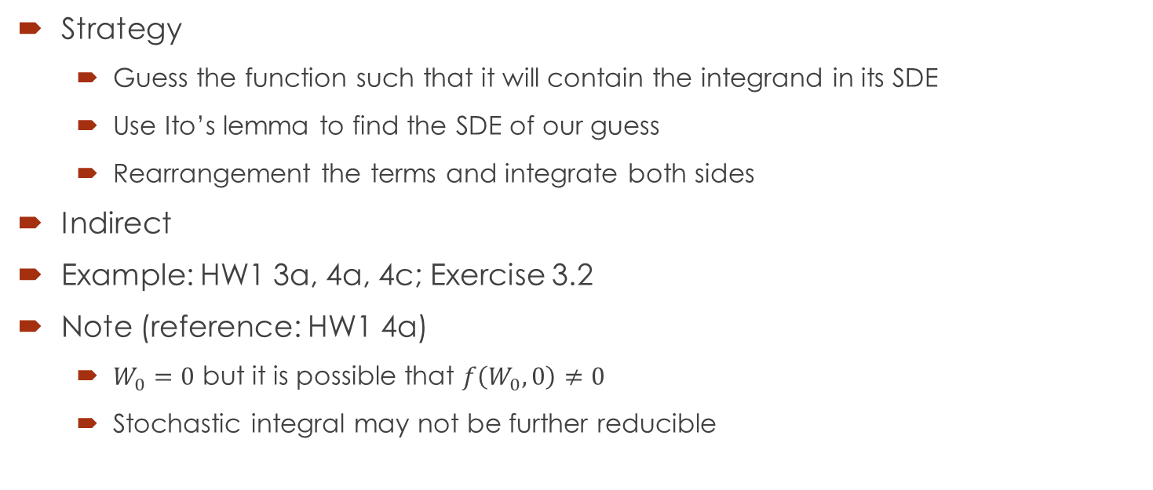
Finding Stochastic Integral
Strategy
Guess the function such that it will contain the integrand in its SDE
Use Ito’s lemma to find the SDE of our guess
Rearrangement the terms and integrate both sides
Indirect
Example: HW1 3a, 4a, 4c; Exercise 3.2
Note (reference: HW1 4a)
$W_{0}=0$ but it is possible that $f\left(W_{0},0\right)≠0$
Stochastic integral may not be further reducible

Slide 7
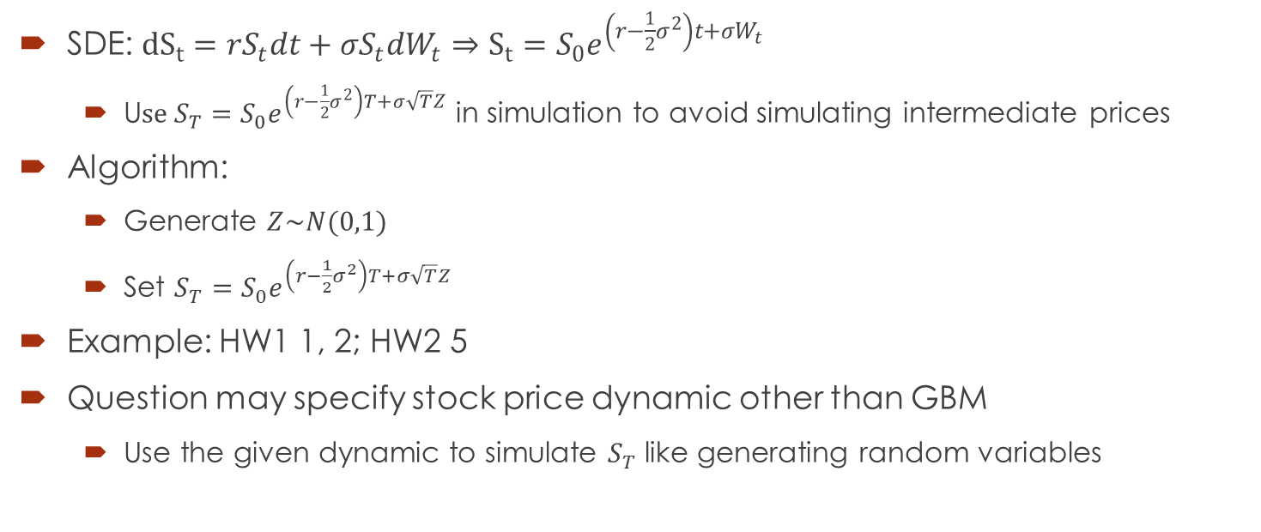
Geometric Brownian Motion
SDE: ${dS}_{t}=rS_{t}dt+σS_{t}dW_{t}⇒S_{t}=S_{0}e^{\left(r−\frac{1}{2}σ^{2}\right)t+σW_{t}}$
U$se S_{T}=S_{0}e^{\left(r−\frac{1}{2}σ^{2}\right)T+σ\sqrt{T}Z}$ in simulation to avoid simulating intermediate prices
Algorithm:
Generate $Z\sim N(0,1)$
Set $S_{T}=S_{0}e^{\left(r−\frac{1}{2}σ^{2}\right)T+σ\sqrt{T}Z}$
Example: HW1 1, 2; HW2 5
Question may specify stock price dynamic other than GBM
Use the given dynamic to simulate $S_{T}$ like generating random variables

Slide 8
The Black-Scholes World

Slide 9
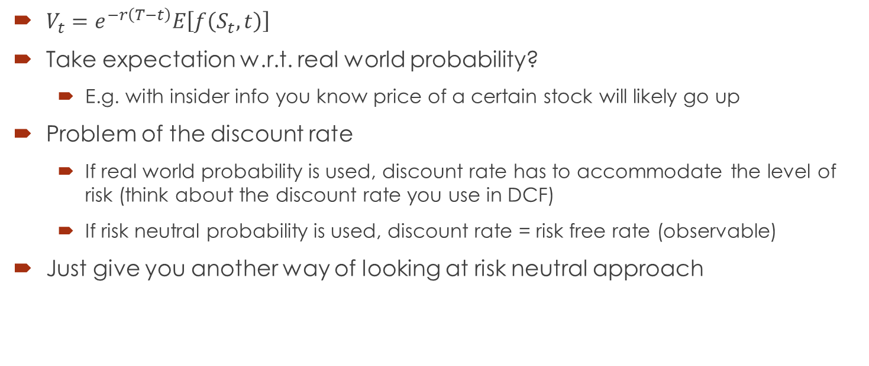
Risk Neutral Valuation
$V_{t}=e^{−r\left(T−t\right)}E\left[f\left(S_{t},t\right)\right]$
Take expectation w.r.t. real world probability?
E.g. with insider info you know price of a certain stock will likely go up
Problem of the discount rate
If real world probability is used, discount rate has to accommodate the level of risk (think about the discount rate you use in DCF)
If risk neutral probability is used, discount rate = risk free rate (observable)
Just give you another way of looking at risk neutral approach

Slide 10
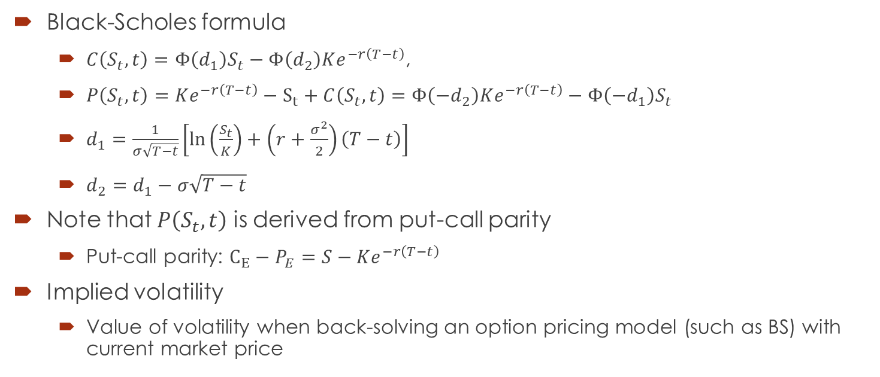
Black–Scholes–Merton Model
Black-Scholes formula
$C\left(S_{t},t\right)=Φ\left(d_{1}\right)S_{t}−Φ\left(d_{2}\right)Ke^{−r\left(T−t\right)}$,
$P\left(S_{t},t\right)=Ke^{−r\left(T−t\right)}−S_{t}+C\left(S_{t},t\right)=Φ\left(−d_{2}\right)Ke^{−r\left(T−t\right)}−Φ\left(−d_{1}\right)S_{t}$
$d_{1}=\frac{1}{σ\sqrt{T−t}}\left[\ln\left(\frac{S_{t}}{K}\right)+\left(r+\frac{σ^{2}}{2}\right)\left(T−t\right)\right]$
$d_{2}=d_{1}−σ\sqrt{T−t}$
Note that $P\left(S_{t},t\right)$ is derived from put-call parity
Put-call parity: $C_{E}−P_{E}=S−Ke^{−r\left(T−t\right)}$
Implied volatility
Value of volatility when back-solving an option pricing model (such as BS) with current market price

Slide 11
Monte Carlo Method

Slide 12


Key idea
Use repeated random sampling to obtain numerical estimate
The estimate is usually average in our course
Example: estimate $π$ (picture credit: nicoguaro)

Slide 13
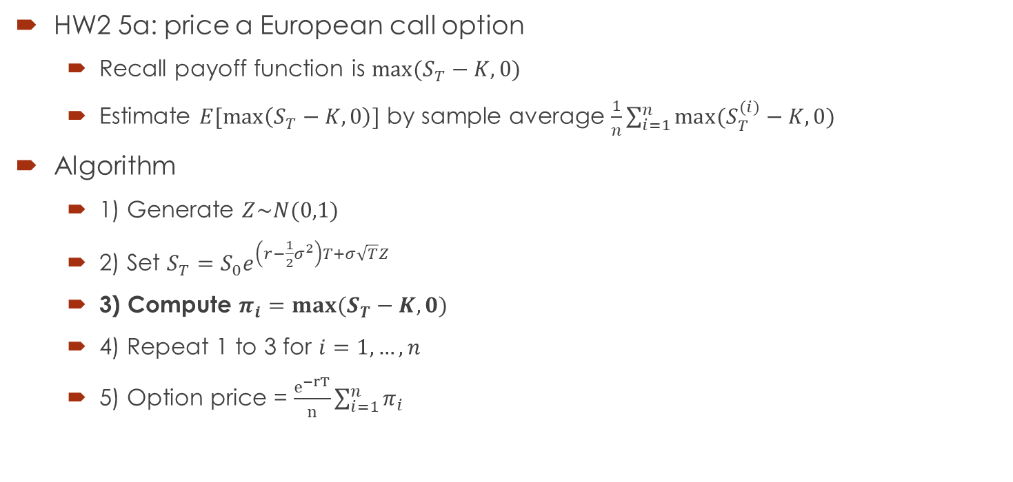
Standard Monte Carlo
HW2 5a: price a European call option
Recall payoff function is $max⁡(S_{T}−K,0)$
Estimate $E[\max\left(S_{T}−K,0\right)]$ by sample average $\frac{1}{n}\sum_{i=1}^{n}{max⁡(S_{T}^{(i)}−K,0) }$
Algorithm
1) Generate $Z\sim N(0,1)$
2) Set $S_{T}=S_{0}e^{\left(r−\frac{1}{2}σ^{2}\right)T+σ\sqrt{T}Z}$
3) Compute $π_{i}=max⁡(S_{T}−K,0)$
4) Repeat 1 to 3 for $i=1,…,n$
5) Option price = $\frac{e^{−rT}}{n}\sum_{i=1}^{n}{π_{i}}$

Slide 14
Random Variable Generation

Slide 15
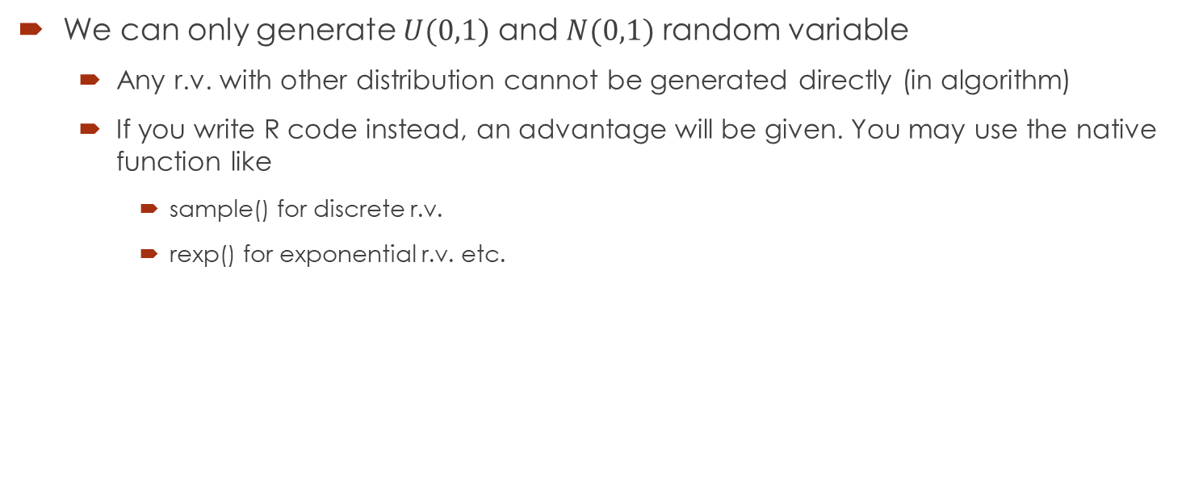
Assumption
We can only generate $U(0,1)$ and $N(0,1)$ random variable
Any r.v. with other distribution cannot be generated directly (in algorithm)
If you write R code instead, an advantage will be given. You may use the native function like
sample() for discrete r.v.
rexp() for exponential r.v. etc.

Slide 16
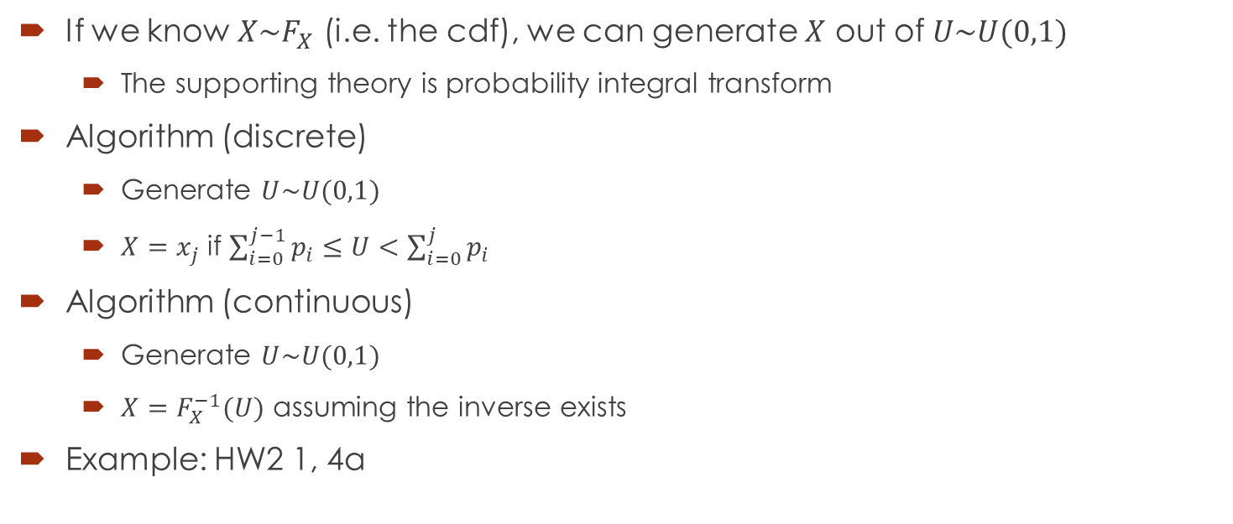
Inverse Transform
If we know $X\sim F_{X}$ (i.e. the cdf), we can generate $X$ out of $U\sim U(0,1)$
The supporting theory is probability integral transform
Algorithm (discrete)
Generate $U\sim U(0,1)$
$X=x_{j}$ if $\sum_{i=0}^{j−1}{p_{i}}≤U<\sum_{i=0}^{j}{p_{i}}$
Algorithm (continuous)
Generate $U\sim U(0,1)$
$X=F_{X}^{−1}(U)$ assuming the inverse exists
Example: HW2 1, 4a

Slide 17
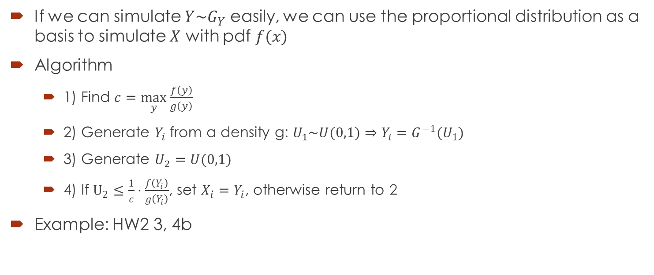
Rejection Sampling
If we can simulate $Y\sim G_{Y}$ easily, we can use the proportional distribution as a basis to simulate $X$ with pdf $f(x)$
Algorithm
1) Find $c=\max_{y}{\frac{f\left(y\right)}{g\left(y\right)}}$
2) Generate $Y_{i}$ from a density g: $U_{1}\sim U(0,1)⇒Y_{i}=G^{−1}(U_{1})$
3) Generate $U_{2}=U(0,1)$
4) If $U_{2}≤\frac{1}{c}⋅\frac{f\left(Y_{i}\right)}{g\left(Y_{i}\right)}$, set $X_{i}=Y_{i}$, otherwise return to 2
Example: HW2 3, 4b

Slide 18
Variance Reduction Technique

Slide 19
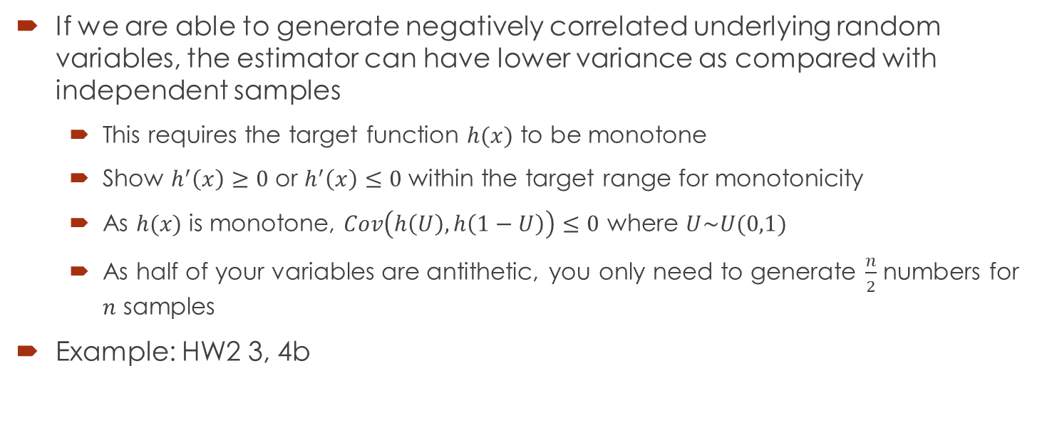
Antithetic Variables
If we are able to generate negatively correlated underlying random variables, the estimator can have lower variance as compared with independent samples
This requires the target function $h(x)$ to be monotone
Show $h^{′}\left(x\right)≥0$ or $h^{′}\left(x\right)≤0$ within the target range for monotonicity
As $h(x)$ is monotone, $Cov\left(h\left(U\right), h\left(1−U\right)\right)≤0$ where $U\sim U(0,1)$
As half of your variables are antithetic, you only need to generate $\frac{n}{2}$ numbers for $n$ samples
Example: HW2 3, 4b

Slide 20
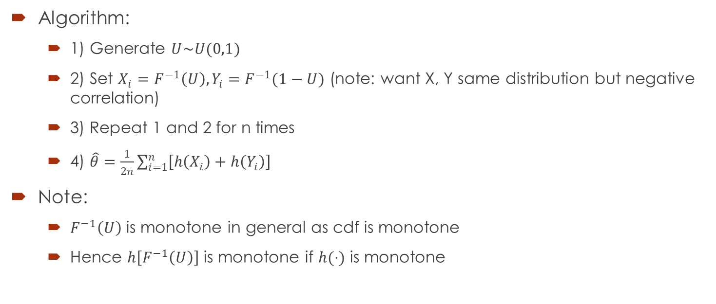
Antithetic Variables
Algorithm:
1) Generate $U\sim U(0,1)$
2) Set $X_{i}=F^{−1}\left(U\right), Y_{i}=F^{−1}(1−U)$ (note: want X, Y same distribution but negative correlation)
3) Repeat 1 and 2 for n times
4) $\hat{θ}=\frac{1}{2n}\sum_{i=1}^{n}{\left[h\left(X_{i}\right)+h\left(Y_{i}\right)\right]}$
Note:
$F^{−1}\left(U\right)$ is monotone in general as cdf is monotone
Hence $h\left[F^{−1}\left(U\right)\right]$ is monotone if $h(⋅)$ is monotone

Slide 21
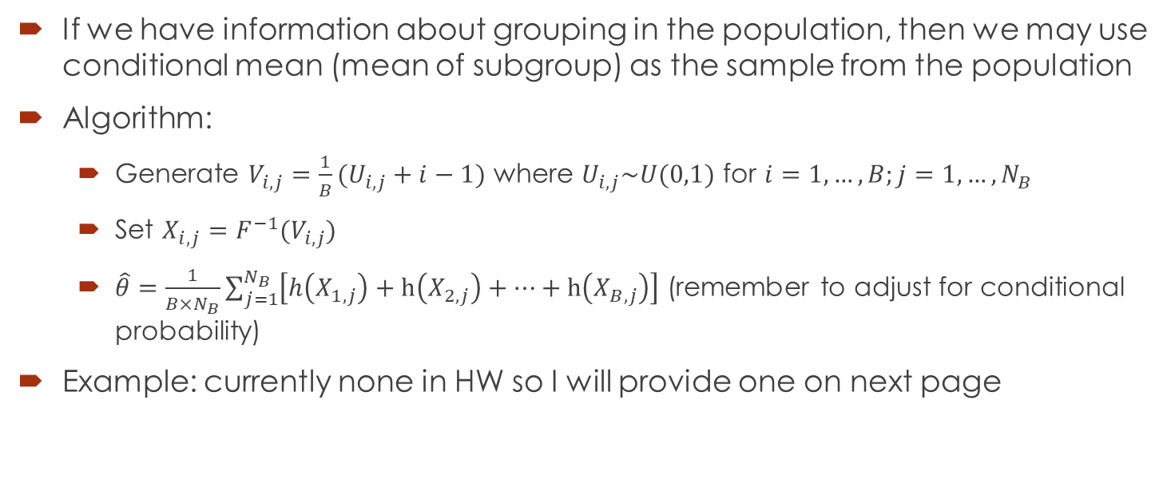
Stratified Sampling
If we have information about grouping in the population, then we may use conditional mean (mean of subgroup) as the sample from the population
Algorithm:
Generate $V_{i,j}=\frac{1}{B}(U_{i,j}+i−1)$ where $U_{i,j}\sim U(0,1)$ for $i=1,…,B;j=1,…,N_{B}$
Set $X_{i,j}=F^{−1}(V_{i,j})$
$\hat{θ}=\frac{1}{B×N_{B}}\sum_{j=1}^{N_{B}}{\left[h\left(X_{1,j}\right)+h\left(X_{2,j}\right)+…+h\left(X_{B,j}\right)\right]}$ (remember to adjust for conditional probability)
Example: currently none in HW so I will provide one on next page

Slide 22
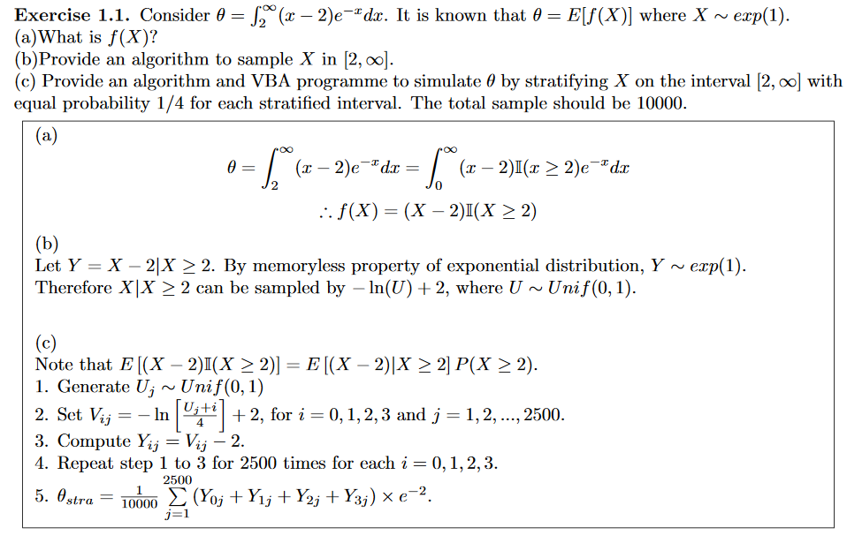
Stratified Sampling

Slide 23

Q&A

