Slide 1
Digital Steganography
Hemansh Agnihotri
Kanwaljeet Singh Panwar

Slide 2
Outline
What is Steganography?
Technology Used
Problem in Existing System
Implementation
Types of Steganography
Hiding message inside images
Hiding image within images
Hiding message inside audio and video files
Use-Case Diagram

Slide 3
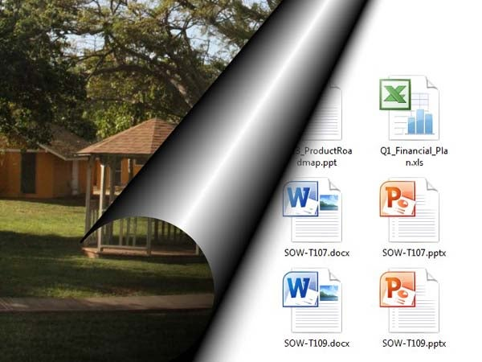
What is Steganography?
Origin of the term: steganos: secret – graphy: writing

Slide 4
Problem In Existing system
This project addresses the security problem of transmitting the data over internet network, the main idea coming when we start asking that how can we send a message secretly to the destination? The science of steganography answers this question. Using steganography, information can be hidden in carriers such as images, audio files, text files and videos.

Slide 5
Implementation
Types Of steganography
Hiding a Message inside Images
Hiding a Message inside Audio Files
Hiding a Message inside Video Files
Hiding a Image inside Image

Slide 6
Hiding a Message inside Images
The most popular medium!
Least-significant bit (LSB) modifications
24-bit vs. 8-bit images
Masking and Filtering

Slide 7

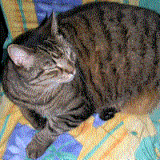
Hiding an Image within an Image
Removing all but the two least significant bits of each color component produces an almost completely black image. Making that image 85 times brighter produces the image below
source: wikipedia.org

Slide 8
Hiding a Message inside Audio or Videos Files
Audio Files
Least Significant Bit (LSB) Coding
Echo Data Hiding
Parity Coding
Phase Encoding
Spread Spectrum
Video files
Hash Based Least Significant Bit Technique
Redundant pattern encoding
Encrypt and Scatter

Slide 9

Technology Used
Java
Java Swing
Java AWT
Launch4j

Slide 10
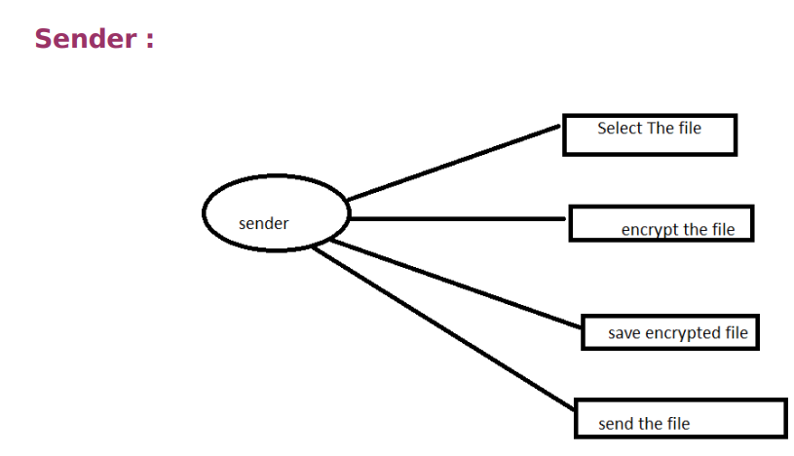
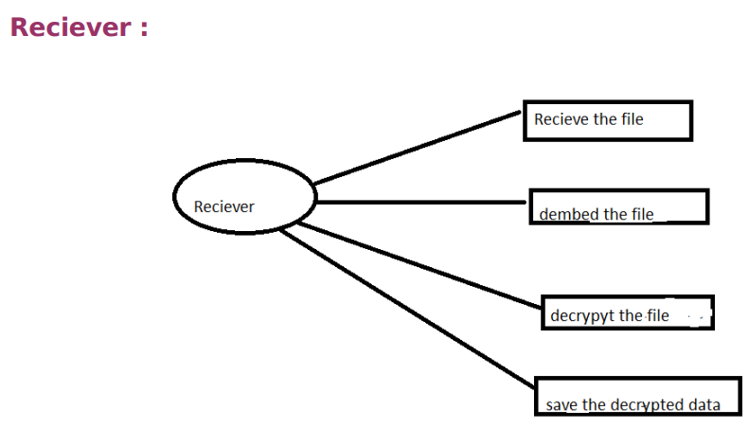
Use-Case diagram

Slide 11
Thank You

