Slide 1
RECORD MANAGEMENT
Team 3 - RBS Chennai

Slide 2
TEAM
Iswarya Sambamoorthi
Kamala Ramaswamy
Architha Babu
Aravinth Ganesh
Baveshya Pachaimuthu
Bagawathi Roshini

Slide 3
Introduction
What?
Company
Why?
How?
Record - Proofs and documents
Metadata
Authentication of customers
Reduce risks
Dedicated department to handle the storage and maintenance of the records

Slide 4

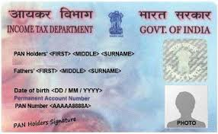
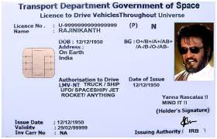
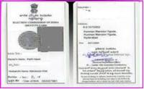


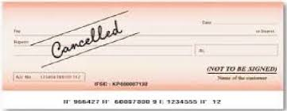
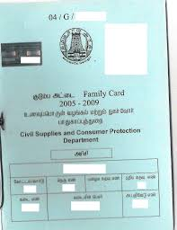

Types of Records

Slide 5
Functionalities

Slide 6
Inserting a new record for an existing customer
Option to edit the record source and metadata
Create
Search
Update
Delete
Search active and inactive records - with filters
Mark a customer record inactive

Slide 7
Methodology

Slide 8

Followed Agile Principles
Three sprints
Daily scrum meetings,Sprint Retrospective

Slide 9
Sprint Goals
Sprint 1
Sprint 2
Sprint 3
SRS
TRS
Design document
Database creation and updation
REST API Services for all functions
User Interface
Integration
Testing

Slide 10
Architecture

Slide 11
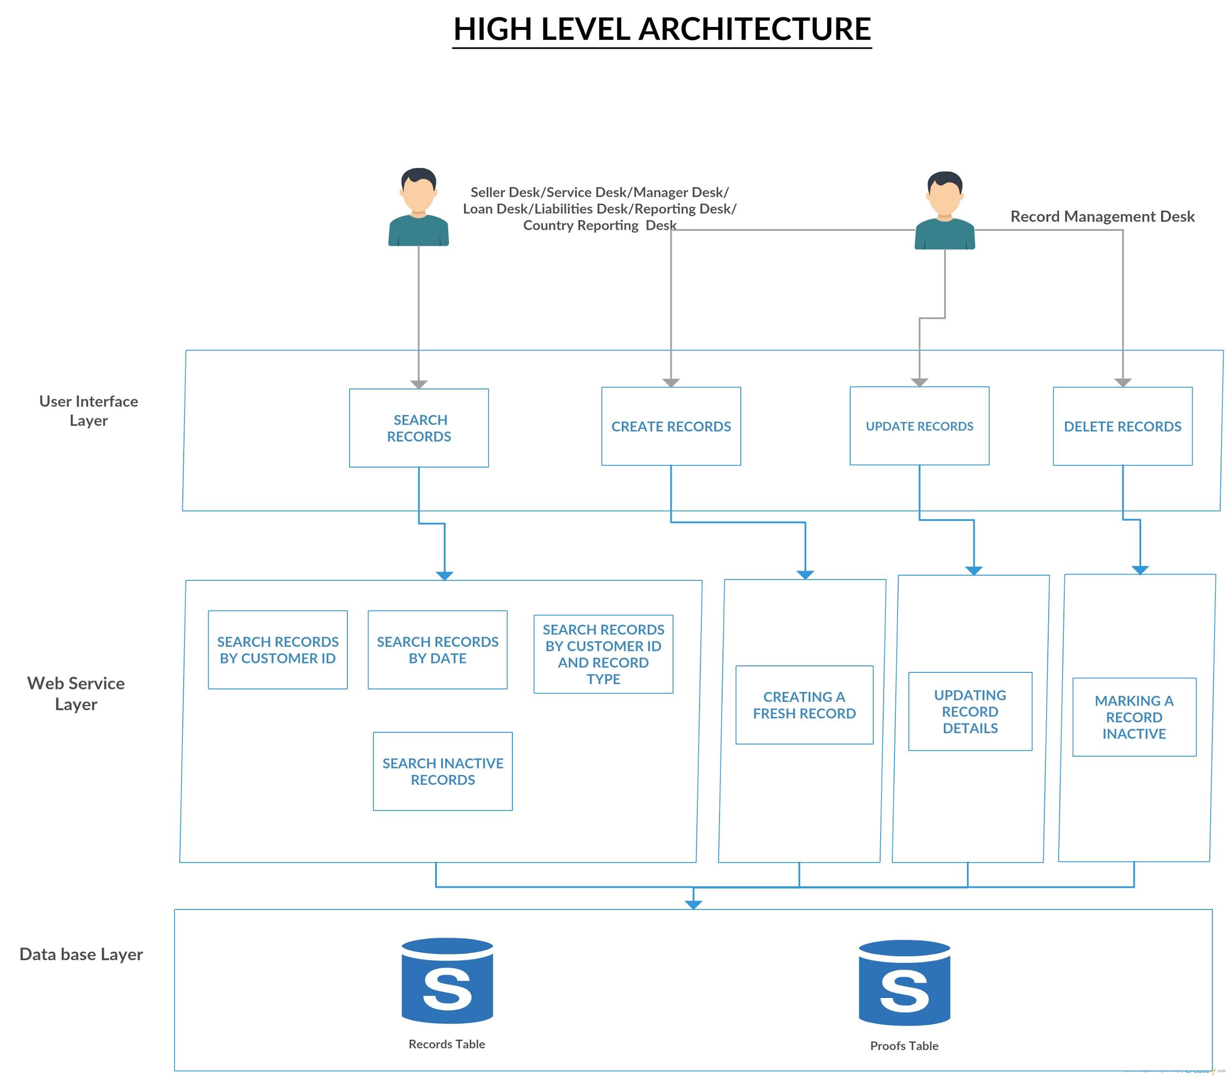

Slide 12
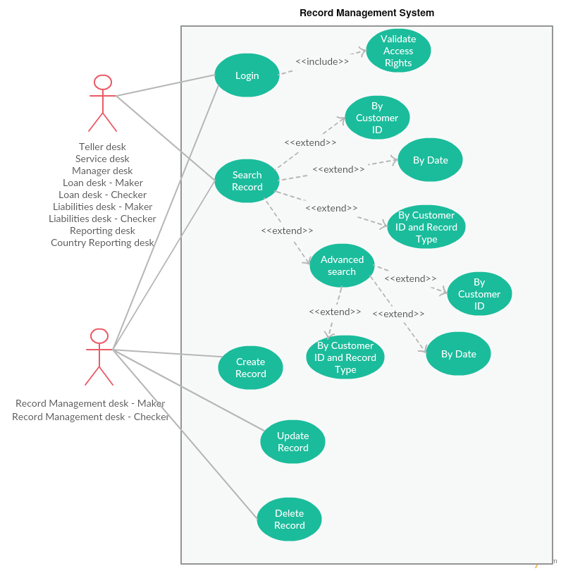

Slide 13
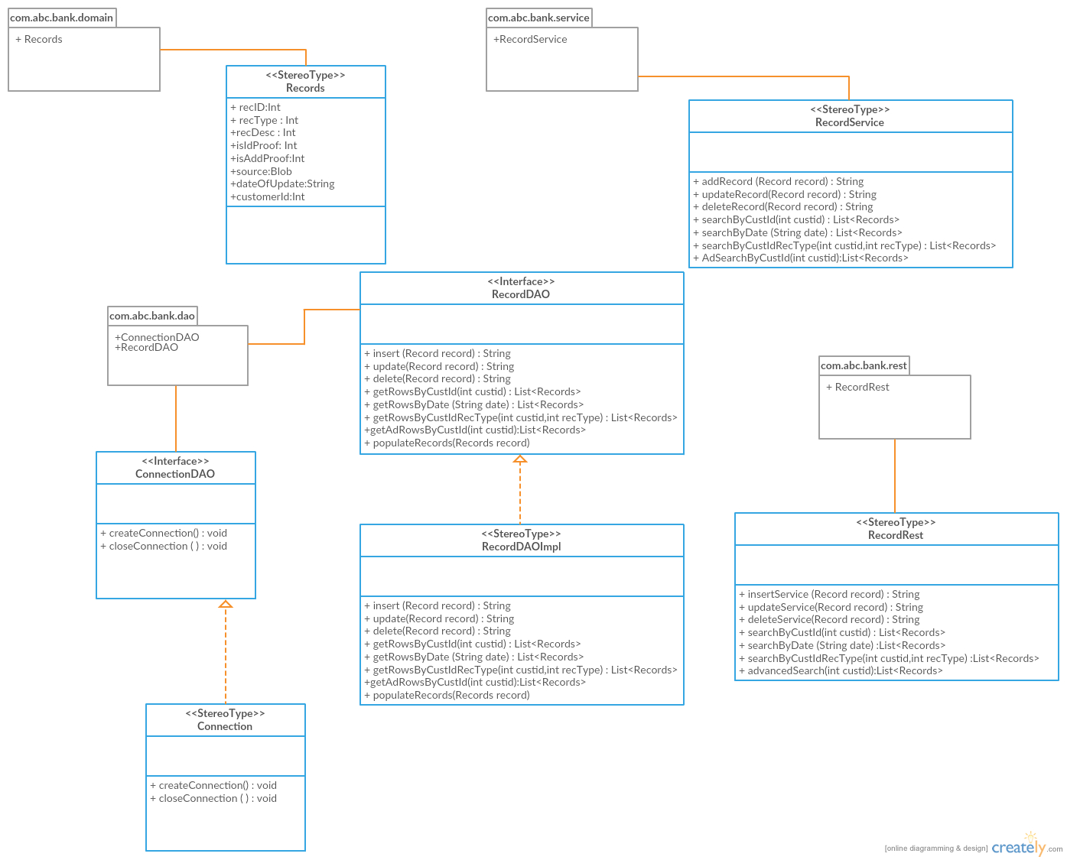

Slide 14
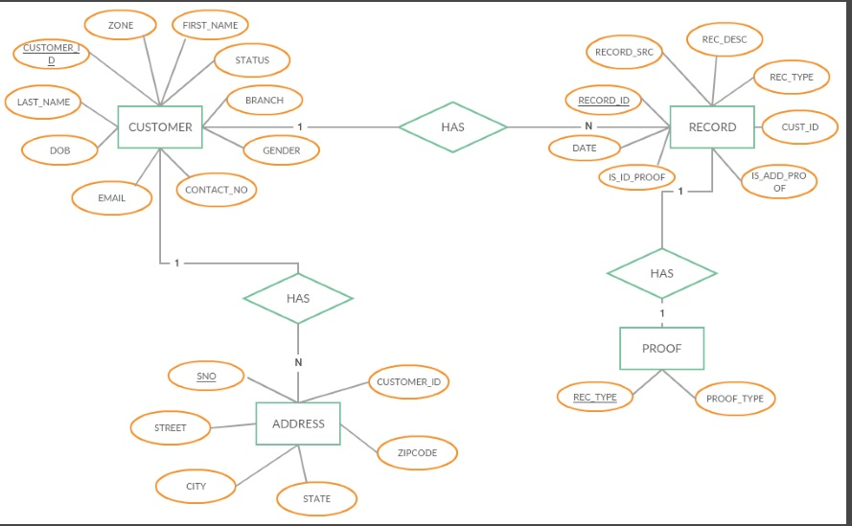

Slide 15
Module Dependencies
Login
Bank Structure
Customer Management

Slide 16
Tools

Slide 17





Slide 18
Softwares and Technologies

Slide 19







Slide 20

DEMO

Slide 21
Testing
max growth

Slide 22
Testing Methodologies
Manual Testing
Functional Testing - Service implementation Tool->SOAPUI - NGPRO

Slide 23
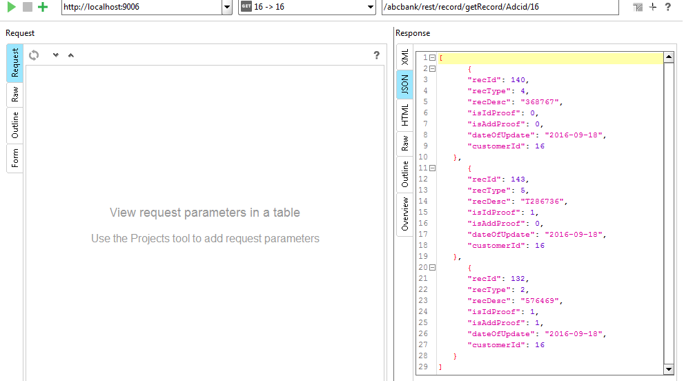

Slide 24
THANK YOU

