Slide 1
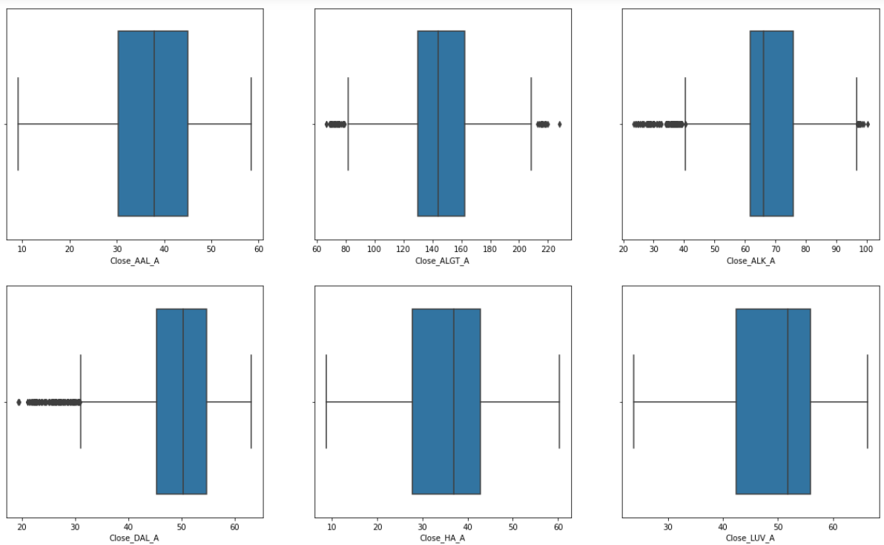
Box plot of Aviation industry

Slide 2
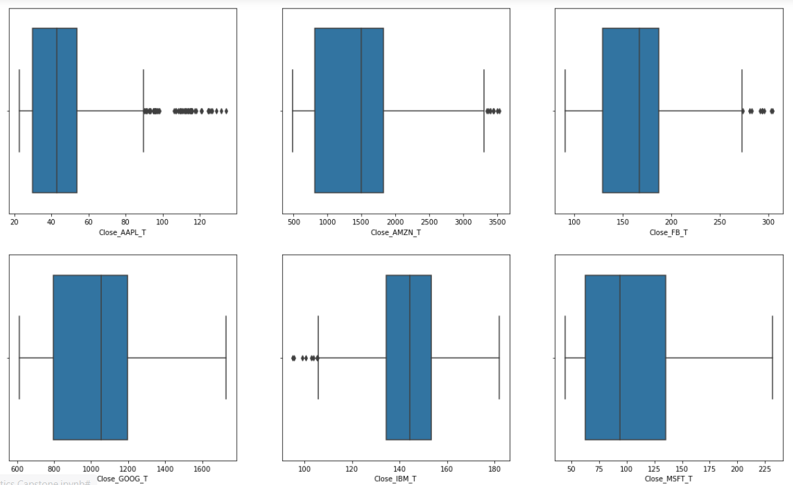
Box plot of Technology industry

Slide 3
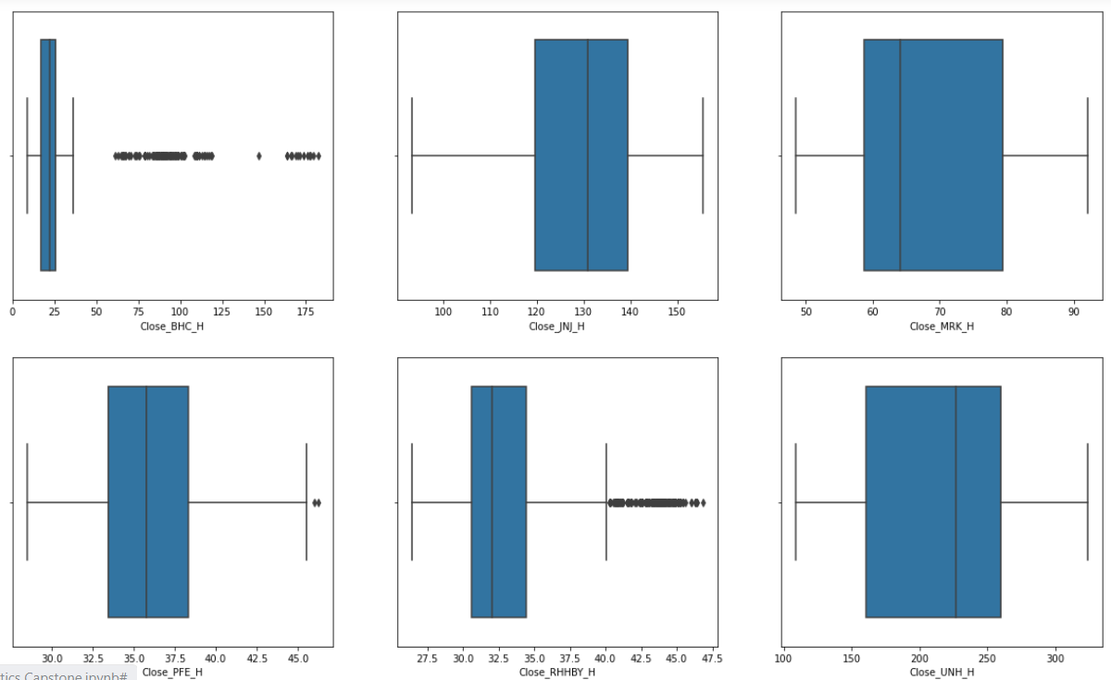
Box plot of Healthcare industry

Slide 4
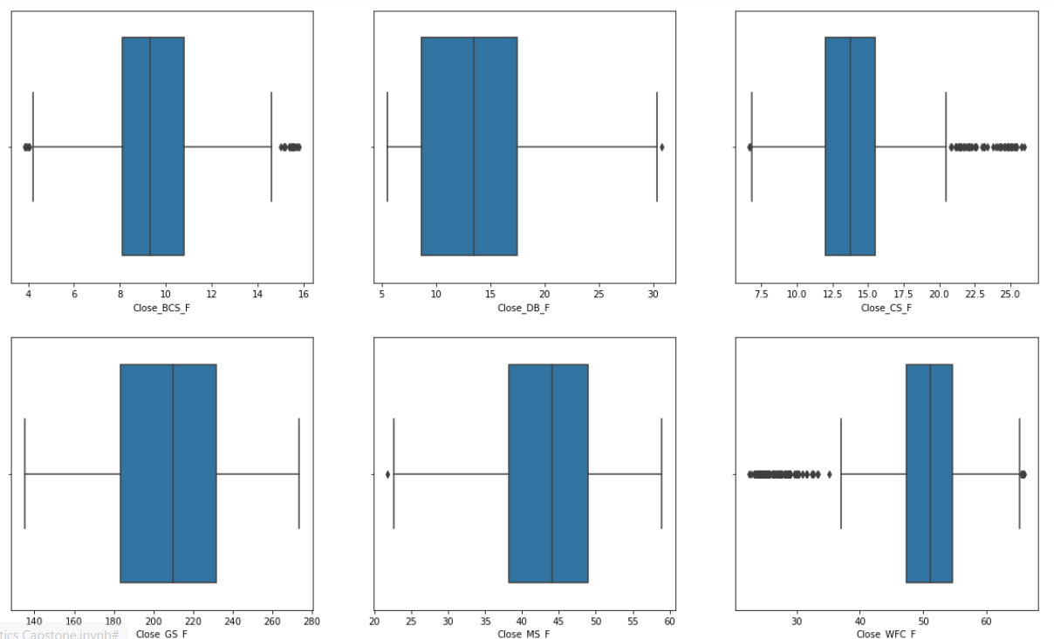
Box plot of Finance industry

Slide 5
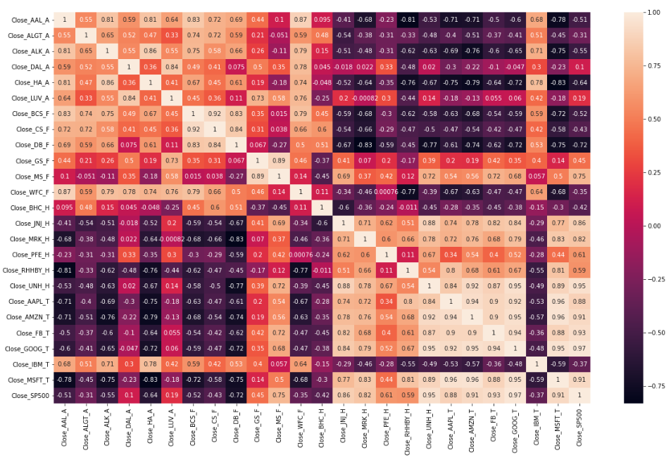
Observations wrt S&P 500:
1. Strong Positive Correlation (0.6 to 1): Apple, Amazon, Google, Goldman Sachs, J&J, Merck & Co, Microsoft, Facebook
2. Weak Positive Correlation (0 to 0.6): American Airlines, Hawaiian Holdings, RHHBY, GS, LUV
3. Negative Correlation (0 to -1): Bausch Health, Credit Suisse, Deutsche Bank, IBM, WFC, BCS, HA
4. Ideally, the stocks that have negative correlation with the Index (S&P 500) should be avoided in the portfolio since they may prove to be very risky.
Plotting the correlation of Stock Prices

Slide 6
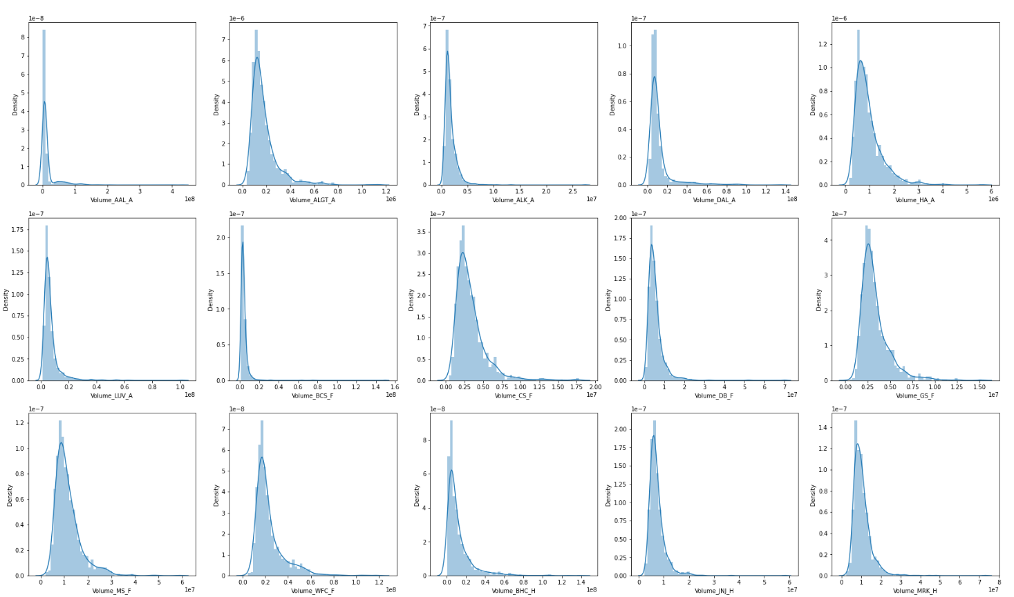

Slide 7
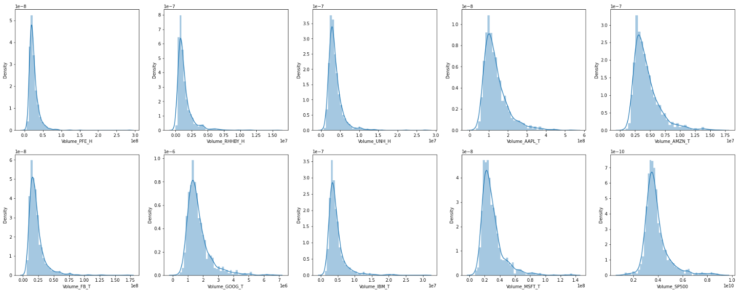
histogram plots of the Volumes of Stocks
Observation:
1. Higher the standard deviation, more volatile is the stock. So, in the above figures a volatile stock will cover more area.
2. ALGT, DAL, HA, CS, GS, MS, WFC, BHC, RHBY, AAPL, GOOG, IBM --> Volatility can be seen in these stocks.

Slide 8
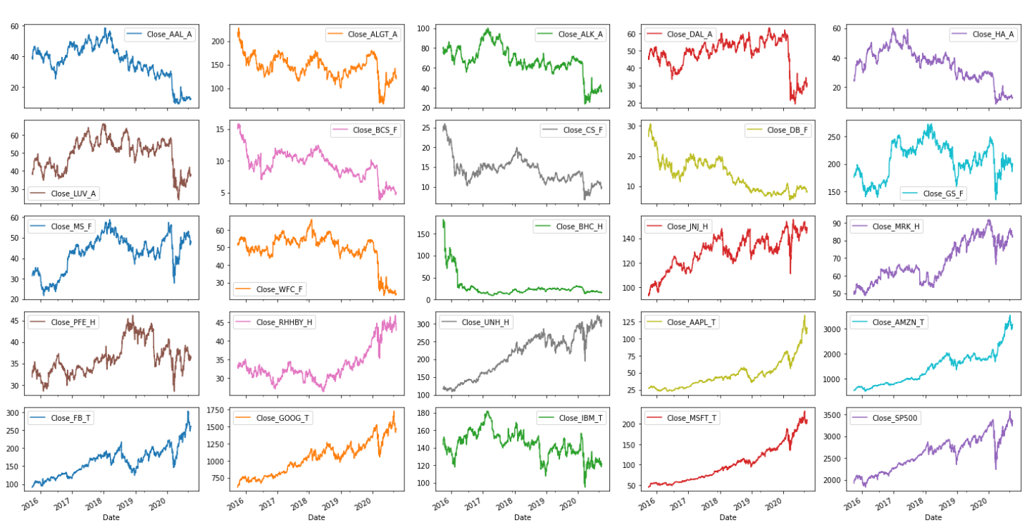
Observation:
1. We should consider stocks that have a positive movement suggesting that price has increased during the given period
2. Also, it suggests that the prices are expected to show an uptrend in the future.
3. The price of aviation and banking stocks has gone down. The highest drop in the prices can be observed in DB and BHC.

Slide 9
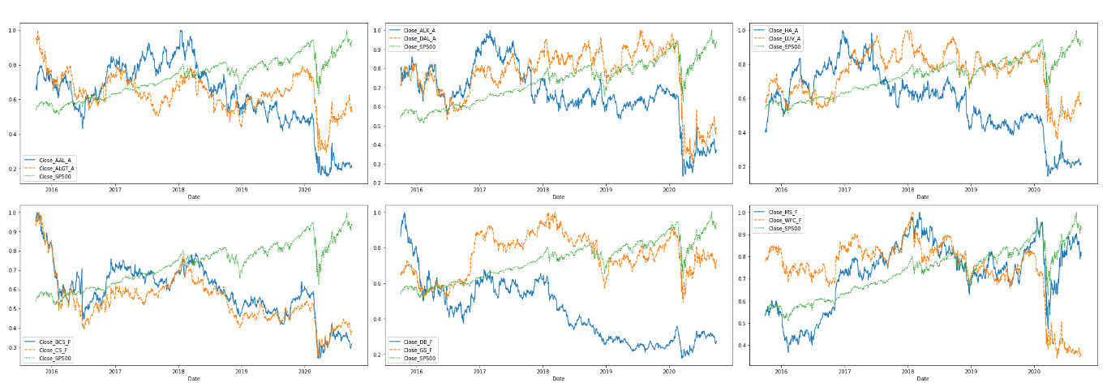
Normalized Stock Prices against Index

Slide 10
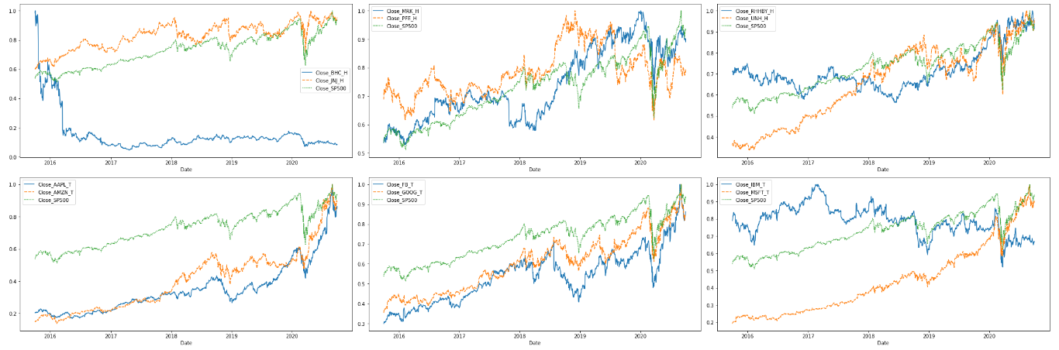
Observation:
1. In Technology MSFT GOOG, FB, AAPL, AMZN are showing an uptrend, whereas IBM is showing a downtrend.
2. In Healthcare - BHC showing a downtrend
3. In Finance - DB, BCS, CS and WFC are showing a downtrend
4. In Aviation - HA, DAL, AAL, ALK are showing a downtrend.

Slide 11
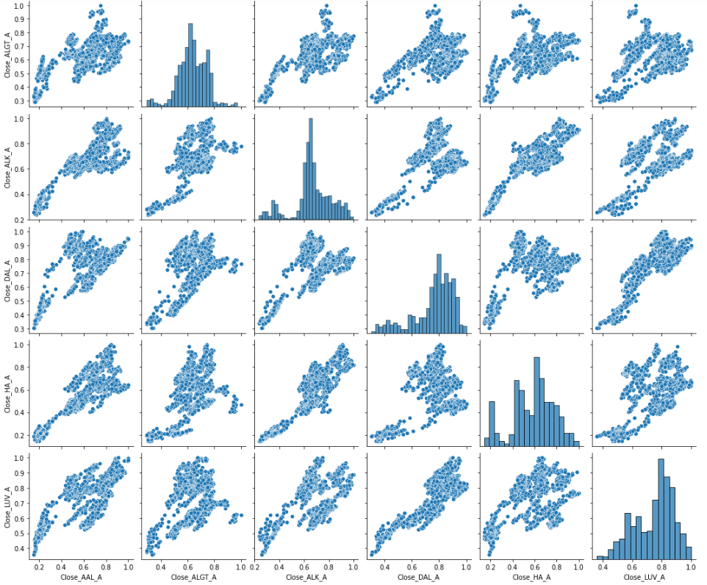
Scatter Plot Of Aviation Industry

Slide 12
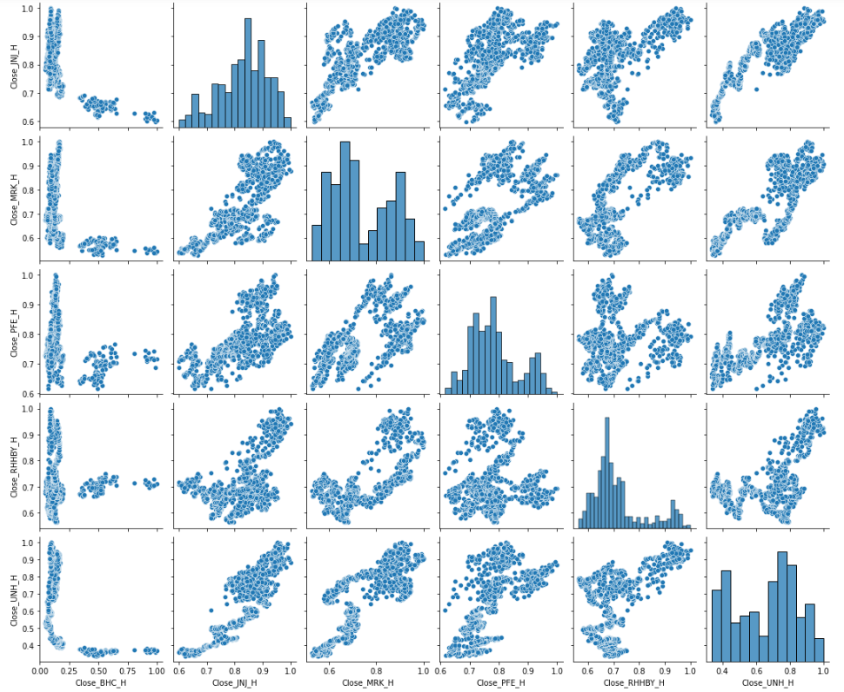
Scatter Plot Of Healthcare Industry

Slide 13
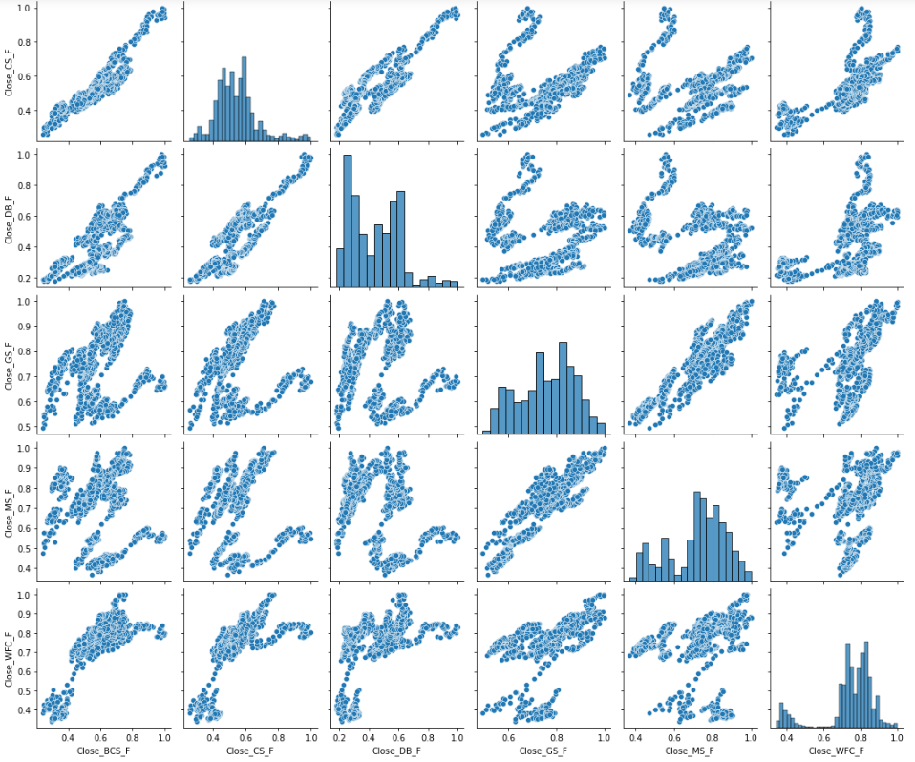
Scatter Plot Of Finance Industry

Slide 14
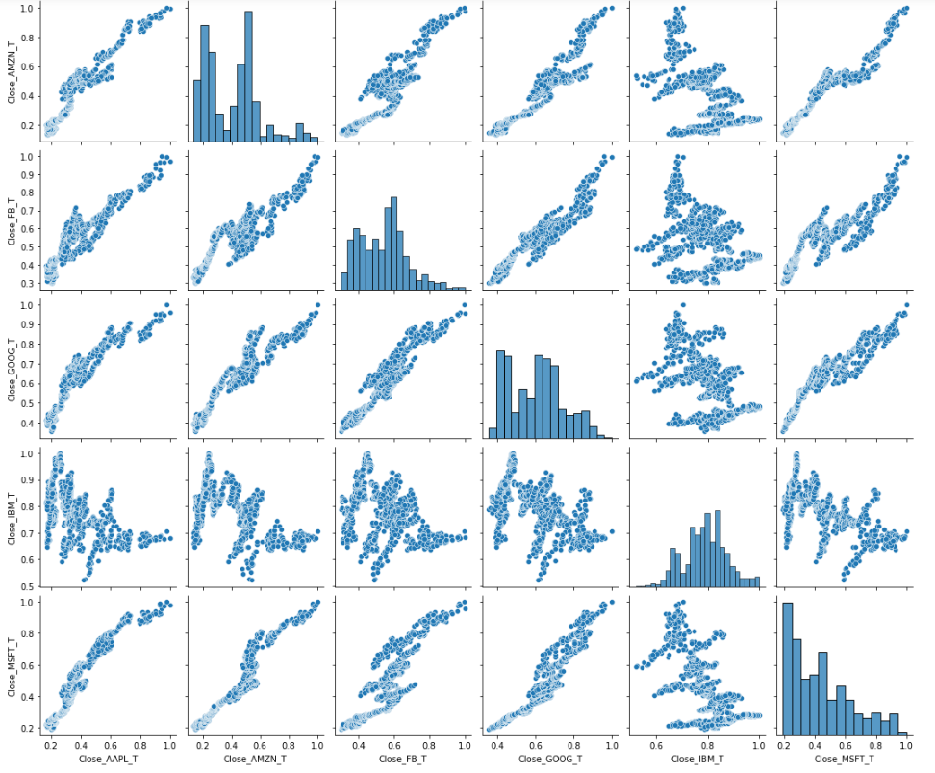
Scatter Plot Of Technical Industry
All technical stocks has positive relation except IBM

Slide 15
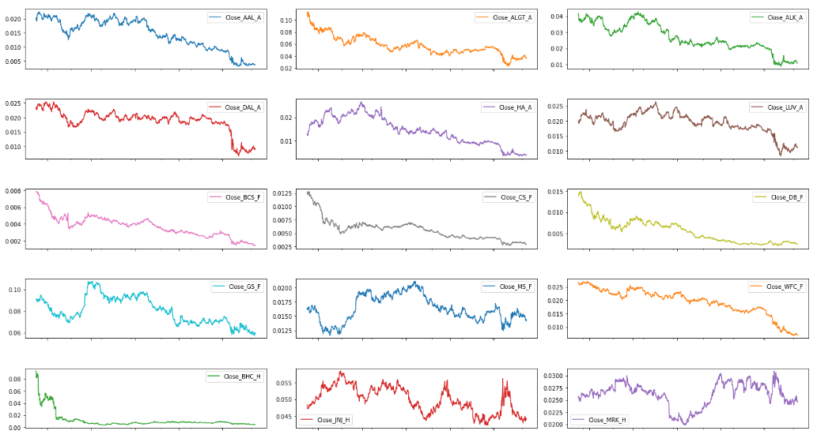
Relative strength analysis

Slide 16
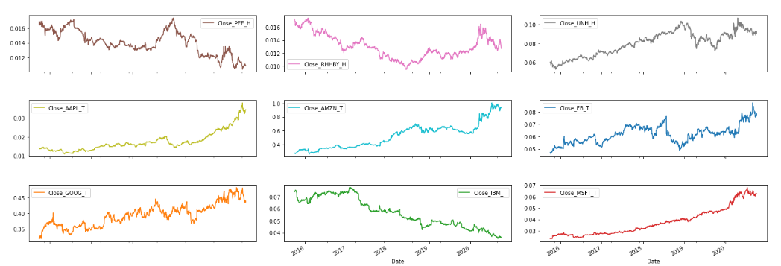
Observation:
1. Only few stocks have positive line wrt S&P500 Index.
2. Like MSFT, GOOG, AMZN, FB, UNH, APPL etc.

Slide 17
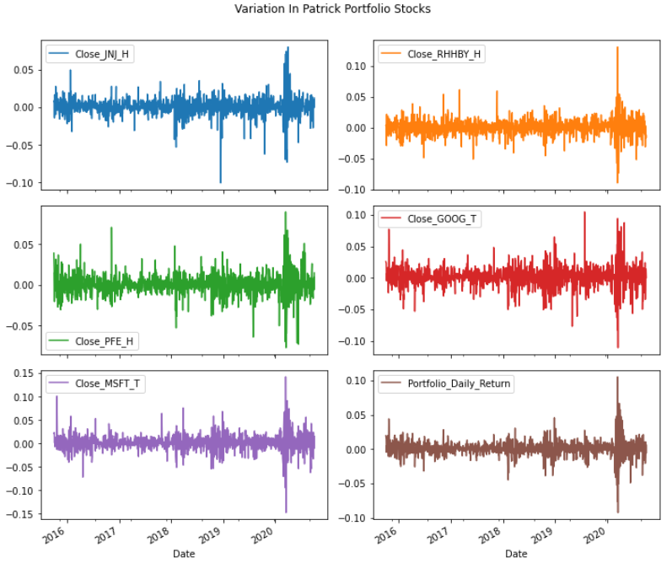
Observation:
1. As seen in the plot, the portfolio shows larger variation in prices from 2020 onwards.
2. Otherwise Portfolio plot is very stable

Slide 18
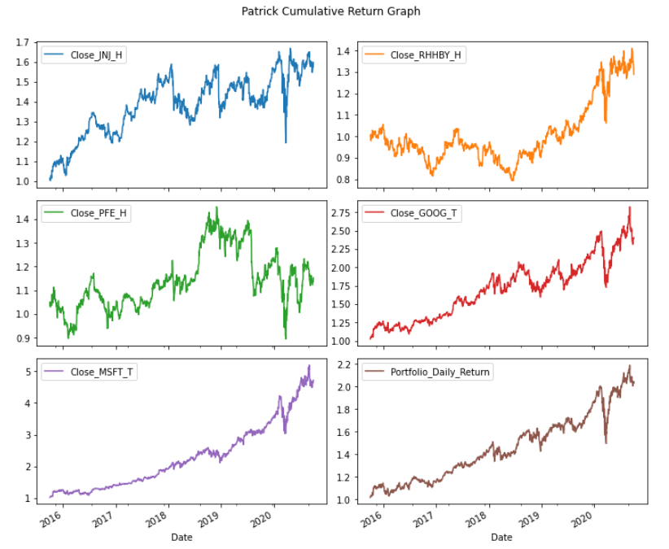
Observation:
1. Google, Microsoft and Jonson and Jonson shows good relative strength.

Slide 19
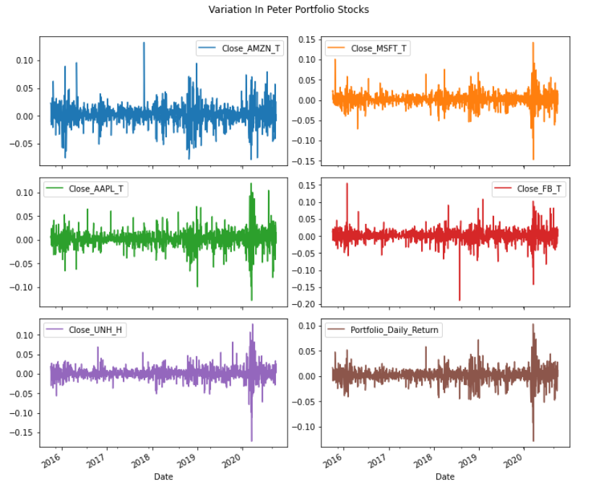
Observation:
1. As seen in the plot, the portfolio shows larger variation in prices from 2020 onwards.
2. Variation in Portfolio plot is more than Patrick Portfolio

Slide 20
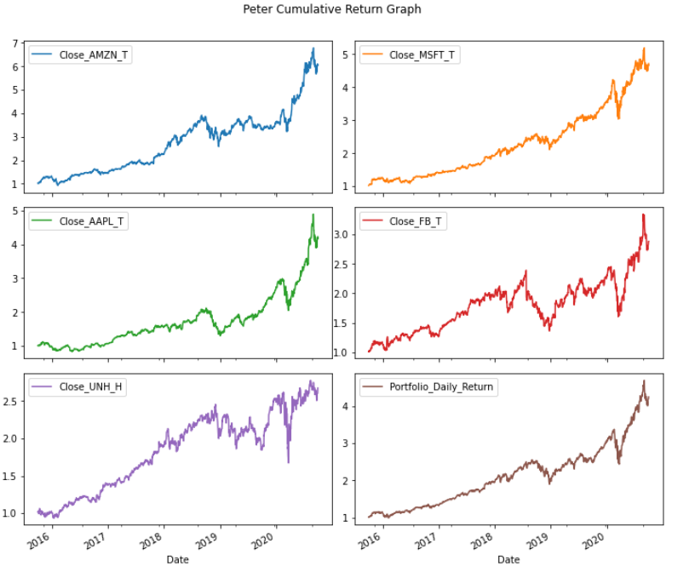
Observation:
1. Amazon, Microsoft, Apple, Facebook shows good relative strength.

Slide 21
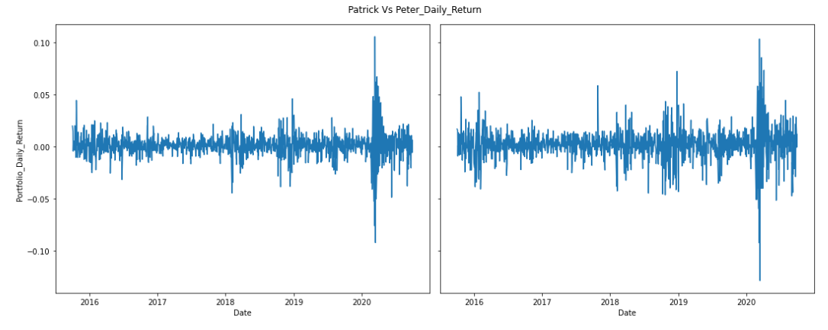
Patrick
Peter
Observation:
There is more deviation in Peter Portfolio compare to Patrick

Slide 22
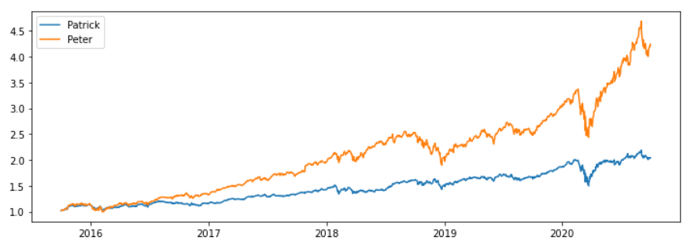
Patrick Vs Peter Cumulative Income
Observation:
Peter line chart shows more income compare to Patrick portfolio

