Slide 1

Energy Efficient GPGPU
Data Specific Thread Scheduling
Project Guide:-Dr. Jaynarayan T Tudu Submitted By: Hemant Kumar Pathak
Dept. of Computer Science & Engineering, Roll No. : CS20M007
Indian Institute of Technology, Tirupati Email : cs20m0007@iittp.ac.in
Session : 2021-22

Slide 2
Contents
Abstract
Tools and Technology Used Literature Review
Tool and Technology Requirements
GPGPU Key Features
Nvidia 480 GPU Architecture
Problem Definition and Motivation
Procedure and Technique
Result and Conclusion

Slide 3
Abstract
Power remains one of the biggest issue in the computing domain to be solved.
GPGPU based computing machines are currently being used extensively to solve computational problems in the field of machine learning and matrix-based computations,etc.
In this paper,I had explored the methodology that how dynamically regrouping data specific thread into new warp based on minimal hamming distance of Register content in such a way that correctness of the program remain as same.
To achieve my goal I performed elementary operations and succeed little.Performance analysis part completed.

Slide 4
Literature Review
→ Dynamic power & clock gating mechanism on entire datapath components i.e.,IFID unit, Scheduler unit, Operand collector unit, Execution unit in reverse order.[paper0]
→Instruction reordering:- wavefront scheduler that clusters the similar type (INT/FP/SFU/LD&Store) of instructions and issues them to the execution units using power gating. OOO( out of order) principle to modify PTX code without impacting the correctness of the program[pape1]
→Two-level warp scheduler in (round-robin or greedy) and register file caching instead of Main register file methodology.[paper2]
→Thread block + Warp (two level scheduling) :- Try to throttle active # core and warp.To improve efficiency for memory intensive workload.[paper 3]
→Dynamic warp formation and scheduling using different heuristic approach.[paper4]

Slide 5
Tools and Technology Requirement
→Programming language:C++
→GPGPU Sim simulator
→NVIDIA 480 GPU
→CUDA (Compute Unified Device Architecture).
→Rodinia Benchmark
→Google Colab Notebook

Slide 6
GPGPU Key Features
It uses Single Instruction Multiple Thread (SIMT) Principle of execution.
High data throughput: Hundreds of cores performing the same operation on multiple data in parallel.
Massive parallelism: Used for matrix computation or modeling complex system.
Issue with GPGPU suffers from low power efficiency due to the lack of not efficient thread level parallelism (TLP) algorithm or memory intensive applications.
Costly as compared with cpu
High complexity

Slide 7
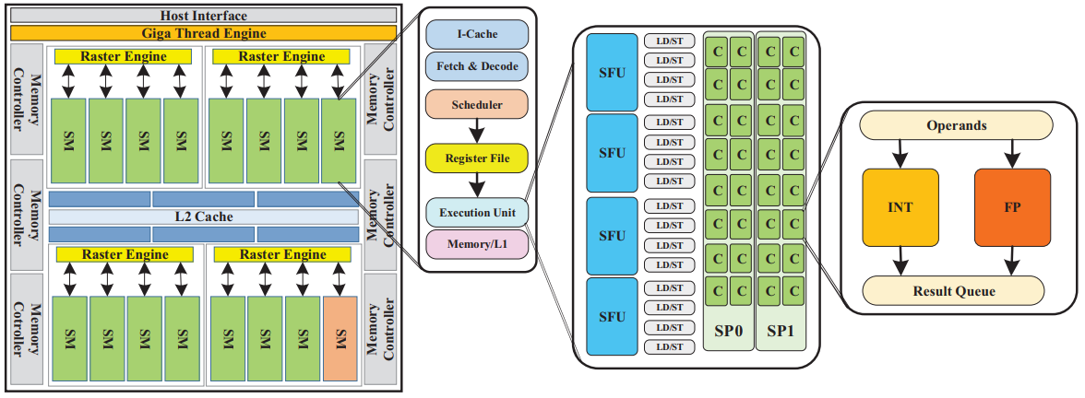
Nvidia 480 GPU Architecture

Slide 8
Nvidia 480 Description
Made up of 15 Streaming Multiprocessors (SMs)
SM consist of Instruction cache, register file unit, warp scheduler, and execution units, memory unit.
Per SM accommodate maximum 48 active warps at a time i.e., 48 * 32= 1536 threads
Execution unit consist of 2 SP, 16 Load/Store units, and 4 SFUs
Each of SP has 16 SIMT processing lane cores (also known CUDA core)
During each cycle, each SP can operate 32 concurrent threads i.e., 2 * 16=32 threads

Slide 9
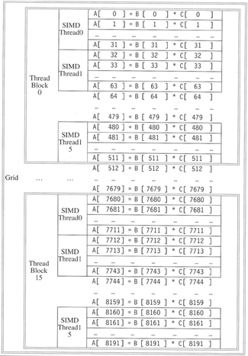
Example
Lets Vector having 8192 elements.
Assuming, 512 elements / Block
=16 SIMD threads / block * 32 elements / thread
Fermi have 7-16 multithreaded SIMD processors, here 16
each SIMD processor, there are 32 SIMD lanes
=An SIMD instruction executes 32 elements at a time

Slide 10
Problem Definition and Motivation
Problem: Data-specific dynamic thread scheduling based on the signature of the register file changed during the instruction execution within the GPU pipeline.
Motivation behind choosing this topic is to find out the way how to reduce the power consumption without major effect on performance of GPU by analyzing the the behavior of register throughout the execution process dynamically.

Slide 11
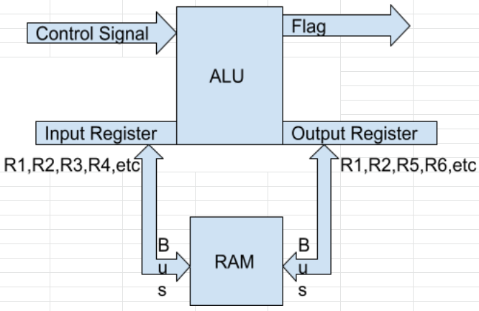
Instruction Cycle
Fetch instruction from memory using PC
Decode the instruction
Warp Scheduling
Fetch the operands on register
Execute the instruction
Write the result back to register or memory
Flag will send signal iff ALU generate 0.

Slide 12
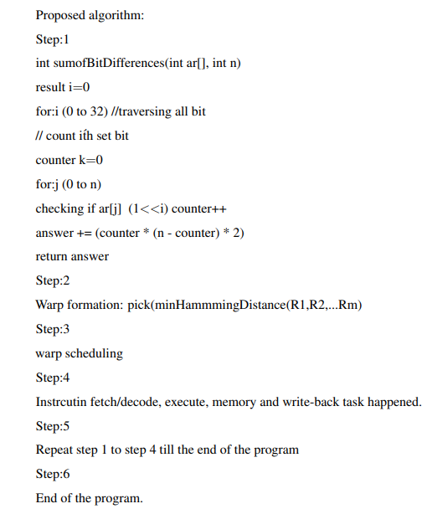
Procedure and Techniques

Slide 13
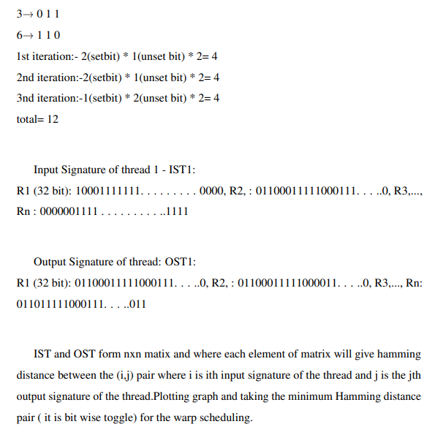
Explanation

Slide 14
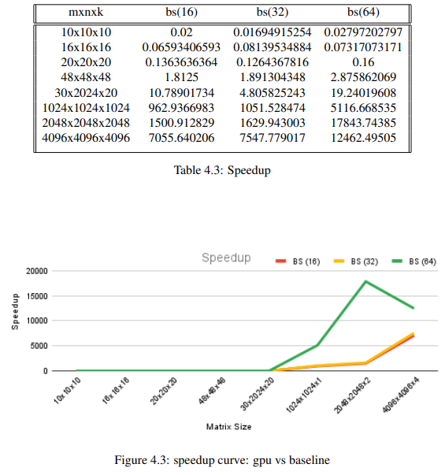
Result
Table 4.4 inferring Graph 4.4 which shown the
relationship between the baseline and modified
GPU which is clearly reflecting as we increase the matrix size
the computation time increase gradually but baseline taking
too much time as compared with modified GPU.

Slide 15
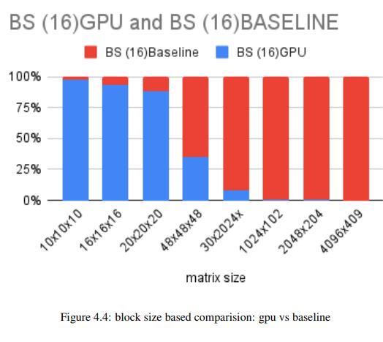
Figure 4.4 which shows the relationship between the
baseline and modified GPU which is clearly reflecting
as we increase the matrix size the computation time
increase gradually but baseline taking too much time
as compared with mod. GPU.

Slide 16
Conclusion
The result shows that the performance of the GPU will be increased by 10% for the most of the input data-set which is not a great but is a good improvement. Power analysis is missing here due to Our proposed methods required power-Watch to read the data but it not worked due to some version mismatch with provided simulator,Therefore there is good future scope to analyse the Power impact also the performance is analyzed here for matrix based computation so ample scope of analyzing the other benchmark tools

Slide 17
Thank You

