Slide 1
MedCare
Create a blockchain application to store and share patient records with Doctors and Health care intermediaries.

Slide 2
Team Details
Team Leader: Jatin Dua
Team Member 1: Rohit Saxena
Team Member 2: Ayushi Dhama
Team Member 3: Sneha Ramani
Team Member 4: Aayush Rai
Team Member 6: Muskan Gupta
BackEnd Developer
BackEnd Developer
FrontEnd Developer
UI/UX Designer
FrontEnd Developer
BackEnd Developer

Slide 3
Idea/Approach Details
As per the reports one of the major problems one face during the insurance claim for the hospital bills is the insufficient documentation.
Getting an insurer is never an easy task. If the required documents are not in proper order then this adds to the problem in a major way.
With the increasing speed of the growth in the medical field using latest technologies, many healthcare organizations still depend on outdated systems to maintain patient records.
Such outdated software keeps the patient medical data in local records that make the diagnosis time consuming as well as complicated for the doctors, patient and the insurer.

Slide 4
From the patient’s personal information to diagnostic reports and doctor’s prescriptions, healthcare organizations currently use the centralized database for saving data.
As the data is stored at a single centralized location, it leads to problems like:
Identity thefts
spamming
financial data crimes

Slide 5
Due to data theft and spamming, the patient’s data can be misused for many reasons as they don’t control it.
2017 Ponemon Cost of Data Breach Study says that the cost of data breaches for healthcare organizations is estimated to be $380 per record.
Can decentralization solve the data security issues in healthcare? Is it possible to save data securely on the blockchain? Yes. By implementing blockchain technology in the healthcare sector, a lot of these issues can be solved.

Slide 6
Hence we’ve come up with a solution where we are creating an application using blockchain.
With the help of this decentralized application we can store the information of an individual in a proper way so that it’s easy for them to access their data and is easier for them to claim the insurance.

Slide 7
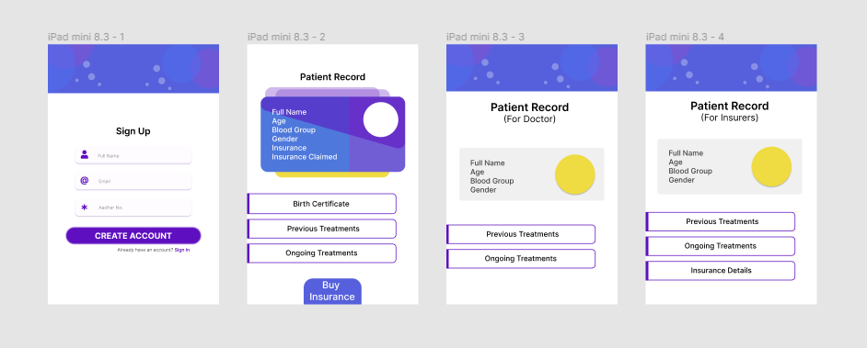
User Interface of the idea

Slide 8
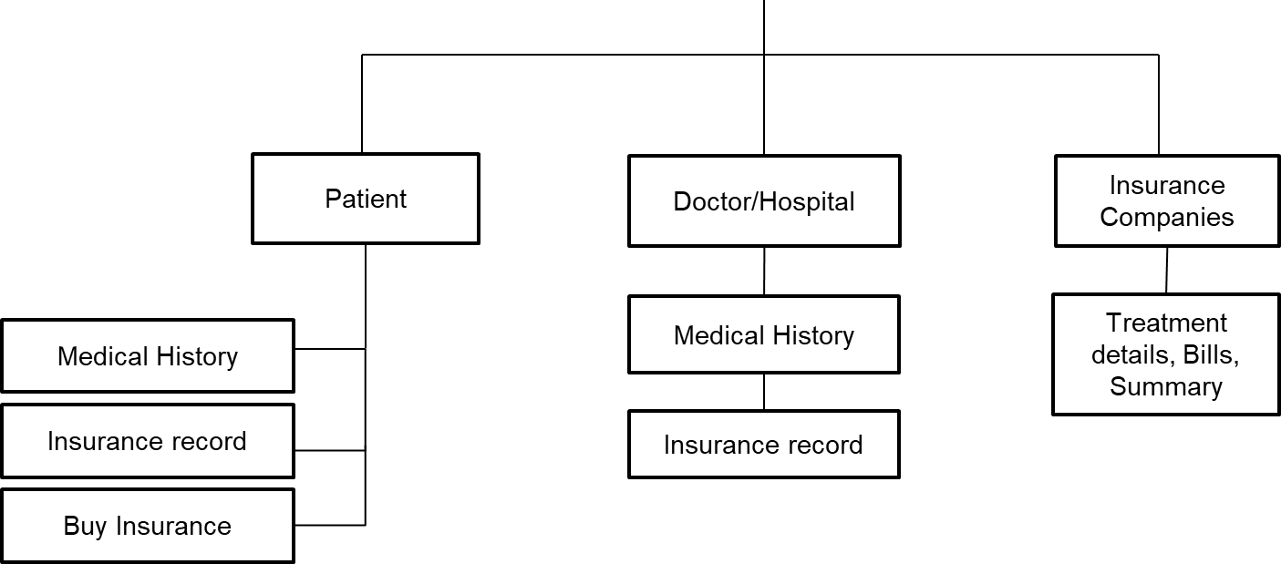
Process Flowchart
MedCare

Slide 9
Aim and points this idea covers
Monitoring the journey of individual claim
Beautifully designed and easily navigable interface
It will give patients more control over their data
Improve the accuracy and security of Electronic Health Record System making healthcare services more accessible and reduce healthcare costs
The epitome of using blockchain is to boost electronic medical records and permit patients records to be accessed firmly by the authorities.
It will help patients to make claim process easy by working as a bridge between insurance companies & hospitals.
It maintains the proper integrity of all the medical records correctly.
All the issues related to the maintenance, claims and security of the healthcare records of an individual can be solved using blockchain.

