Slide 1
G.H.PATEL COLLEGE OF ENGINEERING AND TECHNOLOGY
IoT improved Shared Lock
Guided By:- Submitted By:-
Prof. Hetal Gaudani Rahul Shah (130110107049)
Hemant Suthar (130110107058)

Slide 2
Content
What is Shared Lock?
Advantages of Shared Lock
Front End
Flow of Working Solution
Back End
Working Videos
Mobile Applications
Q & A

Slide 3
What is Shared Lock?
First thing, It is a Keyless Entry.
One can use this Shared lock on any vehicle
Bike share schemes allow people to borrow a bike from point "A" and return it at point "B".
Shared lock is unlock by mobile Application, that Application use Bluetooth component to access the lock if user is Authorized.

Slide 4
Advantages of Shared Lock
Key-Less Entry :- Never worry about losing your key, searching for them in your purse, pocket, or on your key ring.
Share Access :- Share the location and access to your bike with friends and family.
Track Activity :- Lock can help you effortlessly keep track of your cycling activity.
Secure :- Shared Lock uses encryption found in online banking systems, so bike thieves will not possible.

Slide 5
Advantages of Shared Lock
Reliable :- Shared Lock is designed to withstand inclement weather conditions. The internal components are sealed and weatherproofed inside a plastic compartment. The electronics and battery can also operate under an extended temperature range.
Authentication:-We Authenticate verified user’s mobile by One time pad technique.

Slide 6
Front-End
In front End we have fully automated Lock as hardware solution.
In side Lock
Door Lock mechanism
esp8266 NodeMCU
12v dc 6mm gear robot motor
VK3FF-S-DC5V-C relay
H-bridge circuit
hc-06 Bluetooth module
Battery
GPS Chip

Slide 7
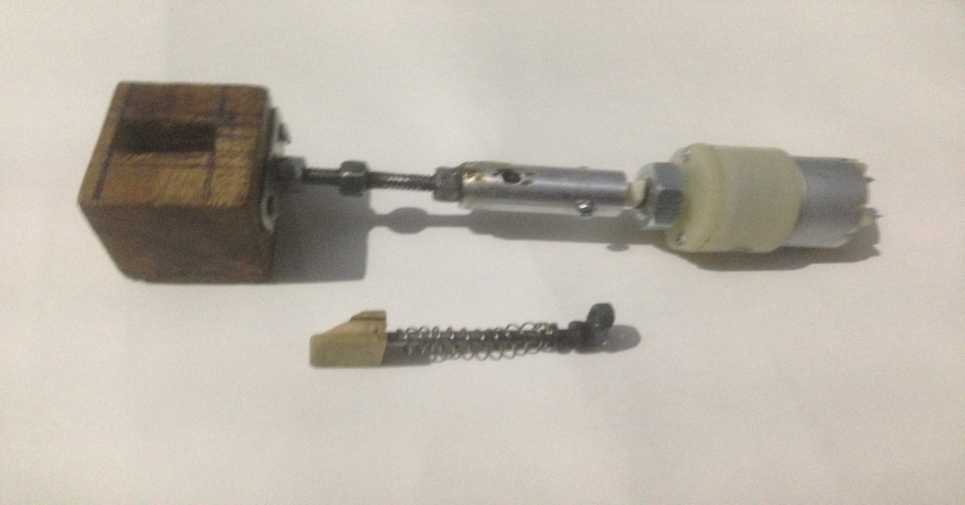
Continue…….
Door Lock mechanism

Slide 8
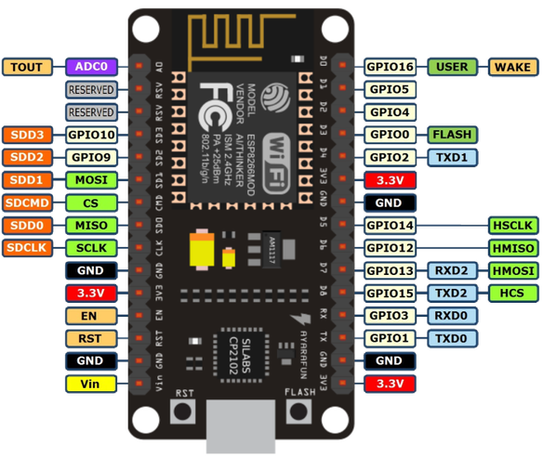
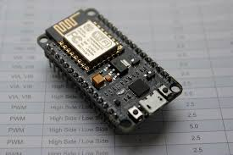
Continue…….
ESP8266 NODEMCU

Slide 9
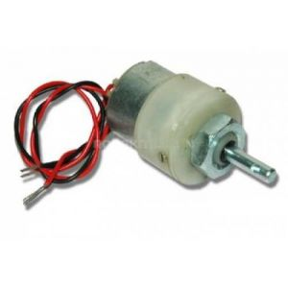
Continue…….
12v DC 6mm Gear Robot Motor
For our lock , we have used 200 rpm motor

Slide 10
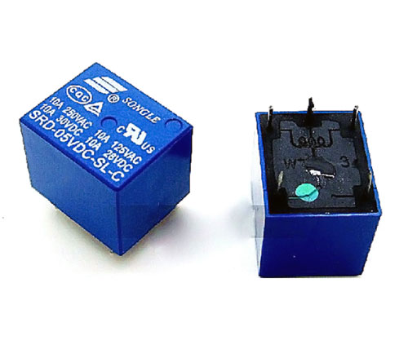
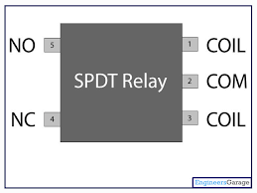
Continue…….
VK3FF-S-DC5V-C Relay

Slide 11
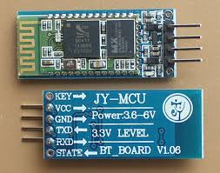
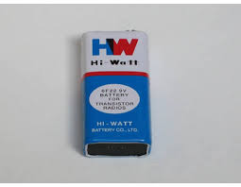
Continue…….
HC-06 Bluetooth Module
9 Volt Battery

Slide 12
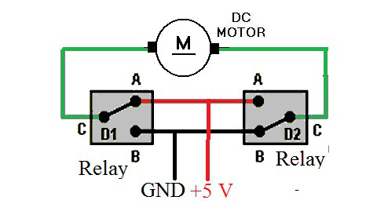
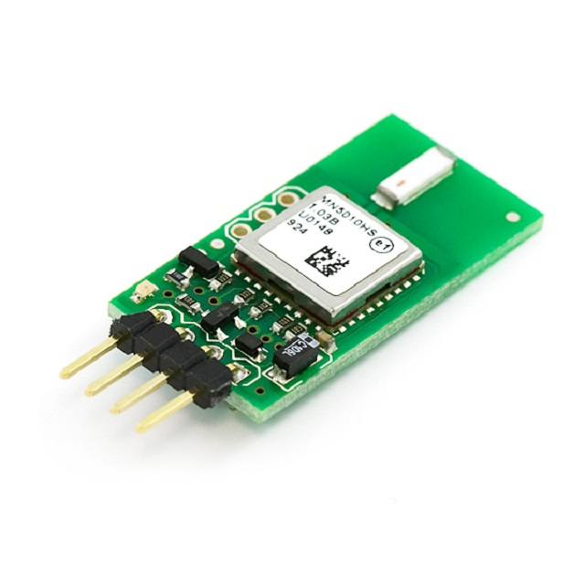
Continue…….
H Bridge
GPS Chip

Slide 13


Step 1:- Connect lock’s Bluetooth with your device
Step 2:-Enter the key
Key:-1234
1234
Lock

Slide 14
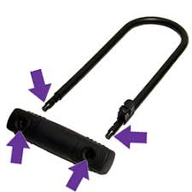
HIGH
“1234”
Bluetooth
Module
Node MCU
H Bridge
Motor
Validate Key and Proceed
{
If(correct)
“make pin high”
}
Motor will Rotate
And Lock will Open

Slide 15
Back-End
In Back End we have Computational System. which is heart of product
In side Lock
PHP file
Google map API
Way 2 SMS messaging API
XAMPP Server
SQL Database
PayUMoney digital transaction API

Slide 16

Continue…
Use of PHP
Interacting with database
Generate random OTP code for Authentication
Json Parsing ,Json Encoding

Slide 17
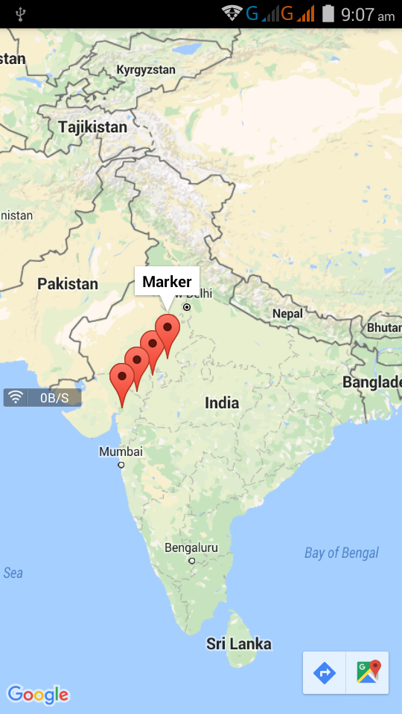
Continue…
Google Map API

Slide 18
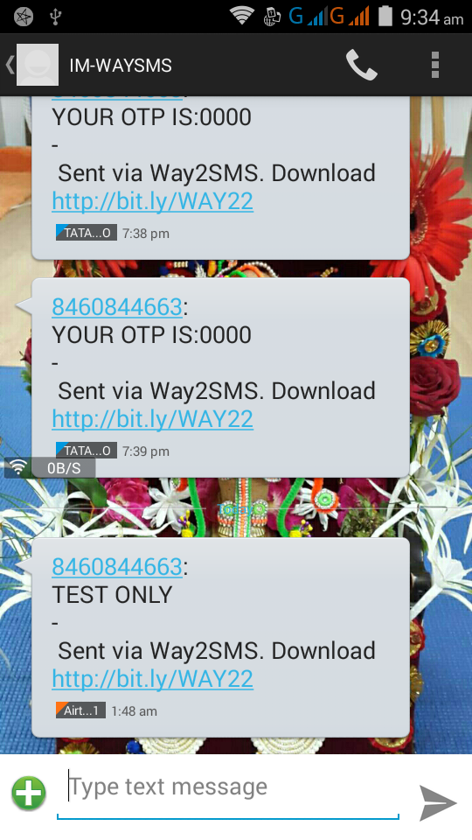
Continue…
Way 2 SMS messaging API

Slide 19
OTP Code
Web-Server
DataBase-Server
OTP | id | value
 | 1 | 4352
JSON.Encoded(
Name,Mobile No,
Adhar Card id No,etc….)
Store into Database
Parsing- - - >
Name, id
Mobile No,
etc……..
Generate OTP
Name | MobileNo. | Email id | Adhar Card Id
xyz | xxx | x@x.com | 123..
1)Fill the Sign Up Form , make data into Json Encoded & goes to webserver
2)Webserver execute require Php File
->Php file will Parse the Json Data & fetch Contact Information
3)Webserver will generate Random OTP and make temporary entry in database
4)Webserver will use Way2Sms Messaging API & send it to User’s Mobile
5)User will enter OTP & pass to Webserver
6)Webserver Verifiy both OTP ->one from database & another from mobile
7)If OTP is correct , WebServer will make entery of User’s Detail into Permanent DataBase

Slide 20


Slide 22
PayUMoney digital transaction API

Slide 23
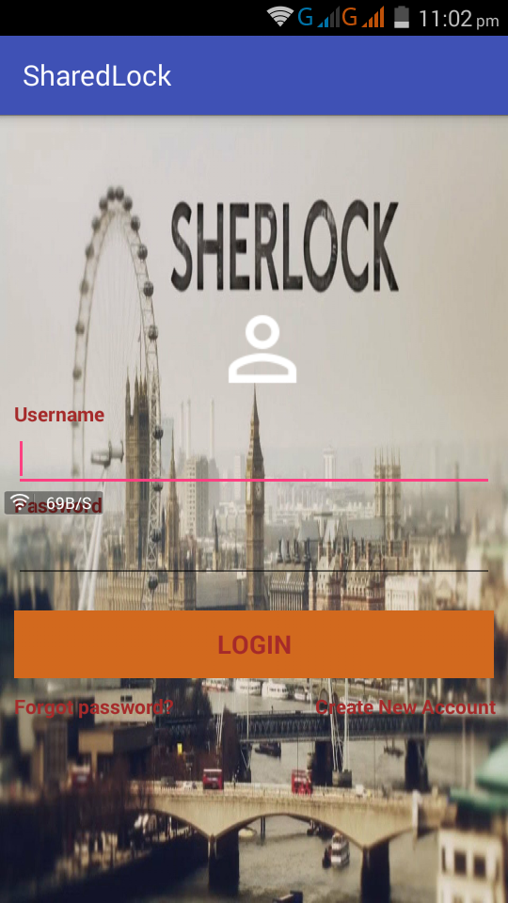
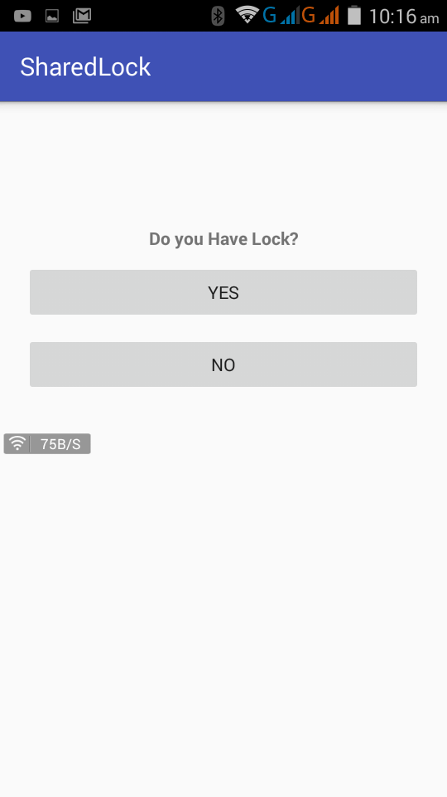
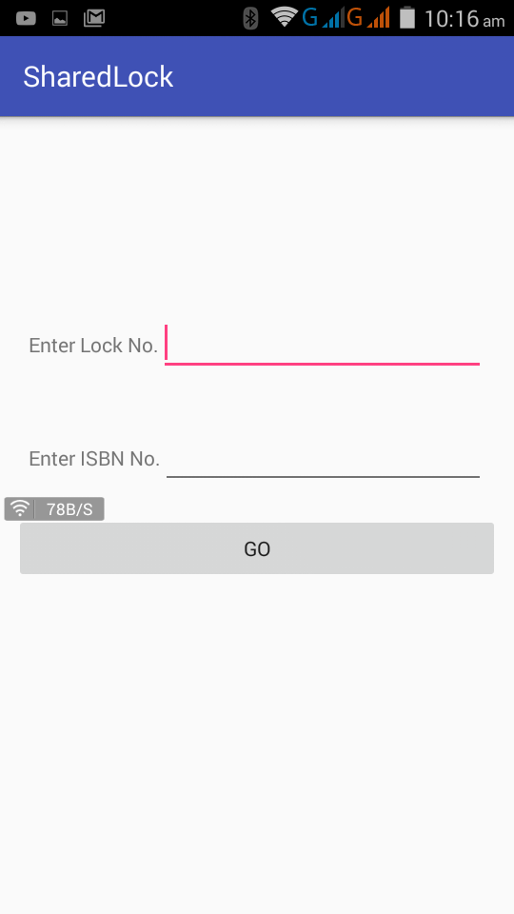
Mobile Application

Slide 24
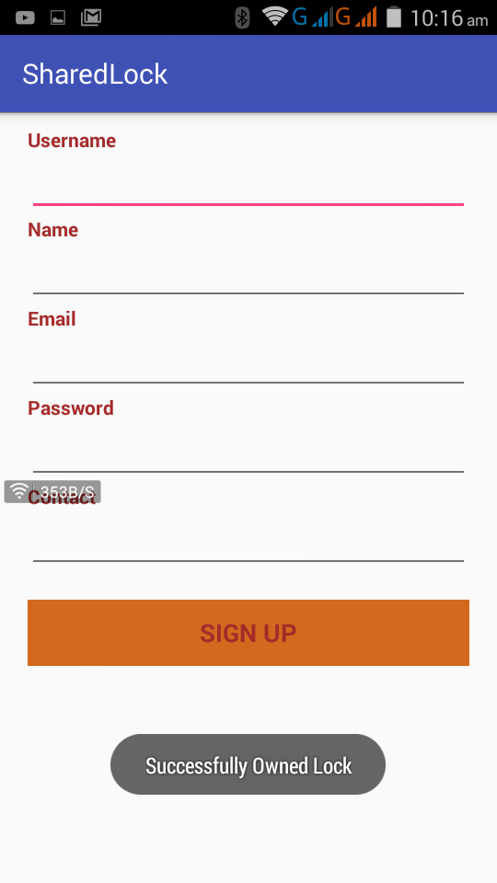
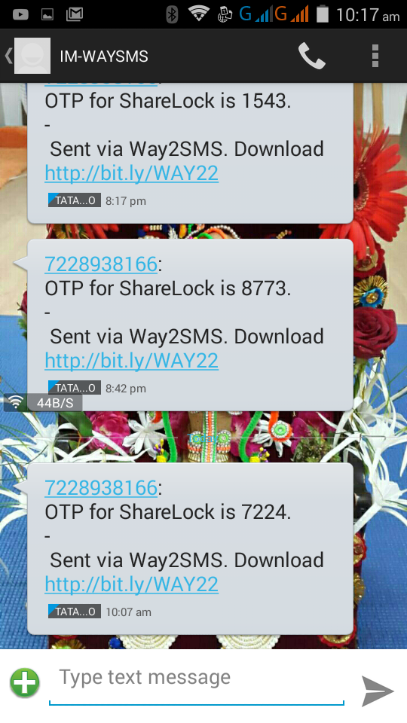
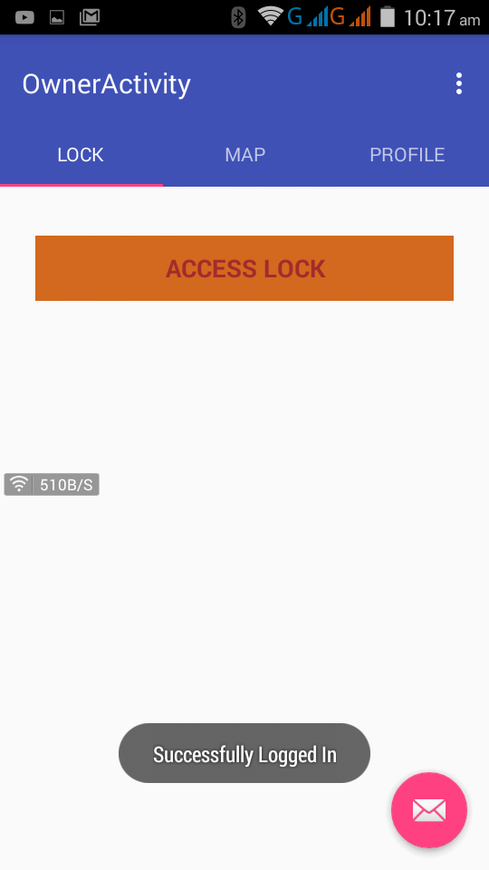
Mobile Application

Slide 25
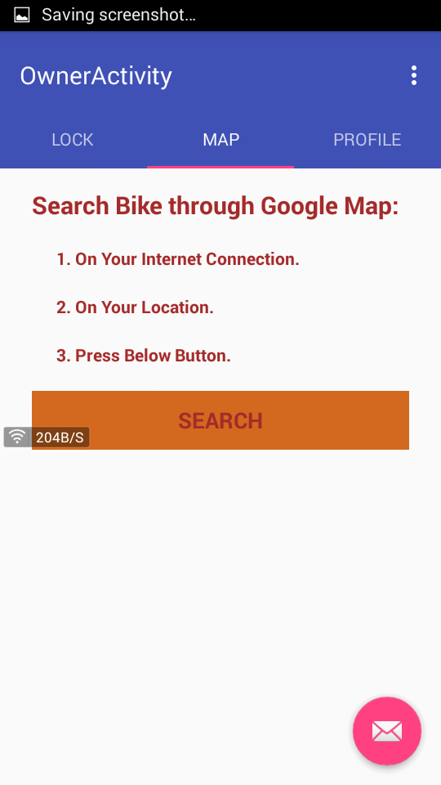
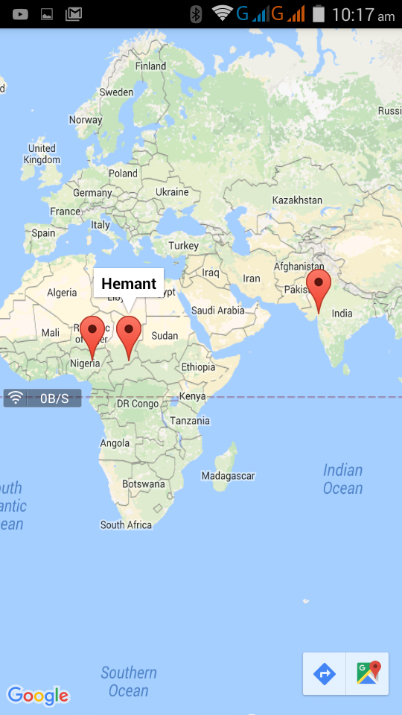
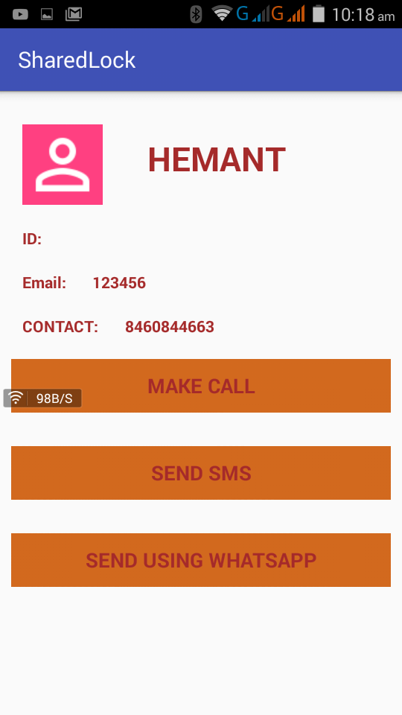
Mobile Application

Slide 26
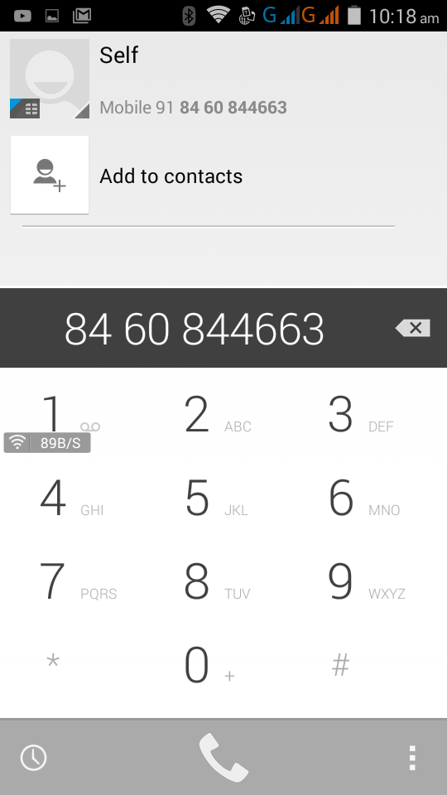
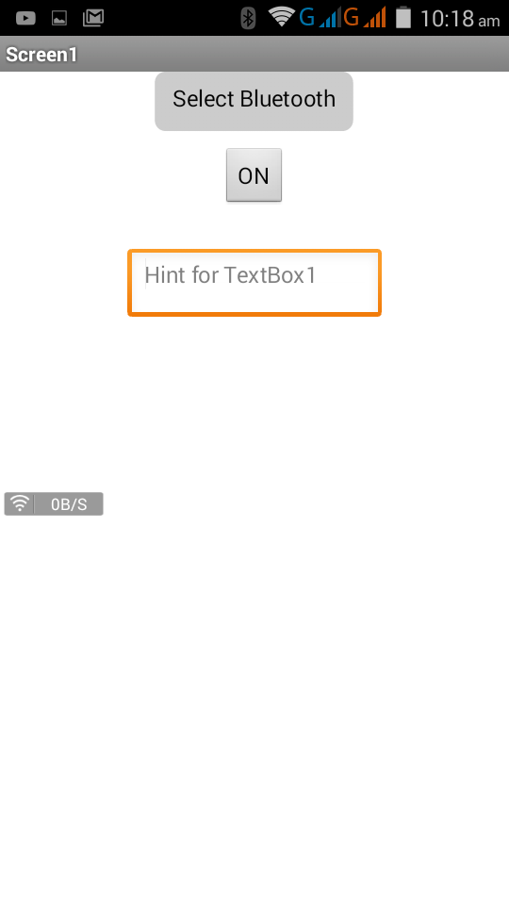
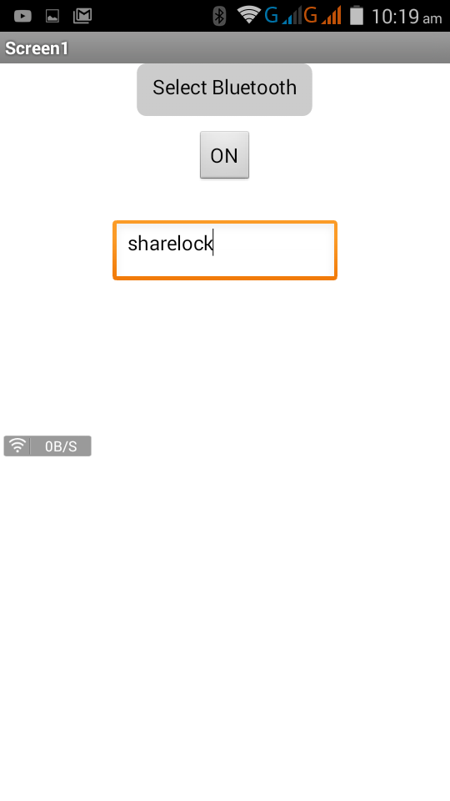
Mobile Application

Slide 27
Applications
University Campus Bike Sharing Systems
Smart Cities
Daily Home Use
Bank Lockers
Security Systems

Slide 28
Do you have any Questions?

Slide 29


