Slide 1
Social Media for Aid Awareness
Hemanta Sapkota

Slide 2
Content
What is Social Media ?
The Concept
  Sharing of Aid Visualization
Integrating Google Public Data
  Brief description of DSPL
Integrating Facebook and Twitter
Summary
Index of Resources

Slide 3
What is Social Media
Social Media
  Facebook
  Twitter
  Google Plus
  Digg
  And many more

Slide 4
Facebook
Social Network
  750M+ active users
Sharing
  Statuses
  Pictures
  Comments
facebook.com

Slide 5
Twitter
Microblogging
  200M users
Sharing
  140 characters “tweet”
  Group posting using Hashtags.
    Ex. #nepalaid
twitter.com

Slide 6
Google Plus
Social Network
  10M users
Sharing
  Statuses
  Pictures / Videos
Functionality similar to facebook
plus.google.com

Slide 7
Digg
Social News Website
  Users “digg” or “bury” content
  Content with a lot of “diggs” move on to the top of the page
  News are about business, entertainment, technology, Science, Sports, etc.
www.digg.com

Slide 8
What is Social Media
SHARING

Slide 9
The Concept
Sharing of Aid Visualization

Slide 10
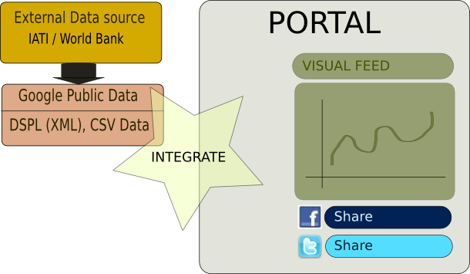
The Concept

Slide 11
The Concept
External Data
  Converted to Dataset Publishing Language (DSPL)
  Google Public Data creates great visualization of the data
  Visualization is hosted on Google's server
  Visualization is embeddable

Slide 12
The Concept
Aid Portal
  Hosts information on
    All the aid projects
    Donors
    Recipient agencies
  Ex. http://www.worldbank.org.np/external/default/main?menuPK=286967&pagePK=141155&piPK=141124&theSitePK=223555

Slide 13
The Concept
Sharing
  Visualization is shared
    On the portal
    On Facebook
    On Twitter
    On Google Plus
  Tapping existing social network users
    Facebook + Twitter + Gplus = 960M Users

Slide 14
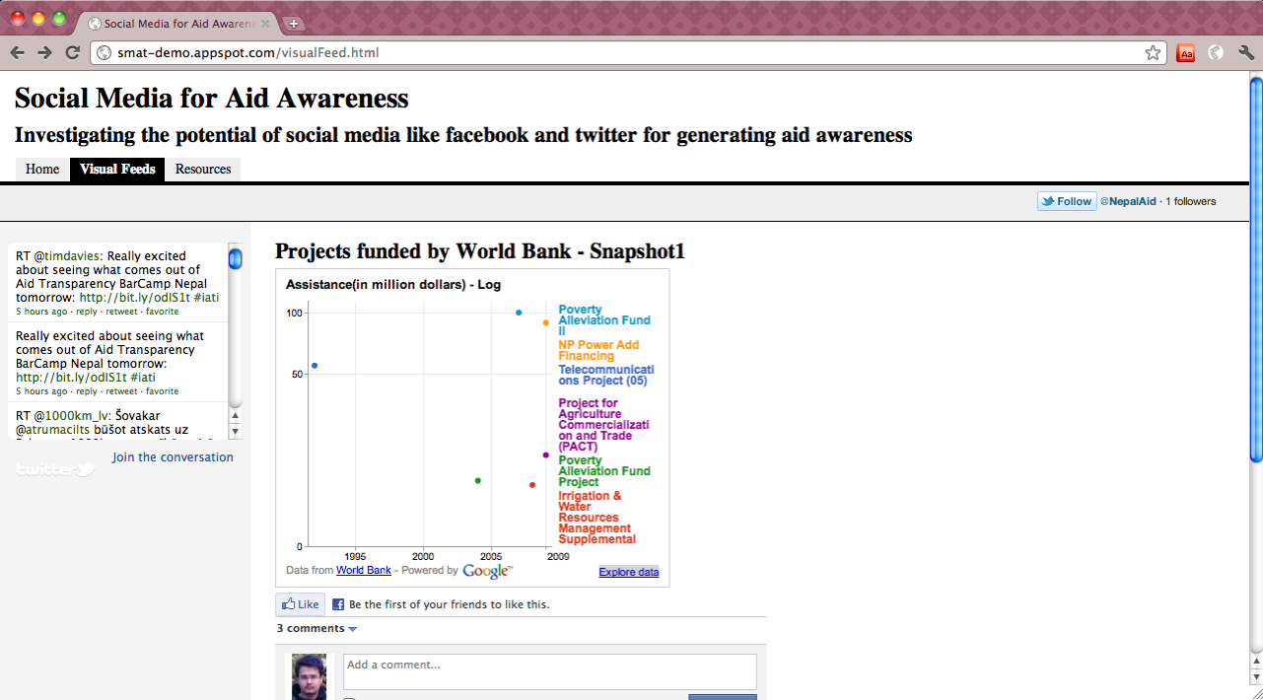
The Concept
Demo - smat-demo.appspot.com

Slide 15
Integrating Google Public Data
Google Public data
  Dataset Publishing Language (DSPL)
    XML based meta-data format / CSV data format
  www.google.com/publicdata/
Sample – Projects funded by World Bank in Nepal
  Sample DSPL
  http://smat-demo.appspot.com/resources.html
  Data Visualization - http://www.google.com/publicdata/overview?ds=z3ikuqdjllkmqh_

Slide 16
DSPL : Brief Description
XML Metadata format
  <info>
  <provider>
  <topics>
  <tables>
  <concepts>
  <slices>
  http://code.google.com/apis/publicdata/docs/tutorial.html

Slide 17
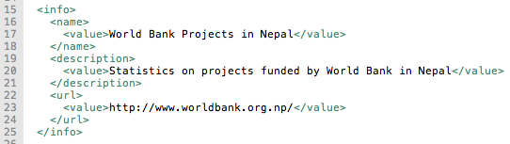
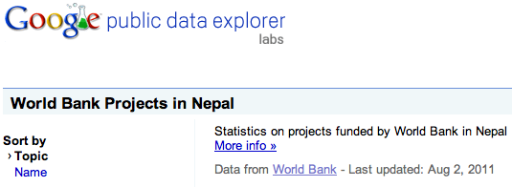
DSPL : Brief Description
<info> Tag

Slide 18
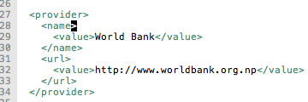
DSPL : Brief Introduction
<provider> Tag

Slide 19
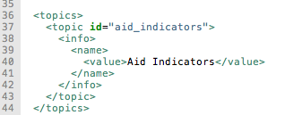
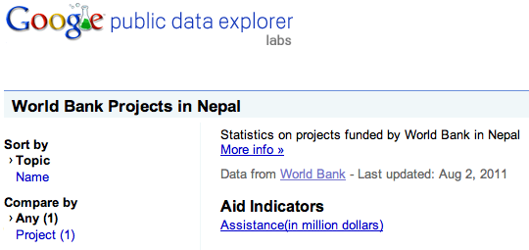
DSPL : Brief Introduction
<topics> Tag

Slide 20
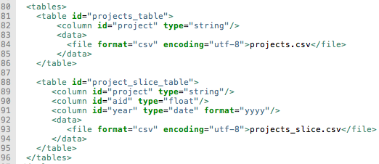
DSPL : Brief Description
<tables> Tag

Slide 21
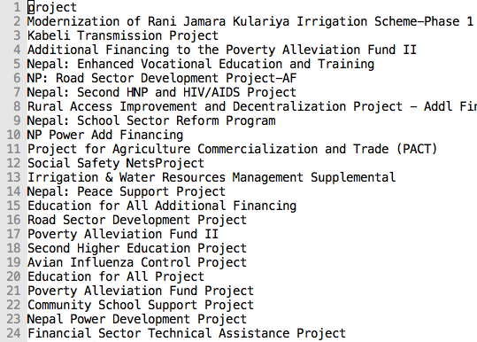
DSPL : Brief Description
Projects - CSV Data Format

Slide 22
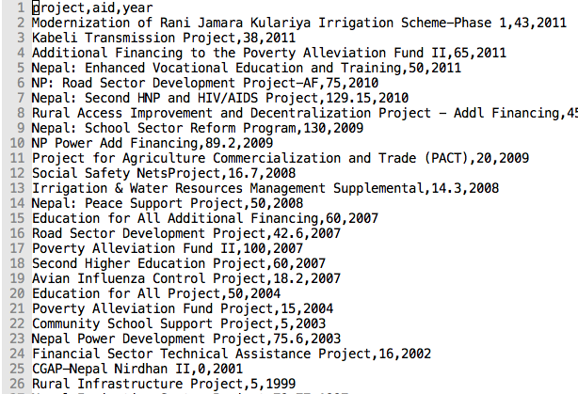
DSPL : Brief Description
Projects and Aid Amount - CSV Data

Slide 23
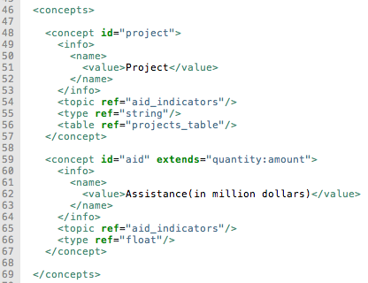
DSPL : Brief Description
<concepts> Tag

Slide 24
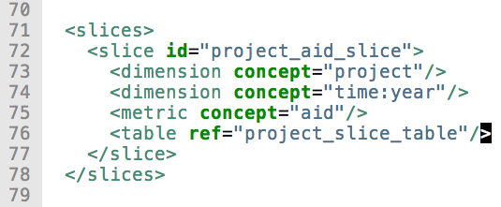
DSPL : Brief Description
<slices> Tag

Slide 25
Integrating Facebook and Twitter
Facebook provides
  Social Plugins
    Like button
    Comments
  Embedded HTML/JavaScript
Twitter provides
  Search Widget.
    Can be used to list conversations of hashtags.

Slide 26
Summary
Sharing of Aid Visualization to existing social networks like Facebook, Twitter and Google Plus should increase the aid awareness.

Slide 27
Index of Resources
Demo of the concept
  http://smat-demo.appspot.com
Sample DSPL file
  http://http://smat-demo.appspot.com/resources.html
Visualization of Sample DSPL
  http://www.google.com/publicdata/overview?ds=z3ikuqdjllkmqh_

Slide 28
OPEN FOR DISCUSSION

Slide 29
Credits
Mr. Cabel Dhoj Shrestha and Ms. Aniva Mainali for providing valuable insights and criticisms.
Matthew James Taylor (http://matthewjamestaylor.com/) for providing web template for the demo.
YIPL for giving me an opportunity to present this concept.
All rights reserved by Hemanta Sapkota.

