Slide 1

Basic Details of the Team and Problem Statement
Ministry/Organization Name/Student Innovation:
Government of Gujarat
PS Code: SH1365
Problem Statement Title:
Online Blockchain based certificate generation and validation system for government organization.
Team Name: Vallhala
Team Leader Name: Shambhavi Verma
Institute Code (AISHE): U-0064
Institute Name: Indian Institute of Technology Patna
Theme Name: Blockchain & CyberSecurity

Slide 2
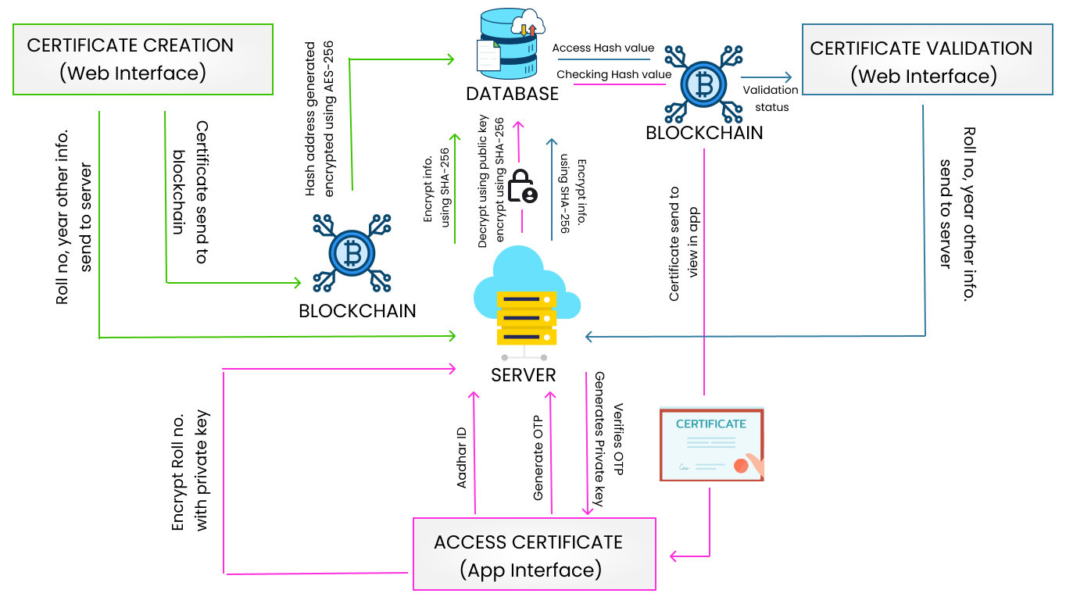
Idea/Approach Details
Idea/Solution :
We have made a Blockchain-based Certificate Generation and Verification Management System:
Secure: Utilizes cutting-edge technologies, enhanced gas efficiency, and prioritizes security and privacy.
User-friendly: Offers seamless certificate management, data loss prevention, and document storage.
Scalable: Has the potential to combat forgery of crucial certificates across multiple fields.
Transformative: Will transform the process of certificate management and establish an unprecedented benchmark for safeguarded and streamlined data administration.
Technology stack :
Kotlin
Node.js and Express
React.js & Hardhat
Encryption (SHA-256 & AES-256)
Blockchain
IPFS
Ethereum

Slide 3
Idea/Approach Details
Use Cases
Dependencies / Show stopper
Bulk Certificate Generation : Ease for government to generates certificates in bulk saving both time and money using Batch minting.
Certificate Storage : We are creating a database for users where all their certificates will be stored reducing the need for physical copies and thus preventing any losses.
Verification : We are providing facilities to government and industries where they can check if the certificate shown by user is legitimate or not.
Cost Efficient Methodology : One of the prominent aspects of our solution to this challenge pertains to the utilization of artificial intelligence and machine learning for the purpose of predicting the hourly Ethereum Gas Price. This application has proven to be highly cost-effective, particularly in the context of batch minting operations.
Blockchain : We are depending on Blockchain for creation of NFTs using ERC721A Token.
Cryptography : We employ robust encryption measures, utilizing the SHA-256 and AES-256 algorithms, to safeguard our data against cyber threats effectively. The utilization of AES-256 offers a high level of security, greatly mitigating the risk of data breaches.
Blacklisting : To address the challenge of immutable certificates on the blockchain, we propose a solution: "blacklisting" incorrect certificates and issuing new ones. This preserves data integrity while maintaining blockchain immutability.
Scalability : In our pursuit of a robust blockchain certificate management system, we acknowledge the challenge of counterfeit birth and death certificates. We are dedicated to fortifying our backend infrastructure to ensure the credibility and accuracy of these critical documents.

Slide 4
Team Member Details
Team Leader Name: Shambhavi Verma
Branch : B.Tech Stream : Computer Science and Engineering Year : II
Team Member 1 Name: Hemant Chaurasia
Branch : B.Tech Stream : Chemical Engineering Year : II
Team Member 2 Name: Kanahia Kaushal
Branch : B.Tech Stream : Mathematics and Computing Year : II
Team Member 3 Name: Satyam Raj
Branch : B.Tech Stream : Mechanical Engineering Year : II
Team Member 4 Name: Harpranav Singh Uppal
Branch : B.Tech Stream : AI&DS Year : II
Team Member 5 Name: Krishna Rathore
Branch : B.Tech Stream : Mathematics and Computing Year : II
Team Mentor 1 Name: Rajendra N.P.
Category (Academic/Industry): Finance/Economics Expertise: Microeconomics Domain Experience (in years): 11
Team Mentor 2 Name: Mayank Agarwal
Category (Academic/Industry): Computer Science Expertise: Neural Computing, ML, Wifi Security Domain Experience (in years): 10

