Slide 1

Frontend architecture
SolMan CR/CO Agent
How an AI agent's questions become screens — the AG-UI protocol, the component contract, and what happens between a token arriving and a card appearing.
REACT 19 · NEXT 16 · TYPESCRIPT STRICT · AG-UI OVER AWS BEDROCK AGENTCORE

Slide 2
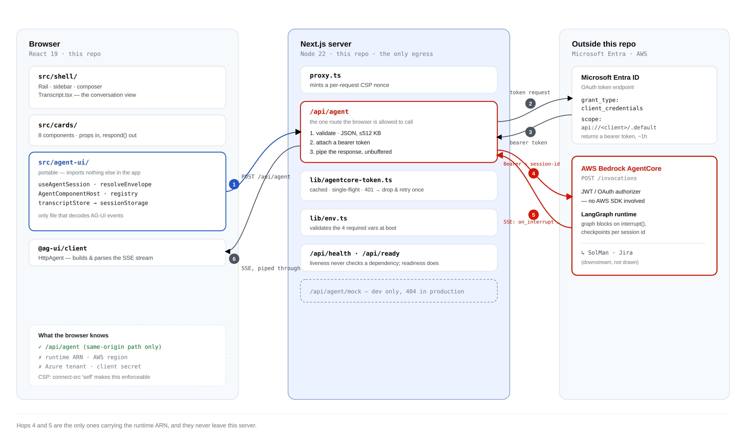
02 / 23
SYSTEM OVERVIEW
Runtime — one request, six hops
agent-ui/ is the only browser code that understands AG-UI events; /api/agent is the only route allowed to hold the AgentCore runtime ARN and the Azure client secret.
CR/CO FRONTEND ARCHITECTURE

Slide 3
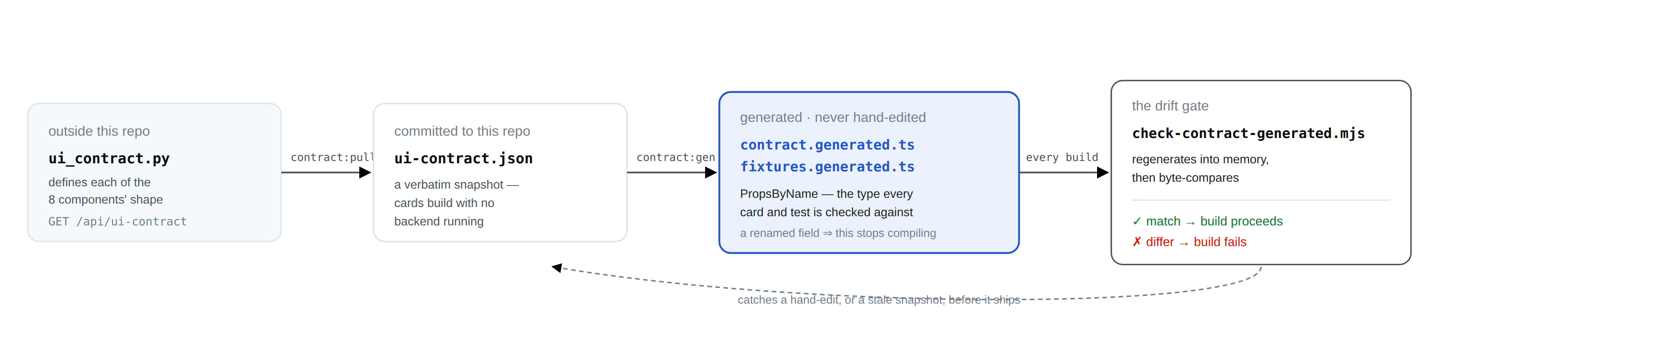
03 / 23
SYSTEM OVERVIEW
Build time — how the two teams stay in sync
A different mechanism, running before any of the runtime path on the previous slide: how the frontend learns what a card is allowed to look like, and what stops the two sides drifting apart.
This runs at build time, not at request time — it never touches the runtime path above. A backend change that isn't additive shows up here as a failed build, not as a blank card three weeks later.
The rule this whole page encodes: the agent may only name one of eight components. The registry (src/agent-ui/registry.tsx) is total — a ninth component with no matching card fails the build, the same way a contract mismatch does.
CR/CO FRONTEND ARCHITECTURE

Slide 4
04 / 23
THE JOB
What this app does
Raising a change request in SAP Solution Manager means filling about fifteen fields, spread across SolMan, Jira and a set of platform lookups.
Here, an agent asks one question at a time. It pulls what it can from Jira, proposes similar past CRs, drafts the request, and submits it — after a human approves the draft.
The frontend's whole job: turn each question into a screen, and send the answer back.
Visual: the real crModeChoice card, as the user sees it — the first question the agent asks.
Create Change Request
How would you like to proceed?
Single Change Request
8
~7
1
Bulk Change Request
KINDS OF QUESTION
TURNS END TO END
HTTP ENDPOINT
CR/CO FRONTEND ARCHITECTURE

Slide 5
05 / 23
THE RULE
The agent never ships UI
An LLM can generate anything — including markup. This app is built so that never matters: the agent can only send this, and nothing else.
WORST CASE
Stated plainly: a confused or compromised agent names a component that does not exist.
It gets a fallback card explaining the problem — never a blank screen, never injected markup.
{ "version": 1, "name": "crModeChoice", "props": { … } }
The agent sends a name and a props object. The frontend looks the name up in a fixed map of eight. It cannot send markup, because nothing renders markup — react/no-danger is a build error.
CR/CO FRONTEND ARCHITECTURE

Slide 6
06 / 23
THE VOCABULARY
Eight components, and nothing else
Every screen the agent can ask for maps to exactly one of these eight named components — nothing else is renderable.
COMPONENT | SCREEN IT PRODUCES
crModeChoice | Single vs. bulk change request
crIntakeForm | The core CR fields, prefilled where possible
templateOrCrPicker | Start from a template or a prior CR
cycleIdPicker | Choose the release / cycle
draftReview | Review the drafted request before submit
fieldPrompt | One missing field, asked directly
submissionResult | Success, failure, or partial outcome
featureComingSoon | A path not yet supported
CR/CO FRONTEND ARCHITECTURE

Slide 7
07 / 23
TWO TEAMS
Who owns what
Content and presentation are split across two teams. Neither can fully ship without the other.
 | Decides | Supplies | Controls | Changes by
Agent / backend | All wording — titles, labels, prompts, error text | The name + props envelope for each screen | Which question comes next, when the graph interrupts | A config or prompt change — no frontend deploy
Frontend | Layout, spacing, interaction pattern per component | The 8 component implementations + the validation layer | What happens to an unknown or malformed envelope | A layout or new-component change — a frontend deploy
The frontend contains no business text. A wrong word on screen is a backend change, not a frontend one.
CR/CO FRONTEND ARCHITECTURE

Slide 8
08 / 23
THE PROTOCOL
What AG-UI is
AG-UI (the Agent-User Interaction Protocol) is an open, lightweight, event-based protocol, maintained by CopilotKit, that standardizes how AI agents connect to user-facing applications — instead of every team hand-rolling its own event stream.
Transport: the client POSTs one JSON run input; the agent replies with a stream of typed events, by default over HTTP + Server-Sent Events.
Our client: @ag-ui/client, the HttpAgent class. One instance per thread.
Their server: ag-ui-langgraph 0.0.42, wrapping a LangGraph graph, running on AWS Bedrock AgentCore.
The spec defines ~16 event types across 5 categories — lifecycle, text message, tool call, state, and custom. This app's graph only ever emits 8 of them.
Source: docs.ag-ui.com — Concepts: Events, and the ag-ui-protocol GitHub repository.
CR/CO FRONTEND ARCHITECTURE

Slide 9
09 / 23
OUTBOUND
The request: one RunAgentInput
POST /api/agent
{
"threadId": "t-1764…", // the conversation
"runId": "…", // this one turn
"state": {}, // client-held state (none)
"messages": [], // chat history (none)
"tools": [],
"context": [],
"forwardedProps": { } // ← everything bespoke rides here
}
One shape, three jobs — the point of the slide:
forwardedProps: {} — start the conversation
forwardedProps.command.resume — answer the open question
forwardedProps.lookup — a dropdown or Jira lookup, answered as JSON without waking the graph
CR/CO FRONTEND ARCHITECTURE

Slide 10
10 / 23
INBOUND
The response: one SSE stream
RUN_STARTED lifecycle
STEP_STARTED lifecycle
CUSTOM on_interrupt ← THE CARD
STATE_SNAPSHOT ← the fallback copy
MESSAGES_SNAPSHOT (empty — no chat)
STEP_FINISHED lifecycle
RUN_FINISHED lifecycle
Worth noting: the card arrives inside a CUSTOM event, not as a run outcome — this graph's own design choice, and worth flagging since a reader of the AG-UI spec's lifecycle events would otherwise expect the other thing.
Two of seven carry payload. The other five are bookkeeping.
CR/CO FRONTEND ARCHITECTURE

Slide 11
11 / 23
THE CLIENT
Five handlers, and one we refuse
What agent.subscribe({…}) actually implements — the whole of our AG-UI surface on one slide.
onCustomEvent — on_interrupt gives the card; progress gives the status line
onTextMessageStart / Content / End — the draft, token by token
onStateChanged — merged state; the fallback copy of the card
onRunErrorEvent — surfaces the message
onRunFinishedEvent — does not mean the conversation ended; this backend finishes the run and leaves the interrupt pending
The refusal: onStateDeltaEvent is deliberately unimplemented. It fires with the patch, and reading agent.state inside it returns the state from before the patch — which silently produced no card at all when the agent sent ui_component as a delta. onStateChanged receives state already merged, so there is no patching to re-implement.
CR/CO FRONTEND ARCHITECTURE

Slide 12
12 / 23
STREAMING
Three things stream. The card does not.
Progress messages — CUSTOM name:"progress", emitted from inside a node: "Fetching Jira ticket AAZM-4668…". Without them the longest steps look frozen.
Draft tokens — TEXT_MESSAGE_CONTENT deltas, appended as they land. node_6 writes the CR draft with a plain LLM call, so it relays as text rather than structured output.
State — snapshots and deltas, merged by the client before we see them.
onTextMessageContentEvent({ event }) {
if (event.messageId !==
streamingMessageId.current) return; // ← guard
setDraftStream(prev =>
(prev ?? "") + event.delta);
}
And the contrast that makes the point: the card itself never streams. It arrives whole, in a single event, after the graph has stopped.
CR/CO FRONTEND ARCHITECTURE

Slide 13
13 / 23
THE ROUND TRIP
Resuming a blocked graph
How the conversation continues once the graph has stopped and the interrupt card is on screen.
The graph is parked on interrupt(envelope), checkpointed, holding no connection.
An answer is a whole new run carrying forwardedProps.command.resume. There is no open socket to write to.
AgentCore keys the checkpoint on the runtime session id, derived from our threadId — padded to 33 characters, because AWS requires that length and the graph must resume the same checkpoint.
Protocol detail: the AG-UI spec also defines a top-level resume field on the run input. This backend doesn't read it — the field is accepted silently and the graph does not wake. Resuming here always goes through forwardedProps.command.resume.
CR/CO FRONTEND ARCHITECTURE

Slide 14
14 / 23
JOURNEY, PART 1
Agent → validated props
Traced end to end with one real payload — the actual crModeChoice fixture.
① the agent builds it
{ "title": "Create Change Request",
"subtitle": "How would you like to proceed?",
"modes": [ { "value": "single", "label": "Single CR", … },
{ "value": "bulk", "label": "Bulk CR", … } ] }
② wrapped { version: 1, name: "crModeChoice", props: ↑ }
③ encoded json.dumps(…) → a *string*
④ on the wire CUSTOM name:"on_interrupt" value:"{…}"
⑤ unwrapped unwrapInterruptValue() → back to an object
⑥ validated resolveEnvelope() → version? name? props?
⑦ result { status:"ok", name:"crModeChoice", props: unknown }
Step ⑥ is the security boundary: version checked before name, name checked against COMPONENT_NAMES, props required to be an object. Anything failing becomes a named error, never a blank screen.
CR/CO FRONTEND ARCHITECTURE

Slide 15
15 / 23
JOURNEY, PART 2
Validated props → a rendered card
Where the props become pixels. Same payload, carried through.
Every readable word on that card came from the agent — title, subtitle, both labels, both descriptions. The frontend supplied the radio, the spacing and the type.
const Card = REGISTRY["crModeChoice"];
const props = resolution.props as
PropsByName["crModeChoice"];
<Card props={props} respond={respond}
pending={true} />
And inside the card, the line that puts the agent's words on screen:
One cast, one line. props crosses the transport as unknown; the contract guarantees its shape for a name that passed validation. Everything downstream of that single line is fully typed.
{props.modes.map(mode => (
<button role="radio" onClick={...}>
<Radio checked={selected===mode.value}/>
<span>{mode.label}</span>
<span>{mode.description}</span>
</button>
))}
CR/CO FRONTEND ARCHITECTURE

Slide 16
16 / 23
JOURNEY, PART 3
The answer travels back
Closes the loop, and explains the two-argument signature that surprises people.
respond("single", "Single Change Request")
└ value ┘ └──── label ─────┘
routes is displayed
Why a transcript: it's the frontend's own record of the conversation — the agent itself holds only the latest envelope. Every past turn is re-resolved through resolveEnvelope and re-rendered settled, so a page refresh restores the full conversation.
The value is what the graph routes on. It must not be prose: the draft-approval guard is a substring test, so "Submit for Approval" contains no approve, and "I do not approve" contains one.
The label is what the transcript shows the user. Echoing approve back at them would show routing internals.
Then: settle the open turn in the transcript, and start a new run with resume.
CR/CO FRONTEND ARCHITECTURE

Slide 17
17 / 23
PRECEDENCE
Two channels carry the card. The interrupt wins.
Two channels can each carry the crModeChoice card — the CUSTOM interrupt event and the STATE_SNAPSHOT fallback copy. When both are present, the interrupt always wins.
The interrupt is re-delivered on every reconnect; state is deliberately not resent. Built the other way round, the card blanks or reverts on reconnect — intermittently. It's also why pending is passed down as a prop rather than inferred from which channel delivered the card.
CR/CO FRONTEND ARCHITECTURE

Slide 18
18 / 23
TYPES
Where the props' types come from
Slide 15 cast props to PropsByName["crModeChoice"] and moved on. Here's why that cast is safe: a generated pipeline, not a hand-maintained guess.
ui_contract.py
→
contract:pull
→
committed JSON
→
contract:gen
→
types + fixtures
→
registry
Three kinds of drift, three different catchers.
CR/CO FRONTEND ARCHITECTURE

Slide 19
19 / 23
TOPOLOGY
One origin. Every call goes through us.
Every request from the browser passes through one proxy before it ever reaches the agent:
Browser
→
Next server
→
AgentCore
Azure AD
The secret stays server side; there is no CORS for the browser to use anyway; one egress makes connect-src 'self' possible.
CR/CO FRONTEND ARCHITECTURE

Slide 20
20 / 23
WHEN IT GOES WRONG
Every failure is a named case
Five resolution states cover every outcome a submission can reach — including success with a null CR id, which renders as a failure rather than a false positive.
“Your request has not been lost.”
CR/CO FRONTEND ARCHITECTURE

Slide 21
21 / 23
LIVE
Four surfaces, ten minutes
Four dev-only routes cover the whole demo. On /dev/session, run delta and text to show streaming live, then reconnect to demonstrate the precedence rule.
/dev/walkthrough
/dev/cards
/dev/session
/
All four 404 in a production build.
CR/CO FRONTEND ARCHITECTURE

Slide 22
22 / 23
STATUS
Where we are, and what we need
VERIFY
Complete — the streaming, contract-validation and precedence behavior this deck walks through.
Open — the app itself has no login of its own today; it inherits identity from the Azure AD session at the proxy.
Eight backend asks — the outstanding items this frontend is blocked on.
npm run verify
6
106
GATES
TESTS
CR/CO FRONTEND ARCHITECTURE

Slide 23
In one sentence
The agent streams its intent over AG-UI; it may only name one of eight components; and every prop is validated before a single pixel is drawn.
REACT 19 · NEXT 16 · TYPESCRIPT STRICT · AG-UI OVER AWS BEDROCK AGENTCORE

