Slide 1

Frontend architecture
SolMan CR/CO Agent
How an AI agent's questions become screens — the AG-UI protocol, the component contract, and what happens between a token arriving and a card appearing.
REACT 19 · NEXT 16 · TYPESCRIPT STRICT · AG-UI OVER AWS BEDROCK AGENTCORE

Slide 2
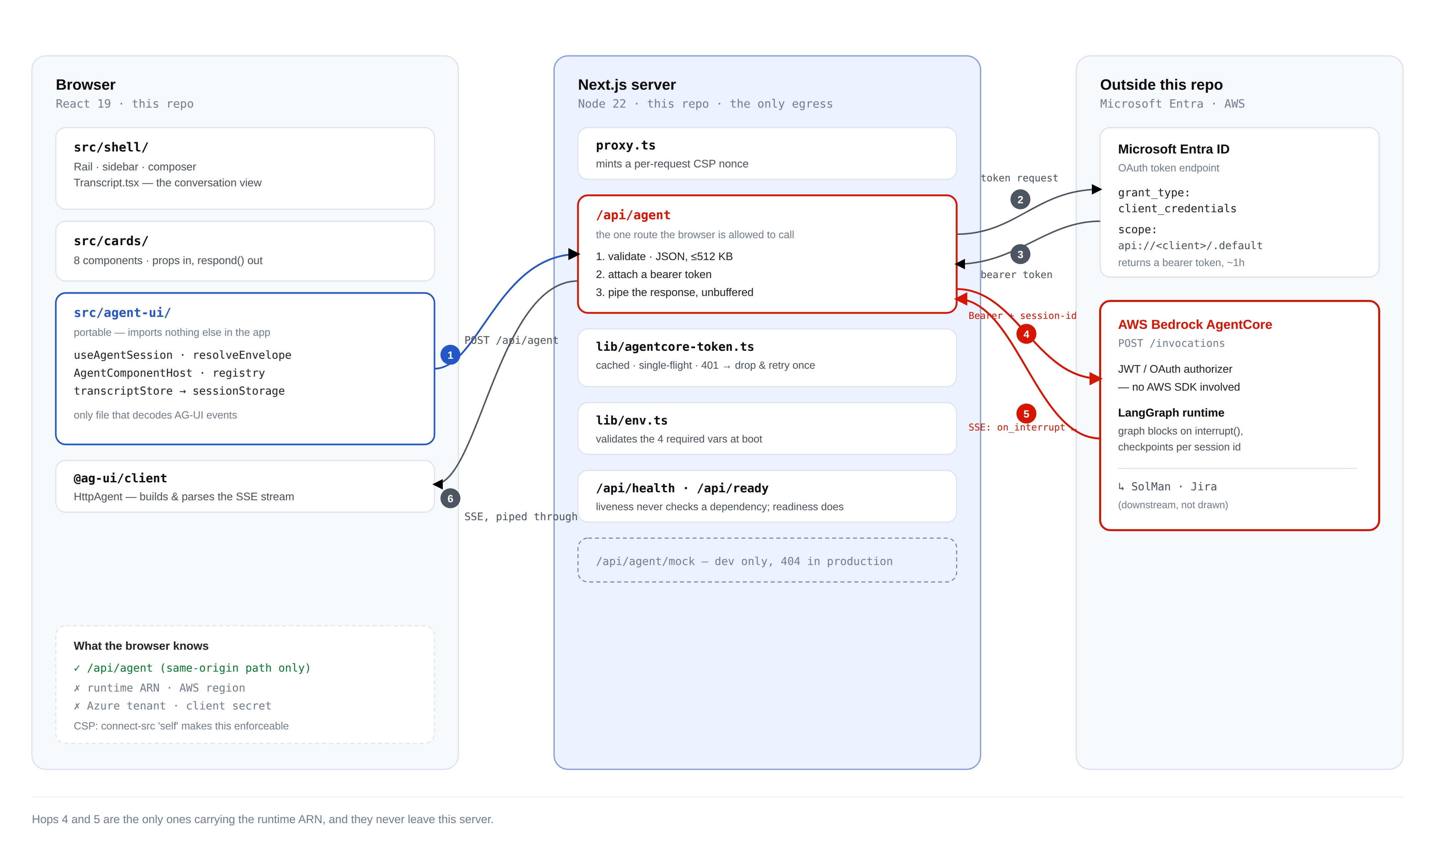
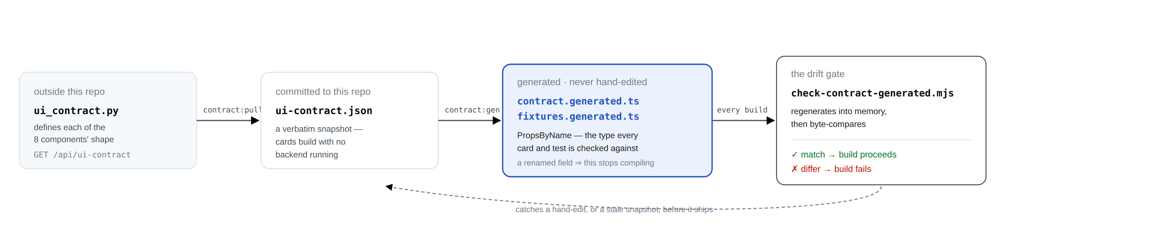
02 / 12
SYSTEM OVERVIEW
System architecture — runtime and build time
Runtime, six hops: agent-ui/ is the only browser code that understands AG-UI events; /api/agent is the only route allowed to hold the AgentCore runtime ARN and the Azure client secret. The secret stays server-side, the browser has no CORS to exploit, and one egress makes connect-src 'self' enforceable.
Build time: a separate mechanism, run before any request above. ui_contract.py (backend) is pulled into a committed ui-contract.json snapshot, generated into contract.generated.ts / fixtures.generated.ts, and byte-compared on every build — a hand-edit or a stale snapshot fails the build, not a blank card three weeks later.
CR/CO FRONTEND ARCHITECTURE

Slide 3
03 / 12
THE BASICS
What this app does, and why the agent can't ship UI
THE JOB
THE RULE
Raising a change request in SAP Solution Manager means filling about fifteen fields, spread across SolMan, Jira and a set of platform lookups.
Here, an agent asks one question at a time: it pulls what it can from Jira, proposes similar past CRs, drafts the request, and submits it after a human approves the draft.
The frontend's whole job: turn each question into a screen, and send the answer back.
An LLM can generate anything — including markup. This app is built so that never matters: the agent can only ever send this,
{ "version": 1, "name": "crModeChoice", "props": { … } }
a name and a props object. The frontend looks the name up in a fixed map of eight; it cannot send markup, because nothing renders markup — react/no-danger is a build error.
If the agent names a component that doesn't exist, the frontend renders a named fallback card explaining the problem — never a blank screen, never injected markup.
8 kinds of question · ~7 turns end to end · 1 HTTP endpoint (/api/agent). The first question is always crModeChoice — see the eight-component table on the next page.
CR/CO FRONTEND ARCHITECTURE

Slide 4
04 / 12
THE VOCABULARY
Eight components, and who owns them
COMPONENT | SCREEN IT PRODUCES
crModeChoice | Single vs. bulk change request
crIntakeForm | The core CR fields, prefilled where possible
templateOrCrPicker | Start from a template or a prior CR
cycleIdPicker | Choose the release / cycle
draftReview | Review the drafted request before submit
fieldPrompt | One missing field, asked directly
submissionResult | Success, failure, or partial outcome
featureComingSoon | A path not yet supported
TWO TEAMS, ONE LINE OF SEPARATION
The agent / backend decides and supplies all wording — titles, labels, prompts, error text — and controls which question comes next.
The frontend supplies the eight component implementations plus the validation layer, decides layout and interaction, and controls what happens to an unknown or malformed envelope.
The frontend contains no business text. A wrong word on screen is a backend change, not a frontend one — a config or prompt edit ships without a frontend deploy; a layout or new-component change does not.
CR/CO FRONTEND ARCHITECTURE

Slide 5
05 / 12
THE PROTOCOL
AG-UI: transport and the request
AG-UI (the Agent-User Interaction Protocol) is an open, event-based protocol maintained by CopilotKit that standardizes how AI agents connect to user-facing applications, over HTTP + Server-Sent Events by default. The spec defines ~16 event types across 5 categories; this app's graph only ever emits 8 of them.
Our client: @ag-ui/client, the HttpAgent class — one instance per thread.
Their server: ag-ui-langgraph 0.0.42, wrapping a LangGraph graph, running on AWS Bedrock AgentCore.
THE REQUEST — ONE RUNAGENTINPUT
ONE SHAPE, THREE JOBS
POST /api/agent
{
"threadId": "t-1764…", // the conversation
"runId": "…", // this one turn
"state": {}, "messages": [], // both unused here
"tools": [], "context": [],
"forwardedProps": { } // ← everything bespoke rides here
}
forwardedProps: {} — start the conversation
forwardedProps.command.resume — answer the open question
forwardedProps.lookup — a dropdown or Jira lookup, answered as JSON without waking the graph
Source: docs.ag-ui.com — Concepts: Events, and the ag-ui-protocol GitHub repository.
CR/CO FRONTEND ARCHITECTURE

Slide 6
06 / 12
INBOUND
The response: the SSE stream and the client's handlers
ONE SSE STREAM, SEVEN EVENTS
AGENT.SUBSCRIBE({…}) — FIVE HANDLERS, ONE REFUSED
RUN_STARTED lifecycle
STEP_STARTED lifecycle
CUSTOM on_interrupt ← THE CARD
STATE_SNAPSHOT ← fallback copy
MESSAGES_SNAPSHOT (empty — no chat)
STEP_FINISHED lifecycle
RUN_FINISHED lifecycle
onCustomEvent — on_interrupt gives the card; progress gives the status line
onTextMessageStart / Content / End — the draft, token by token
onStateChanged — merged state; the fallback copy of the card
onRunErrorEvent — surfaces the message
onRunFinishedEvent — does not mean the conversation ended; this backend finishes the run and leaves the interrupt pending
Two of seven carry payload; the rest are bookkeeping. The card arrives inside a CUSTOM event, not as a run outcome — worth flagging, since a reader of the AG-UI spec's lifecycle events would otherwise expect the other thing.
Refused: onStateDeltaEvent is deliberately unimplemented — reading agent.state inside it returns the state from before the patch, which silently dropped the card when the agent sent it as a delta. onStateChanged receives state already merged, so there's no patching to redo.
CR/CO FRONTEND ARCHITECTURE

Slide 7
07 / 12
MID-CONVERSATION
Streaming, and resuming a blocked graph
THREE THINGS STREAM. THE CARD DOES NOT.
RESUMING, ONCE THE CARD IS ON SCREEN
Progress — CUSTOM name:"progress" from inside a node: "Fetching Jira ticket AAZM-4668…". Without it, long steps look frozen.
Draft tokens — TEXT_MESSAGE_CONTENT deltas, appended as they land; node_6 writes the CR draft with a plain LLM call, so it relays as text.
State — snapshots and deltas, merged by the client before we ever see them.
The graph parks on interrupt(envelope), checkpointed, holding no connection.
An answer is a whole new run carrying forwardedProps.command.resume — there's no open socket to write to.
AgentCore keys the checkpoint on the runtime session id, derived from threadId and padded to 33 characters, because AWS requires that length.
onTextMessageContentEvent({ event }) {
if (event.messageId !== streamingMessageId.current) return; // guard
setDraftStream(prev => (prev ?? "") + event.delta);
}
Protocol detail: the AG-UI spec also defines a top-level resume field on the run input. This backend doesn't read it — accepted silently, graph never wakes. Resuming here always goes through forwardedProps.command.resume.
The card itself never streams — it arrives whole, in a single event, after the graph has stopped.
CR/CO FRONTEND ARCHITECTURE

Slide 8
08 / 12
ONE PAYLOAD, TRACED
The journey: agent → validated props → rendered card
① agent builds it { "title": "Create Change Request", "subtitle": "How would you like to proceed?",
"modes": [ {"value":"single","label":"Single CR",…}, {"value":"bulk","label":"Bulk CR",…} ] }
② wrapped { version: 1, name: "crModeChoice", props: ↑ }
③ encoded json.dumps(…) → a *string* ④ on the wire CUSTOM name:"on_interrupt" value:"{…}"
⑤ unwrapped unwrapInterruptValue() → object ⑥ validated resolveEnvelope() → version? name? props?
⑦ result { status:"ok", name:"crModeChoice", props: unknown }
Step ⑥ is the security boundary: version checked before name, name checked against COMPONENT_NAMES, props required to be an object. Anything failing becomes a named error, never a blank screen.
PROPS BECOME PIXELS
ONE CAST, ONE LINE
const Card = REGISTRY["crModeChoice"];
const props = resolution.props as PropsByName["crModeChoice"];
<Card props={props} respond={respond} pending={true} />
props crosses the transport as unknown; the contract guarantees its shape for a name that passed validation. Everything downstream of that single cast is fully typed.
Every readable word on the card — title, subtitle, both labels, both descriptions — came from the agent. The frontend supplied the radio, the spacing, and the type.
CR/CO FRONTEND ARCHITECTURE

Slide 9
09 / 12
CLOSING THE LOOP
The answer travels back — precedence and types
RESPOND(VALUE, LABEL) — TWO ARGUMENTS, TWO JOBS
PRECEDENCE: THE INTERRUPT WINS
respond("single", "Single Change Request")
└ value ┘ └──── label ─────┘
routes is displayed
Two channels can each carry the card — the CUSTOM interrupt and the STATE_SNAPSHOT fallback. The interrupt is re-delivered on every reconnect; state deliberately isn't resent. Built the other way round, the card blanks or reverts on reconnect, intermittently.
value routes the graph. It must not be prose — the approval guard is a substring test, so "Submit for Approval" contains no approve, and "I do not approve" contains one.
label is what the transcript shows the user; echoing approve back would expose routing internals.
WHERE THE TYPES COME FROM
ui_contract
.py
contract
:pull
ui-contract
.json
contract
:gen
types+
fixtures
registry
Why a transcript: it's the frontend's own record — the agent holds only the latest envelope. Every past turn is re-resolved through resolveEnvelope and re-rendered settled, so a refresh restores the full conversation.
Three kinds of drift, three different catchers — see the build-time diagram on the architecture page.
CR/CO FRONTEND ARCHITECTURE

Slide 10
10 / 12
WHEN IT GOES WRONG, AND HOW IT'S SHOWN
Failure handling and the live demo
EVERY FAILURE IS A NAMED CASE
FOUR DEV-ONLY ROUTES, TEN MINUTES
Five resolution states cover every outcome a submission can reach — including success with a null CR id, which renders as a failure rather than a false positive.
On /dev/session, run delta and text to show streaming live, then reconnect to demonstrate the precedence rule.
“Your request has not been lost.”
/dev/walkthrough
/dev/cards
/dev/session
/
All four 404 in a production build.
CR/CO FRONTEND ARCHITECTURE

Slide 11
11 / 12
STATUS
Where we are, and what we need
VERIFY
Complete — the streaming, contract-validation and precedence behavior this deck walks through.
Open — the app itself has no login of its own today; it inherits identity from the Azure AD session at the proxy.
Eight backend asks — the outstanding items this frontend is blocked on.
npm run verify
6 gates
106 tests
CR/CO FRONTEND ARCHITECTURE

Slide 12
In one sentence
The agent streams its intent over AG-UI; it may only name one of eight components; and every prop is validated before a single pixel is drawn.
REACT 19 · NEXT 16 · TYPESCRIPT STRICT · AG-UI OVER AWS BEDROCK AGENTCORE

