Slide 1
Making Pair Programming Work

Slide 2
The idea behind pair programming is of course very simple, essentially “two heads are better than one” most of the time.
In addition, in pair programming all code is always reviewed by at least one other person who is focussed on what the code needs to do.

Slide 3
There are no hard and fast rules to how to do this, there are things that can help:
1. Engage in a dialogue
2. Listen to each other
3. Take frequent breaks
4. Don’t be a back seat driver
5. Make pair programming practical
6. Use a common environment
7. Shared language and vocabulary
8. Allowing non-pair time
9. Change partners often

Slide 4
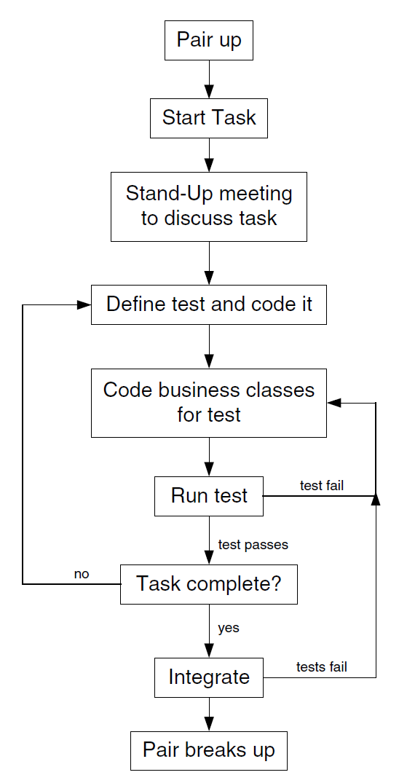
Typical pair programming workflow

