Slide 1
Module II
Extreme Programming

Slide 2
syllabus
Extreme Programming: Introduction, core XP values, the twelve XP practices about extreme programming, planning XP projects, test first coding, making pair programming work

Slide 3
Core XP values
Communication: communication b/w programmers, b/w end user and development teams, b/w developers and managers.
Simplicity: keep things simple, then easier to understand, easier to implement,test,maintain,easier to find and correct bugs in the s/w
But harder to write a simple code than a complex one
Feedback: should get feedback from the end users, from project stake
holders,
To identify the problems early on, deal with unknowns, and clarify issues
Courage: need the courage to refactor the code, courage to throw away code,

Slide 4
User stories
Developed by customers
Describing what the system needs to do
In practice developer may write down what the customer tells them
Eg: index cards
Each user story contains
Name
The purpose of story
Estimate how long it will take to implement
Relative importance(must have….should have ….could have)

Slide 5
12 XP practices
1.The planning game. This focuses on planning the next release.
2. Small releases. A software system is developed iteratively with small releases adding system features and allowing rapid feedback.
3. Simple design. Keep things as simple as possible .
4. Testing. Unit tests and acceptance tests must be continually developed and the code must pass unit tests for development to continue.
5. Refactoring. This involves improving the system implementation without changing the functionality.

Slide 6
6. Pair programming. All code is developed by developers working in pairs (at a single machine).
7. Collective ownership. Everyone owns all the code so anyone has the right to change any of the code at any time in order to improve it.
8. Continuous integration. New code is integrated and the system rebuilt every time a task is completed (which may be many times a day).
9. On-site customer. Have a real customer as part of the team, so that they are always available to answer questions.
10. Coding standards. Have them and use them.
11. 40-hour week. Work no more than 40hours a week so that the developers are always fresh and ready for the challenges facing them.
12. System metaphor. Use the system metaphor to guide the whole development. It is a metaphor for how the system operates (it is similar to the architecture of the system but typically simpler).

Slide 7
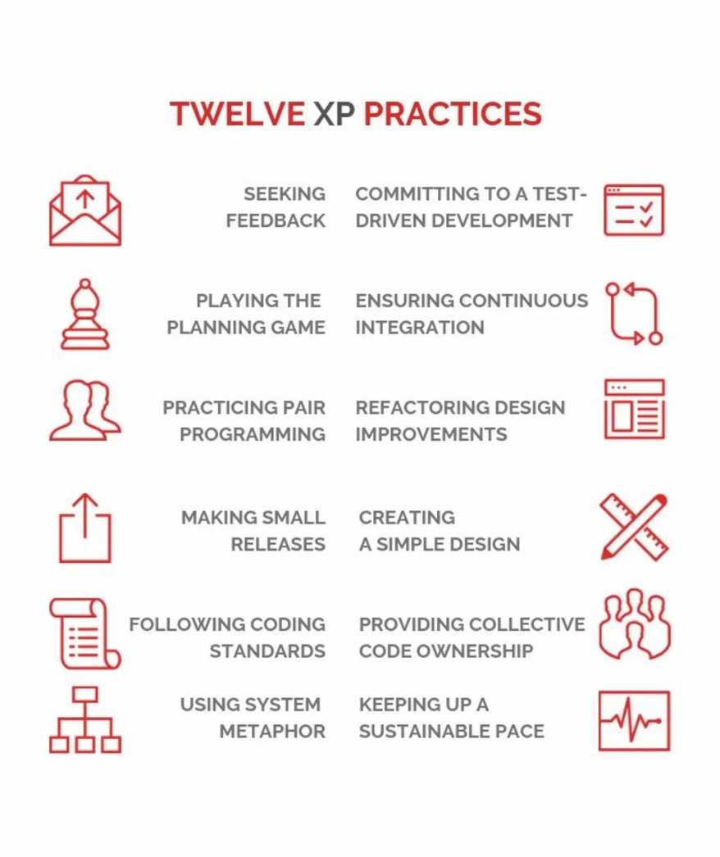

Slide 8
Roles
The Customer
The Customer role is responsible for making all of the business decisions regarding the project including:
What should the system do (What features are included and what do they accomplish)?
How do we know when the system is done (what are our acceptance criteria)?
How much do we have to spend (what is the available funding, what is the business case)?
What should we do next (in what order do we deliver these features)?
The XP Customer is expected to be actively engaged on the project and ideally becomes part of the team.

Slide 9
The Developer
Because XP does not have much need for role definition, everyone on the team is labeled a developer.
Developers are responsible for realizing the stories identified by the Customer.
Because different projects require a different mix of skills, and because the XP method relies on a cross functional team providing the appropriate mix of skills, the creators of XP felt no need for further role definition.

Slide 10
The Tracker
Some teams may have a tracker as part of their team.
This is often one of the developers who spends part of their time each week filling this extra role.
The main purpose of this role is to keep track of relevant metrics that the team feels necessary to track their progress and to identify areas for improvement.
Key metrics that your team may track include velocity, reasons for changes to velocity, amount of overtime worked, and passing and failing tests.

Slide 11
Trainer(coach):
This is usually an outside consultant or someone from your organization who has used XP before and is included in your team to help mentor the other team members on the XP Practices and to help your team maintain your self-discipline.
The main value of the coach is that they have gone through it before and can help your team avoid mistakes that most new teams make.

Slide 12
1. Planning an XP project
Planning is core to XP
Steps for planning
Start of making a rough plan quickly,
plan is gradually refined,
as more information become available, and as required features change
Plan for now: do the planning need for the next release
Responsibility: developers feel that the plan is as much as theirs as it is managers.
Dependencies: you should ignore the dependencies between parts
Should give highest business priorities first
Simplicity: keep things as simple as possible

Slide 13
Planning in detail:-The planning game relies on user (customer) stories to drive the iterations of the project
the primary output of the Business Game is the plan,
It allows customers to make business decisions,
allows developers to make technical decisions.
Within this framework the customer determines:
Scope – what is in and out of the system.
Priority – what is more important, less important, must haves and nice to haves, etc.
Composition of releases – what will be in each release.
Release dates

Slide 14
the development team decides
Estimates of how long various features will take.
Consequences of using a particular technology,
for example,
Linux Vs Microsoft Windows XP
Java Vs C#
Team and Project Organization (e.g. the organization of the tasks)
Risks associated with different features (e.g.will MySQL provide the required level of performance or should an Oracle database be used).
Detailed scheduling–which features are to be done when and in what order. This involves balancing the technical risks (which will beneﬁt from being addressed early on) with the business priorities that may be more important to the end user.

Slide 15
Planning game is comprised of 2 players
Business: made up of people can make decision about what the system should do
Development: made up of those who will be involved in implementing the system
Game has 3 phases through which the play proceeds
Exploration phase
Commitment phase
Steering phase

Slide 16
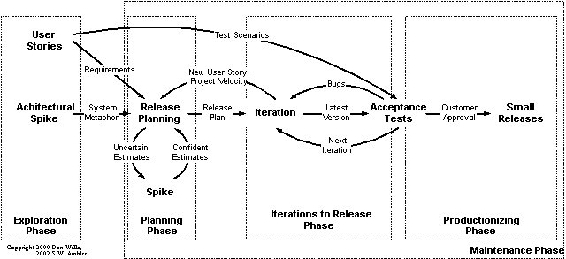

Slide 17
Elaboration phase:-
These phases help to identify what the system needs to do. It is compressed of the following steps:
Write a story–the business writes a user story describing some behavior required of the system.
Estimate a story–development estimates how long the story will take to implement. If they cannot estimate the story or the story seems too big then they can ask for clariﬁcation or break the story up into smaller chunks.
Break a story up – the business must break a story down into small chunks if required.

Slide 18
Commitment Phase :This phase allows business to determine the scope of the release and when that release will occur(based on information provided by development and business).
The steps within the commitment phase are:
Sort by value – business must sort the stories (written on index cards) into three plies (1) must have, (2) should have and (3) nice to have. This is effectively applying a relative priority to each story.
Sort by risk–Development now sorts the stories into three further piles(1)stories that can be estimated precisely, (2) stories that can be estimated roughly and (3) stories that can’t be estimated.
Set velocity – development indicates how quickly they will be able to achieve the estimates (which have been made in an idealized type of time).
Choose scope – Business selects which user stories will be in the next release

Slide 19
Steering Phase: The purpose of the steering phase is to allow the plan to be updated as things change over time due to
Changing requirements
New requirements
Changing priorities
Incorrect estimates
Changing resources
The steps in the steering phase are:
Iteration planning
Project Recovery
Identifying New story
Project Re-estimation

Slide 20
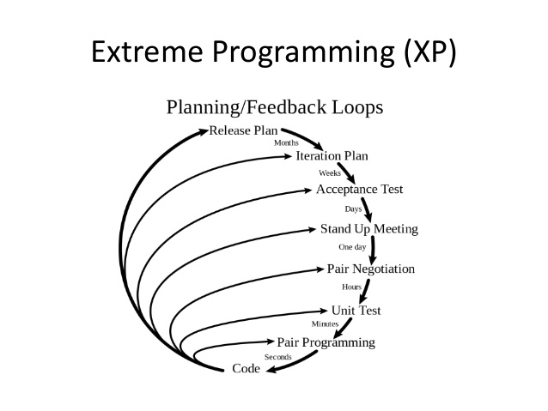

Slide 21
Iteration – from each iteration the business picks the stories that will form that iteration.
Recovery–if it is realized that not all the stories can be implemented for a particular iteration, then Development must ask Business to help determine which stories should remain in the iteration and which might be moved to later iterations.
Helps to re-prioritize the user stories
New Story – if Business realizes that an important story has been omitted, then it can introduce that story to Development. This story can be estimated and the iteration re-planned..
Re-estimate–if it is clear that the current plan was over or under optimistic, then Development can re-estimate the remaining user stories and adjust the project velocity and consider the resulting implications.

Slide 22
2.Small release:-
Developed system should be released often to end users
So the customers can provide rapid and frequent feedback to the development team
3.Simple design:-
Passes all the tests available for it
Has no duplicated logic
Ensure all assumptions made by developers are explicit to anyone reading the code.(understandability)
Has the fewest possible classes and methods.

Slide 23
4.Testing:-
Test first coding gives you…….
a complete set of tests for all code produced (as you created the tests ﬁrst).
simplest code that passes all tests.
a clear view of what code should and should not do.
a simple way of checking that refactored code has not altered functionality.
a great deal of “documentation” explaining what a particular modules should or should not do.
2 types of tests are mandatory in XP
Unit tests(produced by programmers)
Acceptance tests (by customers & end users)

Slide 24
5.Refactoring:-
The two points at which refactoring should occur are:
Before implementing a new feature. Re factoring performed at this point may make it easier to add the new feature.
After implementing a new feature. Refactoring at this point may help to make the resulting solution simpler.

Slide 25
6.Pair programming:-
2 developers working together at one machine
One focuses on the method, class or interface, etc. being implemented (this is the one with the keyboard and the mouse).
The second focuses on the more strategic issues such as how well does this solution ﬁt with the rest of the system, what are its implications, is there a simpler solution, do the tests cover all possibilities, etc.
Pairs change as tasks change ,thus you may Pair with several other developers within a single task

Slide 26
Benefits are
Two brains are better than one.
Knowledge of the system is spread amongst the team.
Test coverage maybe better as two people will bring two different perspectives with them.
Experience is spread amongst team
All code is dynamically reviewed by other one

Slide 27
7.Collective ownership:-
Every one owns all the system code
Every one should share the responsibility
Should not blame the team members for a problem
8.Continuous integration:-
Every time a task is completed, the resulting code should be integrated into the current build
The new code must pass all the unit tests.
If a problem cannot be resolved, then the new code cannot be released and the programmers must return to the source code.
They must then either rework the code until it passes the test

Slide 28
9.On-site customer:-
In XP, a customer should be part of the team so that such queries can be answered quickly and effectively allowing for rapid responses and rapid feedback.
On-site customers can also help to resolve disputes
Helps to set priorities
10.Coding standards:-
It avoids wasted arguments over silly things such as where brackets should go (on the same line or the next line) within a Java statement.
It means that everyone gets familiar with the style of coding to be adopted which makes code easier to read.
Simple guidelines such as “All constants in capitals” mean that as soon as such a convention is seen its meaning is known immediately.
Helps to create an environment where code becomes de-personalized.
Helps make activities such as refactoring and pair programming easier.

Slide 29
40 hour work per week:-
An XP team should be enthusiastic, full of energy, and ready for challenges facing them.
They should be fresh and eager.
So should keep this rule
System Metaphor:-
Less detailed than the architectural design
Providing developers with an overview of the core element and how they fit together rather than provide detailed description.

Slide 30
What Is So Extreme About Extreme Programming?
Extreme Programming is very lightweight – it really only focuses on the programming of a software system.
2. Extreme Programming takes the best practices to their ultimate conclusions.

Slide 31
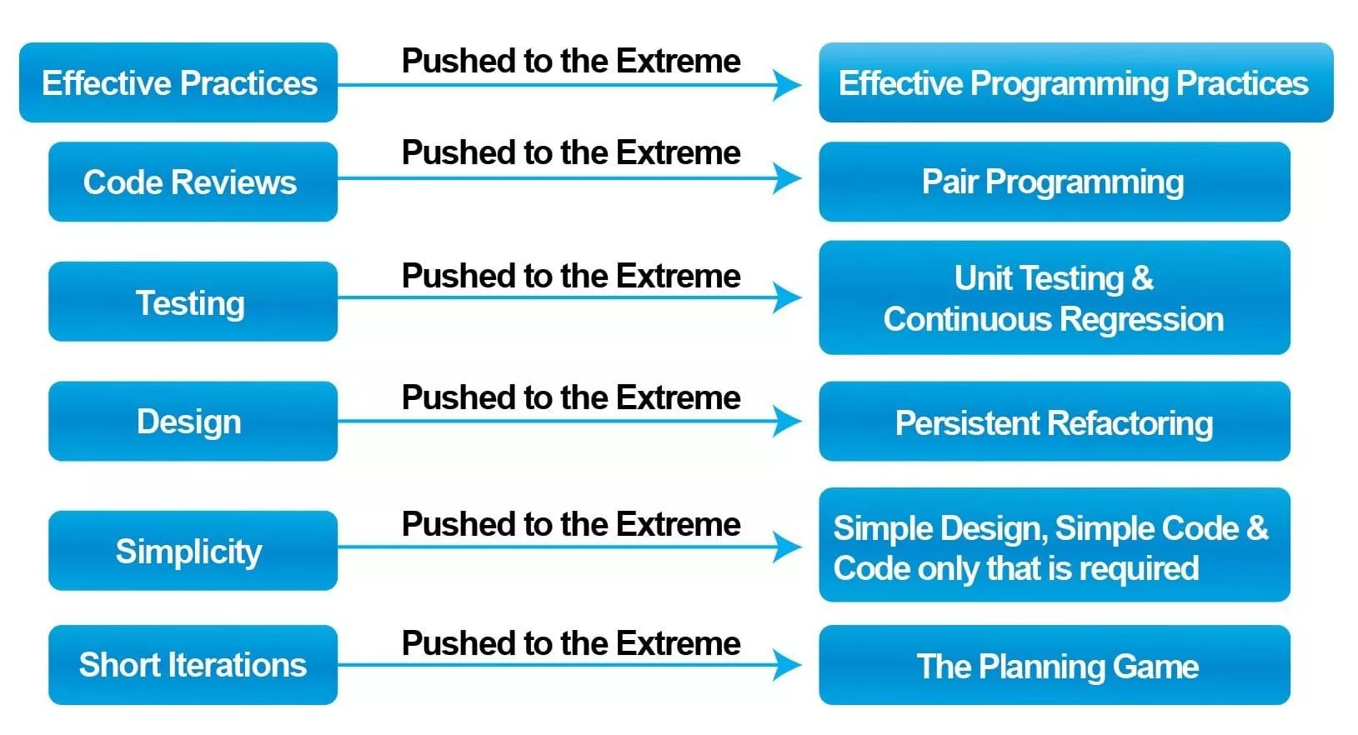

Slide 32
If we consider the second point in more detail, the concept goes as follows:
1. If code reviews are good, then review code all the time (pair programming).
2. If testing is good, every body will test all the time (unit testing), even customers (acceptance testing).
3. If designing is good, then make it part of what everyone does everyday(refactoring).
4. If simplicity is good, then always strive for the simplest effective solution (i.e., the simplest solution that works).
5. If architecture is important, then ensure that everyone is involved in creating and reﬁning the architecture all the time (system metaphor).
6. If integration testing is good, then integration and testing should be an on going (daily or even hourly) thing (continuous integration).
7. If short iterations are good, then make them as short as possible, i.e., hours, or days not weeks and months (the Planning Game).

Slide 33
Planning XP project
Playing the Planning Game:-
The planning game has only two conceptual players;
Business: formed from those stakeholders who can specify the operation of the system
Development: formed from members of the development team relevant to the features being discussed
The number and size of each “team” may change over time
The Goal of the Game
to maximize the value of the software produced by the team.

Slide 34
The Strategy
The main strategy of the game is to invest as little as possible to put the most valuable functionality into production as quickly as possible, but without compromising the required product quality.
The Game Pieces
The pieces used by the two players are the “user stories
user stories can be written down on
whiteboards,
scrapes of paper,
Index cards(most preferable)entered into a software system for recording and reference.

Slide 35
Players:-
Business
Development
The Moves /Playing the Game
There are three stages to play the planning game.
1. Exploration – Determine new user stories of the system.
2. Commitment–Decide which features will be addressed in a particular release.
3. Steering – Update the plan as development progresses
Ideal Engineering Time(IDE): is the amount of development that could be achieved in a single day by the average developer without any interruptions, where there are no dependencies and no un foreseen interruptions

Slide 36
Commitment Phase:-
Commitment Phase :This phase allows business to determine the scope of the release and when that release will occur(based on information provided by development and business).
The steps within the commitment phase are:
Sort by value – business must sort the stories (written on index cards) into three plies (1) must have, (2) should have and (3) nice to have. This is effectively applying a relative priority to each story.
Sort by risk–Development now sorts the stories into three further piles(1)stories that can be estimated precisely, (2) stories that can be estimated roughly and (3) stories that can’t be estimated.
Set velocity – development indicates how quickly they will be able to achieve the estimates (which have been made in an idealized type of time).
Choose scope – Business selects which user stories will be in the next release

Slide 37
Steering Phase: The purpose of the steering phase is to allow the plan to be updated as things change over time due to
Changing requirements
New requirements
Changing priorities
Incorrect estimates
Changing resources
The steps in the steering phase are:
Iteration planning
Project Recovery
Identifying New story
Project Re-estimation

Slide 38
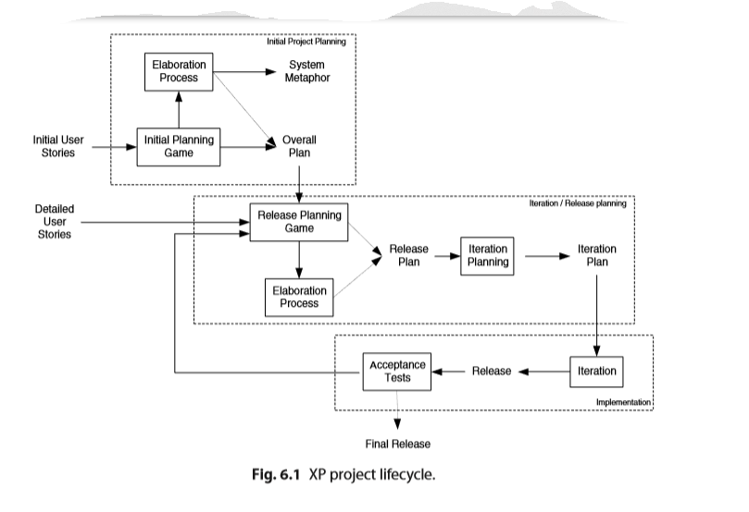

Slide 39
Planning Your XP Project:-
There are actually two forms of the planning game:
1. The initial planning game, and
2. The release planning game. ,
a typical XP project might be planned in the following manner:
1. An initial planning game (aims to get overall view of project);
2. Initial elaboration process (focusing on high level user stories);
3. Release 1 planning game;
4. Release 1 elaboration process (if required);
5. Plan iteration 1;
6. .... Release 1 iteration/implementation ...;
7. Release 2 planning game;
8. Release 2 elaboration process (if required);
9. Plan iteration 2;
10. ...Release 2 iteration/implementation ...;

Slide 40
11. ...
12. Release n Planning game;
13. Release n Elaboration process (if required);
14. Plan iteration n;
15. ...Release n iteration/implementation.

Slide 41
The Initial Planning Game
focuses on what the system as a whole should do.
It considers all user stories that are in scope (and indeed what that scope is).
It happens at the start of the project and may reconvene at various points throughout the lifetime of the project to review the scope of the system, the set of user stories, their relative priorities, etc.

Slide 42
The Release Planning Game:-
User stories need to be ﬂeshed out and may need to be broken down into ﬁner grained stories
2. Detailed estimates of the stories need to be obtained.
3. The user stories to be implemented as part of the release need to be conﬁrmed, revised or modiﬁed as required.
4. The project velocity may need to be revised. For example, as the development team become more experienced in XP and the application in which you may ﬁnd development speeds up.

Slide 43
The Elaboration Process:-
Clarify the user stories, requirements, technical issues
Aims are :-
Lower the risk of bad estimates,
Experiment/prototype different solutions,
Improve the development teams to understand the domain/technology,
Ensure procedures and processes required are in place.
.

Slide 44
Iteration planning:-
Iteration planning usually incorporates the following phases:
1. Evaluation of the last iterations lessons learned, changes to be made, etc.
2. Review of user stories to incorporate into the iteration.
3. Task exploration during which tasks are written for user stories
Task commitment during which tasks are estimated, load factors determined and balancing takes place.
5. Finally, the iteration plan is veriﬁed.

Slide 45
Size of an iteration.
How do you determine how big an iteration should be?
How long is a piece of string?
an iteration needs to be big enough to allow either a new release to be created that adds value to the business or large enough that you are able to make signiﬁcant progress.
It should also be small enough that the development does not move on too far without being reviewed.
The classic length of time for an XP iteration ranges from 1 to 3 weeks
Iteration can be planned in either of these ways:-
1.select one task at a time
2.”fill your bag”

Slide 46
Test first coding:-
When you write code you should also write the unit tests that go with it to verify that code
you should write the tests before you write the code.
clearly focus on what the code needs to do before determining how it will be done
1.How to Write Tests First?
Think about what the code should do and try to ignore how it will do
Now write a test that will use the classes and methods you haven’t yet implemented!

Slide 47
If you haven’t already done so,then write the stub code for the class(es) being tested
Now put the code you have created for the test into whatever project code repository you are using
Now run your newly created test against the stub code.
Now you are in a position to actually write the implementation of the methods being tested
Rerun your tests against the newly implemented methods. If all the tests pass, then continue.
Now re-run the tests for the entire system.
Refactor your code for clarity and to remove any duplication

Slide 48
2.What to test?
Write tests for any tasks being implemented.
2. Write tests for any classes or combinations of classes
3. Avoid writing tests for methods that just call another method.
4. Assume that more tests are better then less and that no one will complain about having too many tests, but that people will complain if an important test is missing.
5. Write tests that instill conﬁdence in the system.
6. Add tests that will help cover areas of the system being modiﬁed.
7. If you happen to notice that a suite of tests for a particular module, subsystem or class appears to be missing in one or more tests, then add them.

Slide 49
3.confidence in the test suite:-
your ability to refactor and prove that you have not changed the functionality of the system;
2. the guarantee that if you code in a test ﬁrst manner, that you have produced the simplest code that covers the requirements.

Slide 50
Making pair programming work:-
pair programming isn’t easy, actually it’s quite hard, bcz programmers have been trained to work alone
It needs interpersonal skills, pair dynamics, communication, tolerance and trust.
Pair programmer’s role
Driver
Navigator

Slide 51
Guide lines for pair programming:-
Engage in a dialogue
Listen to each other
Take frequent breaks
Don’t be a back seat driver
Make pair programming practical
Use a common environment
Shared language and vocabulary
Allowing non-pair time
Change partners often

Slide 52
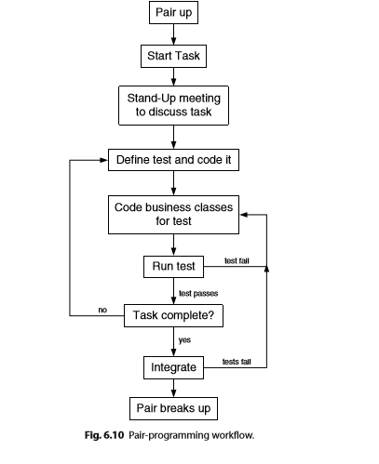

Slide 53
Who will be the core participants of planning game in XP projects?
What are the objectives and out come during planning game?
What is pair programming?
Demonstrate pros and cons faced by agile team when they adopt to this approach
What is TDD(Test Driven Development)? which agile model adopt TDD?
Write short note on test first coding
Explain XP programming
Explain core XP values
Illustrate planning XP projects with an example

