Slide 1
module I AGILE SOFTWARE DEVELOPMENT

Slide 2
Module I syllabus
INTRODUCTION: What is Agile? The Agile manifesto, Agile methods, XP: Extreme Programming, DSDM,SCRUM, feature-Driven Development, modeling misconceptions, agile modelling, tools of misconceptions, updating agile models.

Slide 3
What is agile?
Agile adj. nimble, quick-moving
Agile is a software development approach where a self-sufficient and cross-functional team works on making continuous deliveries through iterations and evolves throughout the process by gathering feedback from the end-users.

Slide 4
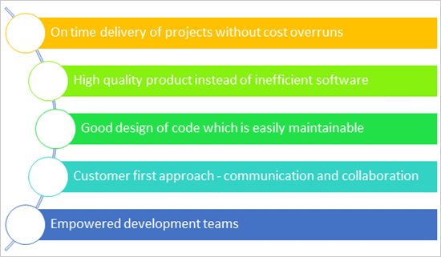
What are agile promises

Slide 5
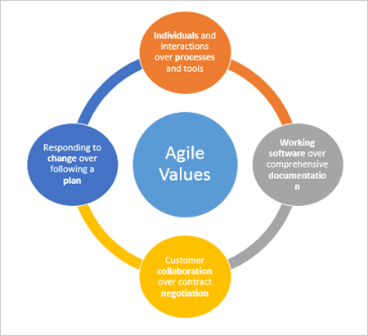
The 4 Agile Values

Slide 6
1) Individuals and Interactions over Processes and Tools
it’s always preferable to have interactions and communication amongst the team members rather than blindly depending on processes to guide the way forward. One of the ways to achieve this is by having an involved product owner who works and can make decisions in collaboration with the development team.
2) Working Software over Comprehensive Documentation
The kind of documentation created for these projects was very detailed and so many documents were created that many of them were not even referred to during the project progress. This was an unnecessary evil with which the project teams used to live with.

Slide 7
3. Customer Collaboration Over Contract Negotiation
What agile says is that instead of negotiation, go for collaboration.
Collaboration implies that there is still room for discussion and the communication is ongoing.
4. Responding to Change Over Following a Plan
The standard thought process is that the changes are an expensive affair and we should avoid changes at all costs. That’s what the unnecessary focus is on documentation and elaborate plans to deliver by sticking onto the timelines and product specifications.

Slide 8
The agile manifesto
Twelve Principles of Agile Manifesto
Customer Satisfaction − Highest priority is given to satisfy the requirements of customers through early and continuous delivery of valuable software.
Welcome Change − Changes are inevitable during software development. Ever-changing requirements should be welcome, even late in the development phase. Agile processes should work to increase customers' competitive advantage.
Deliver a Working Software − Deliver working software frequently, ranging from a few weeks to a few months, considering a shorter time-scale.
Collaboration − Business people and developers must work together during the entire life of a project.
Motivation − Projects should be built around motivated individuals. Provide an environment to support individual team members and trust them so as to make them feel responsible to get the job done.
Face-to-face Conversation − Face-to-face conversation is the most efficient and effective method of conveying information to and within a development team.

Slide 9
Measure the Progress as per the Working Software − Working software is the key and it should be the primary measure of progress.
8.Maintain Constant Pace − Agile processes aim towards sustainable development. The business, the developers, and the users should be able to maintain a constant pace with the project.
How do you achieve a sustainable pace?
A sustainable pace is achieved through proper planning, commitment to goals at all levels in the organization and collaboration and communication up, down, and across the company
9.Monitoring − Pay regular attention to technical excellence and good design to enhance agility.
10.Simplicity − Keep things simple and use simple terms to measure the work that is not completed.
11.Self-organized Teams − An agile team should be self-organized and should not depend heavily on other teams because the best architectures, requirements, and designs emerge from self-organized teams.
12.Review the Work Regularly (introspection)− Review the work done at regular intervals so that the team can reflect on how to become more effective and adjust its behavior accordingly.

Slide 10
Agile methods
What are agile methods?
methodology that is focused on trying to produce a working solution and be able to respond to changing user/client requirements.
agile methodologists have tried to devise methods that move from
heavyweight to lightweight processes,
document-oriented to code-oriented objectives,
predictive to adaptive methods,
process-oriented to people-oriented activities

Slide 11
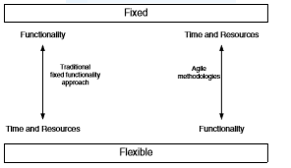

Slide 12
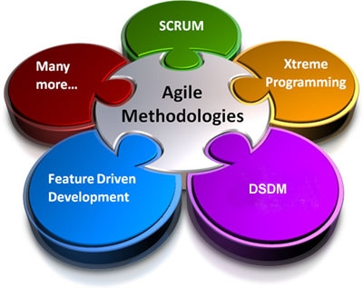
How to practice agile?

Slide 13
XP: Extreme programming
XP is a lightweight, efficient, low-risk, flexible, predictable, scientific, and fun way to develop a software.
eXtreme Programming (XP) was conceived and developed to address the specific needs of software development by small teams in the face of vague and changing requirements.
Four basic principles of XP
Communication
Simplicity
Feedback
courage

Slide 14
Embrace Change
A key assumption of Extreme Programming is that the cost of changing a program can be held mostly constant over time.
This can be achieved with −
Emphasis on continuous feedback from the customer
Short iterations
Design and redesign
Coding and testing frequently
Eliminating defects early, thus reducing costs
Keeping the customer involved throughout the development
Delivering working product to the customer

Slide 15
Extreme Programming involves −
Create test before coding and test heavily:-Writing unit tests before programming and keeping all of the tests running at all times. The unit tests are automated and eliminates defects early, thus reducing the costs.
Starting with a simple design just enough to code the features at hand and redesigning when required.
Programming in pairs (called pair programming), with two programmers at one screen, taking turns to use the keyboard. While one of them is at the keyboard, the other constantly reviews and provides inputs.
Short iterations:-Putting a minimal working system into the product quickly and upgrading it whenever required.
Stay in contact with the customer:-Keeping the customer involved all the time and obtaining constant feedback.
Collective ownership:-does not support cultural blame and recrimination-every one is responsible for all the code

Slide 16
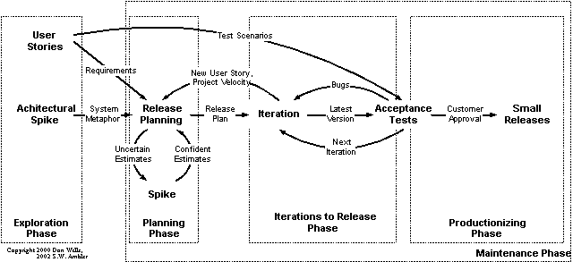
XP lifecycle

Slide 17
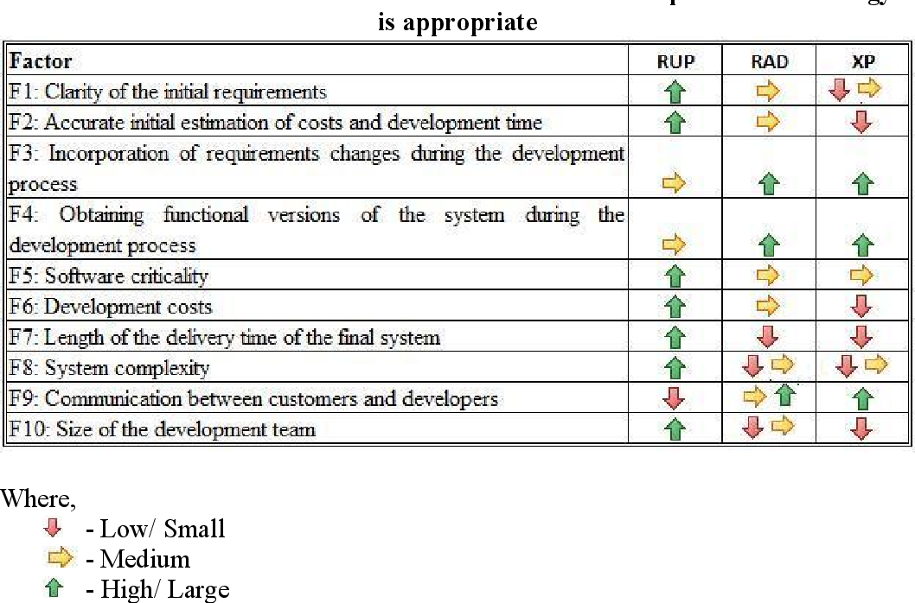

Slide 18
Extreme Programming Advantages
Extreme Programming solves the following problems often faced in the software development projects −
ensure timely deliveries.
− Focus on continuous customer involvement ensures transparency with the customer and immediate resolution of any issues.
− Extensive and ongoing testing makes sure the changes do not break the existing functionality. A running working system always ensures sufficient time for accommodating changes such that the current operations are not affected.
− the unit tests to detect and fix the defects early.
− Making the customer a part of the team ensures constant communication and clarifications.
− Changes are accommodated at any point of time.
− Intensive team collaboration ensures enthusiasm and good will. Cohesion of multi-disciplines fosters the team spirit.

Slide 19
Why is XP controversial?
XP is a hackers paradise or at the very least encourages hacking
XP Programmers get to work in pairs
XP doesn’t force team members to specialize and become analysts, architects, programmers, testers, and integrators
XP doesn’t conduct a complete up-front analysis and design of the system
XP promotes the development of the systems’ infrastructure and its frameworks as you develop your application
XP does not encourage the creation and maintenance of implementation documentation
XP is not a complete methodology

Slide 20
DSDM
Dynamic Systems Development Method (DSDM)
Suitable for RAD
suitable for application development projects that need to develop complex business solutions within tight frame work
DSDM focuses on delivery of the business solution, rather than just team activity.
It makes steps to ensure the feasibility and business sense of a project before it is created.
It stresses cooperation and collaboration between all interested parties.
DSDM makes heavy use of prototyping to make sure interested parties have a clear picture of all aspects of the system.

Slide 21
Core Concepts in DSDM
The following bullet list describes the core concepts of DSDM.
1.Active User Involvement
The people who will be using the product must be actively involved in its development. This important in order for the product to end up being useful to the people who will be using it.
2.The Team Must Be Empowered to Make Decisions
The team should be able to make rapid and informed decisions, without having to cut through red tape to get those decisions approved.
3.Frequent Releases
DSDM focuses on frequent releases. Frequent releases allow for user input at crucial stages in the product's development. They also ensure that the product is able to be released quickly at all times.
4.Iterative Development, Driven by User Feedback
The development of the system is done in iterations, which allows for frequent user feedback, and a partial but prompt solution to immediate needs, with more functionality being added in later iterations.
5.Changes Must Be Reversible
All products should be in a fully known state at all times. This allows for backtracking if a certain change does not work out well.

Slide 22
6.Requirements are Initially Defined at a High Level
High-level requirements are worked out at the beginning of the project, before any coding, leaving the details to be worked out during the course of the development.
7.Fitness for Business Purpose is the Goal
Meeting the business need is more important than technical perfection.
8.Integrated Testing
Testing is done at every step of the way, to ensure that the product being developed is technically sound and does not develop any technical flaws, and that maximum use is made of user feedback.
9.Collaboration and Cooperation are Essential
Collaboration and cooperation between all interested parties are essential for the success of the project. All involved parties (not just the core team) must strive together to meet the business objective.
10.20% / 80% Rule (pareto principle)
DSDM assumes that 80% of the solution can be developed in 20% of the time that it would take to produce the total solution. DSDM focuses on this 80%, leaving another 20% for later revisions. DSDM assumes that not all of the requirements for the final solution are known to begin with, so it is likely that the final 20% of non-essential features are likely to be flawed anyway.

Slide 23
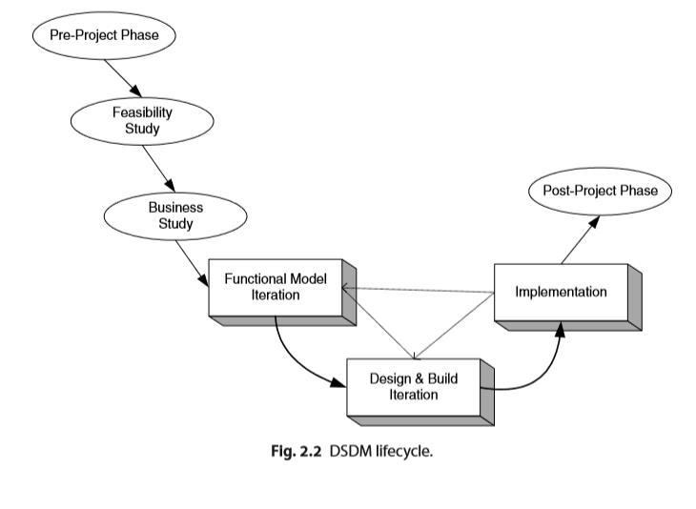

Slide 24
The Phases of DSDM
The DSDM framework consists of three sequential phases,
namely the pre-project, project life-cycle and post-project phases.
The project phase of DSDM is the most elaborate of the three phases.
The project life-cycle phase consists of 5 stages that form an iterative step-by-step approach in developing an IS.
The three phases and corresponding stages are explained extensively in the subsequent sections.
For each stage/phase, the most important activities are addressed and the deliverables are mentioned.
Phase 1: The Pre-Project
In the pre-project phase candidate projects are identified, project funding is realized and project commitment is ensured. Handling these issues at an early stage avoids problems at later stages of the project.

Slide 25
Phase 2: The Project life-cycle
The process overview in the figure above shows the project life-cycle of this phase of DSDM.
It depicts the 5 stages a project will have to go through to create an IS.
The first two stages, the Feasibility Study and Business Study are sequential phases that complement to each other.
After these phases have been concluded, the system is developed iteratively and incrementally in the Functional Model Iteration, Design & Build Iteration and Implementation stages.

Slide 26
Feasibility Study
Business Study
Functional Model Iteration
Design and Build Iteration
Implementation
Phase 3: Post-project
The post-project phase ensures the system operating effectively and efficiently. This is realized by maintenance, enhancements and fixes according to DSDM principles.
The maintenance can be viewed as continuing development based on the iterative and incremental nature of DSDM.
Instead of finishing the project in one cycle usually the project can return to the previous phases or stages so that the previous step and the deliverable products can be refined.

Slide 27
First 3 phases are done sequentially in order
Output of feasibility study phase is “feasibility report”
The Business Study phase of the projects should have three outputs; these should be the
Business Area Deﬁnition(BAD),
The System Architecture Deﬁnition(SAD) and
The Outline Prototyping plan
Business Area Deﬁnition :-Identiﬁes the high-level requirements and provides a process description of the end product.
System Architecture Deﬁnition:- Sketches out the architecture of end system.
Outline Prototyping Plan:-
This states the prototyping strategy to be adopted for the development of the end product.

Slide 28
The core phases of the DSDM are the FMI, the DBI and the Implementation Phase
The FMI(Functional Model Iteration) Phase involves:
Analysis of the features to be designed and implemented.
The production of the Functional Model. It may include prototype code as well as analysis models.
Coding and prototyping

Slide 29
The DBI(Design & Build Iteration) Phase involves:
Designing and Building the features to be implemented during this phase.
This involves reviewing the designs produced so far, the functional prototypes, as well as the creation of code to implement the required functionality.
The primary output of this state is the tested system. This system must meet all the requirements selected as essential in the particular iteration being implemented.

Slide 30
The Implementation Phase involves:
The transfer of the completed system from the development environment to the production environment
The provision of other deliverables such as User training, the creation of the User Manual and the Project Review Report.
If issues arise, then the project can be reiterated back to the appropriate phase.

Slide 31
Core Techniques of DSDM
Time boxing
MoScow
Prototyping
Testing
Workshop
Modelling
Configuration Management

Slide 32
DSDM reﬁnes the concept of time boxing by nesting shorter time boxes of 2–6 weeks within the overall time frame.
Each time box will typically pass through three phases.
Investigation – a quick pass to see whether the team is taking the right direction.
Reﬁnement–to build on the comments resulting from there view at the end of investigation.
Consolidation – the ﬁnal part of the time box to tie up any loose ends.

Slide 33
The prioritized requirements are checked and reassigned using MosCoW rules
Must haves: fundamental to the projects success “on time”
Should haves: important but the projects success does not rely on these
Could haves: can easily be left out without impacting on the project “on budget”
Won’t have this time round: can be left out this time and done at a later date.
A clear prioritization is developed ensuring that the essential work is completed within the given timeframe.

Slide 34
SCRUM
Scrum is one of the implementations of agile methodology. In which incremental builds are delivered to the customer in every two to three weeks' time.
Scrum is ideally used in a project where the requirement is rapidly changing.
In Scrum, collaboration is achieved in daily stand-up meeting with a fixed role assigned to the scrum master, product owner, and team members.
Not too many changes are needed while implementing the scrum process.
n the scrum, after each sprint, a build is delivered to the client for their feedback.
https://youtu.be/XU0llRltyFM: video link

Slide 35
A demonstration of the functionality is provided at the end of every sprint. So that regular feedback can be taken before next sprint.
There is no team leader, so the entire team addresses the issues or problems.
Daily sprint meeting is conducted to review and feedback to decide future progress of the project.
Empirical Process Control is a core philosophy of Scrum based process.
Working software is not an elementary measure.
Scrum team focus to deliver maximum business value, from beginning early in the project and continuing throughout.

Slide 36
Following are scrum principles:
-Self-organization: This results in healthier shared ownership among the team members. It is also an innovative and creative environment which is conducive to growth.
-Collaboration: Collaboration is another essential principle which focuses collaborative work. 1. awareness 2. articulation, and 3. appropriation. It also considers project management as a shared value-creation process with teams working together to offer the highest value.
-Time-boxing: This principle defines how time is a limiting constraint in Scrum method. An important element of time-boxed elements are Daily Sprint planning and Review Meetings.
-Iterative Development: This principle emphasizes how to manage changes better and build products which satisfy customer needs. It also defines the organization's responsibilities regarding iterative development.

Slide 37
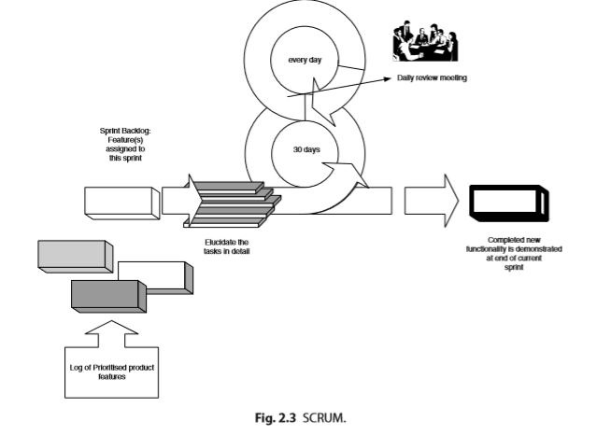

Slide 38
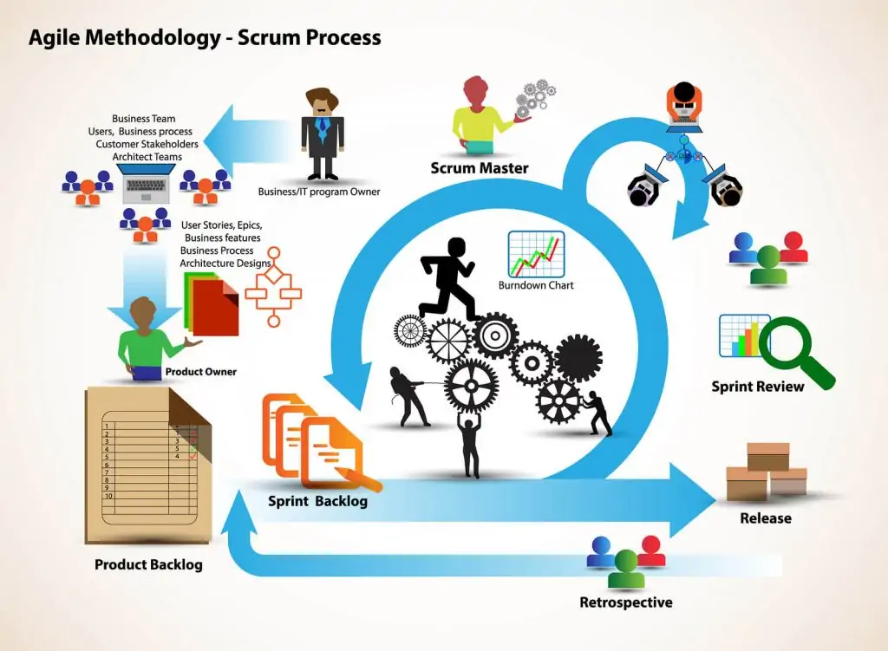

Slide 39
overview of the Scrum Framework
The product owner creates a product backlog (essentially, a wish list of tasks that need to be prioritized in a project)
The Scrum team conducts a sprint planning session where the tasks necessary to complete items on the wish list is broken down into small, more easily manageable chunks
The team creates a sprint backlog and plans its implementation
The team decides a time duration for every sprint (the most common intervals is probably two weeks)
The team gets together every day for a brief Scrum meeting (often referred to as a Daily Standup) where each member of the team shares daily updates, helping the team and the project manager assess the progress of the project
The Scrum Master guides the team and keeps them focused and motivated
The stakeholders and the product owner conduct a review at the end of each sprint
This is the cycle followed by a Scrum team in a product development project.

Slide 40
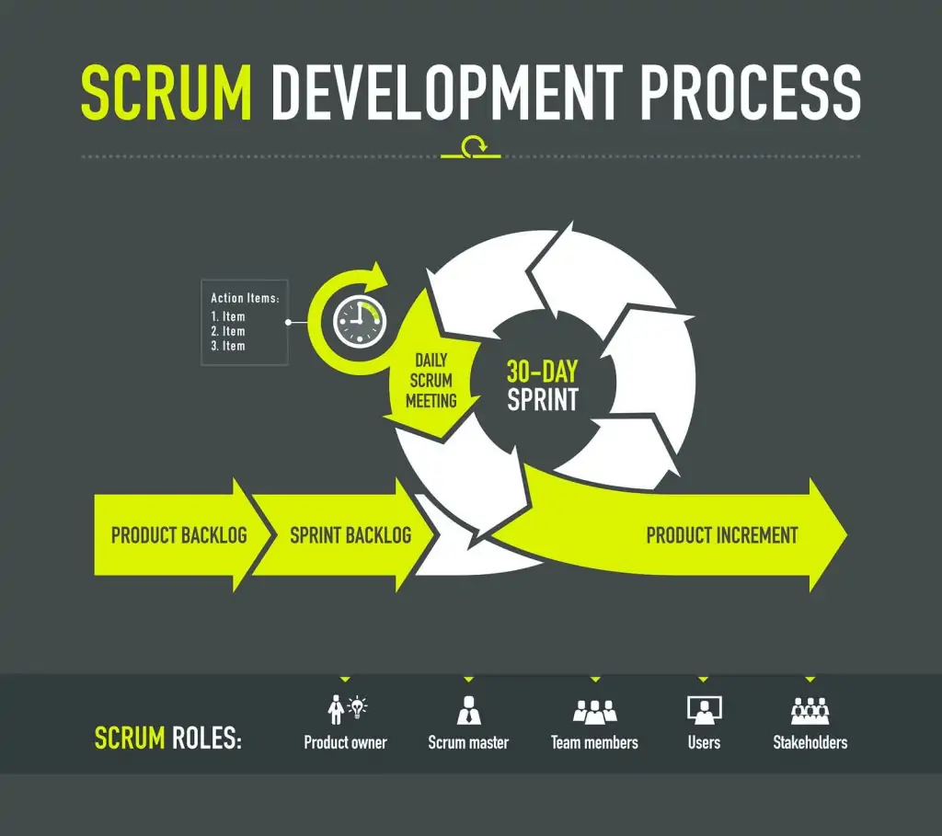

Slide 41
Events in Scrum
Sprint: Sprint is the basic unit of work for a Scrum team. This is the main feature that marks the difference between Scrum and other models for agile development.
Sprint Planning:
To define what is going to be done in the Sprint and how it is going to be done.
This meeting is held at the beginning of each Sprint and is defined how it will approach the project coming from the Product Backlog stages and deadlines.
Each Sprint is composed of different features.

Slide 42
Daily Scrum:
To evaluate the progress and trend until the end of the Sprint, synchronizing the activities and creating a plan for the next 24 hours.
It is a brief meeting that takes place daily during the Sprint period.
Three questions are answered individually: What did I do yesterday? What am I going to do today? What help do I need? The Scrum Master should try to solve problems or obstacles that arise.
Sprint Review:
To show what work has been completed with regards to the product backlog for future deliveries.
The finished sprint is reviewed, and there should already be a clear and tangible advancement in the product to present to the client.

Slide 43
sprint Retrospective:
The team reviews the completed goals of the finished sprint, write down the good and the bad, so as not to repeat the mistakes again.
This stage serves to implement improvements from the point of view of the development process.
The goal of the sprint retrospective is to identify possible process improvements and generate a plan to implement them in the next Sprint.

Slide 44
What Is a Burn down Chart in scrum?
a graphic representation of how quickly the team is working through a customer’s user stories,
an agile tool that is used to capture a description of a feature from an end-user perspective.
The burn down chart shows the total effort against the amount of work for each iteration.
The quantity of work remaining is shown on a vertical axis,
while the time that has passed since beginning the project is placed horizontally on the chart, which shows the past and the future.
The burn down chart is displayed so everyone on the team can see it and is updated regularly to keep it accurate.

Slide 45
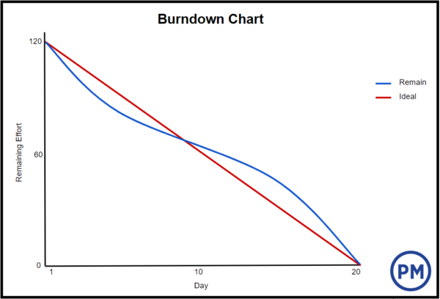
Ideal Work Remaining Line
a straight line connecting the start point to the end point.
It shows the sum of the estimates for all the tasks that need to be completed.
At the end point, the ideal line crosses the x-axis and shows there is no work left to be done. This line is based on estimates and therefore not always accurate.
Actual Work Remaining Line
Then there is the actual work remaining line that shows the actual work that remains in the project or iteration.
At the beginning the actual work remaining and the ideal work remaining are the same, but as the project or iteration progresses the actual work line will fluctuate above and below the ideal work line.
Each day a new point is added to this line until the project or iteration is done to make sure it’s as accurate as possible.
If the actual work line is above the ideal work line, it means there is more work left than originally thought. In other words, the project is behind schedule.

Slide 46
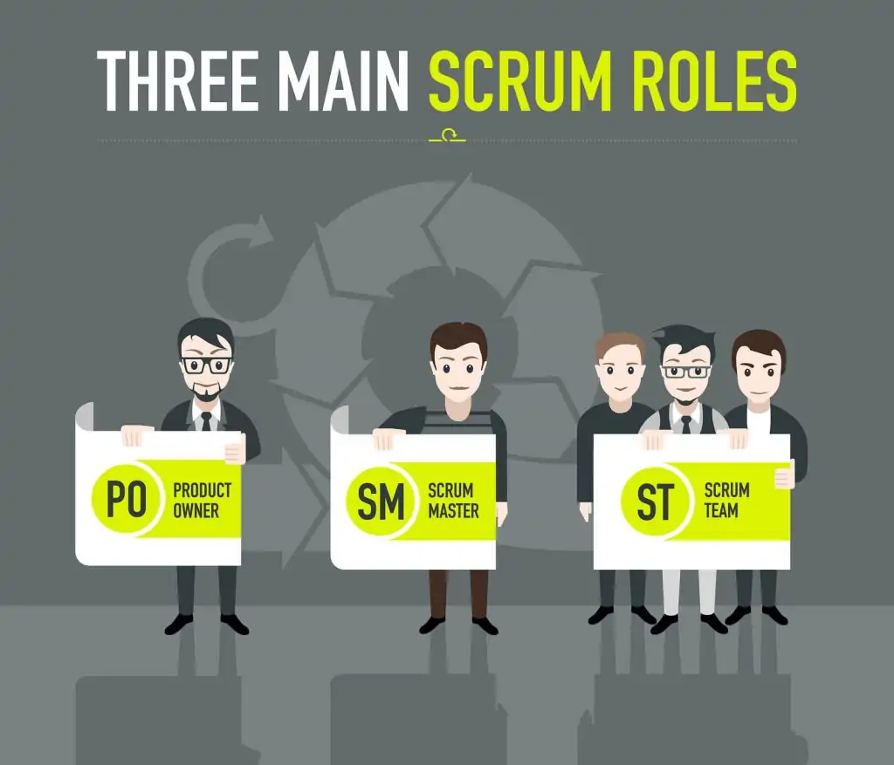

Slide 47
Scrum master:
The person who leads the team guiding them to comply with the rules and processes of the methodology.
manages the reduction of impediments of the project and works with the Product Owner to maximize the ROI.
in charge of keeping Scrum up to date, providing coaching, mentoring and training to the teams in case it needs it.

Slide 48
Product owner (PO):
Is the representative of the stakeholders and customers who use the software.
They focus on the business part and is responsible for the ROI of the project.
They Translate the vision of the project to the team, validate the benefits in stories to be incorporated into the Product Backlog and prioritize them on a regular basis.
Team:
A group of professionals with the necessary technical knowledge who develop the project jointly carrying out the stories they commit to at the start of each sprint.

Slide 49
Scrum Artifacts
Product Backlog: the Product Backlog is an emergent, ordered list of what is needed to improve the product. It is the single source of work undertaken by the Scrum Team.
Sprint Backlog: The Sprint Backlog is composed of the Sprint Goal (why), the set of Product Backlog items selected for the Sprint (what), as well as an actionable plan for delivering the Increment (how).
Increment: an Increment is a concrete stepping stone toward the Product Goal. Each Increment is additive to all prior Increments and thoroughly verified, ensuring that all Increments work together.

Slide 50
Advantages of Scrum
Here's why the framework is so popular today:
Scrum can help teams complete project deliverables quickly and efficiently.
Scrum ensures effective use of time and money
Large projects are divided into easily manageable sprints
Developments are coded and tested during the sprint review
Works well for fast-moving development projects
The team gets clear visibility through scrum meetings
Scrum, being agile, adopts feedback from customers and stakeholders
Short sprints enable changes based on feedback a lot more easily
The individual effort of each team member is visible during daily scrum meetings

Slide 51
Disadvantages of Scrum
Scrum often leads to scope creep, due to the lack of a definite end-date
The chances of project failure are high if individuals aren't very committed or cooperative
Adopting the Scrum framework in large teams is challenging
The framework can be successful only with experienced team members
Daily meetings sometimes frustrate team members
If any team member leaves in the middle of a project, it can have a huge negative impact on the project
Quality is hard to implement until the team goes through an aggressive testing process

Slide 52
Feature Driven Development
Feature centric approach
Feature is a schedulable requirement associated with the activity used to realize it
organizes software development around making progress on features.
Advantage is the potential for managing an agile project for handling the uncertainties that an agile approach introduces.

Slide 53
features should have the following attributes:
Features should be small and “useful in the eyes of system stakeholders.”
Features can be grouped into business-related groupings (called variously feature sets or work packages).
Features focus developers on producing elements within the system that are of tangible beneﬁts to system stakeholders.
Features are prioritized.
Features are schedulable.
Features have an associated (estimated) cost. Can be grouped together into short iterations (possibly as short as two weeks)

Slide 54
following 5 step process outlines how a feature-centric approach works, these ﬁve processes are:
Process 1: Develop an overall model of the domain and create an initial feature list.
Process 2: Build a detailed, prioritized feature list.
Process 3: Plan by feature.
Process 4: Design by feature.
Process 5: Build by feature.

Slide 55
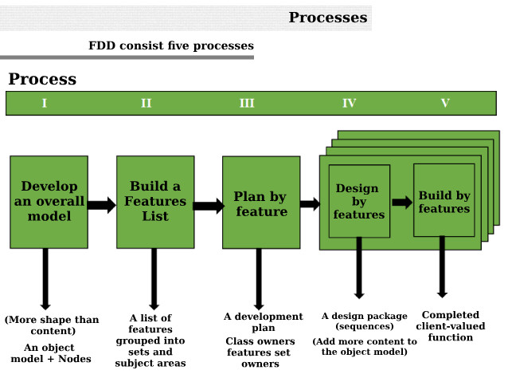

Slide 56
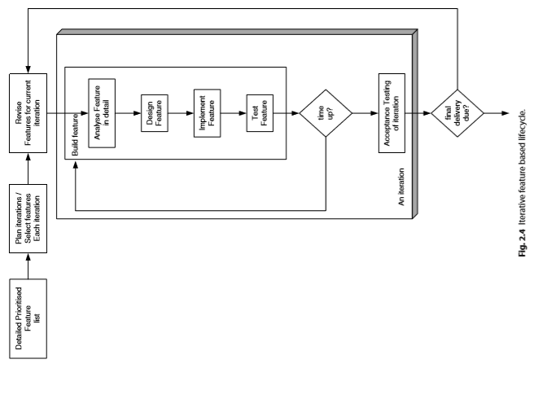

Slide 57
modelling misconceptions
Models equal documentation: No, model is a part of documentation
Modelling implies a heavyweight software process: but,modelling
does not equate to a software process
3. You must “freeze” the requirements.: in reality requirements change
4. Your design is carved in stone: in reality during the implementation some changes may be required to the design.

Slide 58
You must use a CASE tool. Tools will makes things easier but not mandatory
All developers know how to model :the more you study the models the more you will learn
You can think of everything from the start: its hard to determine whether you cover "enough” or whether you missed out some critical areas
Modelling is a waste of time:
The world revolves around the data model

Slide 59
What is Agile Modeling?
Agile Modeling (AM) is a practice-based methodology for effective modeling and documentation of software-based systems.”
It is intended to be a collection of values, principles, and practices for modeling software
that can be applied on a software development project in a more flexible manner than traditional modeling methods

Slide 60
Agile modelling main goals:
The overall objectives of Agile Modeling include:
Defining best practices for effective modeling
Offering a way to apply those best practices
Showing how to improve the modeling approach

Slide 61
Agile Modeling Best Practices:
There are several modeling-oriented best practices. The best practices for Agile Modeling methodology are outlined below:
Active Stakeholder Participation- Stakeholders should provide information in a timely manner, make decisions in a timely manner, and be as actively involved in the development process through the use of inclusive tools and techniques.
Architecture Envisioning- At the beginning of an agile project, the team will need to do some initial, high-level architectural modeling to identify a viable technical strategy for your solution.
Iteration Modeling - At the beginning of each iteration, you will do a bit of modeling as part of your iteration planning activities.
Just Barely Good Enough (JBGE) Artifacts- A model or document needs to be sufficient for the situation at hand and no more.
Look ahead Modeling (model a bit ahead)- someone model a bit ahead of the developers on your team, gathering information, exploring requirements, and thinking through the detailed design before you actually implement the software. This modeling is done in parallel to the development effort, often a few days or weeks before the information is actually needed.

Slide 62
Model Storming - Throughout an iteration you will model storm on a Just in Time (JIT) basis for a few minutes to explore the details behind a requirement or to think through a design issue.
Multiple Models- Each type of model has its strengths and weaknesses. An effective developer will need a range of models in their intellectual toolkit enabling them to apply the right model in the most appropriate manner for the situation at hand.
Prioritized Requirements - Agile teams implement requirements in priority order, as defined by their stakeholders, so as to provide the greatest return on investment (ROI) possible.
Requirements Envisioning - At the beginning of an agile project you will need to invest some time to identify the scope of the project and to create the initial prioritized stack of requirements.
Test Driven Development(TDD) - Write a single test, either at the requirements or design level, and then just enough code to fulfill that test. TDD is a JIT (Just in Time) approach to detailed requirements specification and a confirmatory approach to testing.

Slide 63
What are the criteria the agile model should meet?
Agile models have some utility ie,some one should need them
Agile models fulﬁl their purpose (and no more). Ie,should clarify the purpose
Agile models are sufﬁciently consistent& accurate.
Agile models are understandable to their intended audience
Agile models are sufficiently detailed
Agile models are simple as possible

Slide 64
When to Avoid Agile Modeling?
You don’t use XP, DSDM, Scrum, or FDD.
Agile Modeling was developed to address the need for a coherent modeling process in conjunction with these existing Agile methodologies.
You are not prepared to adopt all of the principles.
For Agile Modeling to be effective, you must commit to applying all of the principles when you develop models.
Your stakeholders are not involved in the process.
If your stakeholders are not involved, modeling efforts will not be successful.
Your organization takes a top-down approach.
Agile and Agile Modeling rely on distributed authority. If the team is entirely directed and does not participate in the requirements process, then Agile Modeling is not likely to add anything useful to the initiative.
Your team is very large and/or distributed.
Agile Modeling is designed for workers in close quarters, with lots of interaction.

Slide 65
Tools of misconceptions
Some misconceptions and myths relating to the use of tools, modelling and UML.
UML requires CASE tools: not true, you can draw a UML diagram on free hand
Modelling requires the use of CASE tools: not mandatory if larger the system and larger the amount of modelling performed ,the better the CASE tools may be
Agile modelers don’t use CASE tools: CASE tool is most appropriate for a complex structure
UML is all you need! :many aspect of s/w projects do not fit with in the remit of software
The CASE tool is master.: CASE tool should not be the master but the servant.

Slide 66
Updating agile models
When you actually need to ……then you go back and rework the model as they had served their purpose
If the model is never needed again ,reworking them would have been a waste
A model which is not properly maintained ,fully documented, recorded can be thrown away
When ever the user requirements changing ,a SE can update the model using reverse engineering

Slide 67
Answer the following questions
Write short note on agile modelling
Write the difference b/w water fall and agile models
Explain the following
XP,DSDM ,SCRUM
What is the methodology adopted by DSDM to “prioritize” the requirements?
What does the term ”feature” mean in FDD? explain what is feature centric approach.
What is SCRUM methodology? What is the purpose of daily SCRUM meeting?
List and explain the principles proposed by agile manifesto

