Slide 1
“ CHATBOT ”
“ Create a Chatbot for Keonics to support student selecting the subjects”
By : Sagar F Honnabindagi

Slide 2
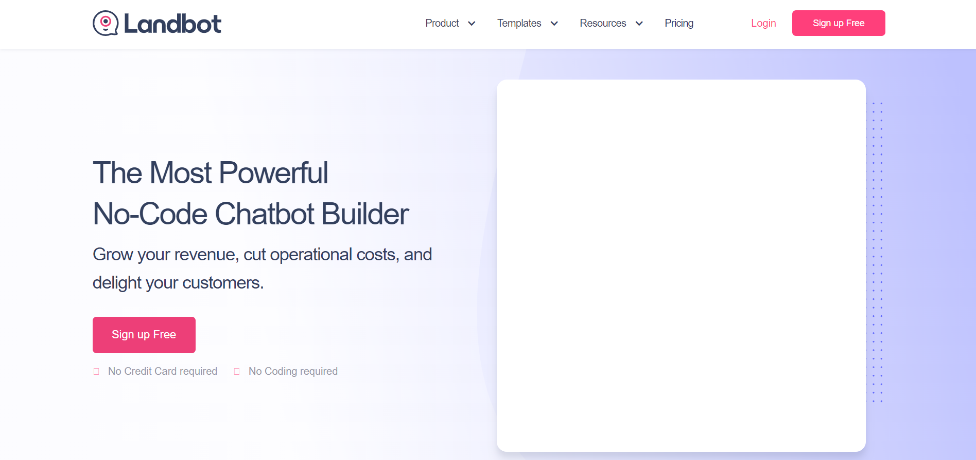
1. Landbot Page

Slide 3
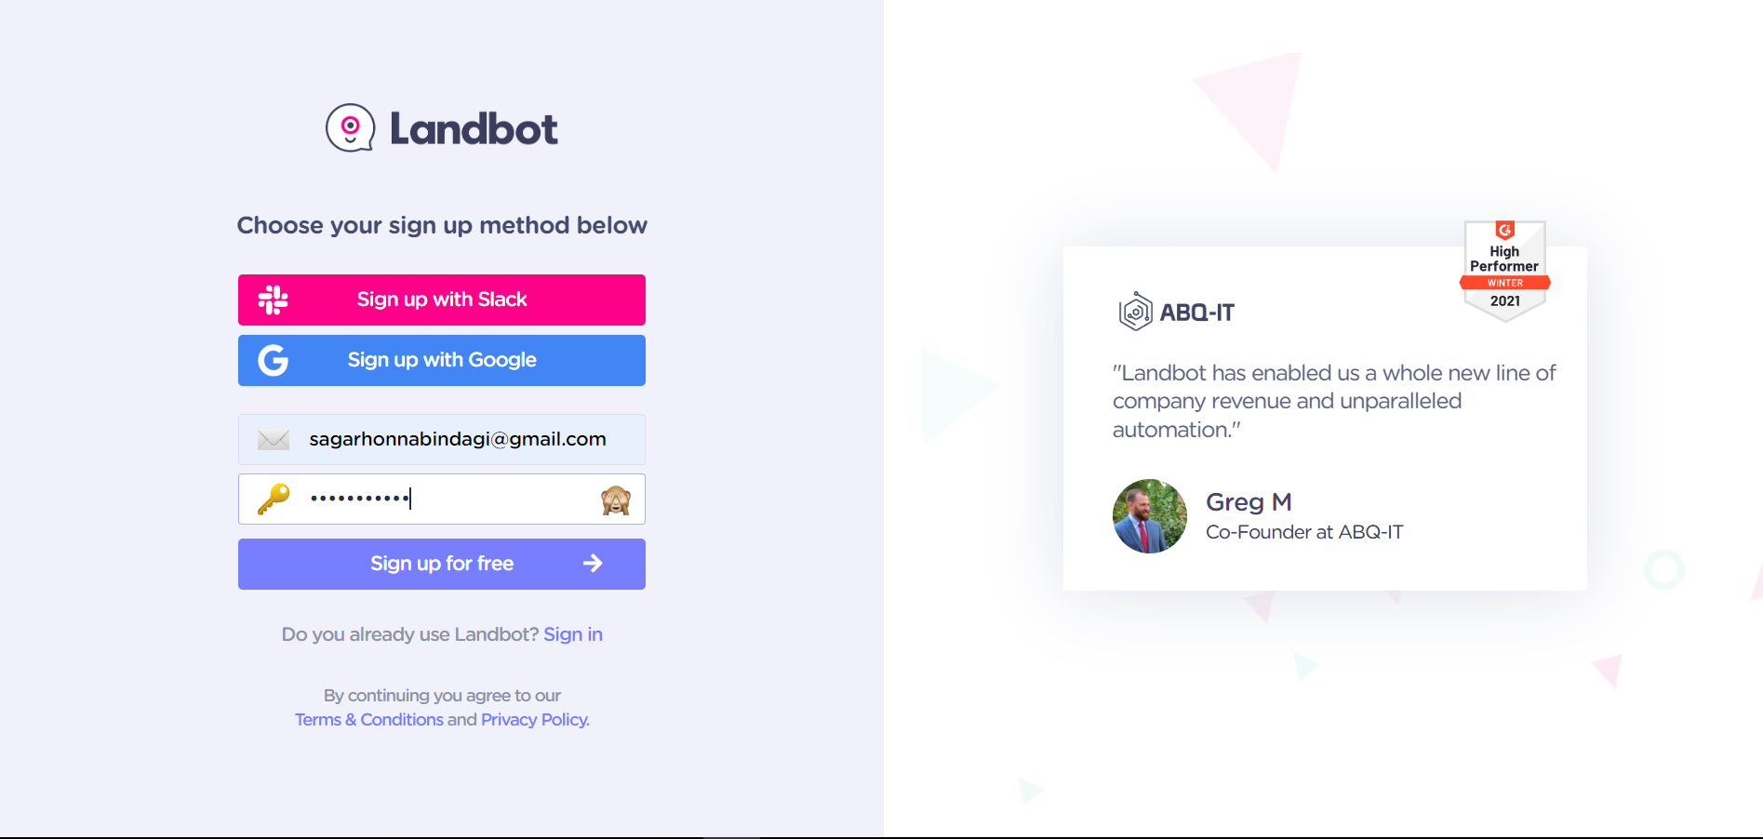
2. Register

Slide 4
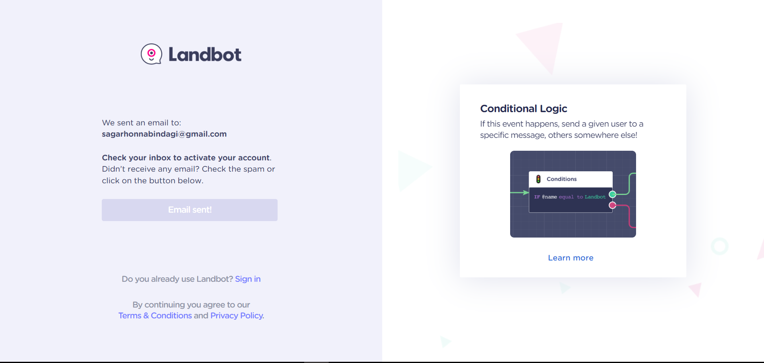
3. Confirmation

Slide 5
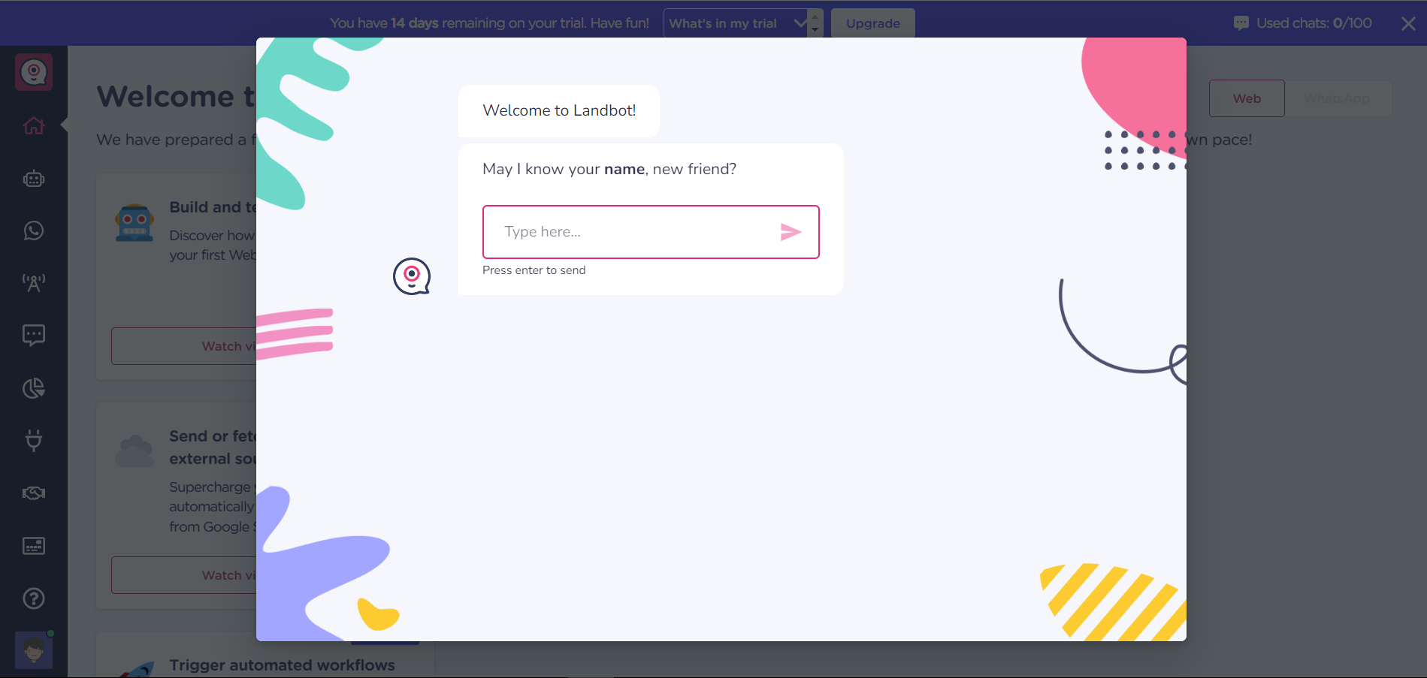
4. Basic Information

Slide 6
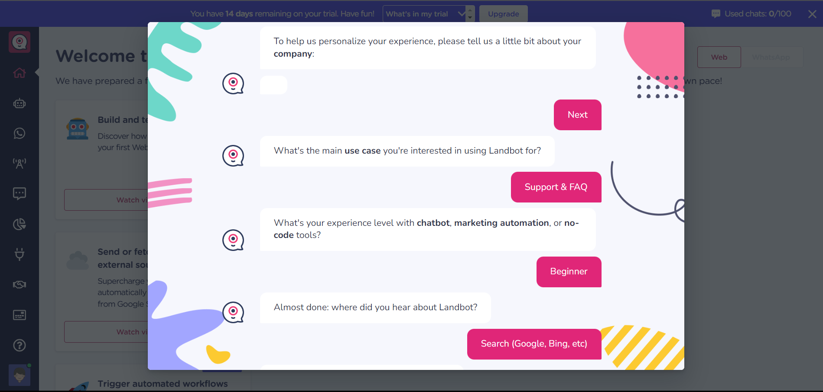
5. Basic Information

Slide 7
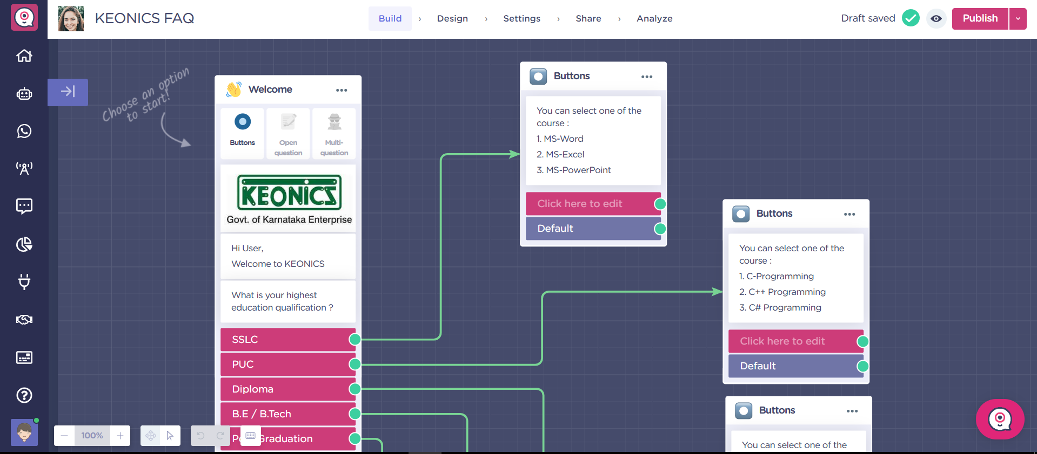
6. Build Section

Slide 8
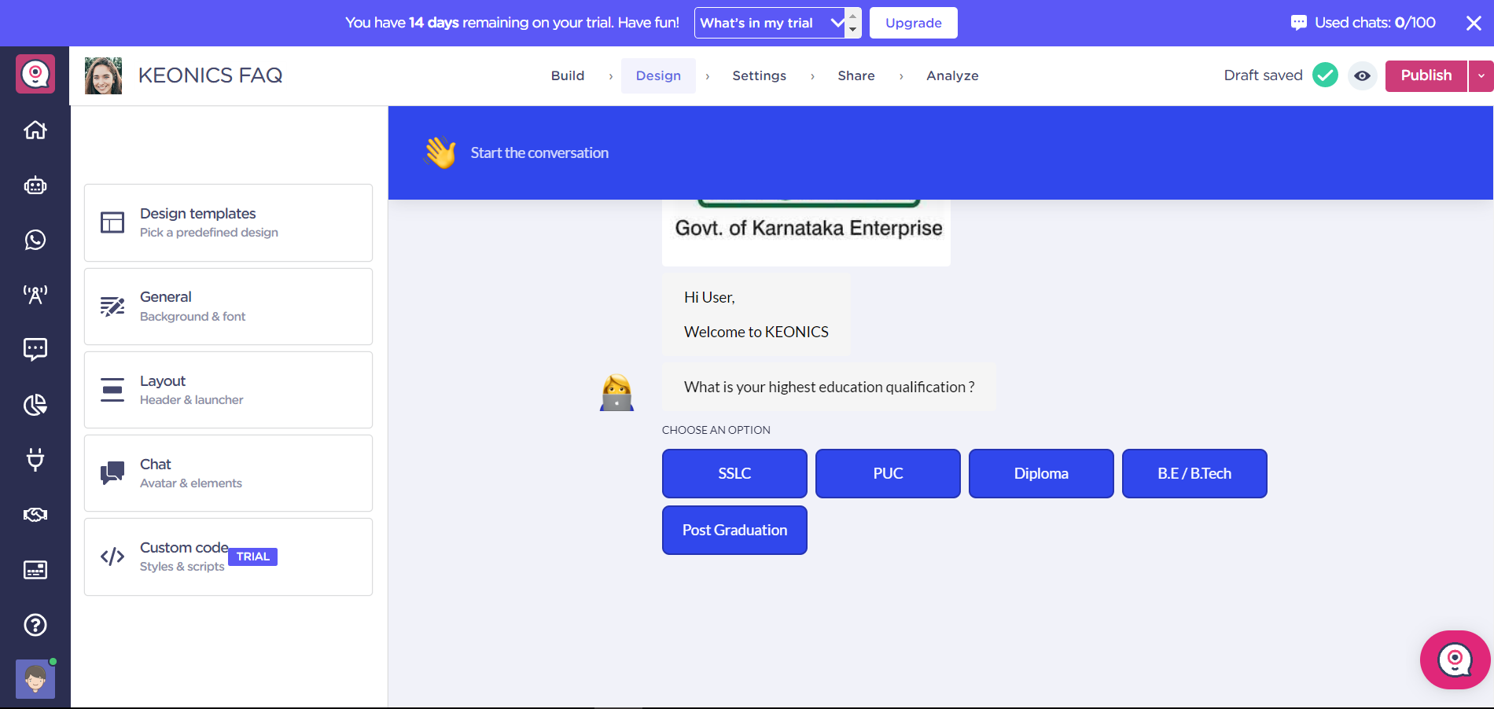
7. Design Section

Slide 9
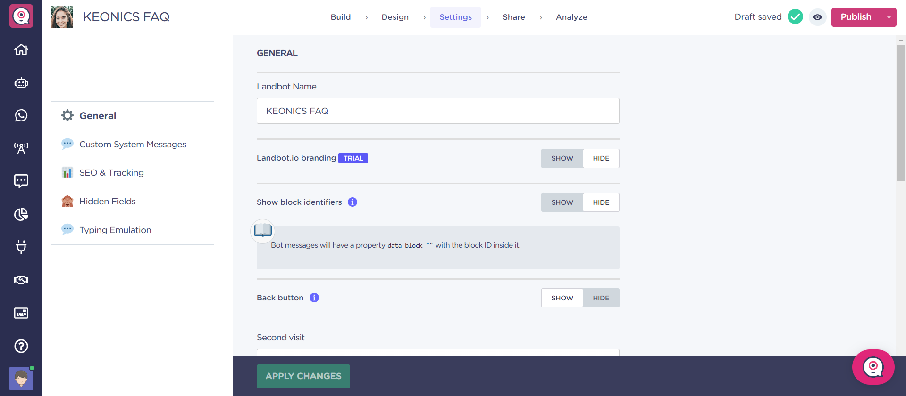
8. Settings Section

Slide 10
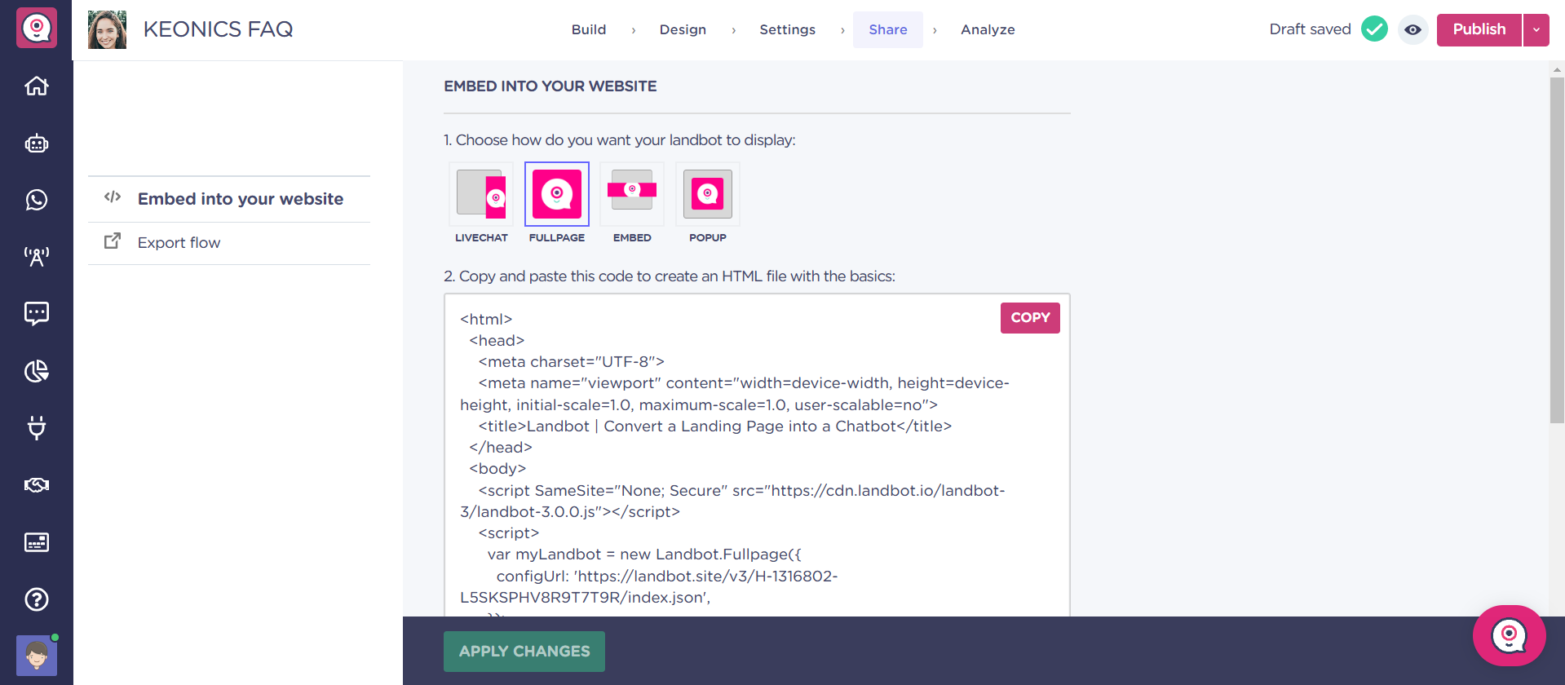
9. Share Section

Slide 11
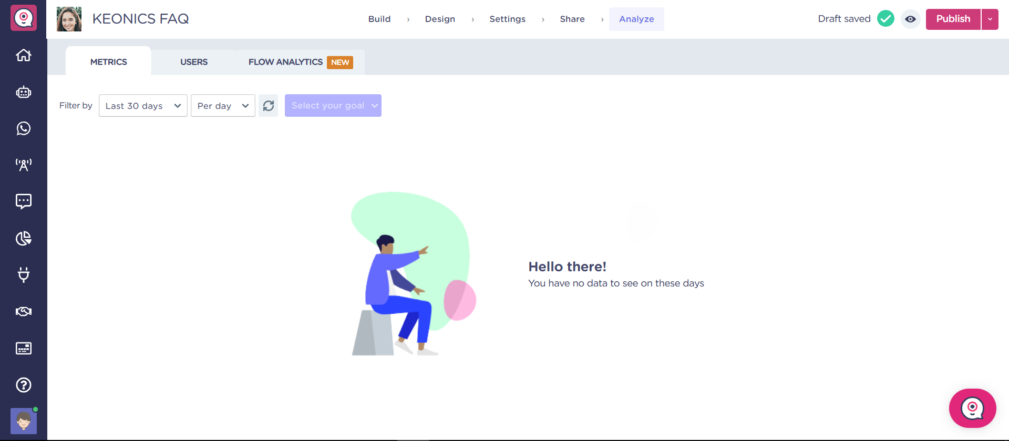
10. Analyze Section

Slide 12
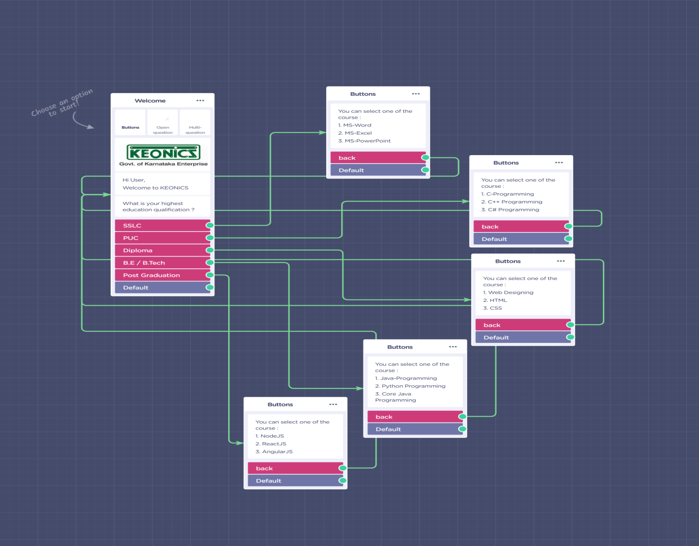
10. Flow Diagram

