Slide 1
“ Jarvis AI ”
“ Create virtual assistant will able to do follow user instructions ”
By : Sagar F Honnabindagi

Slide 2
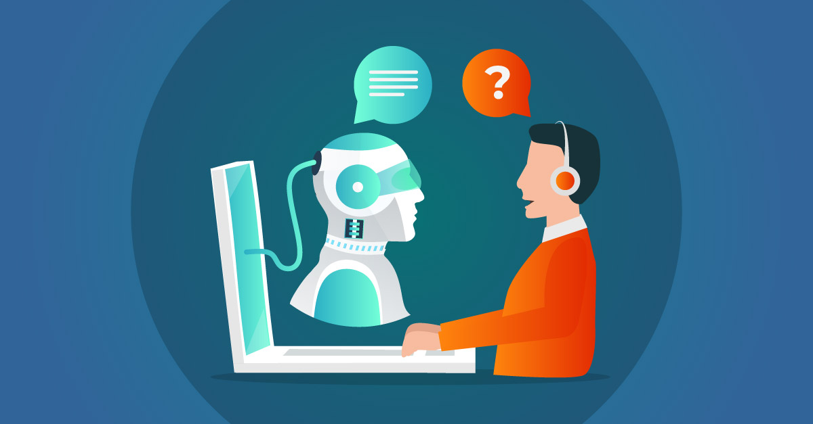
What is Virtual assistant ?
An intelligent virtual assistant (IVA) or intelligent personal assistant (IPA) is a software agent that can perform tasks or services for an individual based on commands or questions.

Slide 3
What does a virtual assistant do?
Answer, monitor and organize emails
Answer, direct and make phone calls
Transcribe documents
Provide customer support, such as answering questions and processing orders
Prepare reports, letters and statements
Organize files and documents
Make appointments
Manage spreadsheets
Research content and/or keywords
Data entry

Slide 4
Some popular virtual assistants are
Sl.No | Virtual Assistant | Company
1 | Alexa | Amazon
2 | Bixby | Samsung
3 | Cortana | Microsoft
4 | Google Assistant | Google
5 | Siri | Apple

Slide 5
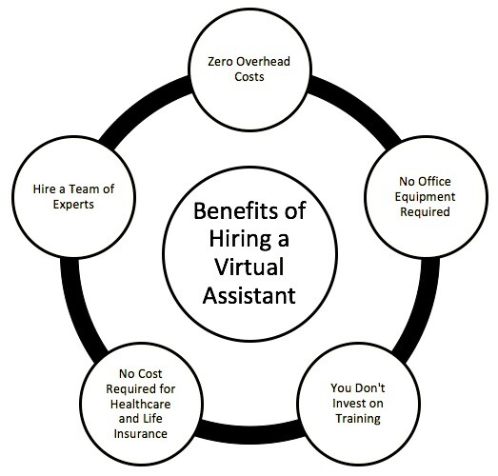
Benefits of virtual assistants are

Slide 6
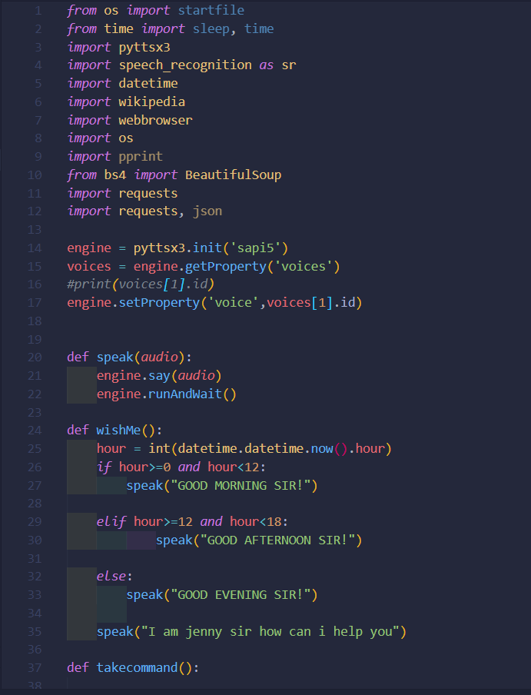
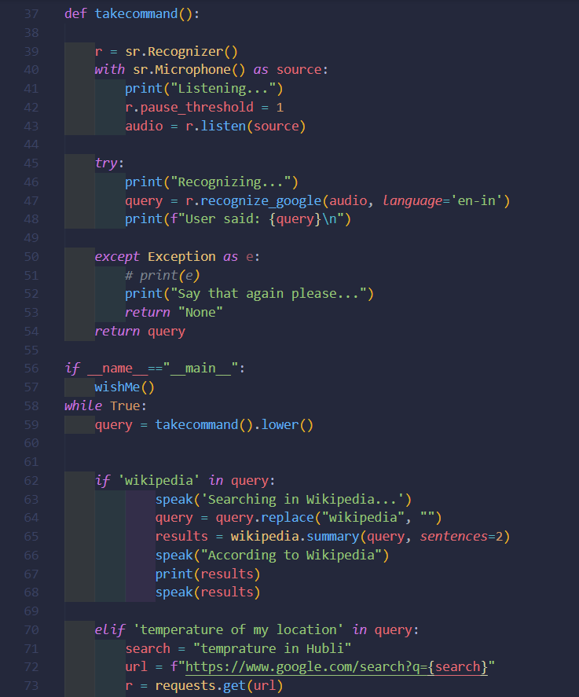
Code Snippet

Slide 7

Software Requirements
Python 3.10
Python Libraries
Visual Studio Code

Slide 8
Functionalities done by out virtual assistants
Greeting on start
Search on Wikipedia
Temperature of Location
Opens YouTube
Opens Google
Plays Music
Time
Opens Mail
Opens WhatsApp

Slide 9


