Slide 1
Mountain Climbers Health Monitoring & GPS Tracker System
Done By B Venkata manish G yagna datta M Hemanth
Guided by
Ms janakiraman

Slide 2
Overview:-
Mountaineering has always been a very adventurist activity. But with this adventure there is high Risk with it. Over 297 people have died trying to climb Mount Everest.If any accident happens it takes hours and days for rescue team to find location of climber and the person is alive or not, and if alive what is the condition. Here our project help them by tracking mountain climber location and health condition in real time.

Slide 3
Objectives:-
Our Aim is to Monitor the health condition & tracking GPS location of Mountain Climber
Live Heartbeat Monitoring
IOT Live Virtual Displaying
GPS Location Tracking
Added SMS alert in case of limit Crossing
Climber can ask for help manually or send a distress signal to some one if he is in need.

Slide 4
1. GSM Module SIM900A. 2. Arduino UNO. 3. Heart Beat sensor(MAX30100). 4. 16×2 LCD Display with I2C Module. 5. NEO-6M GPS Module 6. 1x Push button. 7. 1kohm & 10kohm resistance. 8. Temperature sensor DS18B20. 9. LDR for Demonstration of heartbeat.
Components Required:-

Slide 5
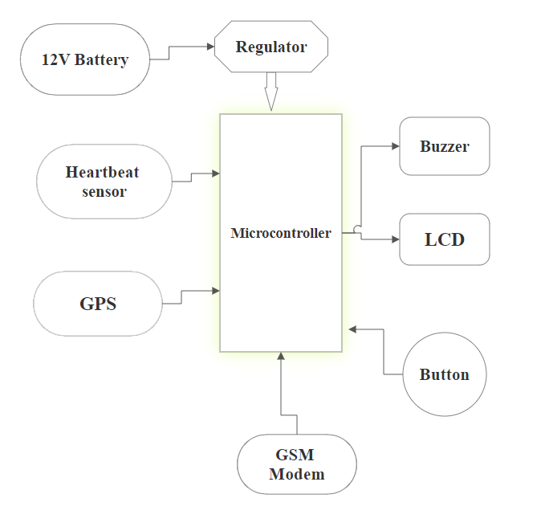
Block Diagram

Slide 6
Software
Using Arduino uno,GPS modem sends the latitude and longitude position and Arduino ide in software
Arduino IDE
It is a open source Arduino software. it is used to write and upload program to Arduino capable board.

Slide 7
Working process:-

Slide 8
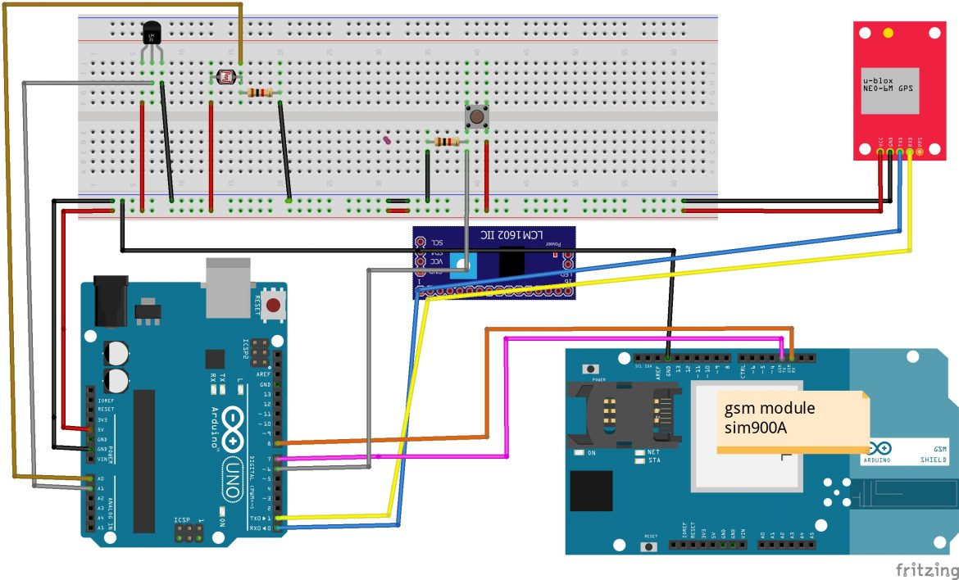
Circuit

Slide 9
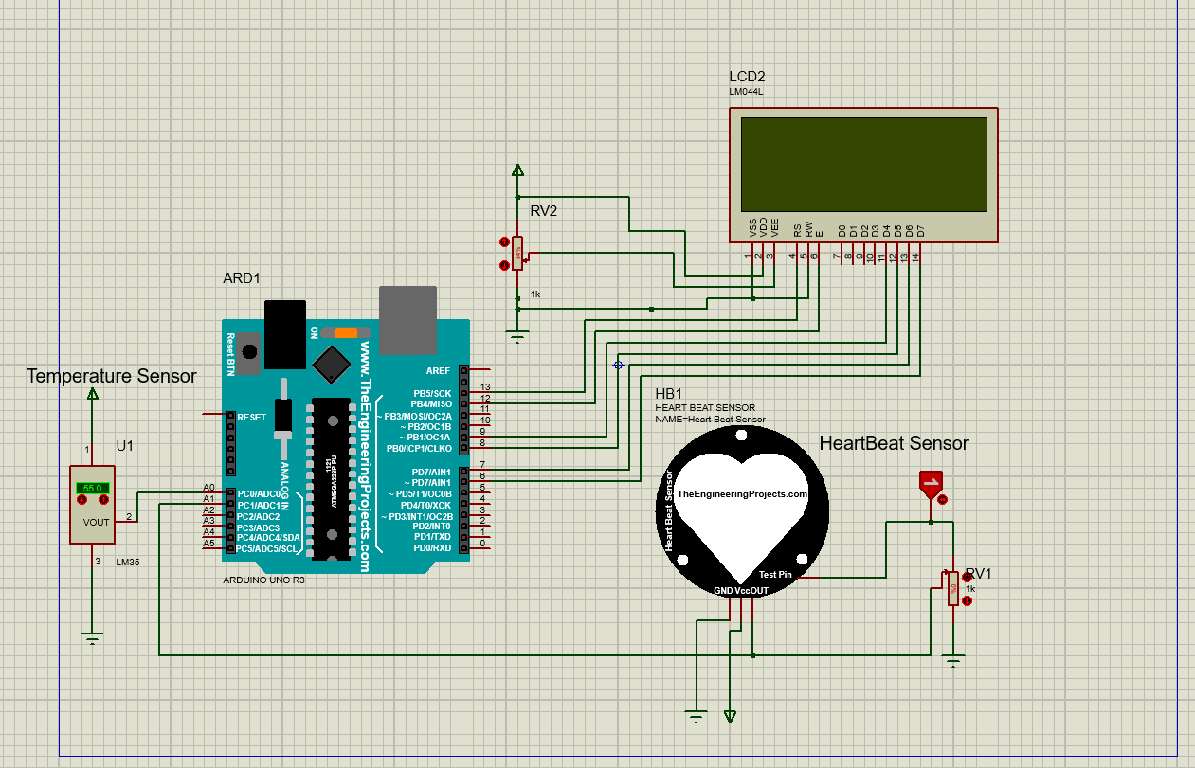
Simulation

Slide 10
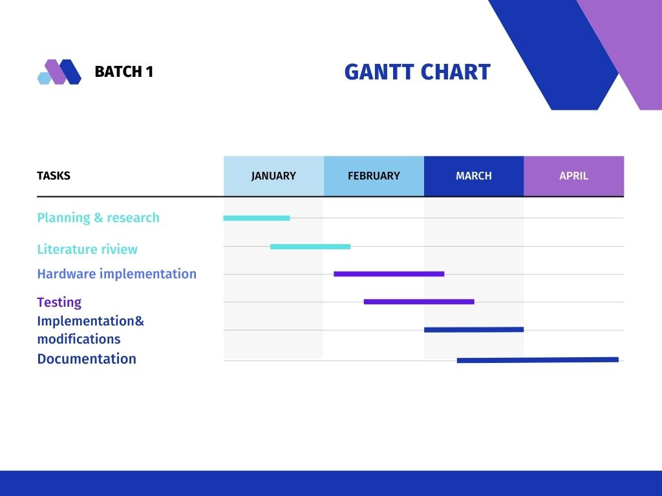
Gant chart

Slide 11
Literature review :-
S.no | TITLE OF THEPAPER | JOURNAL AUTHOR AND_PUBLICATON DETAILS | Technologies & algorithms used | Description
1 | Real Time Health Monitoring System of Remote Patient Using Arm7. | R. Shaikh, 2012 | Zigbee,GPS, GSM | As we are using zigbee communication is done in minimum distances. Best thing is Location can be tracked easily and more accurate.
2 | Health Monitoring and Tracking of Soldier Using GPS. | P.Kumar,G.Rasika, V.Patil, S.Bobade,2014 | Wireless communication | It is Improves security and reduces complexity. There is more Problems due to network error.
3 | A Real Time Autonomous Soldier Health Monitoring and Reporting System Using COTS Available Entities | S.Sharma, S. Kumar, A.Keshari,S.Ahmed, S. Gupta, A. Suri,2015 | Biomedical sensors | Continuous monitoring of health but it adding more load soldire..
4 | SmartHealthMonitoringSystemthroughIOT | AnanthS,SathyaPandMadhanMohanP.2019 | GPS and Bio-medical sensors | Easily trackable and health monitoring but Heavy load and sensor failure

Slide 12
Reference:-
[1]R. Shaikh,’’ Real Time Health Monitoring System of Remote Patient Using Arm7,’’ International Journal of Instrumentation, Control and Automation (IJICA), vol. 1, no. 3-4, pp.102-105, 4, 2012.
[2]R. Kumar and M. Rajasekaran, "An IoT based patient monitoring system using raspberry Pi," International Conference on Computing Technologies and Intelligent Data Engineering, Kovilpatti-India,Jan. 2016, pp. 1-4.
[3] S. Sharma, S. Kumar, A. Keshari, S. Ahmed, S. Gupta and A. Suri, "A Real Time Autonomous Soldier Health Monitoring and Reporting System Using COTS Available Entities," Second International Conference on Advances in Computing and Communication Engineering (ICACCE), Deharadun India, May 2015, pp. 683-687.
[4]AnanthS,SathyaPandMadhanMohanP,”SmartHealthMonitoringSystemthroughIOT“,InternationalConferenceonCommunicationandSignalProcessing,April4-6,2019..

Slide 13
Thank you

