Slide 1
GCC Atlas
A source-backed view of India's GCC activity, built for the people who hire into these centres.
Product Intern Assignment · Flexiple
Working prototype + research dataset of 20 publicly reported GCC events
Research date 10 October 2026
GCC Atlas · Title
1

Slide 2
THE SHORT VERSION
What I built, and why
The problem
Basic facts about India's GCC market are contested. Three credible sources give three different totals, and a single announcement is reported with different dates and different headcounts.
The user
Recruitment and staffing firms selling into GCCs — the segment Flexiple itself sits in. They need to know who is building, and to be able to check it before they act on it.
The product
A curated, source-backed record of GCC activity. Every claim carries its source, a confidence label, and a clear line between reported fact and my own interpretation.
The honest part
20 records, not 2,000. No live data, no prediction, no user research yet. The product says so on its own pages rather than hiding it.
One line: GCC Atlas does not try to know more than the public record. It tries to be the only place where the public record is organised, dated, sourced and honest about its own gaps.
GCC Atlas · Summary
2

Slide 3
PROBLEM
Who is in this ecosystem, and who feels the gap
A company setting up an India GCC touches most of these groups. Each one needs a different slice of the same missing information.
Global company setting up
Which city, what it costs, who to trust
Advisors & consultants
Who is in market, and when
Real estate firms
Who needs space, and how much
Law firms
Entity structure, compliance
State governments
Who is shopping, and what they want
Recruitment & staffing firms
Who is hiring, for what, starting when
EOR providers
Who needs an employer of record first
I chose the highlighted group. They feel this weekly rather than once a decade, they already pay for market data, and they are reachable. They are also the segment Flexiple operates in — it runs a GCC recruitment and staffing business — so the product has a user inside the building.
GCC Atlas · Problem · Stakeholders
3

Slide 4
EVIDENCE
One basic question, three credible answers
"How many GCCs are there in India?" is the simplest question in this market. Here is what three reasonable sources say.
2,000+
Flexiple assignment brief
The figure given in the brief for this assignment.
1,800+
Flexiple's own website
Stated on Flexiple's city-wise GCC directory page, alongside ~3,000 delivery units.
~1,700
Vestian Research
Reported via IANS, July 2025.
None of these sources is wrong. They use different definitions, different dates and different counting methods — and none of them shows its working. That is the problem in one slide: not that information is missing, but that it cannot be checked.
Why this matters commercially: a staffing firm sizing this market picks a number and builds a plan on it. A 300-centre spread between credible sources is the difference between a sound forecast and a guess.
GCC Atlas · Evidence · The counting problem
4

Slide 5
EVIDENCE
What I hit while building the dataset
I set out to verify 20 GCC announcements. The obstacles I ran into are themselves evidence of the problem — these are my own findings, not quoted research.
1
Six different names for the same thing
GCC, Global Capability Centre, Global Value Centre, Global Innovation Centre, capability center, Global Business Solutions — all in my 20 records. Any keyword search misses centres purely because of vocabulary.
2
The same event, different dates
ICE's Pune lease: one source dates it 29 Dec 2025 (registration), another Feb 2026 (reporting). Both are probably right about different events.
3
The same event, different headcounts
Eli Lilly's Hyderabad centre: 1,000+ at announcement, 1,500 at inauguration. HCA Healthcare: ~1,100 in one report, ~1,200 in another.
4
Headline numbers that mean something else
JPMorgan Chase's Mumbai campus is widely reported as "30,000 employees". That is building capacity for a 2029 campus, and the reporting says "consolidating" existing India operations. It is not 30,000 new jobs.
5
Most coverage has no primary source
Only 8 of my 20 records cite a company press release. Much of what circulates is LinkedIn posts and "Top 10 GCCs" roundups with nothing underneath them.
GCC Atlas · Evidence · Research findings
5

Slide 6
CURRENT ALTERNATIVES
How people solve this today — and where it breaks
ALTERNATIVE
WHAT WORKS
WHERE IT BREAKS
Industry reports (Nasscom, Vestian, consultancies)
Credible, broad market picture
Annual, aggregate, not per-company, method rarely shown
Checked
Directory and listicle pages, including Flexiple's own
Fast, free, good coverage of names
A list of names, no dates, no sources per entry, no confidence
Checked
Google News / general search
Current and free
Terminology problem means you miss centres; no way to tell a press release from a blog
Checked
LinkedIn posts and roundups
Early and specific
Usually unsourced; figures are repeated without checking
Checked
Personal networks and referrals
Genuinely the best current tool
Does not scale, cannot be audited, excludes new entrants
Assumed
Sales intelligence tools (Apollo, ZoomInfo)
Strong contact data
No concept of "GCC"; cannot answer who is building a centre
Assumed
Reading the labels: "Checked" means I used the alternative myself while researching this dataset. "Assumed" means it is a reasonable belief I have not tested — I have not interviewed anyone who does this job.
GCC Atlas · Current alternatives
6

Slide 7
OPPORTUNITIES
Four things I could have built. I built the third.
Provider track records
"Which advisor or EOR actually delivers?"
The most-felt pain, but the data is private outcomes. Building it honestly is impossible; building it dishonestly means inventing performance data.
Setup decision copilot
"Which city, what entity, what cost?"
Very few buyers, decade-long cycles, and it depends on verified cost and incentive figures I could not source reliably in the time available.
Source-backed activity record
"Who is building, and can I check it?"
Entirely buildable from public evidence. Serves a user who feels the need weekly. Honest about what it does not know.
Expansion prediction
"Who will set up a GCC next?"
I could not find evidence that public data gives reliable early warning. Claiming prediction without testing it would be the dishonest option.
Rejected
Rejected
Built
Rejected
The deciding question was the same each time: can this be built honestly from evidence I can actually obtain? Only one of the four could. Three of these would have made a more impressive slide and a less defensible product.
GCC Atlas · Opportunities · Prioritisation
7

Slide 8
TARGET USER
The first user, and the job to be done
Felt weekly, not once a decade Frequency is what makes a tool stick.
Business development lead at a recruitment or staffing firm
Their job is to find accounts worth approaching. Today that means reading news, watching LinkedIn, and relying on who they happen to know.
The job to be done: "Show me which companies are building or growing a capability centre in India, tell me when, and let me check it before I put my name to it."
Already pays for market data No new budget line to create — a better one to argue for.
Reachable Thousands of firms, no procurement committee.
Serveable with honest data Public evidence genuinely answers their question.
Flexiple is this user It runs a GCC recruitment and staffing business — it could use this itself.
GCC Atlas · Target user
8

Slide 9
SOLUTION
GCC Atlas
A curated record of publicly reported GCC activity in India where every claim can be traced, questioned and checked.
Every claim carries its source
47 source links across 20 records, each tagged as a company release, trade press or news, with its date. All clickable.
Facts and interpretation never blur
Each record shows what the sources state, then — separately and visibly labelled — what I read into it. The two are styled differently so you cannot mistake one for the other.
Confidence is about evidence, not importance
A small expansion with a company press release outranks a huge announcement carried only by a blog. The reason for each rating is written out.
It refuses rather than guesses
Ask it about salaries, costs, incentives or the future and it names what it does not hold instead of producing something plausible.
What it is not
Not live data — the dataset is a fixed snapshot in a file. · Not a complete register — 20 records, not 2,000. · Not a prediction tool. · Not validated by any real user yet.
GCC Atlas · Solution
9

Slide 10
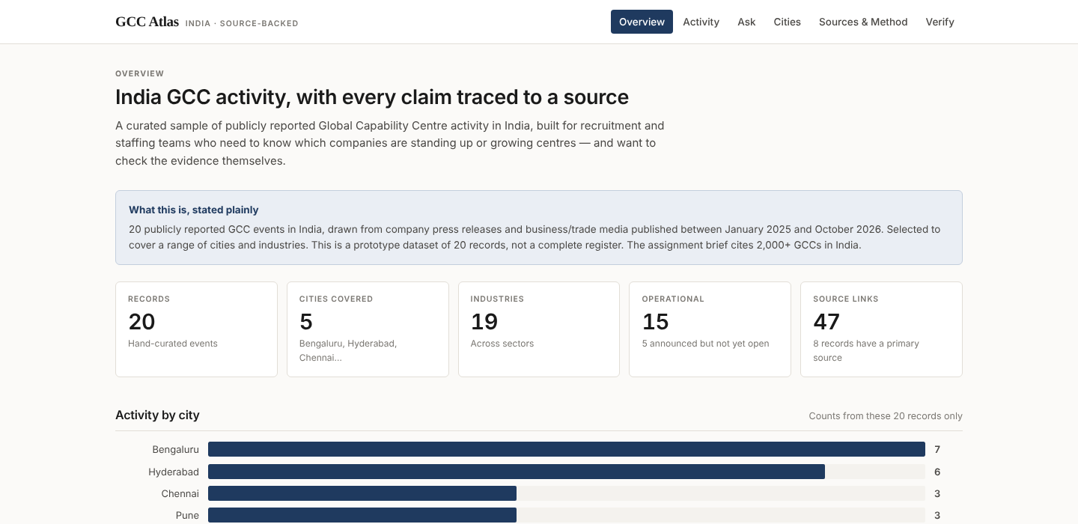
PROTOTYPE
The overview
Every number here is counted from the 20 records at page load — nothing is hardcoded, so the figures cannot drift from the data. The banner states the dataset's size and limits before showing a single chart.
GCC Atlas · Prototype walkthrough
10

Slide 11
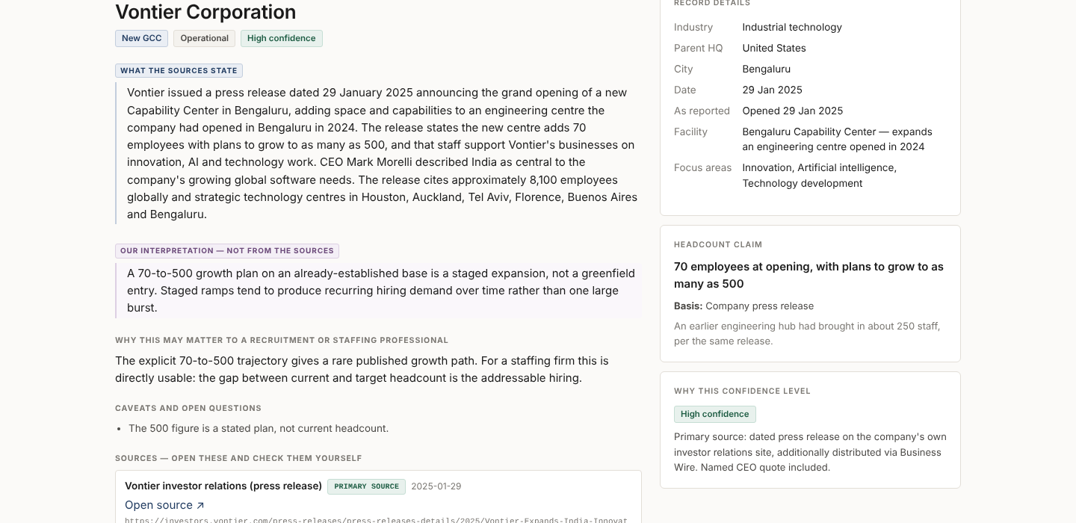
PROTOTYPE
Evidence, separated
The blue-marked block is what the sources say. The purple block below it is labelled "our interpretation — not from the sources". Headcount claims carry their basis. Every source is one click away.
GCC Atlas · Prototype walkthrough
11

Slide 12
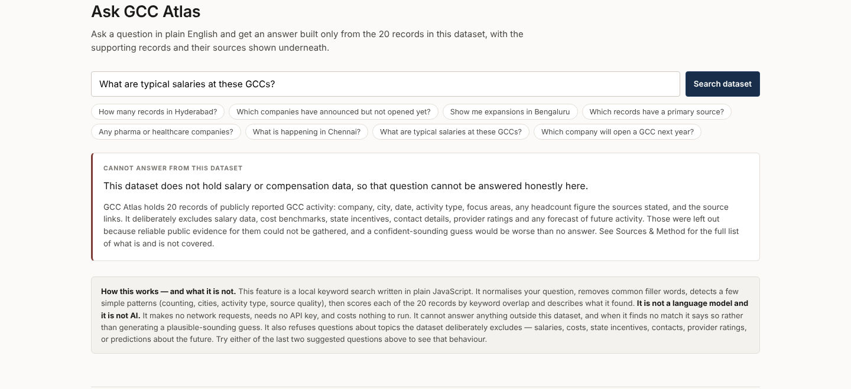
PROTOTYPE
Ask: refusing well
Asked about salaries, it names exactly what it does not hold and why, then points to the method page. It cites nothing, because it has nothing. The panel below states plainly that this is keyword search, not AI.
GCC Atlas · Prototype walkthrough
12

Slide 13
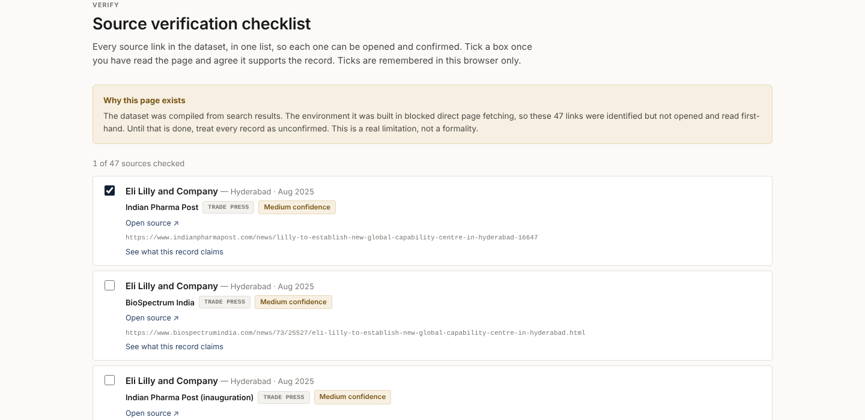
PROTOTYPE
Verification built in
All 47 source links in one checklist, so the research can be audited link by link. This page exists because the dataset was assembled from search results and the links still need first-hand confirmation.
GCC Atlas · Prototype walkthrough
13

Slide 14
SCOPE
Why these features, and what I deliberately cut
BUILT — because the journey breaks without it
CUT — and why
Overview — orientation: what is in here, and how much
State incentive comparison — the most error-prone data in this market; wrong is worse than absent
Activity table + filters — the actual working surface
Office cost benchmarks — could not source reliably enough to publish
Company detail — where trust is won or lost
Contact data — a data-protection question I should not answer casually
Ask — a faster route in for a specific question
Live ingestion — real engineering; not demonstrable in the time
City breakdown — pattern view, counted only from these records
Login and saved accounts — nothing here is private
Sources & Method — a tool that won't explain itself can't be trusted
A database — 20 records in a file is the right answer; a database adds steps, not ability
Verify checklist — makes the research auditable
A framework — no build step means it opens by double-clicking
The build: plain HTML, CSS and JavaScript. No framework, no server, no database, no API key, no paid service. It opens by double-clicking a file and works offline. I can explain every line of it.
GCC Atlas · Scope & trade-offs
14

Slide 15
POSITIONING
Why use this instead of today's alternatives
THEY USE TODAY
WHAT IT GIVES THEM
WHAT GCC ATLAS ADDS
Industry reports
Market-level picture, annually
Per-company and dated, so it supports an action this week
Directory pages
(including Flexiple's)
A list of company names
Each entry carries its source, date, confidence and caveats — a list becomes checkable evidence
Google News search
Everything, unranked and unlabelled
Curated across six naming conventions, with weak sources excluded on purpose
LinkedIn roundups
Fast, specific, usually unsourced
Records without a named publication behind them were left out
A general AI chatbot
Fluent answers, unverifiable
Answers only from 20 cited records, and refuses when it has nothing
A note on Flexiple's own pages: these are good directories and they rank well. GCC Atlas is not a replacement — it is the research layer underneath, where each entry earns its place by citing something.
GCC Atlas · Positioning
15

Slide 16
POSITIONING
What it would take to serve the rest of the ecosystem
I built for one stakeholder on purpose. Here is what each of the others would need before this is worth their time — and which of those I can honestly serve today.
STAKEHOLDER
WHAT THEY USE TODAY
WHAT THEY WOULD NEED FROM THIS
STATUS
Recruitment & staffing
News, referrals, generic sales tools
Dated, cited, per-company activity they can check before acting
Serving now
Advisors & consultants
Their own networks; subscription research
Same record, plus who is at MoU stage rather than already committed
Serving now
Real estate firms
Leasing data they already hold
The reverse view — intent signals that precede a space requirement
Mostly today
State promotion agencies
Their own pipeline; press monitoring
A neutral record of what peer states are winning, with sources
Needs coverage
Companies setting up a GCC
Advisors, who are themselves conflicted
Verified cost, incentive and provider data — none of which I hold
Not yet
EOR & legal providers
Referrals
Entity-level data tying each centre to its Indian legal entity
Not yet
On sizing the problem: I could not find a credible public figure for what this asymmetry costs, and I will not invent one. Measuring it means asking firms how many opportunities they learn about too late — the first thing I would test.
GCC Atlas · Positioning · Other stakeholders
16

Slide 17
HONESTY
What is not true about this yet
Stated here rather than discovered later. The product repeats all of this on its own Sources & Method page.
The source links are not yet confirmed first-hand
I identified them through search. The build environment blocked opening pages directly, so each link still needs to be read and confirmed. The app ships a Verify checklist for exactly this, and nothing should be presented as fact until that is done.
No user research exists
I have not interviewed a single recruitment or staffing professional. Every statement about what they need is my reasoning, not a finding. The alternatives slide marks which claims I tested myself and which I assumed.
20 records is a sample, not a market
Coverage is skewed toward cities and states with active press communications. A count here measures reporting volume, not real activity.
It cannot predict, and does not try
I looked for evidence that public signals give reliable early warning of GCC setups. I did not find enough to support that claim, so the product does not make it.
"Ask" is keyword search, not AI
It scores records by word overlap and detects a few patterns. The app says so on the page itself. No model, no API key, no cost.
GCC Atlas · Limitations & assumptions
17

Slide 18
NEXT
What I would do next, in order
1
Confirm all 47 sources
Open every link, confirm it supports the record, log who checked it and when. Nothing else matters until this is done.
Half a day
2
Talk to eight people who do this job
Recruitment and staffing BD leads. One question above all: what do you use today, and what would make you stop using it? This is the assumption the whole product rests on.
One week
3
Test whether state MoUs are an early signal
One record here shows roughly 17 months between a state MoU and an opening. If that holds across 20 more cases, it is a genuinely earlier signal than anything in the dataset today.
One week
4
Widen coverage with a repeatable method
Move from manual searching to a defined collection process, and record why each candidate was included or excluded.
Two weeks
5
Add company registry data
Tie each centre to its Indian legal entity, so the same company is never counted twice under two names.
Later
GCC Atlas · Next steps
18

Slide 19
The argument in one line
This market does not lack information.
It lacks information you can check.
GCC Atlas is 20 records, 47 sources and five cities. It is small on purpose. Every claim in it points at something you can open, every interpretation is labelled as mine, and everything it does not know is written down.
Prototype: open index.html — no install, no account, no internet needed. Dataset: data/records.js.
GCC Atlas · Close
19

