Slide 1


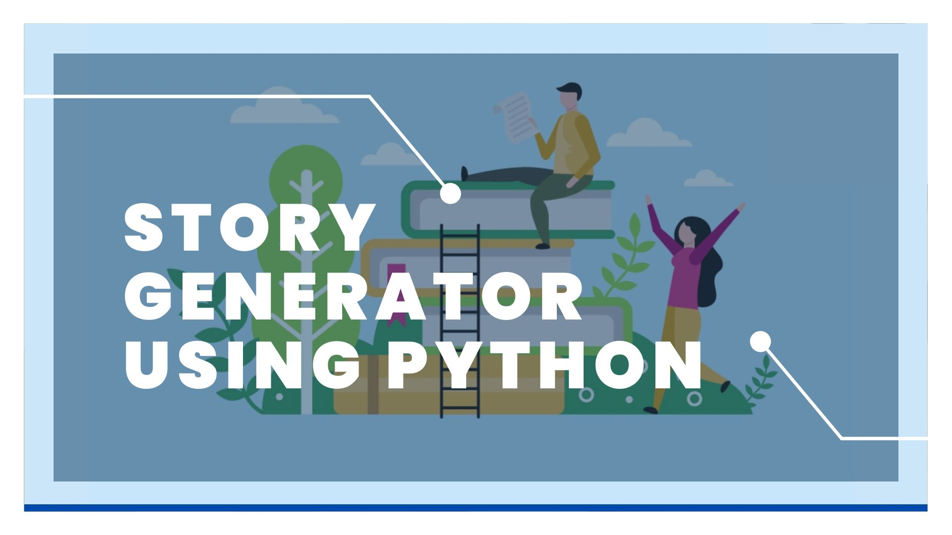
CSA0811 -Python Programming- Slot D
Random Story Generator For Kids Using Python
Guided By, Project By,
T. Vincent Gnanaraj G. Hemanth
(Course Faculty) (192224095)
Python Programming AI&DS
SSE, SIMATS SSE, SIMATS

Slide 2

Abstract
Every time the user runs the software, we must produce a random tale. We'll first store the portions of the tales in distinct lists, and then use the Random module to choose random sections of the stories from those list. To construct a random narrative, we first imported the random module, then built sections of the stories in separate lists, then randomly picked portions of the lists. As a beginning, you are more interested in developing software applications, which is understandable. However, no matter what element of programming you are interested in, spending more time with programs that demand you to think rationally will always benefit you.
Keywords : Random story, python, interfaces, modules

Slide 3

Introduction
In this section, we are going to make a very interesting beginner-level project of Python. It is a random story generator.
The random story generator project aims to generate random stories every time user executes the code. A story is made up of a collection of sentences.
We will choose random phrases to build sentences, and hence stories.
By using this python programming we can generate a random story for kids

Slide 4
Hardware and Software Requirements
HARDWARE :
CPU: 13th Gen intel(R) Core(™) i7-1360p (16cpus),- 2.2GHZ
RAM: 16GB
Storage space : 40GB
SOFTWARE :
SDK: Python 3.12
Editor: IDLE , Pycharm
Packages : CV2, Pytz
OS: windows 11

Slide 5
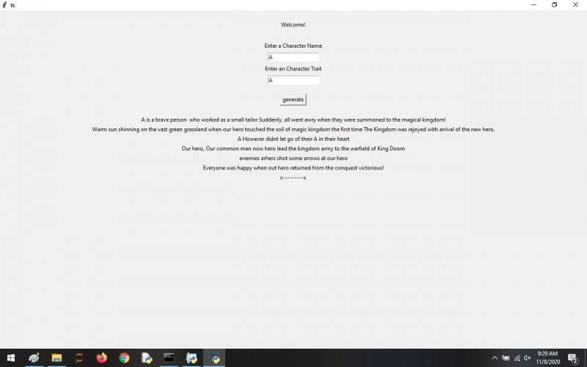
Existing System
Existing System:
The existing system is a simple random story generator using the tkinter library in Python.
It creates a graphical user interface (GUI) window that displays a pre-defined story about Tom’s adventure in a magical forest. The story components, characters, and plot points are hardcoded in the script. The story is generated by shuffling the plot points and concatenating them into a narrative.

Slide 6
Proposed System
Code Structure:
The code is organized into functions for better readability and maintainability.
A separate function, generate _ story, is created to handle the story generation process.
GUI Improvements:
The GUI includes a button ("Generate New Story") for users to generate a new random story interactively.
The text widget is cleared before inserting a new story to avoid appending stories.
User Interaction:
Users can now click the "Generate New Story" button to trigger the generation of a new story with shuffled plot points.
Comments and Documentation:
Comments are added to explain the purpose of functions and sections of code.
A docstring is included for the generate _ story function.
Styling:
The font style for the text widget is changed to "Arial" for better compatibility and readability.

Slide 7
ARCHITECTURE
User interface
Input processing
Theme and setting module
Data storage
Random story generator using python
Character module
Error handling
Dialogue Generation
Plot Generation

Slide 8
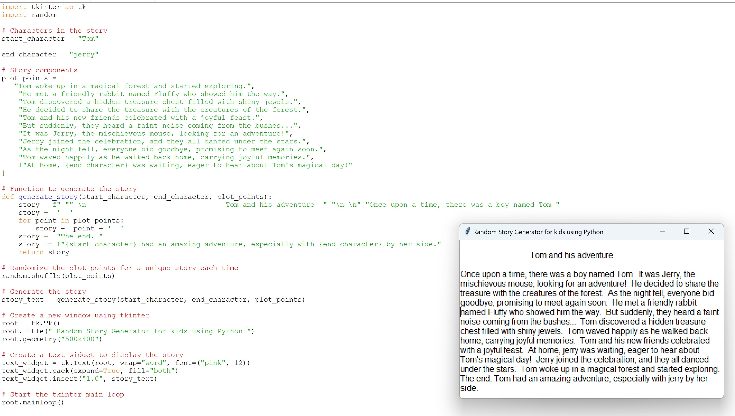
Design

Slide 9
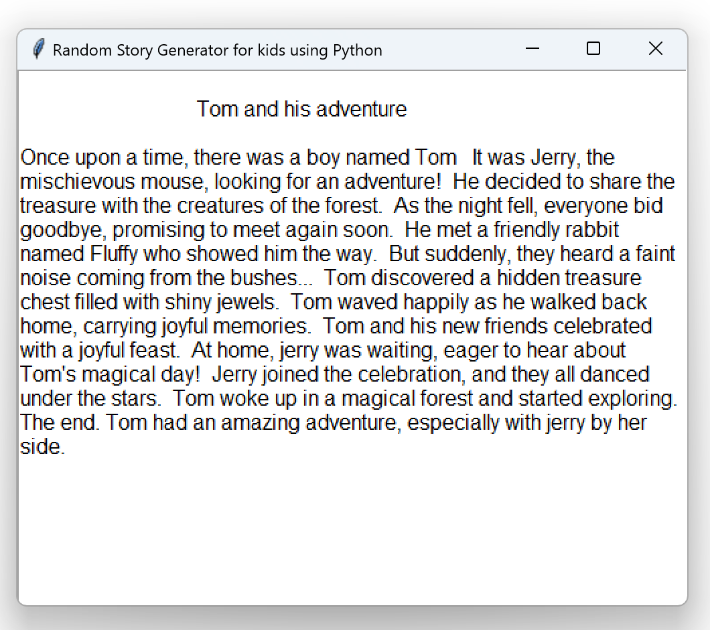
Coding

Slide 10
.
Implementation
User Interface (UI): Input: Child interacts with the UI to provide preferences (e.g., theme, characters, setting)
Input Processing : Implement functions to validate and sanitize user input
Theme and Setting Module: Create a module with predefined themes and settings. Implement functions to randomly select themes and settings.
Character Module: Define a module containing kid-friendly characters . Implement functions to randomly select main and supporting characters.
Plot Generation : Develop algorithms or templates for generating plots.
Dialogue Generation : Write functions to generate age-appropriate dialogues Consider character traits and relationships in dialogue creation.
Create functions to assemble the story components into a complete narrative Apply formatting for readability .

Slide 11
Testing
Unit Testing:
Test individual modules and functions in isolation . Verify that input processing and validation work correctly.
Integration Testing:
Test the interaction between modules . Check if the selected theme, setting, characters, and plot align properly.
User Interface Testing:
Ensure the UI is intuitive and user-friendly . Test user input forms and error handling.
Scenario Testing:
Simulate different scenarios to validate story generation . Test with various combinations of themes, settings, and characters.
Edge Case Testing:
Test with extreme or unexpected inputs . Check how the system handles unusual preferences or constraints.

Slide 12
Final output

Slide 13
Conclusion
In conclusion, the development, testing, and refinement of a random story generator for kids can lead to a polished and reliable tool that inspires young readers.
By continuously improving the functionality based on user feedback, we can create a tool that provides endless entertainment and sparks creativity in children. Let's unlock the magic of storytelling with Python!
Python demands high in India due to their applicability in various industries ,
Including data science ,web development ,automation ,artificial intelligence

Slide 14
Future Scope
Projects requiring Develops scripting can benefit from Python.
Python is a great tool for data scientists . The best statistics and analysis tools are provided by Python if your app deals with large amounts of data.
Make your prototype in Python when implementing your project idea. In 2023, future Python versions are expected to be available..
Python is used for all web development and future app development and image processing etc

Slide 15



Reference
[1] Python Software Foundation. (n.d.). Python: A dynamic, interpreted, open-source programming language. Retrieved from https://www.python.org/
[2] Python Software Foundation. https://www.python.org/
[3] Richardson, L., & Lieb, H. O. (2013). Web Scraping with Python: A Comprehensive Guide. O'Reilly Media.
[4] Harwani, B. (2017). Tkinter GUI Programming by Example. Packet Publishing.
[5] Zelle, J. M. (2005). Python Programming: An Introduction to Computer Science. Franklin, Beedle & Associates Inc.

Slide 16
THANK YOU!
NAME : G.HEMANTH
REGISTER NUMBER : 192224095

