Slide 1
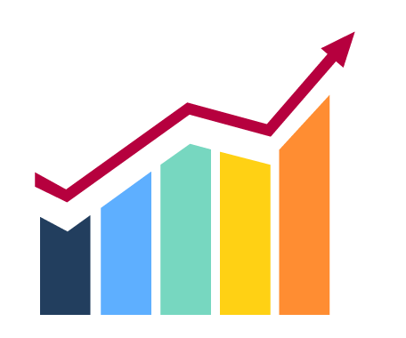




UNLOCKING CURRENT OPPORTUNITIES IN BUSINESS ANALYTICS
MARKET TRENDS, INSIGHTS AND AI APPLICATIONS
BAN 612 DATA ANALYTICS
GUIDE: PROF. DR. LAN WANG
BY: GROUP 6
HEMANTH VARMA PERICHERLA
VAISHNAVI KARINGALA
DIVYASRI YELUBOLU
SAI SOUMYA ALOOR
SRI CHARAN DESETTY
ANANTHA VYASA KURUDI
SANJANA PALURU
VAMSHI KRISHNA SAI MYNENI
Notes:
Good Evening, everyone.
We are group 6 and we are presenting on the topic, "Unlocking current opportunities in business analytics"
As aspiring business analysts, we chose this project to focus specifically on business analytics. During our discussions, the whole group agreed that we wanted to work on business analyst roles, as it's the career path we all aim to pursue.
This project reflects our interest in business analytics and gives us valuable insights for our future careers.
Since health tech is growing rapidly, we also looked into business analyst roles in the healthcare industry. We'll go into more detail about this later in the presentation.

Slide 2





PROJECT WORKFLOW
DATA COLLECTION
DATA VISUALISATION
AI APPLICATIONS
2
4
6
1
3
5
DEFINE OBJECTIVES
DATA EXPLORATION
ANALYSIS
Notes:
Project Workflow:
to give an overview of our project workflow, we followed a structured timeline
Defining Objectives:
We started by setting clear goals, focusing on salary differences across industries for Business Analyst roles.
Data Collection:
Next, we gathered data from BusinessAnalyst.com using web scraping.
Data Exploration:
In this phase, we cleaned and organized the data. We standardized salaries, handled missing values, and used methods like IQR to remove outliers, ensuring a reliable dataset for analysis.
Data Visualization:
We then visualized the data using tools like Matplotlib and Seaborn.
Analysis:
After visualizing, we analyzed the insights. We examined which industries offered the highest salaries, how job location impacted earnings, and the correlation between experience and salary.
AI Applications:
Lastly, we explored how AI can be applied to automate data collection, cleaning, and analysis. We'll discuss this more later in the presentation.

Slide 3

OBJECTIVE
Analyse the relationship between salary, experience, industry, and job location for Business Analyst roles
To analyse salary variations by job type and location(Remote, Hybrid, Onsite)
To Evaluate salary differences across industries for Business Analyst roles.
Notes:
The primary goal of our project was to evaluate salary differences across industries for Business Analyst roles.
Specifically, we focused on analyzing the relationship between salary, experience, industry, and job location.
Another key objective was to understand how job type—whether it’s remote, hybrid, or onsite—affects salary, as well as analyzing salary variations based on different locations.
Our aim was to uncover insights that could help job seekers and employers alike in making more informed decisions about salary expectations in the Business Analyst field.

Slide 4
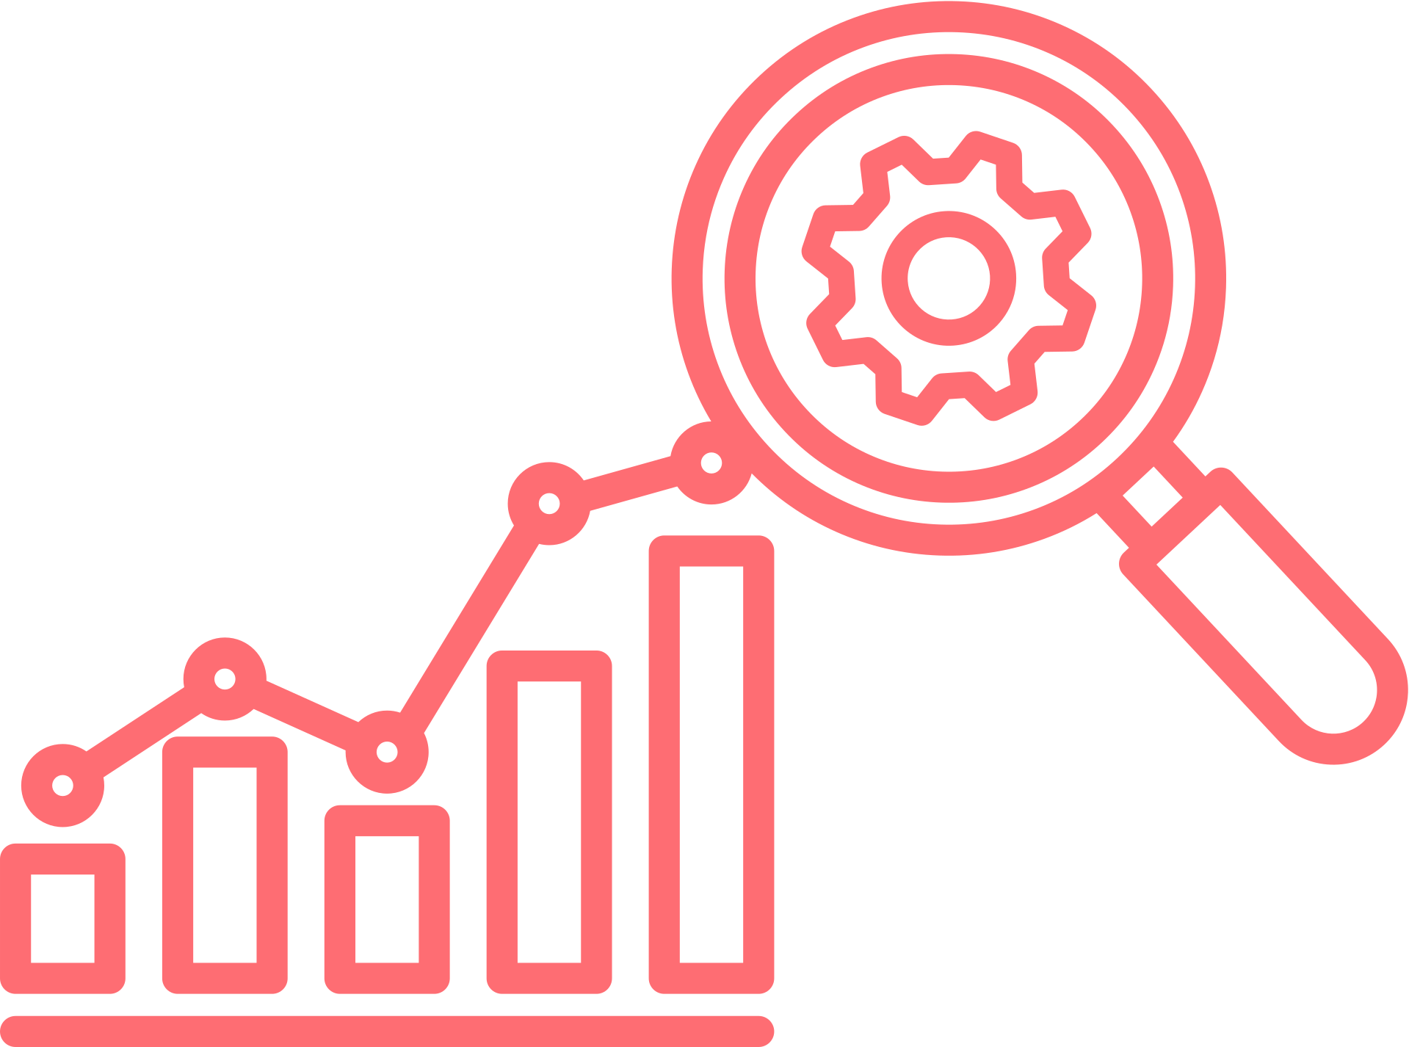


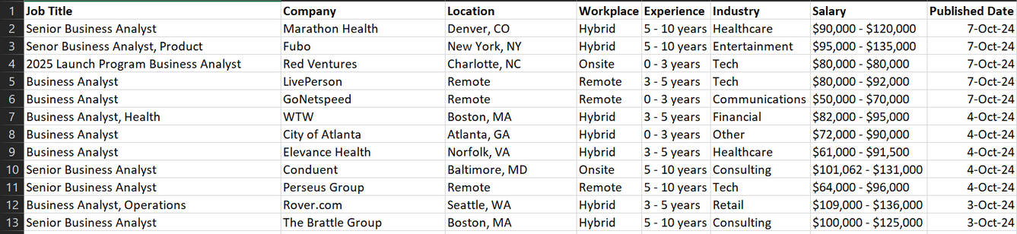

DATA SOURCE
BUSINESSANALYST.COM
1
The dataset includes (e.g., job postings for Business Analyst roles across industries, locations, and experience levels).
Job Title
Industry
Location (Remote, Hybrid, Onsite)
Salary Range
Experience Level
Date of Posting
2
Notes:
Now let’s briefly go over our approach.
The data was collected through web scraping from BusinessAnalyst.com, where we specifically focused on job roles for Business Analysts across various industries.
We used Python libraries to automate the extraction of relevant data, which allowed us to gather large amounts of information efficiently.
This approach helped us analyze the correlation between salary and factors like location, industry, and job type.
Our analysis then focused on providing clear insights into how these factors influence salary variations across different sectors.

Slide 5
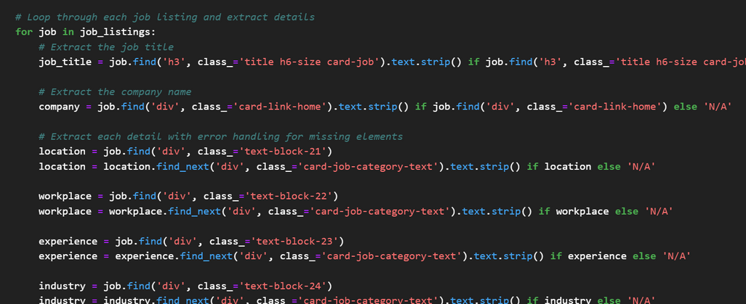
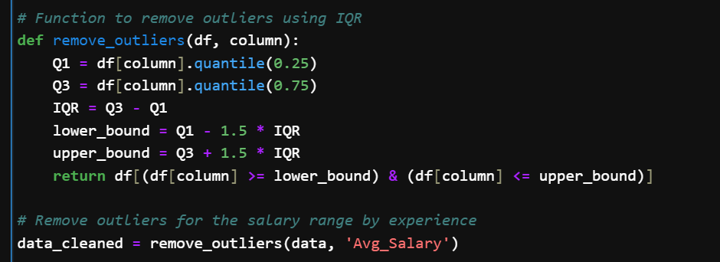
DATA EXPLORATION
code scrapes job listings from BusinessAnalyst.com across 35 pages and saves the data into a CSV file for further analysis.
Cleaned the Salary column by parsing minimum and maximum values, calculating the average salary, and standardizing the Location field by extracting cities and handling "Remote" entries.
Applied the Interquartile Range (IQR) method to the Avg_Salary column to remove outliers, retaining only values within 1.5 times the IQR for cleaner data analysis.
Notes:
During the data exploration phase, we focused on preparing the dataset for analysis:
First, we cleaned the Salary column by parsing the minimum and maximum salary values and then calculated the average salary for each job.
We standardized the Location field by extracting city names and handling entries marked as "Remote."
To ensure the accuracy of our analysis, we applied the Interquartile Range (IQR) method to remove outliers from the salary data.
This process allowed us to retain only the most relevant and clean data for further exploration.

Slide 6
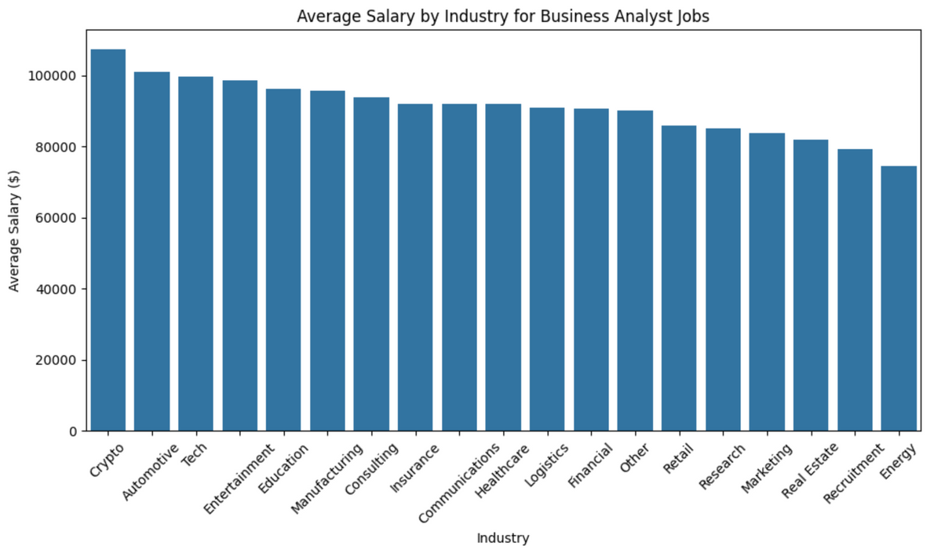
SALARY VS. INDUSTRY
Which industries offer the highest salaries for the Business Analyst roles?
Analysis:
Industries like crypto, Automotive and Tech offer the highest average salaries, while Energy and Recruitment offer comparatively lower salaries
Healthcare, Financial and consulting fall in the mid range.
Notes:
"now we’ll explore some important questions on Which industries pay the most for Business Analysts, and what factors affect these salary differences? Knowing where the highest-paying jobs are can help professionals make better career choices. Let’s start by looking at the top-paying industries and what drives these salary differences
Which industries offer the highest salaries for the Business Analyst roles?
For Business Analyst roles, the industries offering the highest average salaries include crypto, automotive, and tech, reflecting their strong demand for analytical skills and innovation. Industries such as healthcare, financial services, and consulting fall in the mid-range, offering competitive but more standardized compensation. In contrast, sectors like energy and recruitment tend to offer lower average salaries for Business Analysts, possibly due to less emphasis on data-driven roles compared to other industries.
What factors could be driving the differences in salary across industries—such as skills required or demand for analysts?"
Salary differences across industries are driven by the specific skills required, with sectors like crypto, automotive, and tech demanding advanced technical expertise. Fast-growing industries also need more data-driven insights, pushing salaries higher. Additionally, higher profit margins in certain sectors allow for more competitive compensation for Business Analysts.
"Now that we've examined the highest-paying industries for Business Analysts and the factors influencing salary differences, let's shift our focus to geographical variations. We'll explore how salary trends vary across different cities, highlighting the impact of location on compensation for this critical role.

Slide 7
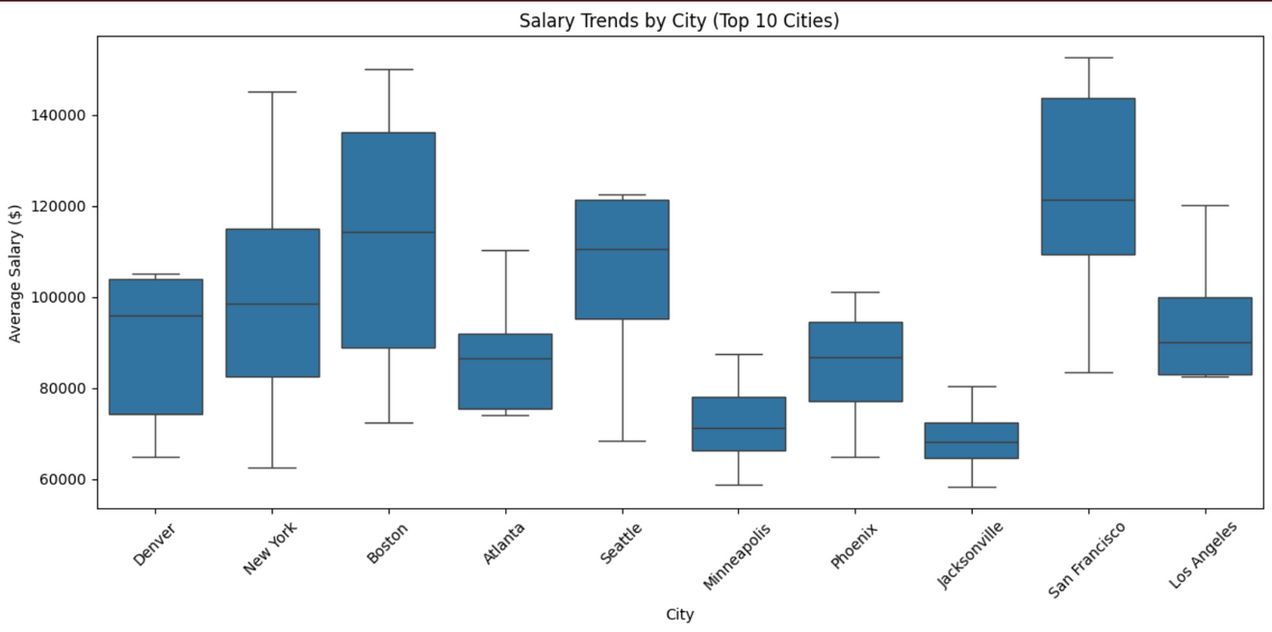
SALARY TRENDS BY CITY(TOP 10)
Which cities offer highest average salaries for Business Analysts, and what are the notable trends?
Analysis:
The box plot reveals that cities like San Francisco, New York and Boston offer higher salary ranges, with SFO having highest median salary.
Cities like Jacksonville and Minneapolis fall on the lower end of the spectrum.
Notes:
"Now, let's focus on which cities offer the highest average salaries for Business Analysts and the trends behind these figures. Understanding these geographic salary differences will help us better grasp the job market dynamics in this field."
which cities offer highest average salaries for Business Analysts, and what are the notable trends?
Certain cities offer significantly higher salaries, which could be driven by factors like a higher cost of living and intense competition for top talent. Cities that are tech or finance hubs, such as San Francisco, New York, and Boston, tend to have higher salary ranges, with San Francisco showing the highest median salary. These cities attract top-tier professionals and companies, leading to elevated pay levels. In contrast, smaller cities like Jacksonville and Minneapolis fall on the lower end of the salary spectrum, likely due to lower living costs and reduced demand for specialized talent in high-paying industries. When presenting, emphasize how the economic environment and industry focus influence regional salary differences.
Having explored the cities that offer the highest average salaries for Business Analysts and the factors influencing these trends, let's now turn our attention to job market dynamics. We'll examine monthly job postings to identify seasonal trends and hiring patterns that can provide insights into recruitment cycles throughout the year."

Slide 8
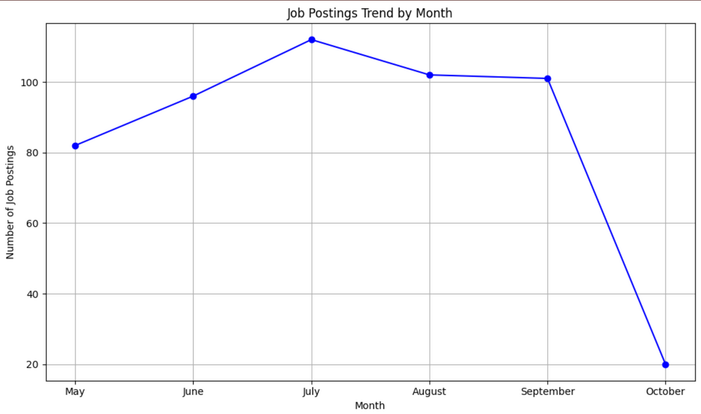
JOB POSTINGS TREND BY MONTH
Is there a seasonal trend in job postings, and if so, what months see the most demand?
Analysis:
The chart indicates that job postings peaked in July and then began to decline, especially in September and October
May through August shows a steady increase, suggesting a mid-year hiring spike.
This trend could indicate mid-year hiring cycles, possibly aligned with new budgets or business needs
Notes:
"Next, we'll look at the relationship between job postings and hiring cycles, particularly how they align with budgeting periods. Understanding these trends will help us see how they influence salary variations across different cities for Business Analysts."
The chart highlights a peak in job postings in July, followed by a sharp decline in September and October. From May to August, there's a consistent increase, indicating a mid-year hiring surge. This pattern likely reflects organizations ramping up recruitment in line with new budget allocations or shifting business priorities during that period.
Could these trends align with business cycles or budgeting periods, like the start of a fiscal year?
"Yes, these trends could align with business cycles or budgeting periods, such as the start of a fiscal year. Many organizations review their financials and set new goals mid-year, often leading to increased hiring during this time to support new projects or growth initiatives. The surge in job postings from May to August could reflect companies acting on fresh budgets, while the decline in September and October may indicate the conclusion of these recruitment phases as budgets stabilize or are fully allocated.
"Now that we've explored how job postings correlate with hiring cycles and business budgeting, let's shift our focus to geographical aspects. We'll examine salary trends by city to understand how location impacts compensation for Business Analysts and identify which regions are currently leading in salaries."

Slide 9
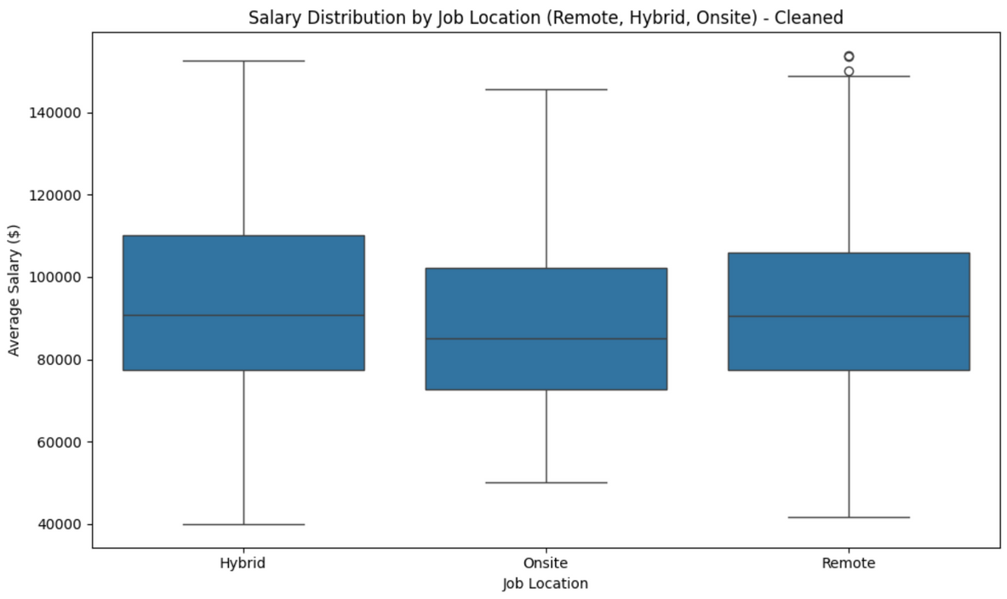
JOB LOCATION VS. SALARY
How does the flexibility of remote or hybrid jobs impact salary compared to onsite roles?
Analysis:
Median salaries for Hybrid jobs appear higher, and range is wider, indicating more variability.
Onsite jobs have narrowest range, with lowest median salary compared to other 2 categories
Hybrid roles tend to offer higher median salaries but also show more variability.
Remote roles have balanced distribution, while Onsite roles ofer the least variation.
Notes:
"Now, we’ll examine how experience levels affect salary ranges for Business Analysts. Understanding this correlation will help us see how expertise influences earning potential throughout different stages of a career."
How does the flexibility of remote or hybrid jobs impact salary compared to onsite roles?
Remote and hybrid jobs tend to offer higher salaries compared to onsite roles, with hybrid positions showing the highest median salary and the widest salary range. This suggests more variability in compensation for hybrid roles, possibly due to the mix of location flexibility and company policies. Onsite jobs have the narrowest salary range and the lowest median, indicating less variation and lower pay compared to remote and hybrid options. Remote roles show a balanced salary distribution, offering flexibility without the extremes seen in hybrid roles.
Are the highest-paying cities typically tech or finance hubs? How do smaller cities compare?"
Yes, the highest-paying cities are often tech or finance hubs, where median salaries are elevated. Smaller cities typically offer lower salaries, with less variability compared to larger metropolitan areas. Hybrid roles generally command higher median salaries and a wider range, while onsite positions have the narrowest salary range and the lowest median.
"With a clear understanding of how remote and hybrid job flexibility affects salaries, as well as the geographic factors that influence compensation, let's now delve into how experience levels shape salary ranges. We'll explore the correlation between years of experience and salary for Business Analysts, revealing how expertise impacts earning potential across different stages of their careers."

Slide 10
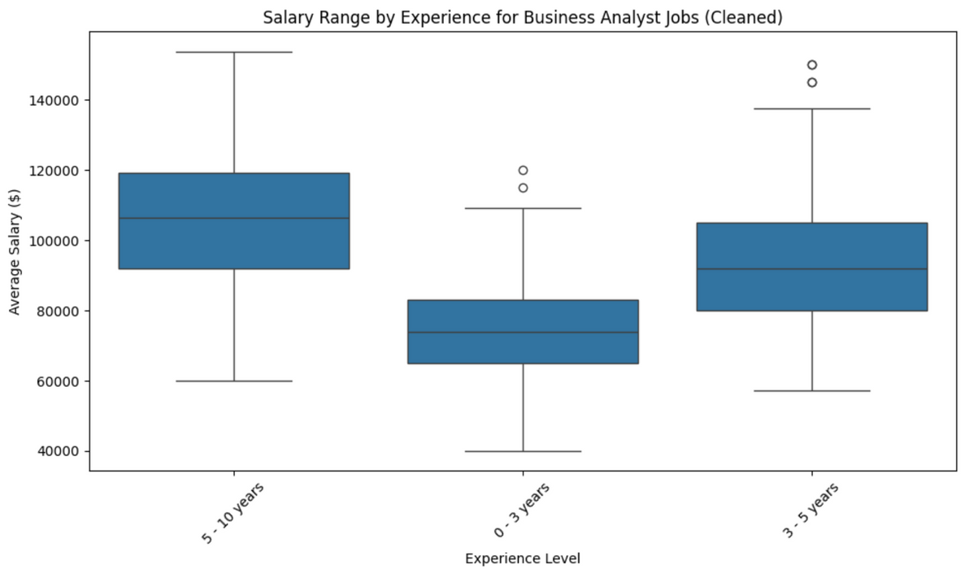
SALARY VS. EXPERIENCE
What is the correlation between experience level and salary for Business Analyst roles? Do higher experience levels consistently result in higher salaries?
Analysis:
The box plot illustrates that those with 5-10 years of experience have the highest median salary, followed by 3-5 years, while 0-3 years offer the lowest salary range.
There is also more variation in the higher experience levers, with a wider salary range for 5-10 years.
Notes:
so here if you look at the graph
The correlation between experience level and salary for Business Analyst roles shows a clear trend: higher experience levels generally lead to higher salaries. The box plot indicates that individuals with 5-10 years of experience have the highest median salary, while those with 3-5 years follow closely behind. In contrast, entry-level positions (0-3 years) offer the lowest salary range. Additionally, there is more variation in salaries at the higher experience levels, particularly for those with 5-10 years of experience, suggesting that factors such as specialized skills and responsibilities significantly impact compensation. When presenting, emphasize the importance of experience in determining salary and the wider salary range for more experienced analysts.
Are there any anomalies, such as mid-level experience earning more than senior-level roles in some cases?"
There can be anomalies where mid-level Business Analysts earn more than senior-level roles due to specific demand for certain skills, budget constraints within companies, or market dynamics favoring mid-level positions. These cases highlight that salary structures are influenced by factors beyond experience alone. Understanding these nuances is essential for navigating salary expectations in the field.
Having analyzed how job flexibility impacts salaries and the geographic variations in compensation, let's now explore how experience levels influence salary ranges. We'll examine how the salary trajectories differ based on experience for Business Analysts, highlighting the correlation between years of experience and earning potential."

Slide 11
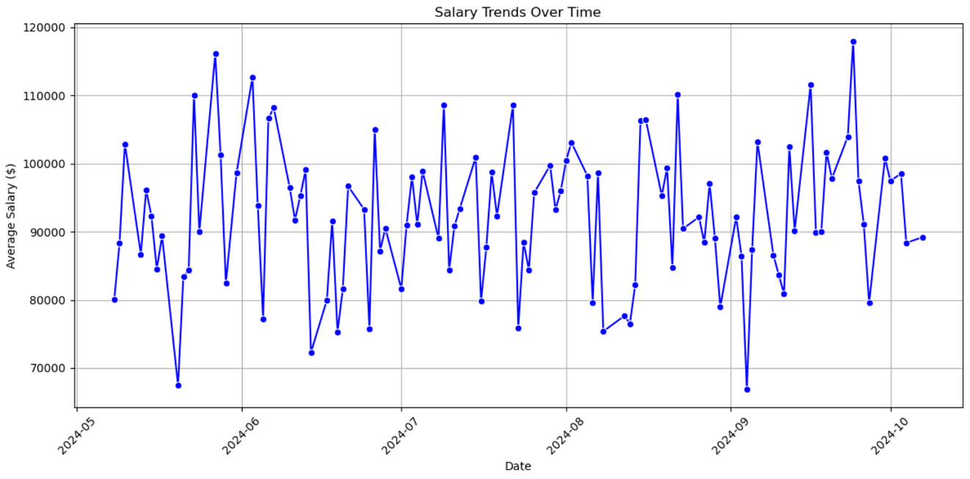
SALARY TRENDS OVER TIME
How do salary trends vary over time across industries?
Analysis:
This graph shows a clear fluctuation in average salary over time. Salaries vary widely with peaks reaching above $110,000 and dips below $80,000
There is no obvious long-term upward or download trend in salary over the time shown. Instead, the salaries appear to oscillate frequently without a clear pattern of growth or decline
Notes:
we'll explore the dynamic landscape of salary trends across various industries. By examining the fluctuations in average salaries over time, we can gain valuable insights into how market conditions and industry demands influence compensation for Business Analysts."
The salary trends across industries exhibit notable fluctuations over time, as illustrated by the graph. Average salaries vary widely, with peaks exceeding $110,000 and dips falling below $80,000. Importantly, there is no long-term upward or downward trend; instead, salaries oscillate frequently without a clear pattern of consistent growth or decline.
In conclusion, the analysis reveals that salary trends are marked by significant fluctuations, with no clear long-term pattern of growth or decline. Understanding these trends is crucial for professionals navigating their careers, as they highlight the importance of staying informed about industry changes and economic factors that may impact earning potential."

Slide 12
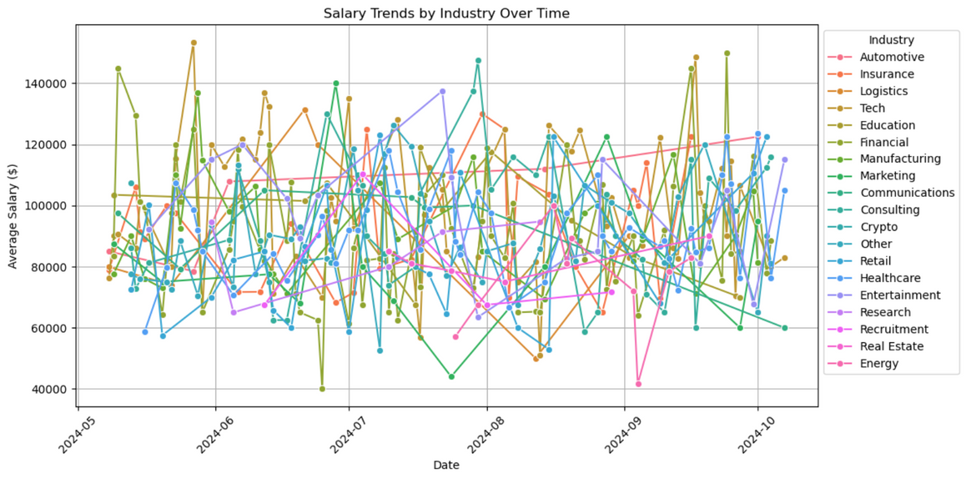
SALARY TRENDS BY INDUSTRY OVER TIME
What are the fluctuations on the salary trends across various industries over time?
Analysis:
Complexity and Overlapping Data: Due to a large number of industries, the, data points overlap extensively, making it difficult to visually distinguish any clear patterns or trends for individual industries.
The dense web of lines makes it challenging to identify which industries are experiencing salary increases, decreases, or consistent salaries. The noise in the data obscures potential insights
Notes:
Slide Title: Salary Trends by Industry Over Time
Opening:
"Let's take a look at how salary trends vary across different industries over time."
Analysis of Plot:
"As you can see from this graph, it's quite dense and cluttered, with many lines overlapping."
"The overlapping data points make it difficult to identify clear patterns for individual industries."
"This type of complexity highlights how salary trends fluctuate in various industries, but at the same time, the data doesn't allow us to pinpoint specific insights due to its crowded nature."
Key Points:
"When analyzing trends across multiple industries like this, the noise in the data makes it hard to determine whether salaries are increasing, decreasing, or remaining stable in specific sectors."
"The web of lines here illustrates that each industry’s salary trends are influenced by various factors like demand, economic conditions, and industry-specific challenges, but the cluttered view makes it hard to draw concrete conclusions."
Transition:
"Because of this complexity and the difficulty in interpreting these salary trends visually, let's focus on a specific industry to provide clearer insights."

Slide 13

HEALTHCARE INDUSTRY
Notes:
"Now, let’s narrow our focus to the healthcare industry, which offers us a more detailed and actionable perspective on salary trends."
"By focusing on one industry, we can analyze trends more effectively and draw meaningful insights."
"The healthcare industry has been particularly volatile in recent months, with many factors such as technological advancements, workforce shortages, and policy changes contributing to salary fluctuations."

Slide 14
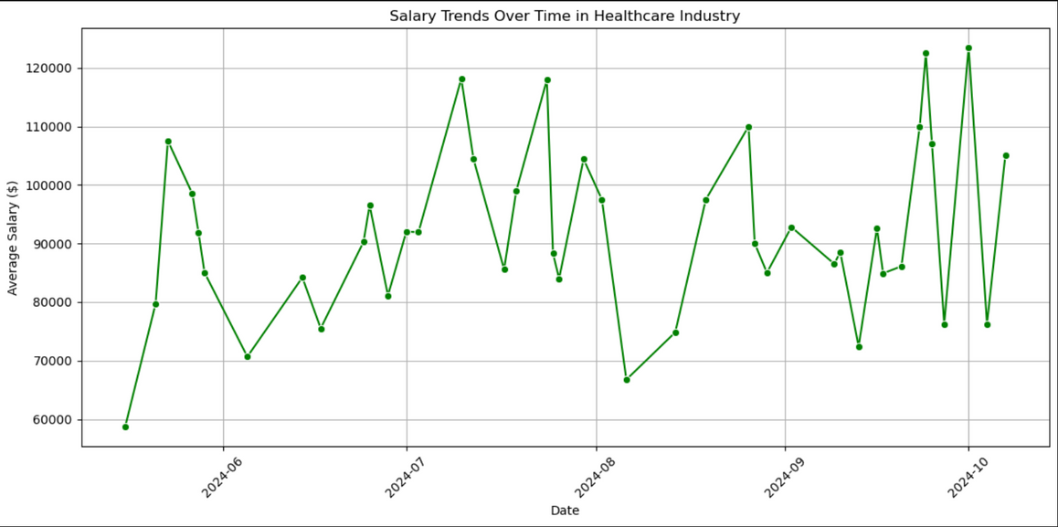
SALARY TRENDS IN HEALTHCARE
What are the salary trends in Healthcare?
Analysis:
Early Peak: Around June 2024, there is a sharp rise in salaries , peaking at over $100,000 before gradually declining.
Volatility in Salaries: Throughout the entire period, salary trends demonstrate high volatility with frequent ups and downs. This suggests an unstable or rapidly changing compensation environment within the industry during this time frame.
Notes:
Overview:
"This graph illustrates the salary trends in the healthcare industry from June to October 2024, and it offers us some fascinating insights into how compensation has evolved."
Key Points:
Early Peak:
"Notice that around June 2024, there's a sharp spike in salaries, with compensation reaching over $100,000."
"This early peak might be attributed to a range of factors, such as increased demand for healthcare professionals, perhaps due to pandemic recovery, or shifts in healthcare policy that created salary surges for specialized roles."
Volatility in Salaries:
"However, this initial peak is followed by a significant dip and then a series of erratic fluctuations throughout the rest of the period."
"The volatility suggests that the healthcare industry has been facing an unstable compensation environment. Factors such as changes in healthcare regulations, workforce shortages, or the introduction of new technologies could be driving these sharp fluctuations."
"Frequent ups and downs indicate that while there are opportunities for higher compensation, the overall industry faces uncertainty, likely reflecting the rapid changes happening within healthcare today."
"While we've seen the overall salary trends in healthcare fluctuate dramatically, it's also important to understand how job types—specifically remote vs onsite roles—impact salaries and how experience plays a part in shaping these dynamics."

Slide 15
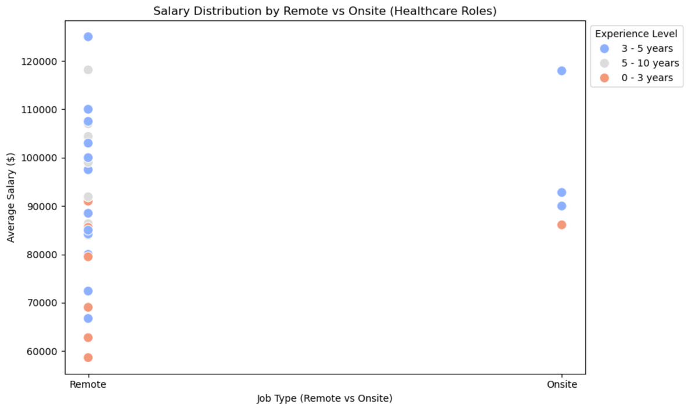
SALARY DISTRIBUTION IN HEALTHCARE ROLES (REMOTE VS ONSITE)
Is there a significant difference in salaries between remote and onsite roles in the Healthcare Industry?
Analysis:
Remote Roles: Employees with 3-5 years of experience dominate the remote roles, while those with 0-3 years also gave a fair presence but tend to earn lower salaries. Very few employees with 5-10 years of experience are represented in the remote roles
Onsite Roles: Onsite jobs are represented by fewer data points. There is a slightly more balanced representation of all three experience levels. Those with 3-5 years of experience still earn higher salaries, while employees with 0-3 years of experience occupy the lower salary end. Notably there are very few earning $100,000 in onsite positions
Notes:
Slide Title: Salary Distribution in Healthcare Roles (Remote vs Onsite)
Introduction:
"Now, let’s dive deeper into a crucial comparison: the difference in salaries between remote and onsite roles in the healthcare industry, and how these are influenced by experience levels."
Remote Roles:
"What we can see here is that remote roles are primarily dominated by employees with 3-5 years of experience. They tend to be clustered around the higher salary range—some crossing the $100,000 mark."
"Interestingly, while employees with 0-3 years of experience are also present in remote roles, they tend to earn significantly less, sitting mostly in the $60,000-$80,000 range."
"One thing to note is the absence of many highly experienced professionals—those with 5-10 years of experience—in remote roles. This could indicate that senior positions in healthcare may still be largely onsite or that those roles demand physical presence due to their nature."
Onsite Roles:
"Onsite jobs present a slightly different picture. We see fewer data points overall, but the representation is more balanced across all three experience levels."
"While those with 3-5 years of experience still occupy the higher salary ranges, it’s notable that there are fewer onsite professionals earning above $100,000 compared to remote roles."
"Employees with 0-3 years of experience in onsite roles tend to cluster around the lower end of the salary spectrum, below $80,000."
Key Insights:
"This contrast indicates that remote roles in healthcare offer a wider range of high-paying opportunities, particularly for mid-level professionals with 3-5 years of experience. Meanwhile, onsite roles, while balanced, may offer slightly less in terms of high compensation, especially for less experienced individuals."
Closing:
"This distinction between remote and onsite roles highlights how healthcare, as a rapidly evolving industry, is adapting to flexible work environments, and that certain experience levels are benefiting more than others in this shift."

Slide 16
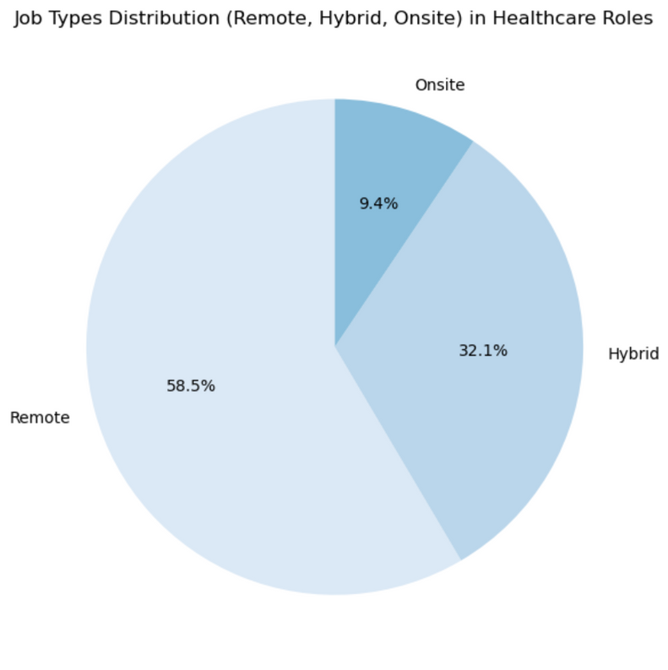
JOB TYPES DISTRIBUTION
How does the distribution of remote, hybrid and onsite role compare in Healthcare industry?
Analysis:
Remote Role Dominance : This reflects the growing trend in the healthcare industry , where many administrative, analytical and technical jobs have transitioned to remote work due to advancements in digital health and remote working infrastructure
Significant Hybrid presence : A significant roles are hybrid indicating many companies still value a mix of in-office and remote work, possibly for team collaboration reflecting Healthcare need for on-site interaction while maintaining flexibility
Notes:
"Now that we've explored the salary implications for remote and onsite healthcare roles, let's take a look at how different job types—remote, hybrid, and onsite—are distributed across the industry, which can provide deeper insights into the shift in work environments."
Analysis of Job Types Distribution:
Remote Role Dominance:
"The first thing that stands out is that 58.5% of roles are remote. This clearly reflects a growing trend in the healthcare industry where many administrative, technical, and analytical roles have transitioned to remote work."
"This shift is likely driven by advancements in digital health technologies and improvements in remote-working infrastructure, allowing healthcare professionals to perform tasks efficiently without being physically present in traditional healthcare settings."
Significant Hybrid Presence:
"Another key observation is the 32.1% representation of hybrid roles. This significant portion indicates that many companies are still valuing a mix of in-office and remote work. This could be due to the need for team collaboration or certain healthcare roles that require some level of onsite interaction, particularly in clinical settings where patient care is involved."
"Hybrid roles likely reflect the flexibility required in healthcare to maintain both in-person patient engagement and the increasing reliance on digital solutions."

Slide 17
JOB TYPES DISTRIBUTION
How does the distribution of remote, hybrid and onsite role compare in Healthcare industry?
Analysis:
Relatively Low Onsite Roles: Onsite roles make up 9.4% which suggests that the necessity for business analysts to be physically present in healthcare settings is much lower compared to other industries where on-site work may be critical.
Notes:
Onsite Roles:
"Finally, 9.4% of roles are purely onsite, which is expected to remain a necessity for direct patient care or roles that require physical presence, such as surgeries or hands-on clinical procedures."
Conclusion:
"This distribution tells us that the healthcare industry is adapting to modern work environments, with a strong inclination toward remote and hybrid roles. However, the presence of onsite roles shows that physical interaction in healthcare will always have its place."
"In summary, we’ve explored various aspects of salary trends and job type distributions within the healthcare industry. We saw how volatile the industry can be, with remote roles gaining prominence, hybrid roles balancing flexibility, and onsite roles maintaining relevance for direct patient care."
"The overall shift towards remote and hybrid models speaks to the growing reliance on technology and the need for a flexible workforce to meet both operational and healthcare demands."
"Now that we’ve laid the groundwork for understanding the current job landscape in healthcare, it's time to explore how technology, specifically AI applications, is revolutionizing this sector. Let’s take a look at how AI is being integrated into healthcare and the vast opportunities it offers."

Slide 18

AI APPLICATIONS

Slide 19
WHAT IS AI?
Artificial intelligence is a field of science concerned with building computers and machines that can reason, learn, and act in such a way that would normally require human intelligence or that involves data whose scale exceeds what humans can analyze.
Notes:
Artificial Intelligence (AI) is the ability of machines to perform tasks that typically require human intelligence.
This includes learning from data, understanding language, and recognizing images. AI helps improve efficiency and decision-making by automating tasks and analyzing large amounts of information.
In web scraping, AI can make the process smarter by adapting to changes in websites and extracting valuable data more effectively.
Overall, AI enhances how we use technology to solve problems and make our lives easier.

Slide 20
WHAT IS WEB SCRAPPING?
Web scraping is the automated process of extracting large amounts of data from websites by mimicking human browsing behavior. This technique collects web content such as text, images, and other structured or unstructured data, and converts it into a usable format like a spreadsheet or database for further analysis or application.
Notes:
Web scraping is the automated process of extracting data from websites, allowing users to gather specific information for various applications, such as market research and data analysis. It involves techniques like HTML parsing, web crawling, and using APIs to access structured data. Various tools and libraries, such as Scrapy and Selenium, facilitate this process, especially for dynamic content.
The extracted data can be saved in formats like CSV or JSON for further analysis and utilization.

Slide 21
AI application in web scraping and the future of web scraping.
Natural Language Processing (NLP): AI uses NLP to extract, understand, and process data from unstructured sources like blogs, news articles, and product reviews, turning them into valuable insights
AI for Data Cleaning and Structuring: AI scrapers can automatically clean and normalize data during extraction, converting messy or inconsistent data into structured, ready-to-use datasets, minimizing manual intervention.
Intelligent Automation and Learning: Machine learning models are being trained to detect changes in website structures and adapt scraping techniques automatically, making the scraping process more resilient to frequent changes in website code.
Notes:
AI application in web scraping and the future of web scraping.
As we know, AI is revolutionizing web scraping, making it more efficient and adaptable to increasingly complex websites. Here are some ways AI is being applied to web scraping, along with future trends:
Natural Language Processing (NLP): AI can use NLP to extract meaningful data from unstructured text, such as articles, reviews, or social media posts. This helps make sense of the content beyond basic HTML parsing.
AI for Data Cleaning and Structuring:
AI scrapers can automatically clean and normalize data during extraction, converting messy or inconsistent data into structured, ready-to-use datasets, minimizing manual intervention.
Intelligent Automation and Learning:
Machine learning models are being trained to detect changes in website structures and adapt scraping techniques automatically, making the scraping process more resilient to frequent changes in website code.
Future of Web Scraping with AI:
Autonomous Scrapers: Self-learning systems adapt and improve over time.
Real-Time Extraction: AI enables instant data extraction and actionable insights.

Slide 22
AI applications in data visualization and its future:
Data visualization is the graphical representation of information and data using visual elements like charts, graphs, maps, and dashboards.
Automated Data Insights: AI-powered tools can automatically analyze datasets and generate visualizations that highlight key patterns, trends, and outliers, saving time and providing deeper insights.
Future of Immersive Visualization: The integration of AI with virtual reality (VR) and augmented reality (AR) technologies will revolutionize data visualization, creating immersive environments for data exploration.
Real-Time and Interactive Visuals: The future of data visualization will see AI enabling real-time data streaming and interactive visuals that automatically update as new data comes in, allowing users to explore and manipulate data more intuitively.
Notes:
Data visualization helps by simplifying complex data, enabling users to quickly identify trends, patterns, and outliers. It enhances understanding and retention of information, facilitating better decision-making and communication among stakeholders. Additionally, visual representations make data more accessible, allowing non-technical users to engage with and interpret insights effectively.
Automated Insights: AI enhances dashboards by detecting patterns and generating visuals or narratives automatically.
Future of Immersive Visualization:
This evolution aims to make data more accessible and engaging, fostering a deeper understanding of complex datasets.
Real-Time Visualization: AI processes live data for dynamic, real-time insights, crucial in sectors like finance and IoT.

Slide 23
Q & A SESSION

Slide 24
THANK YOU!

