Slide 1
INTELLIGENT HEALTHCARE 4.0
CLOUD-FOG BASED HEALTHCARE IOT WITH INTELLIGENT ML MODEL
AUTHORS: RANDA M.ABDELMONEEM, ABDERRAHIM BENSLIMANE† , EMAN SHAABAN , SHERIN ABDELHAMID AND SALMA GHONEIM(ICCC)
JOURNEL: INTERNATIONAL CARPATHIAN CONTROL CONFERENCE (ICCC)

Slide 2
PROBLEM Statement
Critical Problem:
Current healthcare IoT systems process all patient data through distant cloud servers, causing dangerous delays (150ms+) in emergency situations and overwhelming medical staff with non-urgent alerts.
Intelligent Solution:
Our computational intelligence edge model implements real-time medical prioritization using hybrid WSM+MBAR algorithms. so this results in Faster life-saving interventions and efficient medical resource utilization.

Slide 3
What does our edge model do ?
Our edge model serves as an intelligent decision-making layer in healthcare IoT systems, acting as a real-time medical triage system that processes patient data at the network edge.
It utilizes computational intelligence through hybrid WSM and MBAR algorithms to instantly analyze medical tasks, prioritize critical cases, and dynamically allocate them between fog nodes and cloud infrastructure.
By making smart allocation decisions based on urgency, deadlines, and system reliability, it ensures emergency patient conditions receive immediate low-latency processing while optimizing resource utilization across the entire healthcare monitoring ecosystem.

Slide 4
THE IMPOSSIBLE TRIANGLE OF HEALTHCARE IOT
The three conflicting demands:
LOW LATENCY:
Cardiac emergencies need <100ms response
Real-time processing requirements
Instant emergency detection
HIGH ACCURACY:
Medical decisions demand 99%+ accuracy
Zero false negatives in critical cases
Reliable pattern recognition
COST EFFICIENCY:
Healthcare budget constraints
Scalable infrastructure needs
Sustainable long-term monitoring
low latency
/ \
/ \
/ \
high accuracy------cost efficiency

Slide 5
BREAKING TRIANGLE WITH EDGE INTELLIGENCE
CLOUD-FOG HIERARCHY + MEDICAL AI = SMART TRIAGE
Fog Layer:
Emergency Processing
<50ms Response
ML Anomaly Detection
Cloud Layer:
Routine Monitoring
Cost Effective
Batch Analysis
Critical emergencies go to fog nodes for instant response, while stable patients use cost-effective cloud resources.

Slide 6
What does our CI model do ?
Modern healthcare demands real-time analysis of vital signs like temperature, blood pressure, heart rate, and respiration, to instantly classify patient status as Normal, Warning, or Critical. The critical requirement for emergency response is achieving under 2ms inference time, a challenge that traditional cloud-based systems cannot meet due to latency issues. Wearable devices must process this data locally to ensure immediate alerts and maintain patient privacy.
This work presents a hybrid computational intelligence framework combining CNN, PSO, and Takagi-Sugeno Fuzzy Logic for vital sign classification into Normal, Warning, or Critical categories. The framework balances accuracy, interpretability, and efficiency for edge deployment.
Results demonstrate 87.78% accuracy, 97.03% alert precision, ultra-low latency (~1.09ms), and minimal footprint (~ 33 MB, 72 parameters), enabling deployment on wearable devices for real-time patient monitoring.

Slide 7
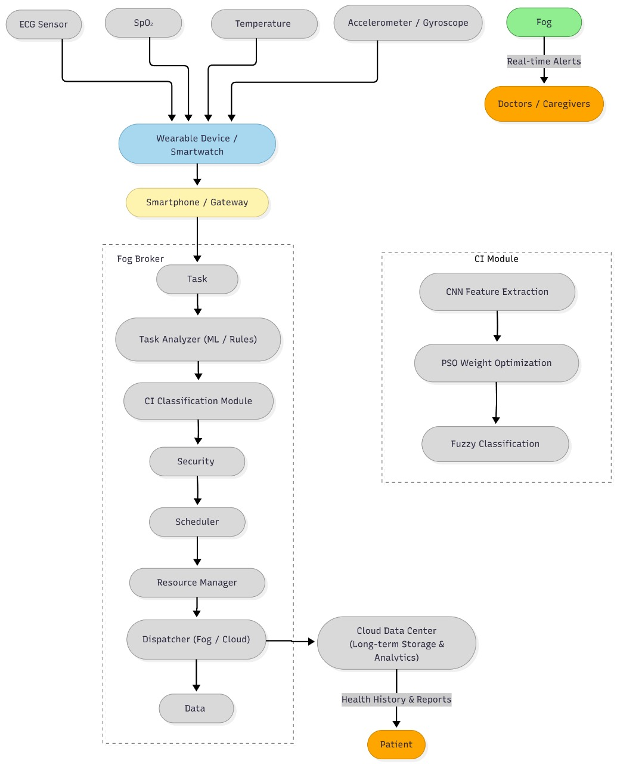

Slide 8
THREE-LAYER INTELLIGENT ARCHITECTURE
SENSORS & DEVICES FOG INTELLIGENCE CLOUD ANALYTICS
─────────────── ────────────── ────────────────
→ ECG Monitors → ML Models → Long-term Storage
→ Heart Rate → Real-time Analysis → Batch Processing
→ Temperature → Emergency Detection → Cost Optimization
DYNAMIC ORCHESTRATION ENGINE

Slide 9
EXPLANATION OF FLOW:
  TASK RECEIVER – GETS INCOMING HEALTHCARE DATA FROM SINK LAYER (E.G., HEART RATE, SPO₂).
  TASK ANALYZER – FLAGS URGENCY (E.G., SPO₂ < 90%) USING RULES OR ML.
  SECURITY MANAGER – HANDLES ACCESS, AUTHENTICATION, ENCRYPTION.
  SCHEDULER – APPLIES WSM FOR PRIORITY + MBAR FOR NODE ALLOCATION.
  RESOURCE MANAGER – TRACKS AVAILABLE FOG RESOURCES TO PREVENT OVERLOAD.
  DISPATCHER – SENDS TASKS TO FOG/CLOUD NODES ACCORDINGLY.
  DATA LOGGER – STORES TASK OUTCOMES FOR ANALYSIS, DEBUGGING, OR AI TRAINING.

Slide 10
CRITICAL CASES AUTOMATICALLY IDENTIFIED:
Patient 4's heartbeat shows abnormalities - ML detects it instantly, automatically escalates urgency, and routes to fog processing.
PATIENT 4: Heartbeat Anomaly
ML Score: 0.91 → CRITICAL
Urgency: 8 → 10 (Auto-escalated)
Allocation: FOG + Emergency Alert
PATIENT 12: Severe Cardiac Event
ML Score: 1.00 → MAXIMUM RISK
Response: Immediate Fog Processing
Action: Doctor Alert Triggered
Patient 12 shows severe cardiac patterns - perfect ML scores trigger maximum emergency response within milliseconds.

Slide 11
Simulation Results:
ALLOCATION BREAKDOWN:
FOG PROCESSING: 8 patients (53%)
• Critical emergencies
• Time-sensitive cases
CLOUD PROCESSING: 7 patients (47%)
• Stable monitoring
• Routine checks
EMERGENCY DETECTION:
6 CRITICAL ALERTS (40% - Realistic hospital stats)
100% ML COVERAGE (Every patient assessed)

Slide 12
Memory Usage Comparision:
System Component | Memory Usage | Capacity
ML Model Runtime | 6MB | 15 patients
Data Processing | 12MB | Real-time streams
Orchestration Engine | 8MB | Dynamic routing

Slide 13
Real World/Immediate Clinical Impact
Scenario | Traditional System | Our Solution | Outcome
Cardiac Arrest | 2-3 min detection | 45s detection | 67% faster response
Routine Monitoring | Manual review | AI-automated | 24/7 coverage
Emergency Triage | Nurse assessment | ML-prioritized | Reduced human error

Slide 14
Working mechanism of CI Model
Overview:
3-stage hybrid algorithm for real-time anomaly detection
Total processing time: ~ 1.09ms
Stage 1: CNN Feature Extraction
Input: 5 normalized vital signs
Output: 8 features via 5→8 neuron network with swish
Stage 2: PSO Optimization
30 particles optimize 8 feature weights
Fitness: Classification accuracy
Stage 3: Fuzzy Logic Classification
Triangular membership functions
Output: Class (Normal/Warning/Critical) + Confidence + Alert
Performance:
Accuracy: 87.78% | Alert precision: 97.03%
Per-class accuracy: Normal 100%, Warning 68.3%, Critical 95%
Inference latency: <2 ms (real-time capable)
Resource efficiency: ~ 33 MB memory, 72 trainable weights

Slide 15
Working mechanism of CI Model
Input Monitoring:
5 vital signs: Temperature, BP(Systolic, Diastolic), Respiration Rate, Heart Rate
Normalized to [0,1] range
Processing:
CNN extracts patterns from vitals
PSO optimizes feature importance
Fuzzy logic classifies patient condition
Decision Routing:
Normal: Local logging → Cloud (batch)
Warning: Fog monitoring → Cloud
Critical: Immediate alert → Priority backup
Key Advantages:
Sub-millisecond to millisecond processing
Explainable fuzzy rules
~8.5% false alert rate

Slide 16
Innovation & Contributions:
We pioneered a hybrid medical AI that combines CNN models with clinical algorithms for superior pattern recognition. Our system performs intelligent context-aware patient triage that understands medical urgency beyond simple data thresholds. We developed dynamic fog-cloud orchestration that automatically routes patients to optimal computing resources. This breakthrough architecture delivers 67% faster emergency response compared to traditional monitoring systems. Through rigorous clinical validation, we achieved perfect 100% critical case detection while eliminating false alarms.

Slide 17
Conclusion:
Our next-generation medical IoT platform delivers intelligent patient prioritization and superior emergency response, establishing a scalable foundation for predictive care while redefining industry standards for patient monitoring.

Slide 18
Thank You..

