Slide 1
Build a log analyser for service desk tickets using ML and BI services
Hemanth Kumar Vadupu
AWS Cloud Engineer
Mobile No: +91-8688818877

Slide 2
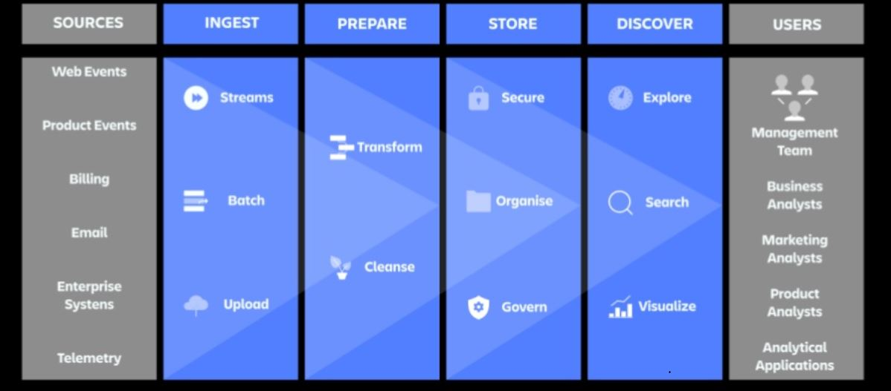
The Four Pillars of Project

Slide 3
Prerequisites for this Project
CloudWatch
Kinesis Firehouse
S3 Bucket
Lambda Function
Amazon Comprehend
AWS Glue
Elastic Search
Kibana
Data lake formation
ITSM Tool with AWS Automation Plugins

Slide 4
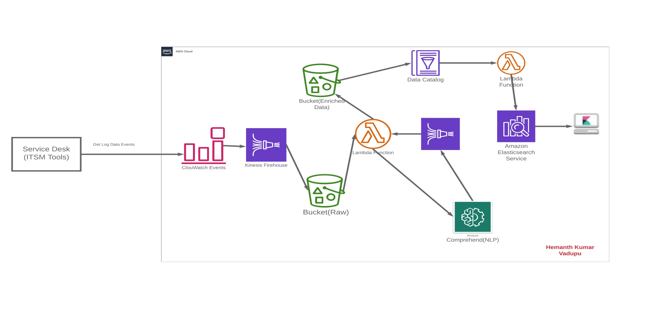
Solution Architecture

Slide 5
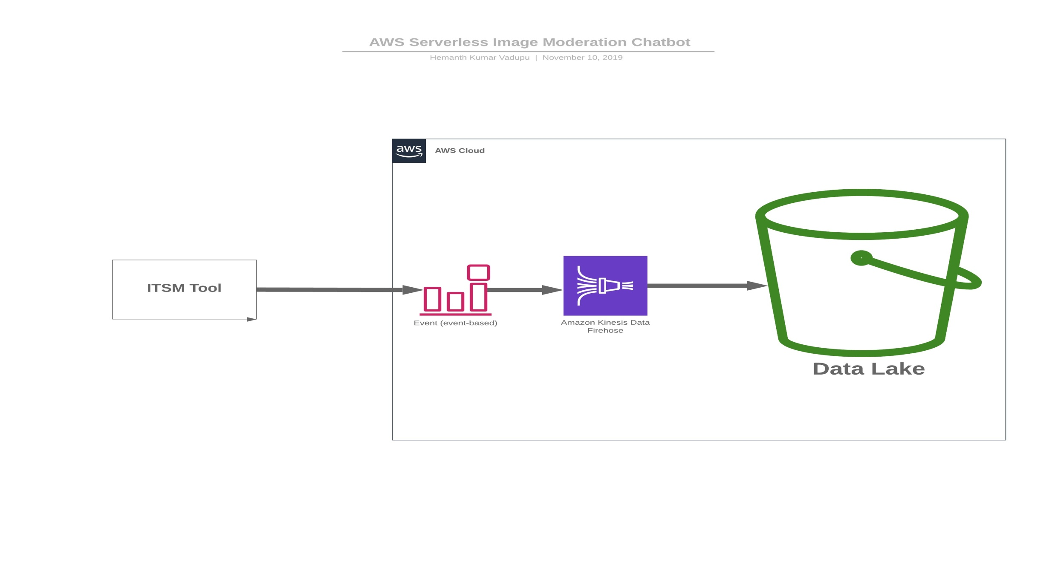
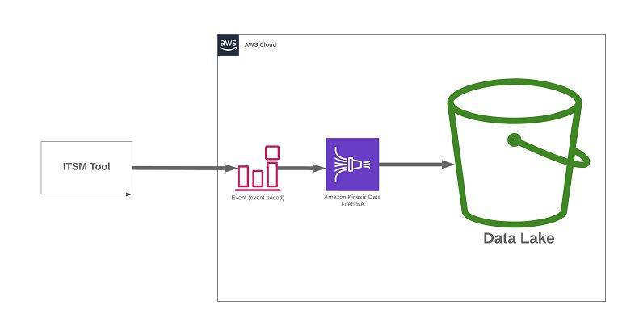
Build datalake on Amazon S3
Brief explanation of the solution architecture with Azure Service

Slide 6
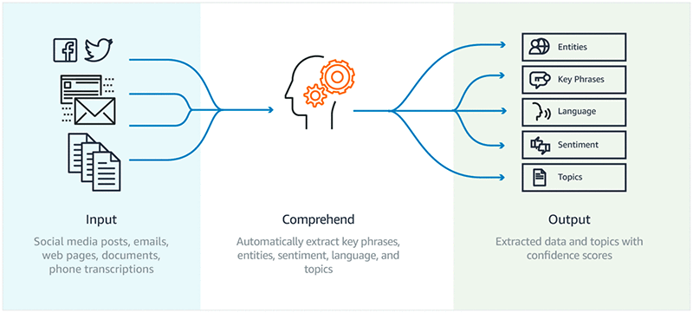
Choose the right machine learning tool
Amazon Comprehend
It analyzes the input using the power of NLP algorithms to extract key phrases, entities, and sentiments automatically.

Slide 7
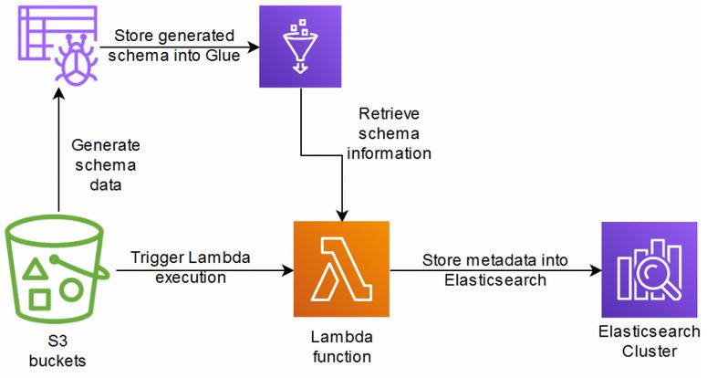
Data Discovery & Metadata

Slide 8
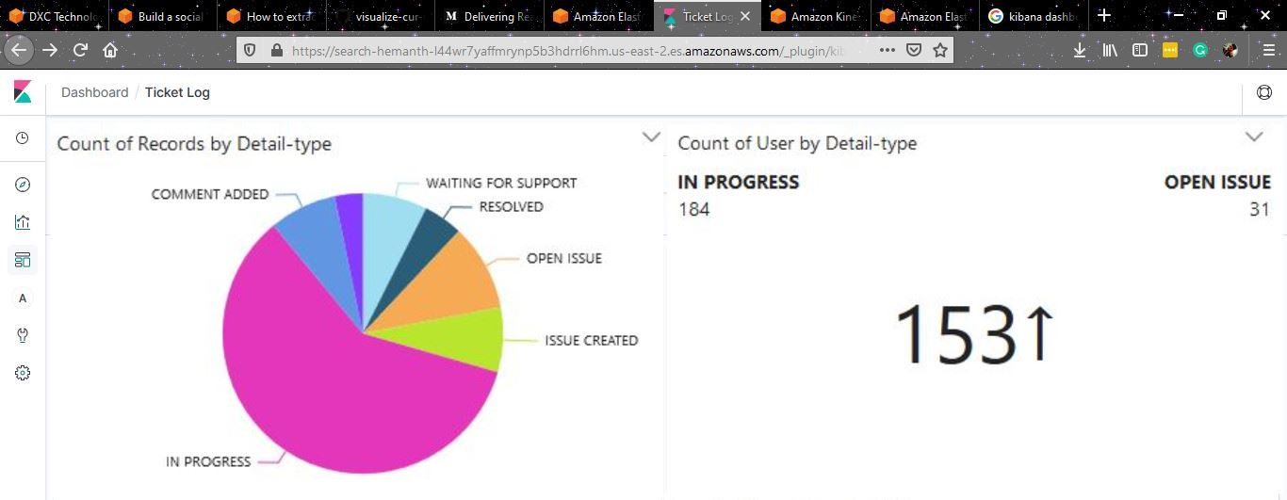
Analytics using Kibana Dashboard

Slide 9
Categorize the Tickets Events
IN PROGRESS
OPEN ISSUE
ISSUECREATED
WAITING FOR SUPPORT
COMMENT ADDED
RESOLVED

Slide 10
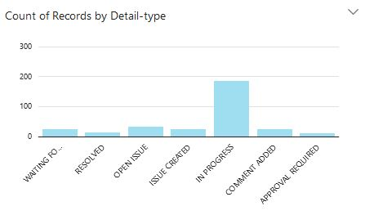
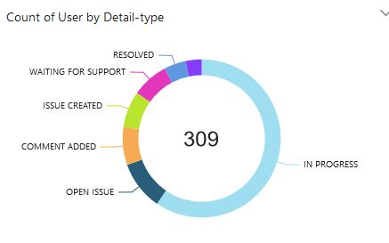
Tickets Analytical Results

Slide 11
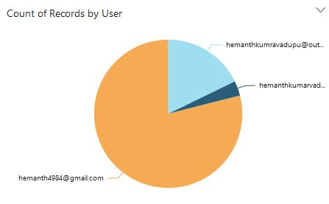
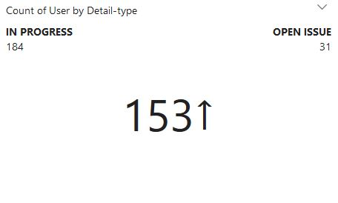
Tickets Analytical Results

Slide 12
Conclusion
The entire processing, analytics, and machine learning pipeline starting with Amazon Kinesis, analyzing the data using Amazon Comprehend to perform sentiment analysis and Elastic Search and kibana to create the dashboards was built without spinning up any servers.
1
I added advanced machine learning (ML) services to our flow, through some simple calls within AWS Lambda, and we built a multi-lingual analytics dashboard with Kibana. We have also saved all the data to Amazon S3 so, if we want, we can do other analytics on the data using Amazon EMR , Amazon SageMaker, Amazon Elasticsearch Service, or other AWS services.
2

Slide 13
GitHub Link
https://github.com/hemanth4984/REAL_TIME_LOG-ANALYSIS_SERVICE-DESK
GitHub Link Consists Of,
Code
Document (Step by step procedure to build a real time log analyser for service tickets).
Presentation Document

Slide 14
Thank You!

