Slide 1

CMR TECHNICAL CAMPUS Accredited by NBA, Approved by AICTE, affiliated to JNTUH Kandlakoya (V), Medchal Road, Hyderabad -501401
DEPARTMENT OF COMPUTER SCIENCE AND ENGINEERING
AI Model For Digital Evaluation of Descriptive Answers
Under the guidance of GROUP MEMBERS
A.Kiran Kumar CH. Mahesh(197R5A0511)
P. Hemanth(197R5A0509)
A. Venkat Vijay(197R5A0512)

Slide 2
Contents
Abstract
Existing System
Disadvantages
Proposed System
Advantages
Hardware Requirements
Software Requirements
System Architecture
Project modules
UML Diagrams
Data Flow Diagram
Sample Code
Screenshots
Future Enanchments
Conclusion

Slide 3
ABSTRACT
Modes of evaluation can be bifurcated into two main types, namely, objective answer evaluation and subjective answer evaluation
In this project, we will build a framework using Artificial Intelligence approach to evaluate subjective answers
The framework has come up with a reliable system based on previous work that formulates the marks scored by the student based on the sentence similarity, Jaccard similarity, and grammar of the model answer and student answer.

Slide 4
EXISTING SYSTEM:
There are many existing evaluating systems which were divided into three main phases which includes prediction of best answers for short questions using NLP.
In essay type long answer evaluation using tools and technologies such as sentence splitting, POS tagging, wordnet and tokenizing.
In the final phase, an approach for qualitative evaluation of structured answers using keyword analysis and sentence analysis is explained.

Slide 5
DISADVANTAGES
The existing systems are only capable of evaluating MCQ type questions and there is a need for a system to evaluate subjective answers.
In traditional method human errors are likely to occur since evaluators have to examine numerous answer papers at every term’s end, this can result in inconsistencies in the correction.
This fails to take into account the different ways in which the same concept can be explained as it evaluates answer on a text-base only.

Slide 6
PROPOSED SYSTEM
This Model comes with the opportunity of making a tedious and tiresome task in the field of education more efficient and less time consuming using Artificial Intelligence
In this system, The input answer sheets of the student will get compared to the model answer sheet by the evaluator and will then generate the final score based on multiple parameters.
In this system OCR will be used to convert handwritten student answers into digital letters. Splitting the model answer and student answer into sentences and then applying Jaccard similarity, grammar checking and algorithm for sentence similarity using BERT on both the texts.

Slide 7
ADVANTAGES
Artificial intelligence can help tackle this by not omitting human errors.
It uses a weighted average of the closest to accurate techniques to provide the most optimized result.

Slide 8
HARDWARE REQUIREMENTS
System : i5 processor.
Hard Disk : 100 GB.
Ram : 4GB

Slide 9
SOFTWARE REQUIREMENTS
Operating system : Windows 7 or Above.
Coding Language : Python.
Tool : python ide, Colab, Flask(Framework).
Database : Firebase DB.

Slide 10
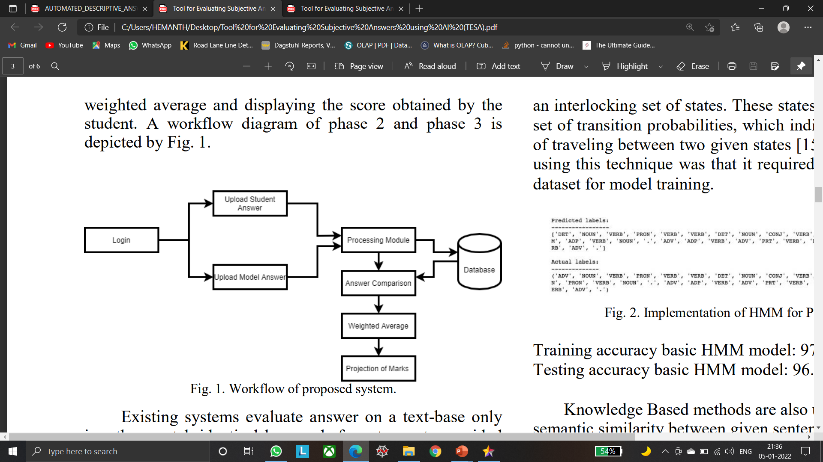
Architecture

Slide 11
Module description
Load Answers:- In this Modules the Model Answers are Loaded and given to the AI MODULE
PRE-PROCESSING:- In this Module The Input Answers are preprocessed such as Extracting Answers.
MODEL TRAINING:- In this Module The model is Trained with Model Answers and evaluation is performed on the Answers
Evaluation:- In this Module The Evaluation is performed on the Answers Written by the Students by Using AI MODEL and Results are Obtained

Slide 12
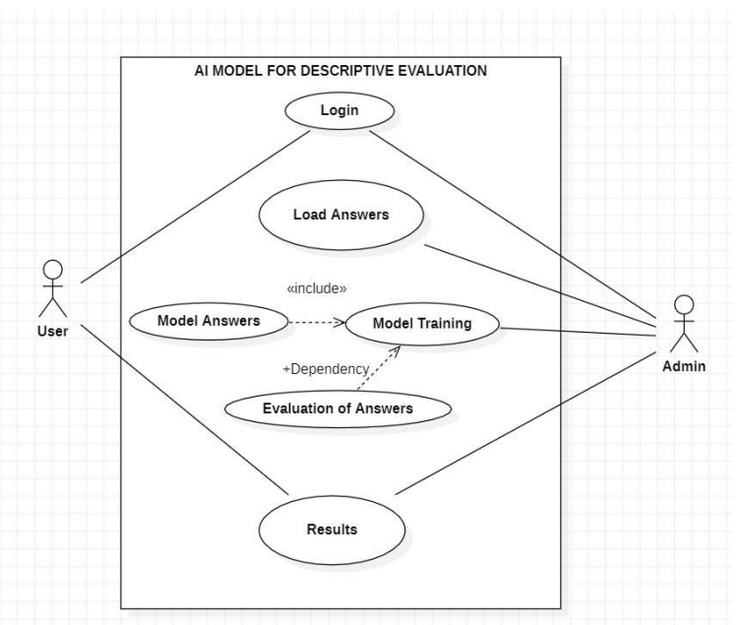
UML DIAGRAMS use case diagram

Slide 13
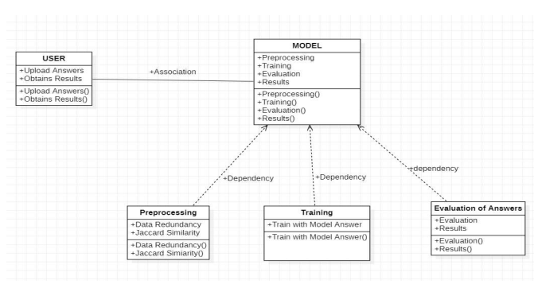
CLASS DIAGRAM

Slide 14
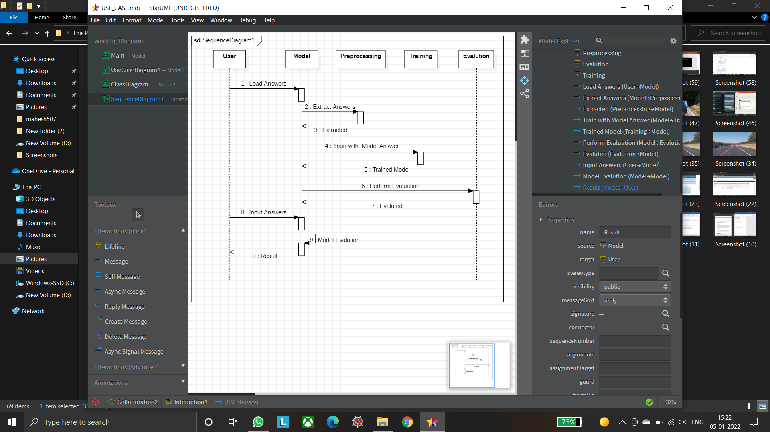
Sequence diagram

Slide 15
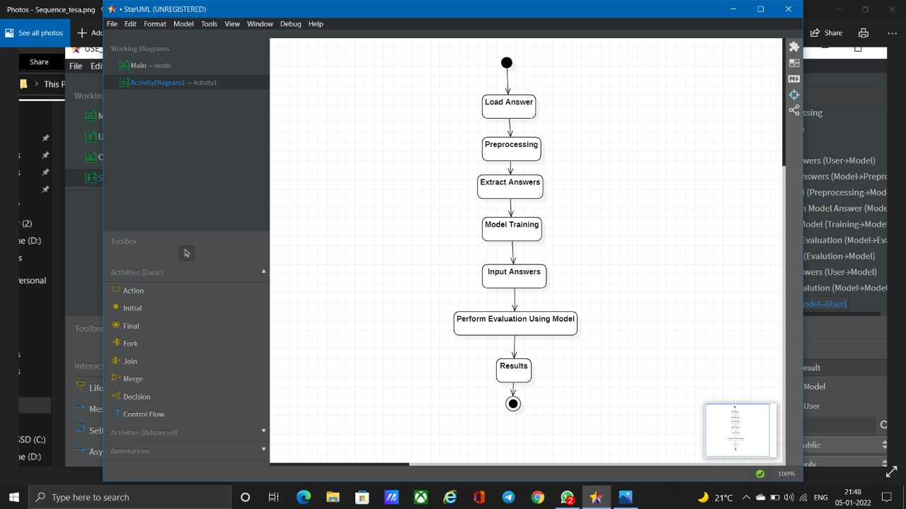
activity diagram

Slide 16
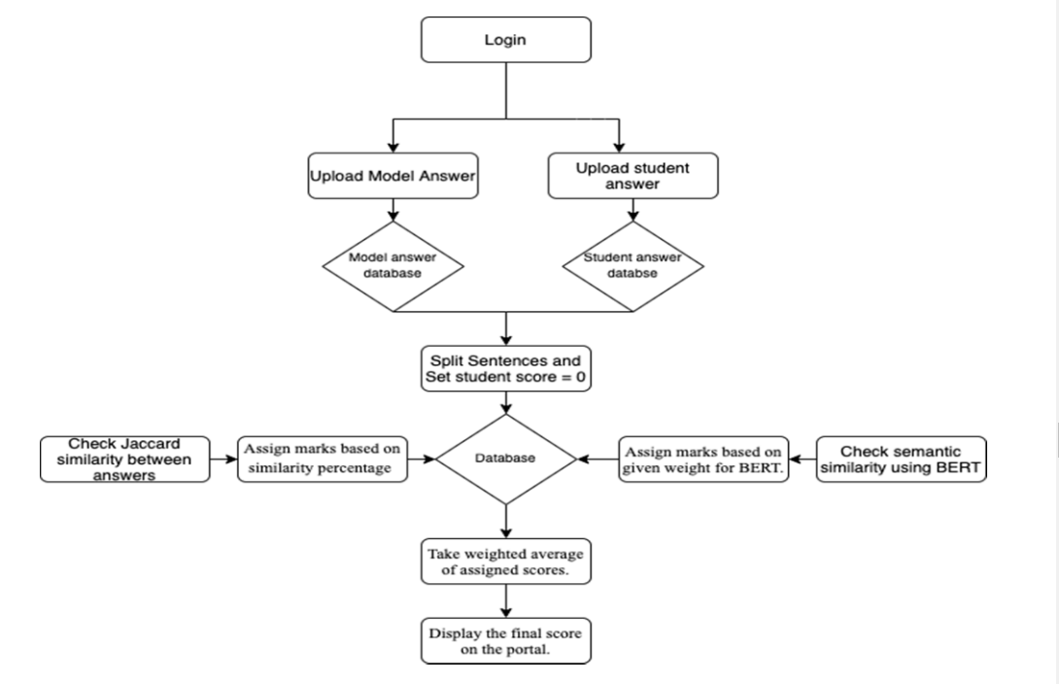
Data flow diagram

Slide 17
Samplecode givval
import math
import re
import nav_test
import pyrebase
import requests
from fuzzywuzzy import fuzz
import Modules.cosine_similarity as keywordVal
import configurations
# TODO- Accuracy prediction library
‘ ' '
e = 1
vg = 2
g = 3
o = 4
p = 5
vp = 6
Grammar:
y = 1
n = 0
'‘’
def givVal(model_answer, keywords, answer, out_of):
# KEYWORDS =>>>>>>>>>>>>>>>>>>>>>>>>>>>>>>>>>>>>>>>>>>
# TODO : Enhacnce this thing
if (len(answer.split())) <= 5:
return 0
# count = 0
# keywords_count = len(keywords)
# for i in range(keywords_count):
# if keywords[i] in answer:
# # print (keywords[i])
# count = count + 1
# k = 0
# if count == keywords_count:
# k = 1
# elif count == (keywords_count - 1):
# k = 2
k = keywordVal.givKeywordsValue(model_answer, answer)
req=requests.get("https://api.textgears.com/check.php?text=" + answer + "&key=JmcxHCCPZ7jfXLF6")
no_of_errors = len(req.json()['errors'])
if no_of_errors > 5 or k == 6:
g = 0
else:
g = 1
print("fuzz1 ratio: ", fuzz.ratio(model_answer, answer))
q = math.ceil(fuzz.token_set_ratio(model_answer, answer) * 6 / 100)
print("Keywords : ", k)
print("Grammar : ", g)
print("QST : ", q)
predicted = nav_test.predict(k, g, q)
# Mathematical model->
# predicted / 10
# what? / out_of
result = predicted * out_of / 10
return result[0]

Slide 18
Sample code Data set collection
from flask import Flask, render_template, request
import json
import os
app = Flask(_name_)email =
"null"@app.route(‘/’)
def Base_qstn_paper_set():
returnrender_template('first.html’)
@app.route('/foo', methods=['POST', 'GET’])
def foo():
if request.method == 'POST’:
first = request.form['first’]
second = request.form['second’]
third = request.form['third’]
email = request.form['emailID']
ans = {"a1": first, "a2": second, "a3": third, "email": email}
json_object = json.dumps(ans, indent=4)
if os.path.exists("data/"+email+".json")==False:
with open("data/" + email + ".json", "w")as outfile:
outfile.write(json_object)
return render_template('Exam_end.html') else:
return render_template('exist_student.html’)
if _name_ == '_main_’:
app.run()

Slide 19
Sample code
Cosine similarity
import re, math
from collections import Counter
import fuzzywuzzy.fuzz
WORD = re.compile(r'\w+')
def get_cosine(vec1, vec2):
intersection = set(vec1.keys()) & set(vec2.keys())
numerator = sum([vec1[x] * vec2[x] for x in intersection])
sum1 = sum([vec1[x] ** 2 for x in vec1.keys()])
sum2 = sum([vec2[x] ** 2 for x in vec2.keys()])
denominator = math.sqrt(sum1) * math.sqrt(sum2)
if not denominator:
return 0.0
else:
return float(numerator) / denominator
def text_to_vector(text):
words = WORD.findall(text)
return Counter(words)
def givKeywordsValue(text1, text2):
vector1 = text_to_vector(text1)
vector2 = text_to_vector(text2)
cosine = round(get_cosine(vector1, vector2),2)*100
kval = 0
if cosine > 90:
kval = 1
elif cosine > 80:
kval = 2
elif cosine > 60:
kval = 3
elif cosine > 40:
kval = 4
elif cosine > 20:
kval = 5
else:
kval = 6
return kval

Slide 20
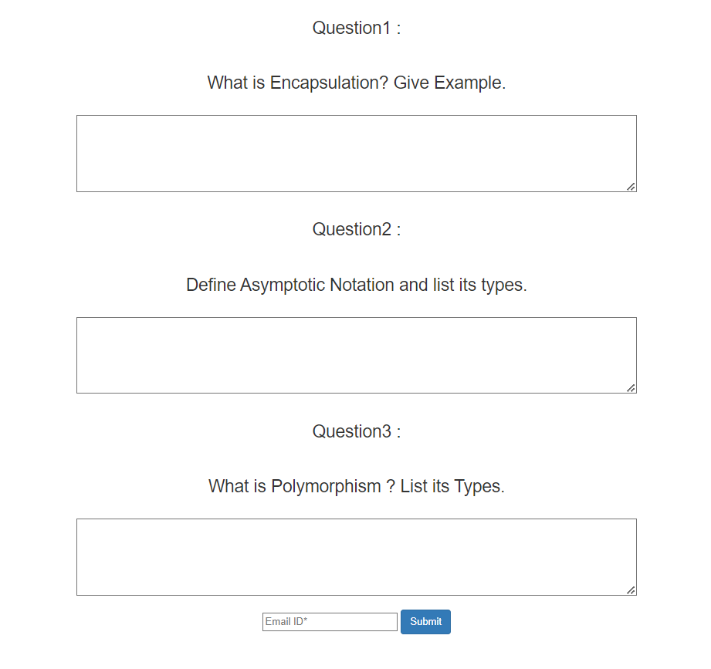
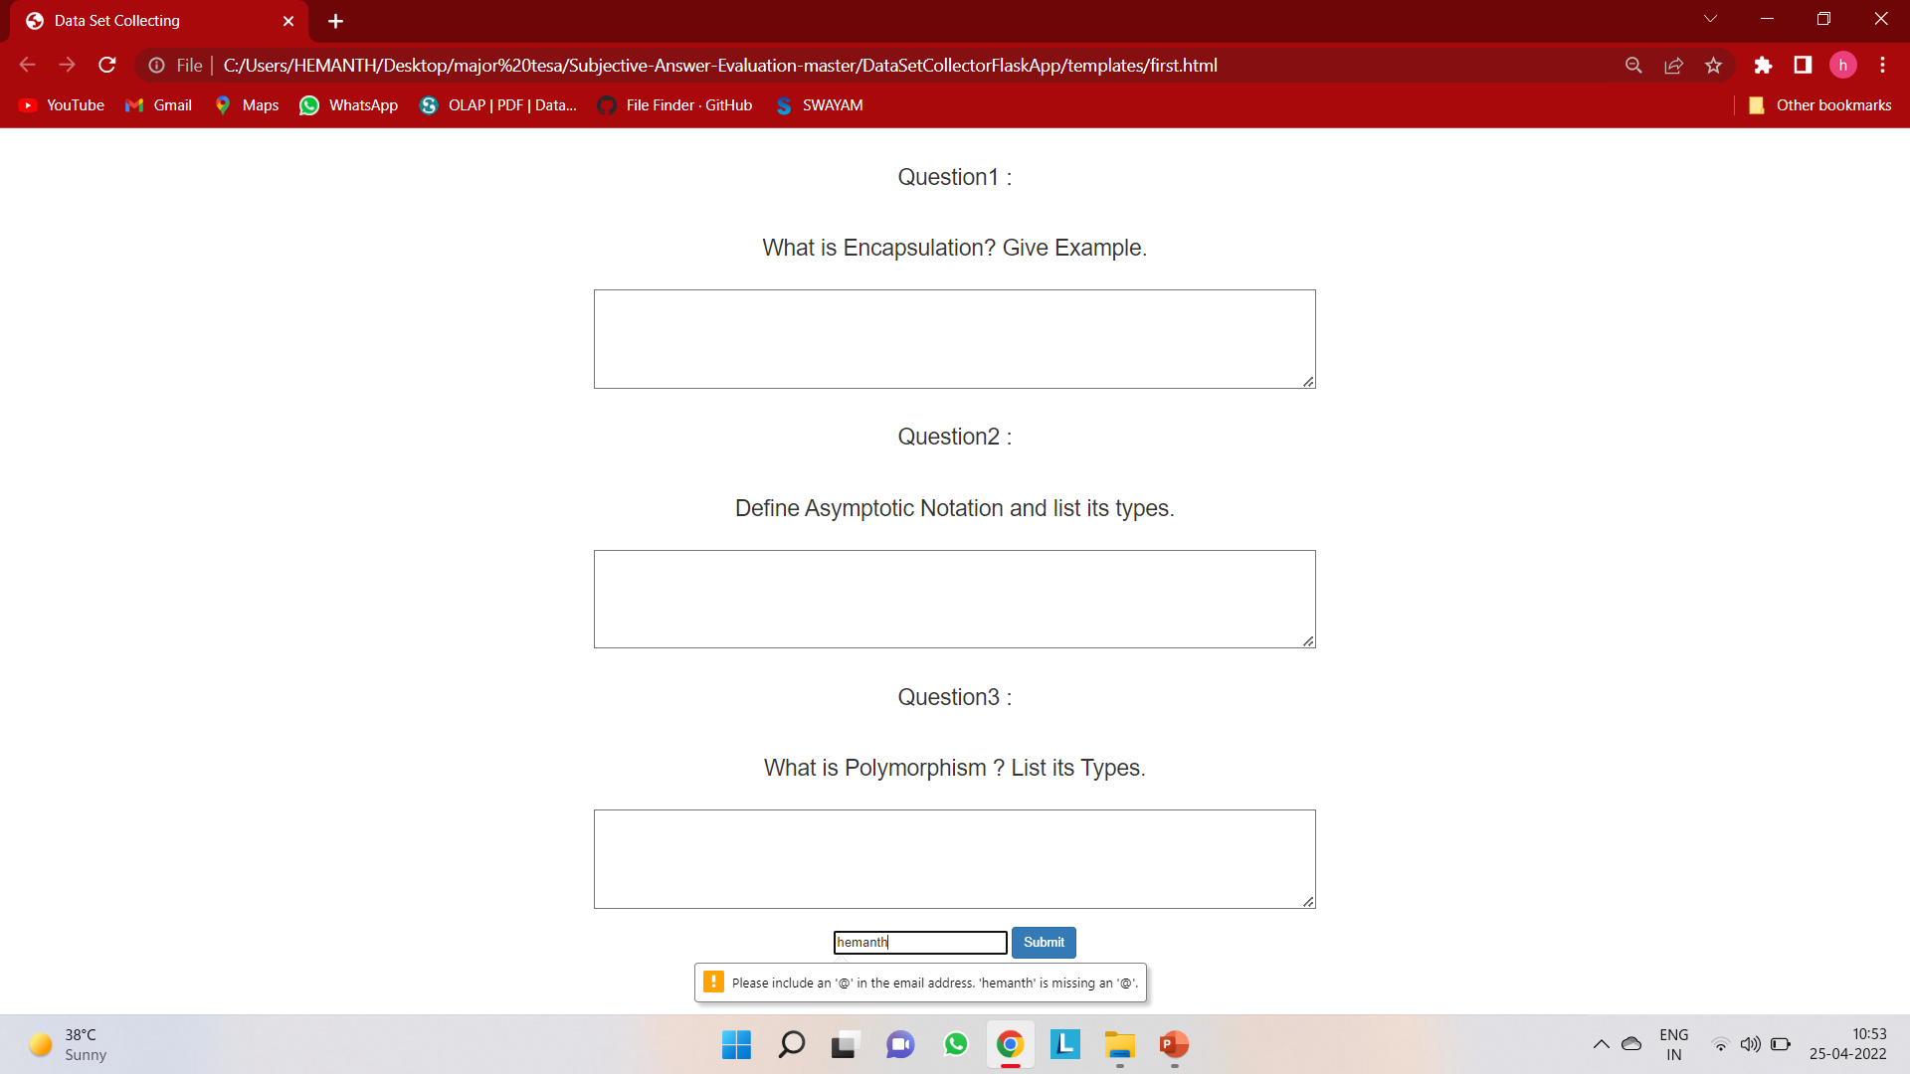
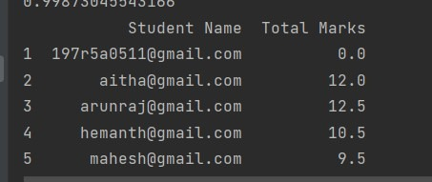
Screen shots

Slide 21
future enhancement
This model can be updated to evaluate answers written in other language and mathematical expression whereas the current approach is only limited to one language and only supports text.
In the future, a system can be developed to evaluate diagrams as well as tables, an inbuilt system can also be made to type and make diagrams to shift examinations from handwritten paper based to completely online and also integrate compiler to support programming language

Slide 22
Conclusion
In this Model for Evaluating Subjective Answers using AI project, the system which have been proposed shows that there are various different techniques for the evaluation of subjective answer sheets.
This Model is a systematic and reliable system which eases the role of evaluators and provides faster and more efficient outputs.
This system offers a reliable, robust, and obvious short response time result

Slide 23
THANK YOU

