Slide 1
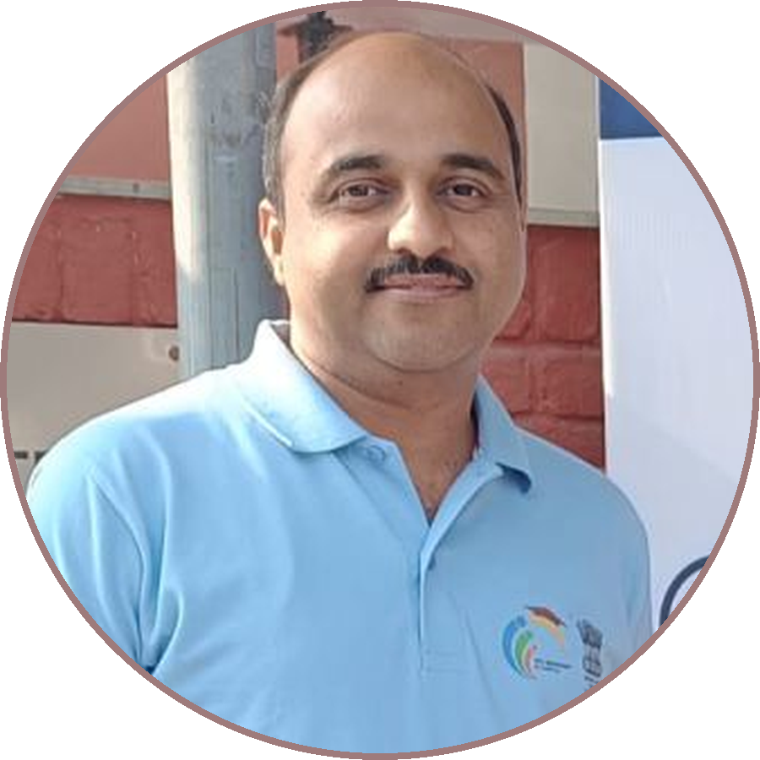
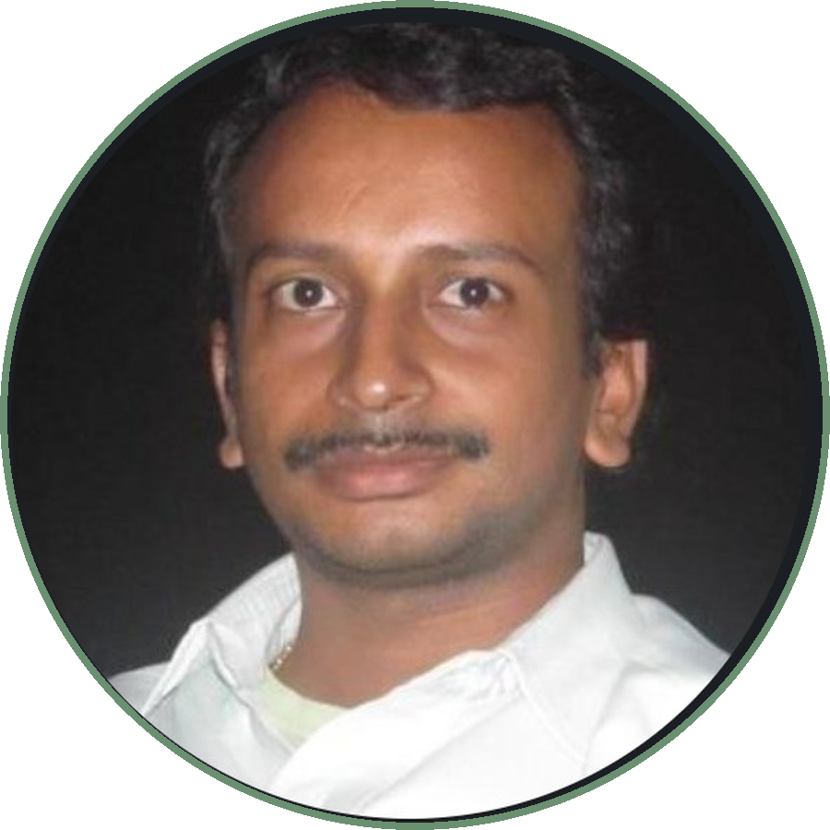
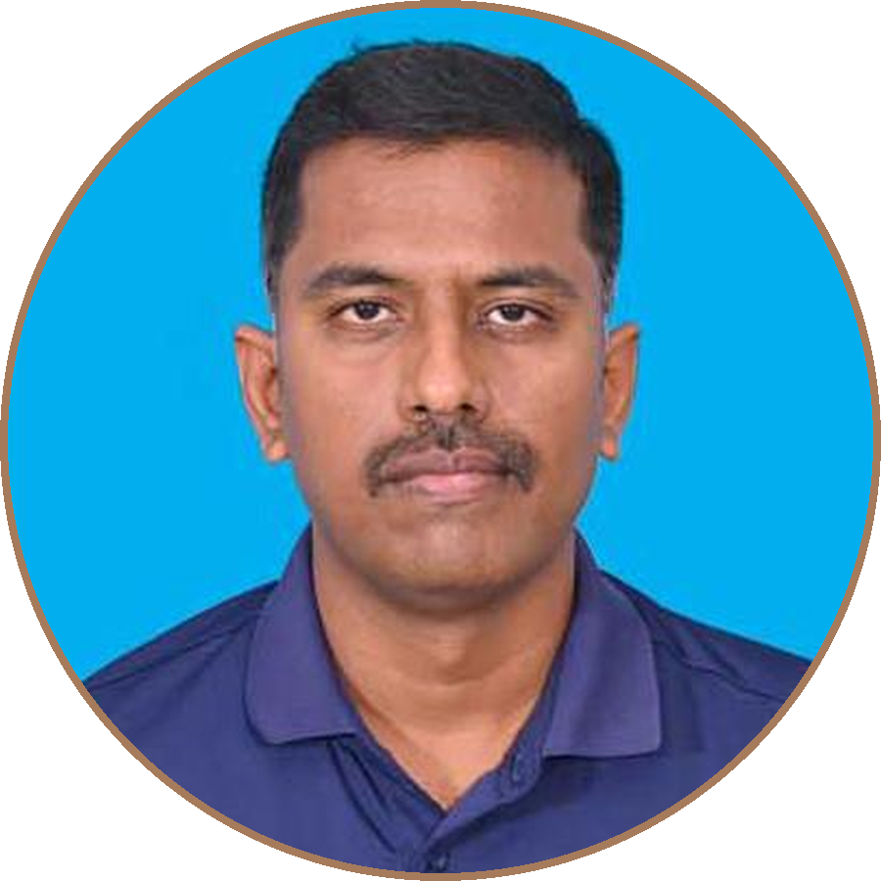
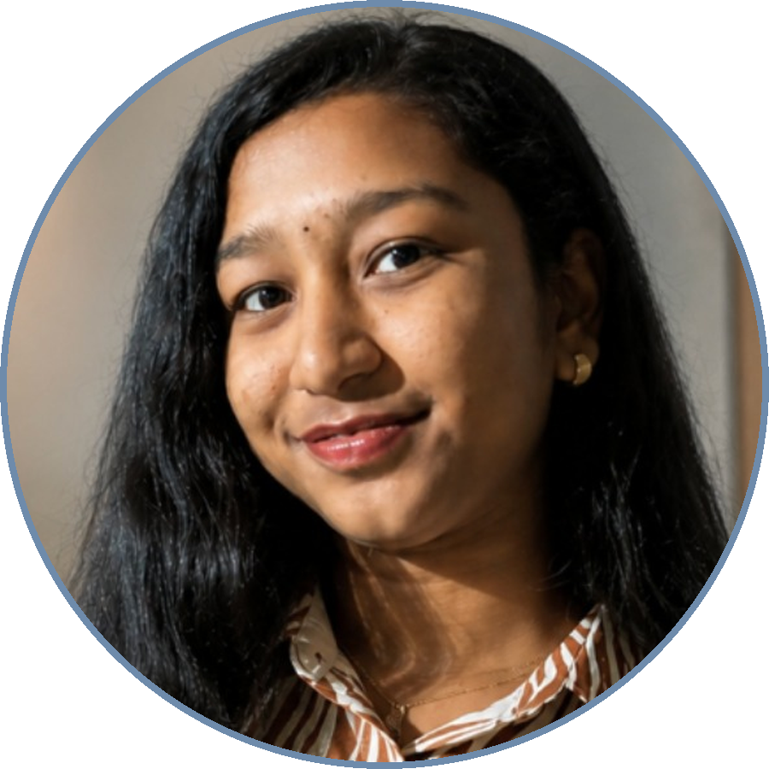
Apex Architects
Hemanth Gajulapalli
SriHari Akula
Keerthi Ramachandran
Mrinal Akula
Senior Product
Architect
Principal
GenAI Architect
Principal Engineer
AI/ML
Undergrad Student
in
hemanthgajulapalli
in
srihari-akula
in
keerthi-ramachandran
in
mrinalakulablr

