Slide 1
PYTHON
A Comprehensive Overview

Slide 2
Intro to Python
What is Python?
Python is a popular programming language. It was created by Guido van Rossum, and released in 1991.
It is used for:
web development (server-side),
software development,
mathematics,
system scripting.

Slide 3
Intro to Python
Why Python?
Easy to read and write
Interpreted language
Dynamically-typed
Extensive standard library
Supports multiple programming paradigms.

Slide 4
Installation and Setup
• Download from python.org
Visit the official Python website at python.org, navigate to the Downloads section, and download the installer for your operating system.
• Installation steps for Windows, macOS, and Linux.
• Setting up an IDE (e.g., PyCharm, VS Code).
Download and install PyCharm or VS Code from their respective websites. Configure the IDE to use the Python interpreter by setting the Python path in the IDE settings.

Slide 5
Essential Python Elements
Print Statement
print(): Outputs a specified message or variable value to the console.
Ex: print("Hello, World!")
Input Function
input(): Reads a line of input from the user as a string.
Ex: name = input("Enter your name: ")
Comments
#: Used to add comments within Python code for documentation or clarification.
Indentation
Whitespace: Indentation is crucial in Python for defining blocks of code, such as in loops or function definitions.

Slide 6
Basic Syntax-Datatypes
Common Data Types in Python
Integers (int):
Whole numbers, positive or negative, without decimals.
Example: `x=10`,`y=-5`
Floating Point Numbers (float):
Numbers with decimals.
Example: `height = 5.5`, `weight= 72.3`
Strings (str):
Ordered sequences of characters enclosed in single, double, or triple quotes.
Example: `name = "Alice“` greeting = `Hello, World!`
Booleans (bool):
Represent one of two values: `True` or `False`.
Example: `is_student = True` , `is_admin = False`

Slide 7
Basic Syntax-Datatypes
Lists:
Ordered, mutable collections of items, which can be of different data types.
Example: `fruits = ["apple", "banana", "cherry" ]`
Tuples:
Ordered, immutable collections of items.
Example: `coordinates =(10.0,20.0)`
Dictionaries:
Unordered collections of key-value pairs.
Example: `person = {"name": "Alice”, “age”:30}`
Sets:
Unordered collections of unique items.
Example: `unique_numbers = {1, 2, 3, 4,5}`

Slide 8



Lists and Tuples
List Methods:
append(): Adds an element to the end of the list.
extend(): Extends the list by appending elements from another iterable.
insert(): Inserts an element at a specified position.

Slide 9



Lists and Tuples
Tuple Methods:
count(): Returns the number of occurrences of a value.
index(): Returns the index of the first occurrence of a value.
List Comprehension:
Creates a new list by applying an expression to each item in an existing iterable.

Slide 10
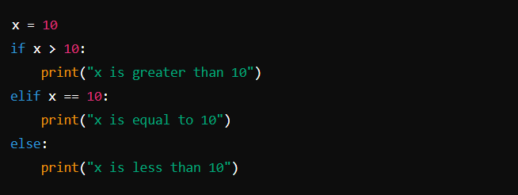
Control Structures
If-Elif-Else Statements
Usage: Allows the program to make multiple decisions based on multiple conditions.
Syntax:

Slide 11

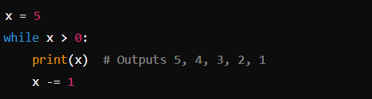
Control Structures
For Loop
Usage: Iterates over a sequence (e.g., list, tuple, string).
While Loop
Usage: Repeats a block of code as long as a specified condition is `True`.

Slide 12
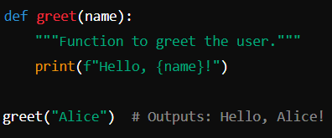
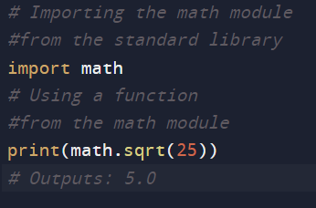
Functions and Packages
Functions
Definition: Functions are blocks of code that perform a specific task and can be reused.
Syntax:
Packages:
Definition: Packages are directories of
Python scripts containing modules.
Usage: Extend Python's functionality by
importing modules from packages.

Slide 13
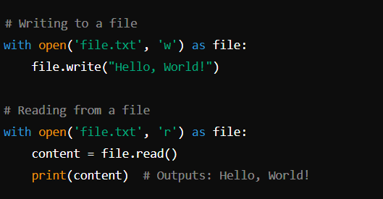
File Handling
Definition: File handling allows Python programs to read and write files.
Usage: Manipulate external files for data storage and retrieval.
Example:

Slide 14
File Handling
File Operations:
open() function is used to open a file in specified mode ( 'w' for writing, ‘r’ for reading, ).
Other Modes:
`a`: Append mode. Opens a file for appending. Creates a new file if it does not exist.
`b`: Binary mode. Opens a file in binary mode.
`+`: Read and Write mode.
Reading: Use `read()` or `readline()` to read file contents.
Writing: Use `write()` to write content to a file.
Closing Files: Always close files after operations using `close()` or use `with` statement.

Slide 15
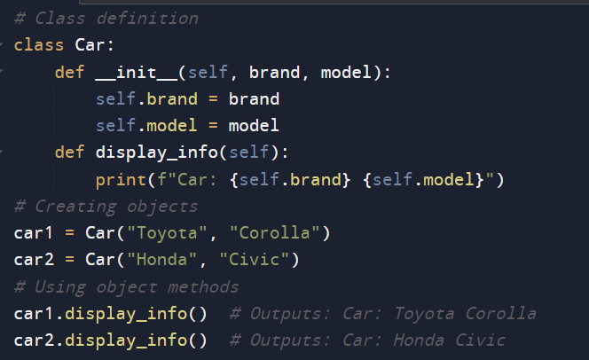
Object-Oriented Programming (OOP)
• Definition: Programming paradigm based on objects representing instances of classes.
• Core Concepts:
Class
Object
Inheritance
Encapsulation
Polymorphism

Slide 16
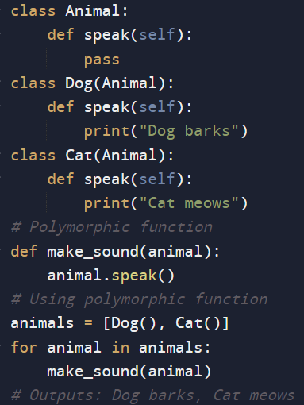
Object-Oriented Programming (OOP)
Inheritance: Subclass inherits attributes
and methods from a superclass.
Polymorphism: Different classes can be
treated as instances of a common superclass.

Slide 17
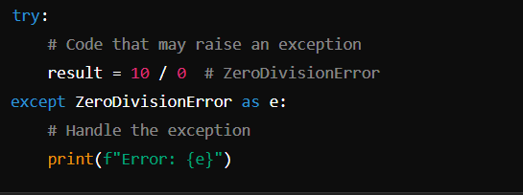
Exceptions Handling
Definition: Exceptions are errors detected during execution that disrupt the normal flow of a program.
Try-Except Block:

Slide 18
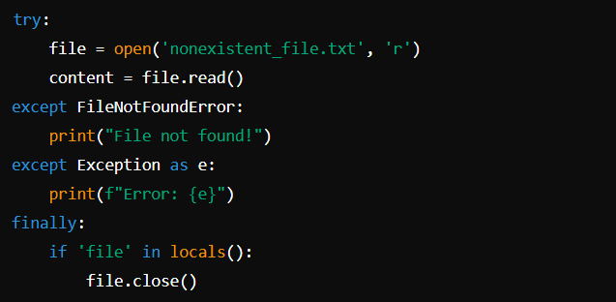
Handling Multiple Exceptions
Multiple `except` blocks handle different types of exceptions.
`finally` block executes cleanup code regardless of whether an exception occurred.

Slide 19
Practice Program: Bike Show Room
Scenario:
Guevara Motor Bike Showroom wish to automate the work process for the motor bike sold from their showroom.
Whenever a bike is sold, the showroom records the details in a file, named BillDetails.txt. The details stored in the file are: bill number, registration number, customer name, and mobile number. The application needs to retrieve the data from the file and process the data.
The file containing bill details is delimited using the comma (,).
`[bill_number, registration_number, customer_name, mobile_numberl`

Slide 20

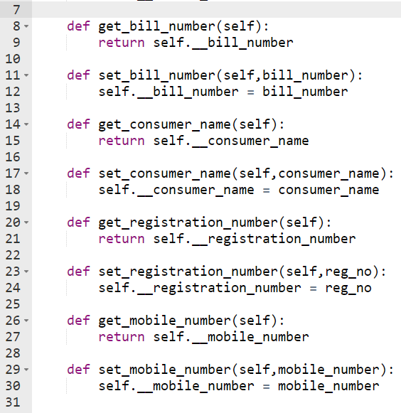

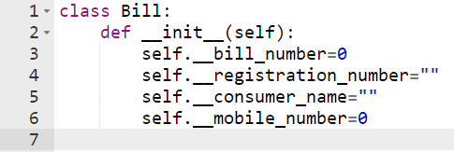
2342, KL52AC1251, James, 9568412301
2343, KL52A96547 , Sam, 9658742541
2344, KL52AA5696, Jeeva, 9489093628
2345, KL52AA321, Rajesh, 7852459674
2346, KL52AF694y , Alex, 6352487549
2347, KL96AA3598, Kamesh, 6389754215
2348, MH62AC1251, Peter, 7595864525
2349, KL52AA7377, Oliver, 8524978534

Slide 21
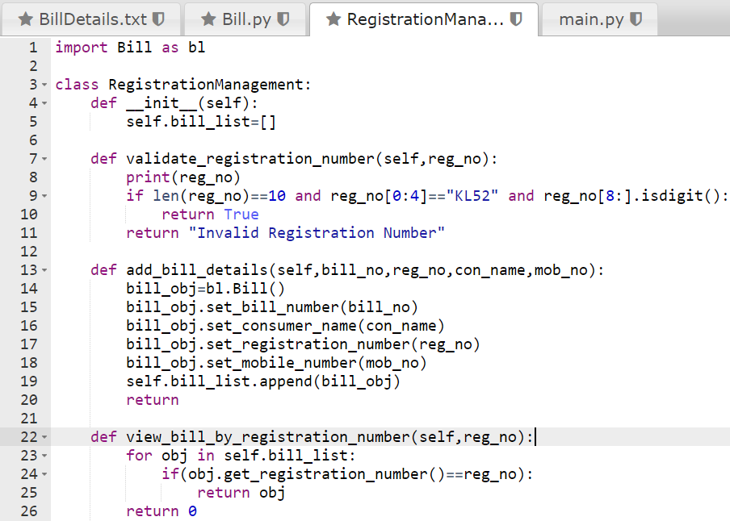

Slide 22
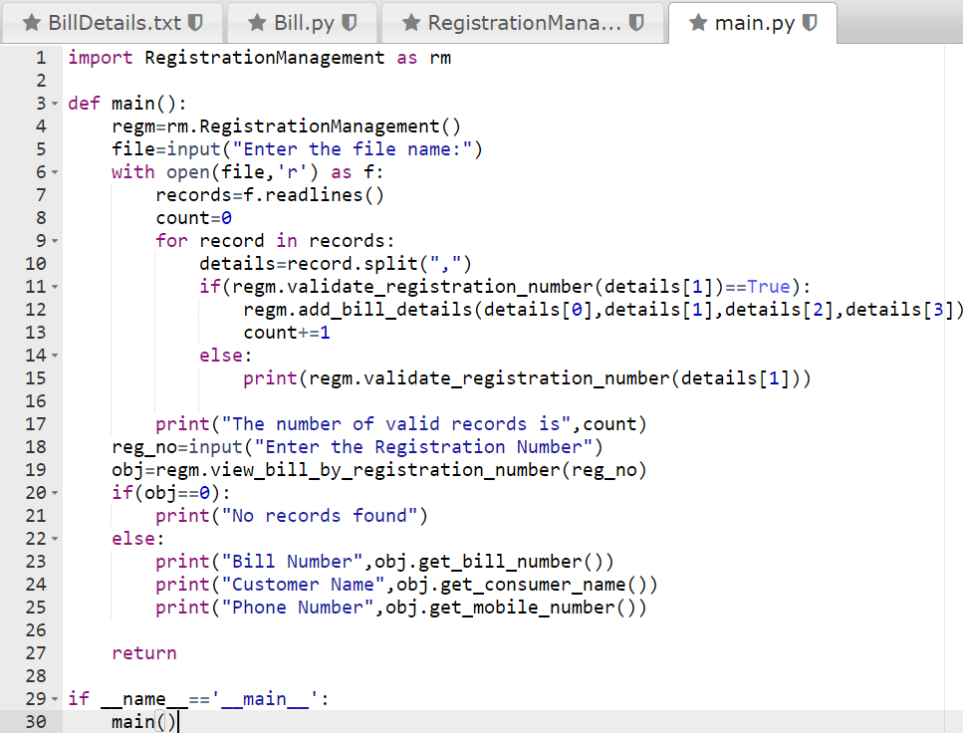

Slide 23
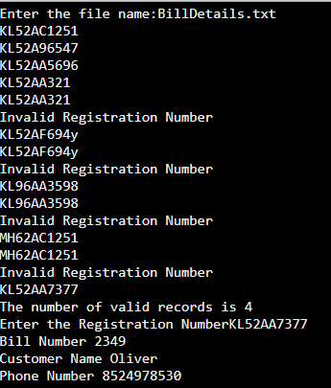
Sample IO:

Slide 24
THANK YOU

