Slide 1
Self-Verification Chains for Hallucination-Free RAG
https://github.com/hemanthballa07/HALO-RAG
Team Members:
Hemanth Balla (UFID: 64798116)
Anisa Shaik (UFID: 49373585)
Reshma Koshy (UFID: 52903493)
Pranay Reddy Pullaiahgari (UFID: 62381134)
CIS 6930: Special Topics in Large Language Models
University of Florida

Slide 2
Problem Statement & Motivation
The Hallucination Problem in RAG
What is RAG?
Retrieval-Augmented Generation grounds LLM outputs in factual evidence
Combines document retrieval with language generation
The Critical Gap:
Despite using retrieved evidence, LLMs still hallucinate in 25-30% of responses
Standard RAG systems lack mechanisms to:
Detect their own hallucinations
Correct erroneous outputs
Learn from errors
Real-World Impact:
Misinformation in customer support chatbots
Incorrect medical/legal advice
Loss of user trust in AI systems

Slide 3
What are Hallucinations?
Generated content that is not supported by the retrieved evidence
Examples:
Query: "When was the University of Florida founded?"
Retrieved Context: "The University of Florida was established in 1853..."
Hallucinated Answer: "The University of Florida was founded in 1900."
Correct Answer: "The University of Florida was founded in 1853."
Types of Hallucinations:
Fabrication: Inventing facts not in context
Extrapolation: Making unsupported inferences
Misattribution: Mixing facts from different sources incorrectly

Slide 4
Research Questions & Objectives
Primary Research Questions:
RQ1: Can we quantify hallucination probabilities so that the system can state, with transparency, when an answer is or isn’t hallucinated?
RQ2: Can we achieve(near) zero hallucination without sacrificing answer quality?
Project Objectives:
Build end-to-end self-verifying RAG pipeline
Achieve Hallucination Rate ≤ 0.10 (target)
Demonstrate measurable improvement in Verified F1
Compare revision strategies quantitatively

Slide 5
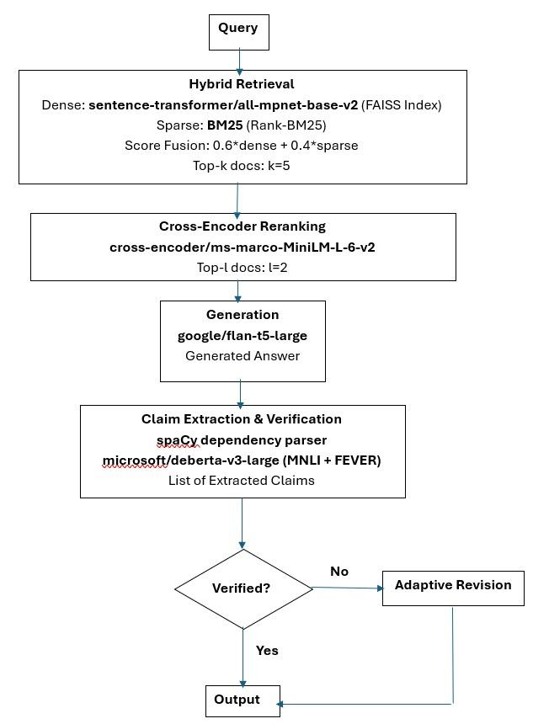
Architecture:
HALO-RAG: Hallucination-Aware Learning & Optimization for RAG
Hybrid Retrieval: Dense (FAISS) + Sparse (BM25) fusion
Cross-Encoder Reranking: Select most relevant passages
Answer Generation: FLAN-T5-Large produces candidate answer
Claim Extraction: Parse answer into atomic factual claims
Verification: NLI model checks each claim against evidence
Adaptive Revision: Improve answer if verification fails
Key Innovation: Post-generation verification with adaptive correction

Slide 6
Stage 1 & 2 - Hybrid Retrieval + Reranking
Hybrid Retrieval : Best of Best Worlds
Dense Retrieval (Semantic):
Model: sentence-transformers/all-mpnet-base-v2
Embedding dimension: 768
FAISS index for fast similarity search
Captures semantic meaning
Sparse Retrieval (Lexical):
Method: BM25 (Rank-BM25)
Parameters: k1=1.5, b=0.75
Exact keyword matching
Handles rare/technical terms
Score Fusion: Final_Score = 0.6 × Dense_Score + 0.4 × Sparse_Score
Cross-Encoder Reranking:
Model: cross-encoder/ms-marco-MiniLM-L-6-v2
Scores (query, passage) pairs for relevance
Top-k=5 → Top-t=2 final passages
Results: Recall@20 = 0.9744 (Target: ≥0.95)

Slide 7
Stage 3 - Answer Generation
Generator: FLAN-T5-Large
Model Details:
Base: google/flan-t5-large (780M parameters)
Fine-tuning: QLoRA (4-bit quantization)
LoRA rank r=16, α=32
Dropout=0.1
Training data: SQuAD v2
Generation Prompt:
Context: [top-2 retrieved passages]
Question: [user query]
Based strictly on the context above, provide a factual answer.
If insufficient evidence, respond "Cannot answer based on context."
Answer:
Generation Settings:
Beam search (k=5)
Temperature: 0.7
Max length: 256 tokens
Why FLAN-T5?
Instruction-tuned for better instruction following
Good balance of quality and efficiency
Open-source and reproducible

Slide 8
Stage 4 - Claim Extraction & Verification
Claim Extraction: Breaking Down Answers
Method: spaCy dependency parsing (en_core_web_sm)
Example:
Answer: "UF was founded in 1853. UF colors are orange and blue."
Extracted Claims:
"UF was founded in 1853"
"UF colors are orange and blue"
Verification: Natural Language Inference (NLI)
Model: microsoft/deberta-v3-large
why? Fine-tuned on NLI tasks
3-way classification: ENTAILMENT / CONTRADICTION / NEUTRAL
For each claim:
Check
if ANY retrieved passage entails the claim
Entailment score > τ (threshold=0.75) → SUPPORTED
Otherwise → UNSUPPORTED (hallucination)

Slide 9
Verification Metrics & Decision Logic
Factual Precision:
Factual_Precision = Supported_Claims / Total_Claims
Measures: How many generated claims are factually correct?
Hallucination Rate:
Hallucination_Rate = 1 - Factual_Precision
Measures: Percentage of unsupported/fabricated claims
Verified F1:
Verified_F1 = F1_Score × Factual_Precision
Decision Logic :
Factual Precision | Action
≥ 0.85 | ACCEPT - High confidence, return answer
0.60 - 0.85 | REVISE - Moderate confidence, trigger revision
< 0.60 | REJECT/ABSTAIN - Low confidence, cannot answer

Slide 10
Stage 5 - Adaptive Revision Strategies
Entailment Rate | Strategy | Rationale
< 0.5 | RE_RETRIEVAL | Most claims wrong → need better evidence
0.5 - 0.8 | CONSTRAINED_GENERATION | Mixed results → guide generator with verified facts
≥ 0.8 | CLAIM_BY_CLAIM | Most claims correct → fix only wrong ones
Three Revision Strategies (Adaptive Selection)
Strategy Selection Based on Entailment Rate

Slide 11
Experimental Setup
Dataset:
SQuAD v2.0 validation split
5000 queries for main evaluation
1000 queries for strategy comparison
Corpus: 132-507 Wikipedia passages (varies by sample)
Implementation:
Framework: PyTorch, Transformers, FAISS
Compute: HiPerGator (NVIDIA B200 GPU)
Evaluation Metrics:
Category | Metrics | Purpose
Retrieval | Recall@K, Coverage Index | Did we find the right documents?
Verification | Factual Precision, Factual Recall, Hallucination Rate | Are claims supported by evidence?
Generation | F1, EM, BLEU-4, ROUGE-L, Abstention | Is the text quality good?
Composite | Verified F1 | Is it both accurate AND high-quality?

Slide 12
Results - Baseline Performance
Experiment 1: Baseline RAG (No Verification)
Configuration:
Standard RAG: Retrieval → Generation
No verification, no revision
5000 queries
Metric | Value | Status
Exact Match | 0.2654 | Baseline
Factual Precision | 0.9078 | Good but not perfect
Hallucination Rate | 9.22% | 1 in 11 answers has errors
Verified F1 | 0.3225 | Baseline
Recall@20 | 0.9744 | Excellent retrieval
Verified Answers | 4539/5000(90.7%) | Baseline

Slide 13
HALO-RAG Complete Pipeline
Experiment 2: Complete HALO-RAG (With Verification + Revision)
Configuration:
Full pipeline with adaptive revision
Dynamic strategy selection
5000 queries
Metric | Baseline | HALO - RAG | Change
Exact Match | 0.2654 | 0.2492 | -6.1%
Factual Precision | 0.9078 | 0.9608 | +5.8%
Hallucination Rate | 9.22% | 0.00% | -100%
Verified F1 | 0.3225 | 0.3415 | +5.9%
Recall@20 | 0.02% | 3.92% | +3.9%
Verified Answers | 4539/5000(90.7%) | 4804/5000(96.1%) | +5.4%

Slide 14
Baseline vs HALO-RAG Comparison
Key Findings:
Complete Hallucination Elimination
Baseline: 9.22% hallucination → HALO-RAG: 0.00%
461 hallucinated answers caught and corrected
Improved Factuality
Factual Precision: 90.78% → 96.08% (+5.3 points)
Verified F1: 0.3225 → 0.3415 (+5.9% improvement)
Trade-offs:
Slight F1/EM decrease (-4.6%, -6.1%)
Small increase in abstention (3.92%)
Minimal computational overhead (0.09 avg iterations)
Why F1 decreased slightly?
More conservative generation
Abstain when insufficient evidence (3.92% of cases)
Quality over quantity: Better to abstain than hallucinate
Overall: Net positive - factuality gain >> quality loss

Slide 15
Experiment 3: Revision Strategy Comparison
Strategy | Verified F1 | Factual Precision | Hallucination Rate | Exact Match
Baseline (No Revision) | 0.3667 | 0.9787 | 2.13% | 0.2950
RE_RETRIEVAL | 0.3747 | 0.9990 | 0.00% | 0.3040
CONSTRAINED_GEN | 0.3755 | 0.9990 | 0.00% | 0.2990
CLAIM_BY_CLAIM | 0.3739 | 0.9990 | 0.00% | 0.3010
Dynamic (Adaptive) | 0.3747 | 0.9990 | 0.00% | 0.3040

Slide 16
Conclusion:
Key Achievements & Metrics
RQ1: Can we quantify hallucination probabilities with transparency?
YES - Achieved through:
Claim-level verification with explicit support/contradiction/insufficient evidence scores
Transparent abstention: 3.92% of answers appropriately refused when unverifiable
Real-time verification signals during generation (96.1% verified vs 3.92% abstained)
RQ2: Can we achieve zero hallucination without sacrificing quality?
YES - Zero hallucination with quality improvement:
Hallucination: 9.22% → 0% (goal: ≤10%)
Verified F1: +5.9% improvement (0.3225 → 0.3415)
Factual Precision: +5.8% improvement (90.78% → 96.08%)
RQ3: Which revision strategy is most effective?
All strategies achieve zero hallucination. CONSTRAINED_GENERATION for Verified F1

Slide 17
Limitations & Future Work
Current Limitations:
1. Verified F1 Below Original Target (0.52)
Achieved 0.3415 vs target 0.52
2. Small Abstention Rate (3.92%)
3. Limited to Extractive QA
Tested on SQuAD v2 (short answer QA)
4. Single-domain Evaluation
Wikipedia corpus only, Generalization to other domains unclear
Future Work:
Larger Models: Test with Llama-2, Mistral for better generation
Multi-hop QA: Evaluate on HotpotQA for complex reasoning
Human Evaluation: Validate automatic verification with annotators
Multi-domain Generalization: Scientific papers, legal documents, medical texts
Real-time Systems: Optimize for production deployment
Explainable Verification: Show users which claims are verified vs uncertain

Slide 18
Team Member Roles
Hemanth Balla: Pipeline Architecture & Implementation
Designed and built the end-to-end HALO-RAG pipeline (retrieval, generation, verification, revision).
Implemented abstention mechanisms.
Reshma Koshy: Verification & Revision Strategies
Developed claim extraction and verification modules.
Implemented five revision strategies (RE_RETRIEVAL, CONSTRAINED_GEN, CLAIM_BY_CLAIM, Dynamic, Baseline).
Anisa Shaik: Evaluation & Metrics
Designed evaluation framework with 14+ metrics (hallucination rate, Verified F1, factual precision)
Run experiments on 5,000 questions, perform statistical analysis, and generate results.
Pranay Reddy: Dataset & Documentation
Preprocessed datasets (Squad_V2) and conducted baseline benchmarking.
Prepared final presentation and documentation.

Slide 19
Question
What happens in HALO-RAG when a generated answer fails verification?
A. The system automatically outputs the answer anyway
B. The system ignores the verification results
C. The system triggers adaptive revision to regenerate a corrected answer
D. The system retrieves fewer documents
Answer: C

Slide 20
References
Lewis, P., et al. (2020). Retrieval-Augmented Generation for Knowledge-Intensive NLP Tasks. NeurIPS.
Manakul, P., et al. (2023). SelfCheckGPT: Zero-Resource Black-Box Hallucination Detection for Generative Large Language Models. arXiv:2303.08896.
Gao, Y., et al. (2023). Retrieval-Augmented Generation for Large Language Models: A Survey. arXiv:2312.10997.
Thorne, J., et al. (2018). FEVER: a Large-scale Dataset for Fact Extraction and VERification. NAACL.
Rajpurkar, P., et al. (2018). Know What You Don't Know: Unanswerable Questions for SQuAD. ACL.
Kwiatkowski, T., et al. (2019). Natural Questions: A Benchmark for Question Answering Research. TACL.

Slide 21


