Slide 1

MALNAD COLLEGE OF ENGINEERING, HASSAN
Department of Information Science & Engineering
A MINI-PROJECT ON ANIMATION OF SORTING ALGORITHMS
Batch:
Hemanth.B.R (4MC16IS010)
Ashik Gowda.N.P (4MC16IS005)
Dhanush.G.D (4MC16IS007)

Slide 2
Contents:
Introduction
Problem statement
System analysis
System design
Code snippet
Test cases
Snapshots
Conclusion
References

Slide 3
INTRODUCTION
ANIMATION OF SORTING ALGORITHMS in a java based GUI Application which helps the user to understand How the Sorting Algorithm Works.

Slide 4
PROBLEM STATEMENT
To design and develop a java based GUI Application for the Visualization of Working of Sorting Algorithms

Slide 5
SYSTEM ANALYSIS
EXISTING SYSTEM
The existing system is a console based Application in which if we input some numbers in return we get resulting Sorted numbers.
Drawbacks – Though we Know the code for Sorting Algorithms we don’t understand how the Algorithms works And it is difficult to visualize it

Slide 6
SYSTEM ANALYSIS CONTINUED
PROPOSED SYSTEM:
The objective of ANIMATION OF SORTING ALGORITHMS to Visualize how Sorting Algorithms Works.
User will be able to understand working of various Sorting Algorithms
User will be able to Select the Sorting Algorithm which they need to visualize.
The user will be able to create the Array without inputting any numbers to it.

Slide 7
SYSTEM REQUIREMENTS SPECIFICATION
Functional requirements:
The system should enable the user to understand the algorithm.
The system should enable the user to visualization it.
The system shall provide the user to Start Stop Pause the Sorting process
The system shall provide the user to select the Speed of Sorting i.e. Fast or medium or Slow
The system shall provide the user to select the various Sorting Algorithms to Demonstrate or Visualize using Buttons

Slide 8
Non functional requirements
For Application Developer:
Hardware requirements
A Personal Computer with Pentium Processor or above with 4GB or more RAM,
250GB or more Hard Disk Drive (HDD) ,
Color monitor,
Mouse ,
Keyboard
Software requirements
Operating system: Windows 7 or higher
Text Editor: Sublime Text Editor and Visual Studio code
IDE: Eclipse
Java Development kit 8
Java Runtime Environment 8

Slide 9
Non functional requirements:
For Application Users:
Hardware requirements:
A Personal Computer with Pentium Processor or above with 4GB or more RAM,
250GB or more Hard Disk Drive (HDD) ,
Color monitor,
Mouse
Keyboard
Software requirements:
Operating system: Windows 7 or higher
Java Development kit 6 or Above
Java Runtime Environment 6 or Above

Slide 10
SYSTEM DESIGN:
LEVEL 0 DFD
Sorting Animator
USER
Graphic visualization of Sorting code

Slide 11
LEVEL 1 DFD
Sorting Animator
application
Button selected
Bar graph
Sorting demo

Slide 12
Code snippet:
Private void initialize () {
Frame = new JFrame ();
frame.getContentPane ().setForeground (Color.WHITE);
frame.setBounds (100, 100, 794, 429);
frame.setDefaultCloseOperation (JFrame.EXIT_ON_CLOSE);
frame.getContentPane ().setLayout (null);
JButtonbtnNewButton = new JButton ("C");
btnNewButton.setForeground (Color.BLACK);
btnNewButton.setBackground (Color.WHITE); btnNewButton.setBackground (Color.WHITE);
btnNewButton.addActionListener (new ActionListener () {
if(sort)
{
String whichSort = "";
for(int i = 0; i<radioButtons[1].length;i++)
if(radioButtons[1][i].isSelected())
whichSort = radioButtons[1][i].getText();
//if selection sort has been chosen call it
if(whichSort.equals("Selection"))
{
Thread t = new selectionSortThread();
t.start();
//selectionSort(g);
}
//if bubble sort has been chosen call it
else if(whichSort.equals("Bubble"))
{
Thread t = new bubbleSortThread();
t.start();
//bubbleSort(g);
}
//if merge sort has been chose call it
else if(whichSort.equals("Merge"))
{
Thread t = new mergeSortThread();
t.start();
//numbers = mergeSort(numbers, 0, g);
}
else if(whichSort.equals("Insertion"))
{
Thread t = new insertionSortThread();
t.start();
}
sort = false;
} btnNewButton.setFont (new Font ("Tahoma", Font.BOLD, 22));
btnNewButton.setVerticalAlignment (SwingConstants.BOTTOM);
btnNewButton.setBounds (10, 202, 51, 177);
frame.getContentPane ().add (btnNewButton);

Slide 13
Test cases:
Test ID | Test Case Title | Test Condition | System Behavior | Expected Result
T01 | Click GET START | Use of Start key | Application should start running | Application runs
T02 | Select preferred algorithm button | Use of algorithm button | Application should sort the array in the selected algorithm. | Application sorts the array.
T03 | Click on stop button | Use of stop button | Application should stop the sorting process | Application stops
T04 | Click on step button | Use of step button | Application should single steps | Application shows single step.

Slide 14
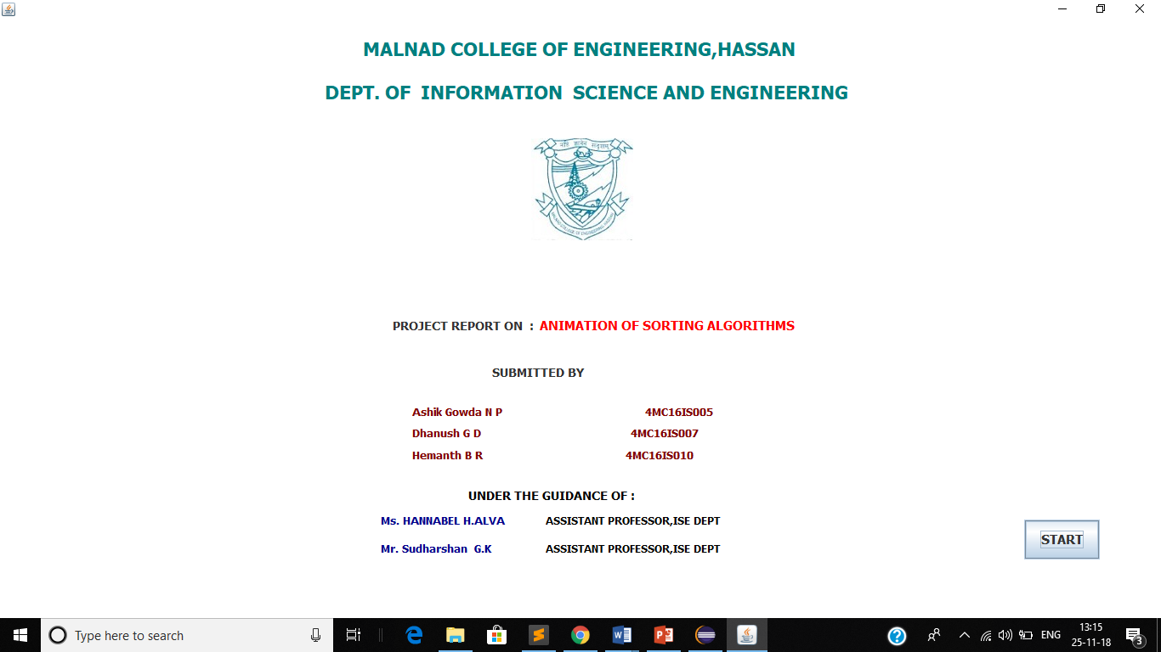
Snapshots:
Welcome page:

Slide 15
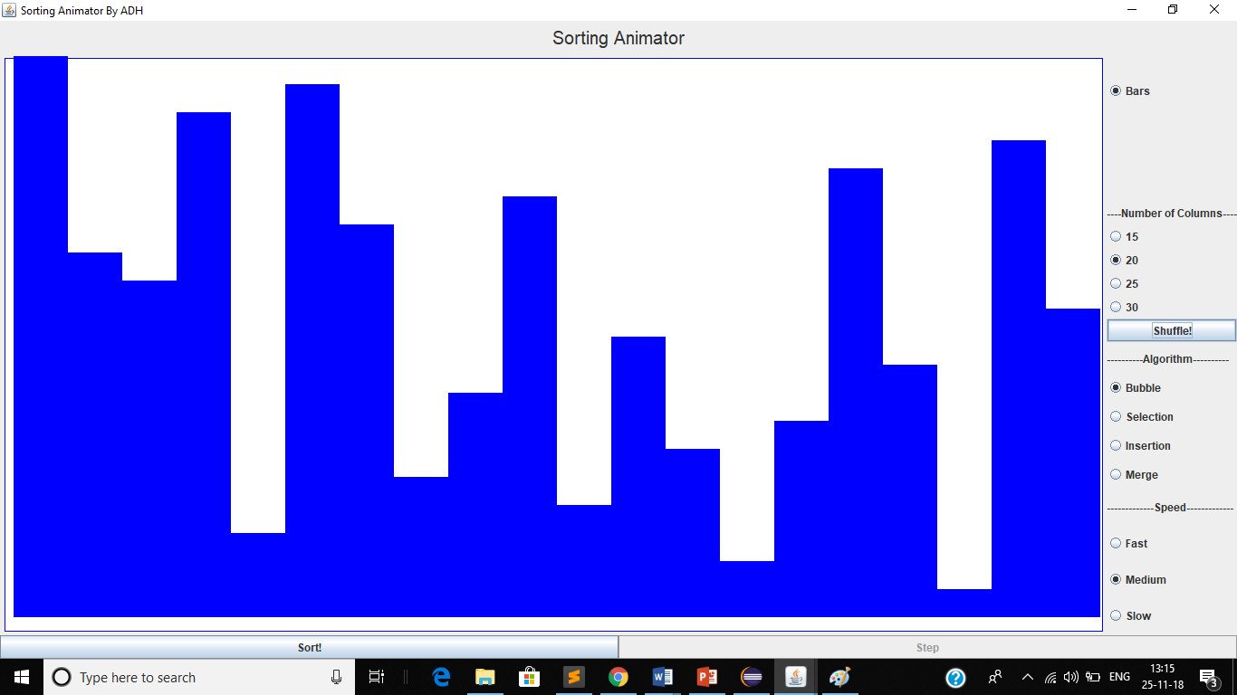
Working model:

Slide 16
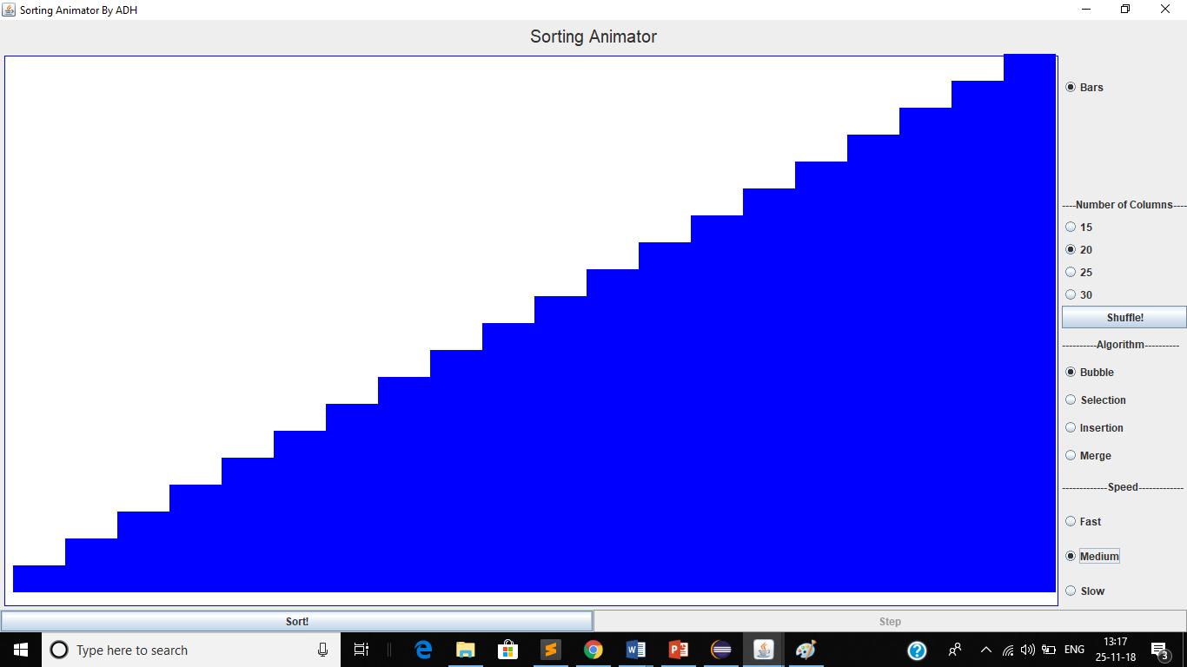

Slide 17
Conclusion:
This project provides an interactive interface for the users who wish to visualize the sorting algorithm.

Slide 18
REFERENCES:
Herbert Schildt, “Java The Complete Reference”, 9th Edition, McGraw-Hill Education, 2014.
Ian Sommerville, “Software engineering”, 9th edition, Pearson Education, 2014.
W3Schools -https://www.w3schools.com/java/java_intro.asp
Stack Over Flow-https://stackoverflow.com/search?q=learn+java
YouTube-https://www.youtube.com/watch?v=Av6zh817QEc(java front page)

Slide 19


