Slide 1
M.TECH (AI & ML) · MINI PROJECT · REVIEW-02
Multi-Agent RAG System for
Academic Research Assistance
Data Engineering · Exploratory Data Analysis · Feature Engineering
CPU-only Agentic RAG
NLI Citation Verifier
Due: 20 June 2026
no GPU required
the novelty
Review-02 scope
Presented by: [Your Name] | Guide: [Guide Name]
Notes:
Review-02 covers the data side of the project: where the corpus comes from, how it is engineered into a searchable index, what EDA reveals, and how features (embeddings) are produced. The project uses off-the-shelf models — no fine-tuning — so classic train/test and SMOTE steps are reframed honestly for a retrieval system.

Slide 2
AGENDA
What this review covers
Recap
Review-01 in one slide — problem, agents, novelty
§3
Data Engineering & Dataset Overview (3.1–3.7)
§4
Exploratory Data Analysis (4.1–4.5)
§5
Feature Engineering (5.1–5.5)
Next
Status Report-1 (27 Jun) → Review-03 (11 Jul)

Slide 3
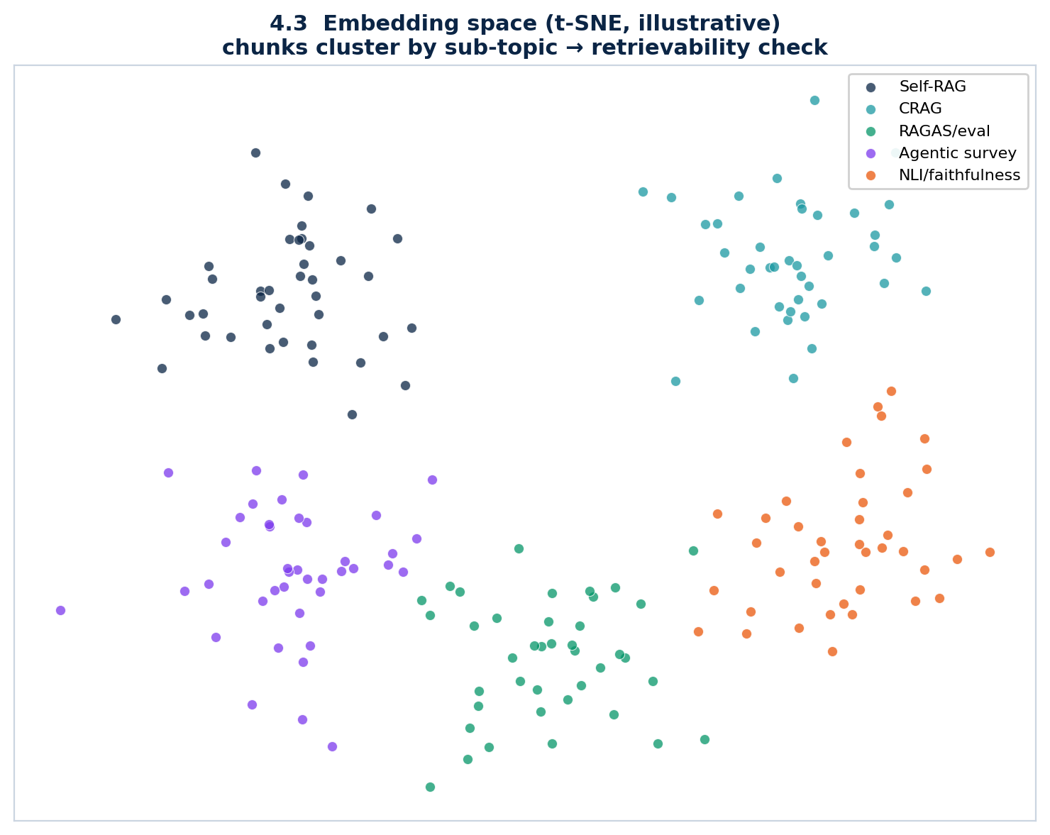
RECAP
Review-01 in one slide
The problem
Up to 57% of RAG citations are unfaithful (Wallat et al. 2024) — they look right but the cited text doesn't support the claim.
Our system
Four agents: Planner → Retriever → Synthesizer → Verifier, orchestrated with LangGraph.
The novelty
A dedicated NLI verifier scores each claim vs its cited evidence and rejects/revises unfaithful ones.
Constraints
CPU-only, ≤11 GB RAM; dual backend — Groq (cloud) / Ollama (local).

Slide 4
3
SECTION 3
Data Engineering & Dataset Overview
How a pile of PDFs becomes a verifiable, searchable evidence base.

Slide 5
3.1 DATA SOURCES
Where the data comes from
1
Primary corpus
30–50 arXiv PDFs on "RAG techniques 2023–2025" — Self-RAG, CRAG, RAGAS, Adaptive-RAG, SQuAI, MA-RAG, MAIN-RAG.
2
Acquisition
arXiv API + bulk full-text (industry analogue of public-dataset / API ingestion). User can also bring their own PDFs at runtime.
3
Evaluation benchmark
20 hand-curated Q&A pairs, each with a ground-truth answer and its source paper(s).
4
Verifier signals
Off-the-shelf NLI entailment labels (DeBERTa-MNLI) — no manual labeling of the corpus required.

Slide 6
3.2 DATASET DESCRIPTION
Corpus profile & chunk schema
Corpus scale (target vs sample-validated)
Chunk schema (per retrievable unit)
Metric | Target | Sample run
Documents | 30–50 PDFs | 21 docs
Chunks | ~900–1,200 | 101
Avg chunk | ~2,048 chars | 1,802 chars
≈ tokens/chunk | ~512 | ~450
Field | Type
chunk_id | str (md5)
text | str
source / page | str / int
section | str
char_start/end | int
embedding | vector(384) f32
Sample figures are produced by running the actual chunker on a document set; the target corpus is arXiv RAG papers.

Slide 7
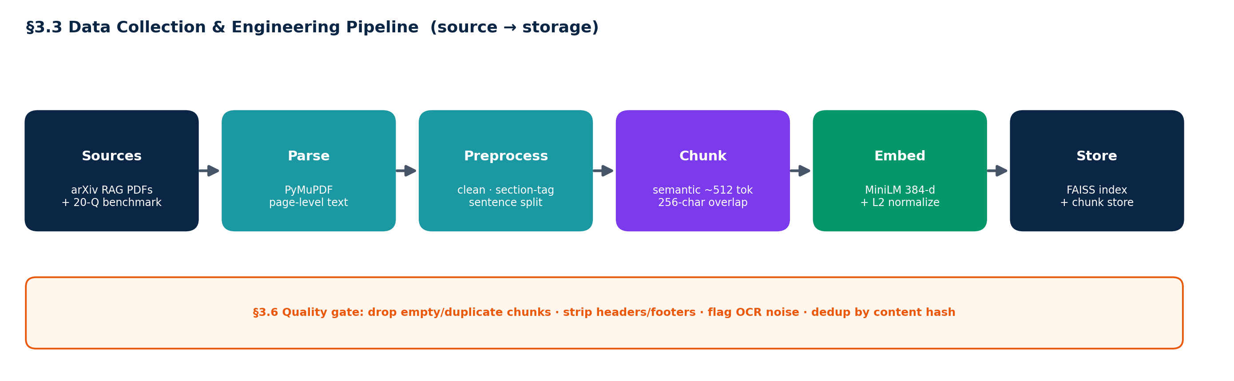
3.3 DATA COLLECTION PIPELINE
Source → storage, fully local
PDFs never leave the device. Embedding (MiniLM), indexing (FAISS) and verification (NLI) run on CPU; only the LLM call may be remote in cloud mode.

Slide 8
3.4 DATA PREPROCESSING
Cleaning, structure, normalization
Text extraction
PyMuPDF, page-by-page — page numbers preserved for citations.
Cleaning
Strip running headers/footers, fix hyphenation, collapse whitespace.
Structure tagging
Detect section headers (ALL-CAPS, numbered, "Title:") → tag each chunk.
Sentence-aware chunking
Regex sentence split, greedily merge to ~512 tokens, 256-char overlap — never split mid-sentence.
Normalization
Embeddings L2-normalized so cosine = dot product. No lowercasing/stemming — the transformer handles casing.

Slide 9
3.5 DATA LABELING & ANNOTATION
Labels for evaluation, not training
No supervised training. All models are off-the-shelf, so labels exist to MEASURE the system, not to fit it.
Benchmark Q&A (manual)
20 questions hand-written by the author; each carries a verifiable ground-truth answer and its source paper(s).
NLI labels (automated)
DeBERTa-MNLI emits entail / neutral / contradict per (claim, evidence) — no hand-labeling of the corpus.
Calibration set (manual, small)
A small human-labeled set of faithful/unfaithful citations tunes the 0.6 entailment threshold.
Annotation protocol
Questions are written blind + adversarial (incl. multi-hop and "answer-not-in-corpus") to avoid confirmation bias.

Slide 10
3.6 DATA QUALITY ASSESSMENT
Catching noise before it reaches the model
99%
~1%
~1%
chunks on-target size (sample)
short outliers (<500 chars)
long outliers (>2,304 chars)
•
Empty / short chunks — dropped — caption-only or boilerplate pages add noise.
•
Duplicates — de-duplicated by content hash (repeated headers, references).
•
Parse / OCR noise — flagged; scanned figure-only pages yield no text and are skipped (text-only scope).
•
Missing section — never drop content — tag as "body" and keep.

Slide 11
3.7 TRAIN–VALIDATION–TEST STRATEGY
Honest split for a no-train system
Because nothing is fine-tuned, there is no train/val/test split of the corpus. The corpus is wholly indexed for retrieval; the SPLIT discipline lives in the evaluation design.
Retrieval index
Calibration (dev)
Held-out test
Comparison
ALL chunks indexed in FAISS — retrieval needs full coverage, not a held-out split.
Small labeled subset tunes the verifier's 0.6 threshold only.
The 20 benchmark questions — never used for any tuning.
Baseline vs Multi-agent vs +Verifier on the SAME questions; paired t-test, p<0.05.

Slide 12
4
SECTION 4
Exploratory Data Analysis
What the corpus looks like before any retrieval — and what that implies.

Slide 13
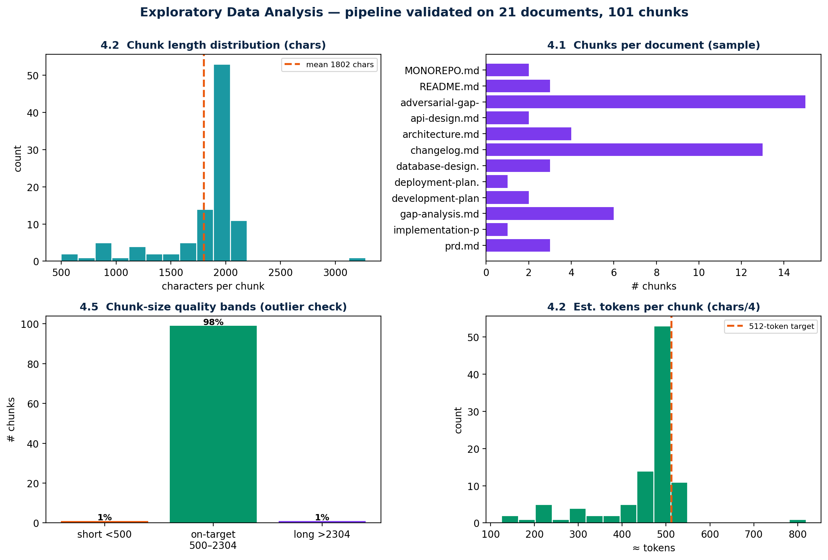
4.1 · 4.2 STATISTICAL SUMMARY & VISUALIZATION
Descriptive statistics over the chunked corpus
Read-outs (sample)
Documents
21
Chunks
101
Mean length
1,802 chars
Median tokens
≈ 450
On-target band
99%
Distribution is tight around the 512-token target — chunking behaves as designed.

Slide 14
4.3 · 4.4 INSIGHTS, PATTERNS & FEATURE CORRELATION
The embedding space tells us if retrieval can work
Topics separate
Chunks cluster by sub-topic (Self-RAG, CRAG, eval, NLI). Separable clusters ⇒ the right evidence is retrievable.
"Correlation" = cosine
Features are dense 384-d vectors; the operative correlation is cosine similarity, not Pearson on raw columns.
High intra / low inter
High within-topic similarity and low cross-topic similarity give strong retrieval contrast (good top-k precision).
Implication
If clusters overlapped heavily, retrieval would mis-fire — so this is a go/no-go check before building agents.

Slide 15
4.5 BIAS, OUTLIERS & MISSING VALUES
Visibility and handling
Bias
Outliers
Missing values
English-only, RAG-domain corpus — acknowledged, not hidden. MiniLM + the LLM inherit web-training bias; the system never claims neutrality.
~1% very-long (reference/caption pages) and ~1% very-short chunks, surfaced by the size-band check (4.5). Flagged, not silently dropped.
Scanned / figure-only pages produce no text → skipped under the text-only scope. Chunks with no detected section default to "body".

Slide 16
5
SECTION 5
Feature Engineering
Turning chunk text into the dense semantic features retrieval runs on.

Slide 17
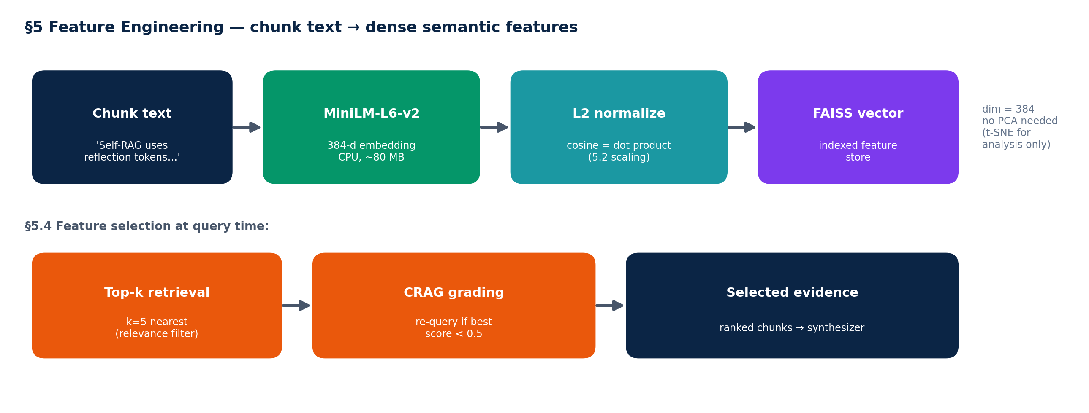
5.1 FEATURE EXTRACTION
Embeddings are the features
Each chunk → a 384-d sentence-transformer embedding (all-MiniLM-L6-v2). This dense vector IS the feature representation; there is no hand-crafted tabular feature set.

Slide 18
5.2 · 5.3 SCALING, NORMALIZATION & DIMENSIONALITY
The right transform for semantic vectors
5.2 Scaling / Normalization
5.3 Dimensionality
L2-normalize every embedding to unit length ⇒ cosine similarity = dot product. Min-Max / Standardization are NOT used — they would distort direction, which is what carries meaning.
384-d is already compact and CPU-friendly. No PCA in the pipeline (it would discard semantic nuance). PCA / t-SNE are used ONLY to visualize the space for EDA.

Slide 19
5.4 · 5.5 FEATURE SELECTION & IMBALANCED DATA
Adapted to a retrieval system
5.4 Feature selection — at query time, not column-wise. Retrieval keeps the top-k=5 nearest chunks (relevance filter); CRAG grades them and re-queries once if the best score < 0.5. This replaces classic filter / wrapper / embedded selection.
5.5 Imbalanced data — reframed. Retrieval has no class labels, so SMOTE / under-sampling are N/A. The balances that matter are: (a) the 20 eval questions are curated to span sub-topics evenly, and (b) the NLI calibration set is balanced between entailed and non-entailed citations so the threshold isn't skewed.
Honesty note: classic ML steps that don't apply to a no-train retrieval system are reframed, not faked — this is itself defensible methodology for the panel.

Slide 20
Next steps
From data to models
Status Report-1
27 Jun 2026 — report after Review-01 & 02 feedback; conference/publication status.
Review-03
11 Jul 2026 — §6 Model Development, §7 System Architecture, §8 Detailed Software Design (UML, API, ER, UI/UX).
Thank you. Questions, comments, and critique on the data pipeline are welcome.

