Slide 1

Door Dash
Data Analysis

Slide 2
Cost and Order Value Comparison by Location:
This bar chart is a comparative analysis tool that juxtaposes the average minimum order value against the average cost per order for each listed city. Business leaders can utilize this visualization to discern which locations are yielding the most considerable average order values and assess whether setting minimum order thresholds are impacting customer spending behaviors. For example, if Phoenix, Arizona shows a higher average cost per order compared to Dallas, Texas, it may indicate differing customer purchasing power or preferences, or the success of different pricing strategies. This insight can drive targeted marketing campaigns or strategic adjustments in pricing or service offerings.

Slide 3
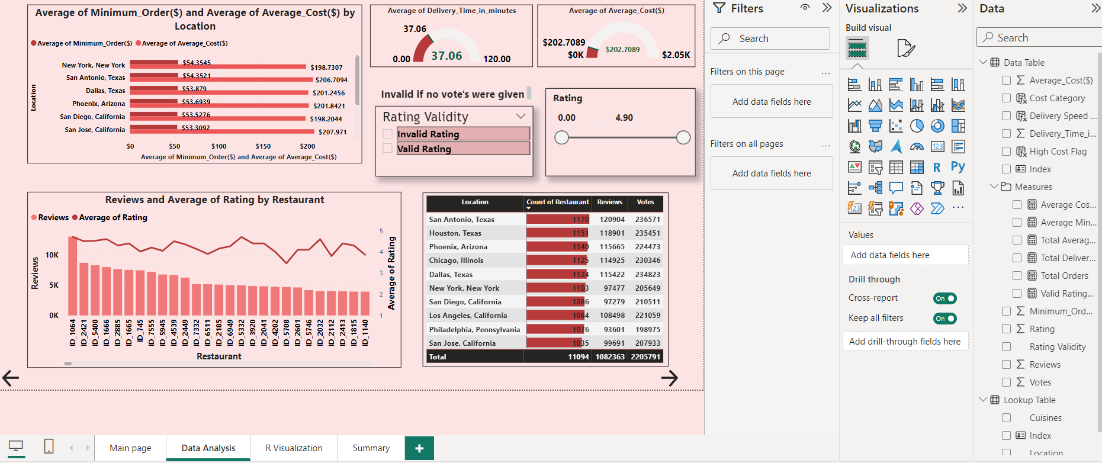
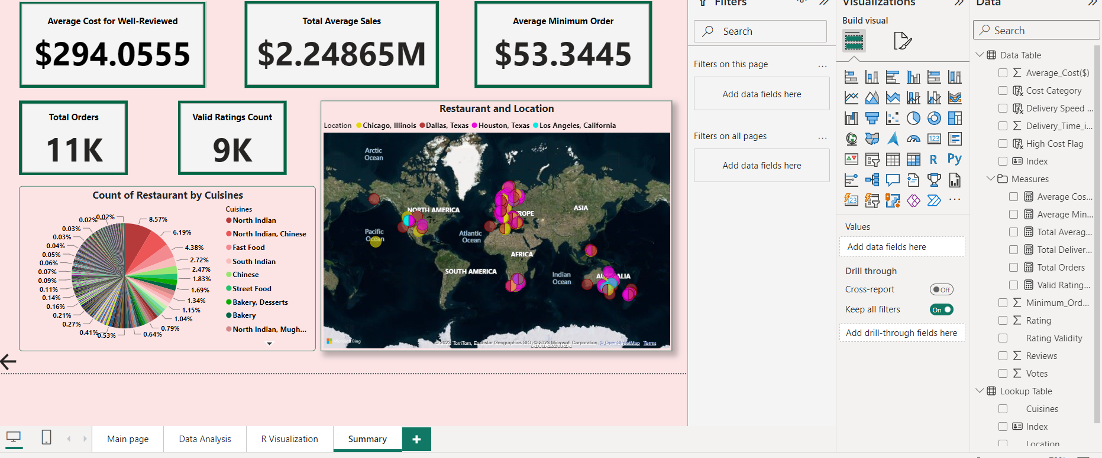

Slide 4
Average Delivery Time Insight:
Presented as a straightforward numerical display, this metric encapsulates the efficiency of the delivery service across the entire operation. An optimized delivery time is crucial for customer satisfaction and retention, and this figure provides a benchmark against which operational efficiency can be measured. If the average delivery time is low, it indicates a swift service that meets customer expectations, a significant competitive advantage. Conversely, a higher average delivery time could signal areas for logistical improvement or the need for additional resources.
Filter for Rating Validity:
The interactive checkboxes offer a critical data segmentation tool that enables business analysts to sift through customer ratings, distinguishing between valid and invalid feedback. This functionality is particularly important for maintaining the quality and reliability of customer data. By focusing on valid ratings, the company can ensure that the insights derived from the data are based on authentic customer experiences, thus informing more accurate business strategies.

Slide 5
Review Count and Rating Correlation:
This dual-axis chart serves as an analytical framework to examine the relationship between the volume of customer reviews and the average rating per restaurant. A high number of reviews with a correspondingly high average rating could indicate a strong customer endorsement, while a large number of reviews with lower average ratings might highlight areas needing attention. This visualization can inform management about brand reputation and pinpoint specific restaurants that might benefit from quality improvements or additional staff training.

Slide 6
Restaurant Popularity and Engagement by Location:
Through a horizontal bar chart and a detailed table, this visualization breaks down the count of restaurants, reviews, and votes by location. This information is invaluable for identifying which areas have the highest customer engagement and popularity. It can guide expansion strategies, restaurant partner engagement, and targeted promotional activities. A high number of reviews and votes in a city like San Antonio, Texas, might suggest a robust market presence and a loyal customer base, while lower engagement in another location could identify opportunities to increase marketing efforts or to improve service quality.
Overall, the "Door Dash Data Analysis" dashboard serves as a strategic asset, providing a multi-faceted view of the business's operational health. The insights gained from this dashboard can guide investment decisions, operational tweaks, and customer relationship management. It highlights the company's strong points and areas for improvement, ensuring that resources are allocated effectively to bolster customer satisfaction and maximize revenue.

