Slide 1
Product Co Quarterly Review
Q1 - Apr- May 2019

Slide 2
Agenda
Team Details(slide 3)
Sales demographics by Region and Market(slide 4)
Product Sales Report Card( slide 5)

Slide 3




Team Members
Meet Our Researcher Team.
Name
Name
Name
Name
Sameer A.
Pavan K.
Rakesh B.
Suresh P.

Slide 4
Team Members
Sameer A.
Pavan k.
Kumar B.
Srinivas B.
Prakash K.

Slide 5
Sales Demographics by Region and Market
Uttar Pradesh
Increase in Product X sales by 20%
increase in customer base
Bihar
Low reach in rural areas
Product Z sales are low
West Bengal
Improvement in Product Y sales by 10%
Needs more sales force
Maharashtra
Needs more salesforce
Product sales can be improved
Madhya Pradesh
Good media outreach
Product sales have increased by 3%
Notes:
5

Slide 6
Sales Report Card

Slide 8
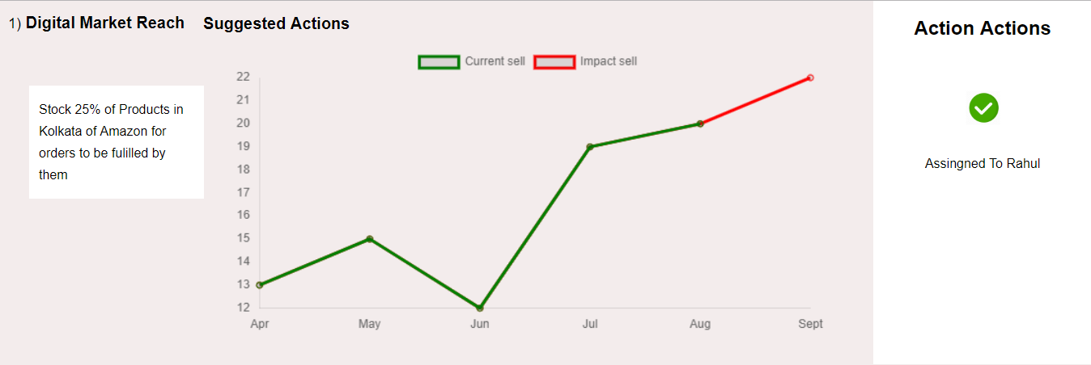
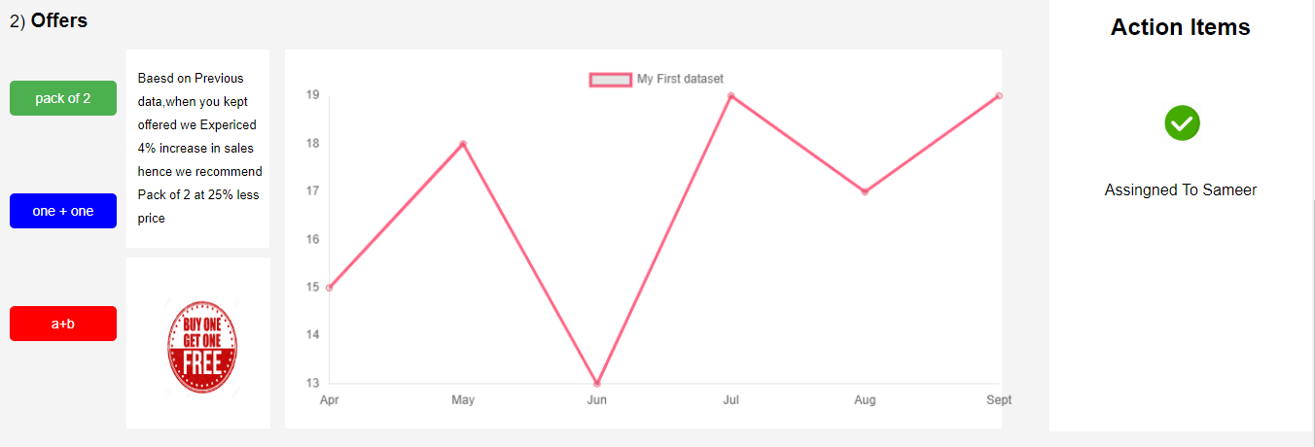
Results of previous Action Items
STATUS: Completed
We achieved a 4.12 percent increase in total sales due to switching the stock to digital platform.
STATUS: Completed
The Pack of 2, and A+B offers led to a 1.05 percent increase in sales

Slide 9
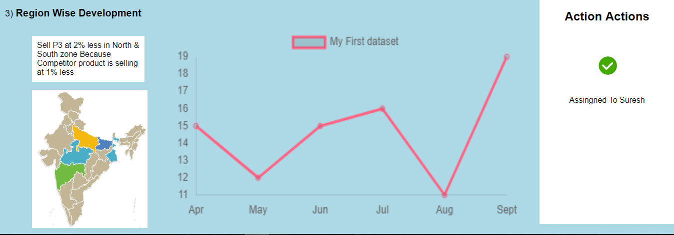

STATUS: Pending
On completion we expect to see a 1.98 percent increase in sales in the north and south regions
Click here to see the complete report analysis or ask CrystalBall to “Show me the Sales Score Card”

