Slide 1
Secure Data Hiding in Image Using Steganography
CAPSTONE PROJECT
Presented By
Student Name : Kalekar Hemanth
College Name : Jaya Prakash Narayan College of Engineering
Department : Computer science and Engineering

Slide 2
OUTLINE
Problem Statement
Technology used
Wow factor
End users
Result
Conclusion
Git-hub Link
Future scope

Slide 3
Problem Statement
Develop a secure image steganography application using LSB encoding and AES-based encryption.
Users can hide encrypted text within an image and retrieve it using a password.
The GUI allows easy text input, image selection, encoding, and decoding.
Security features include password protection and error handling for incorrect passwords or corrupted data.
The application ensures reliability, usability, and strong encryption for data security.

Slide 4
Technology used
Libraries :
Tkinker (GUI)
PIL (Pillow) (Image Processing)
Numpy (Array operations)
Base64, hashlib (Encryption key handling)
Cryptography.fernet (AES-based encryption)
Platforms:
Kali Linux (Compatible with other OS)
Python 3.x (Required for execution)

Slide 5
Wow factors
Dual-Layer Security : Combines LSB steganography with AES-based encryption, ensuring that even if the image is intercepted, the hidden data remains secure.
User-Friendly GUI : Unlike many command-line steganography tools, this project features a Tkinter-based GUI, making it accessible to users with minimal technical knowledge.
Password-Protected Data Retrieval : The hidden message is encrypted with a user-defined password, preventing unauthorized access even if someone extracts the data.
Error Handling & Robustness : Prevents data corruption by validating passwords, handling incorrect inputs, and ensuring proper image processing.
Universal Image Format Support : Works with multiple image formats like PNG, JPG, BMP, TIFF, offering flexibility in choosing cover images.

Slide 6
End users
Cybersecurity Enthusiasts & Researchers : Individuals exploring data hiding techniques and encryption for secure communication.
Investigative Reporters & Activists : People needing to transmit sensitive information discreetly without detection.
Privacy-Conscious Users : Individuals who want to protect personal messages or confidential data from unauthorized access.
Forensic & Law Enforcement Agencies : Professionals investigating hidden data in digital forensics and cybersecurity cases.
Developers & Students : Those learning about steganography, cryptography, and secure data transmission.

Slide 7
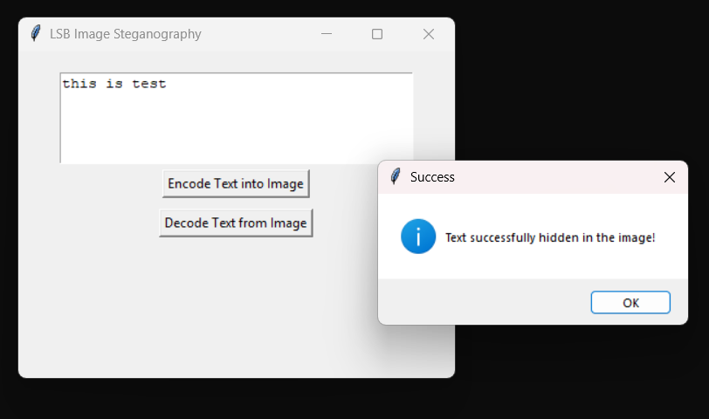
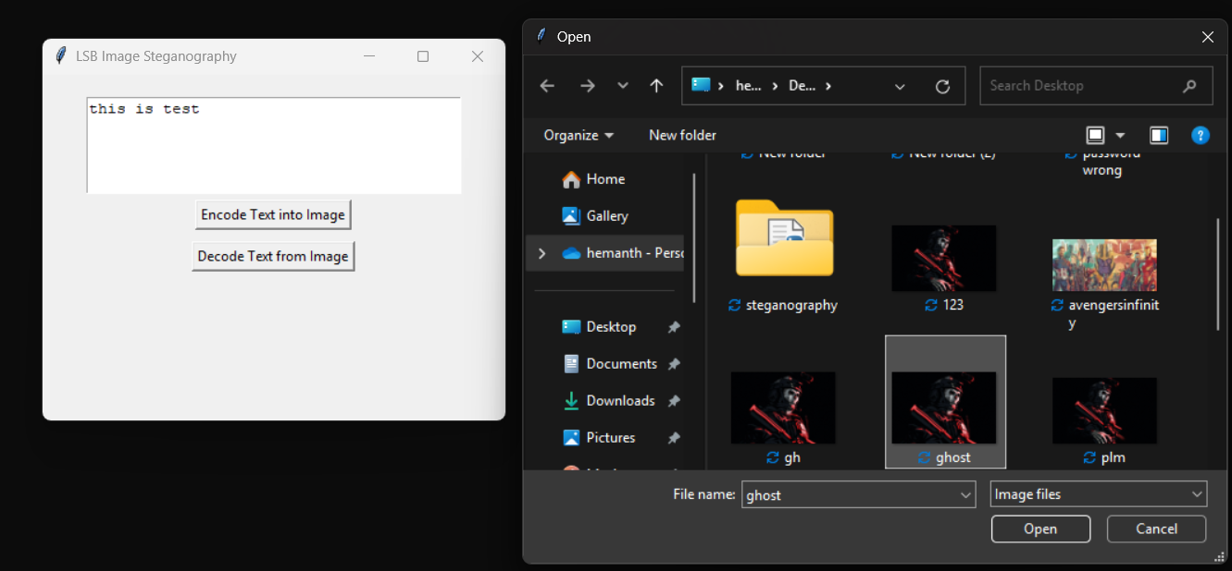
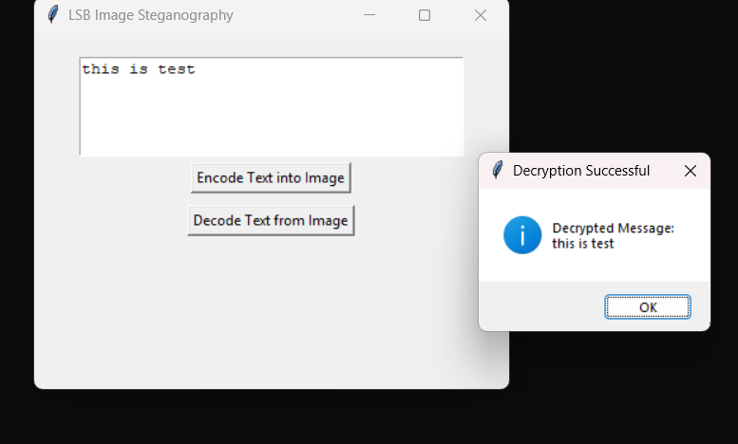
Results
Screenshots of the outcome

Slide 8
Conclusion
This project successfully integrates LSB steganography with AES-based encryption, providing a secure and user-friendly method for hiding and retrieving encrypted messages in images. The password-protected decryption ensures that even if data is extracted, it remains inaccessible without the correct key. With a GUI-based approach, the application is easy to use for cybersecurity enthusiasts, investigative professionals, and privacy-conscious individuals. By ensuring data security, usability, and robustness, this project stands out as a reliable solution for covert communication and information protection.

Slide 9
GitHub Link
https://github.com/hemanthkalekar/image-steganography

Slide 10
Future scope
Support for Video & Audio Steganography : Extend the project to hide encrypted messages in video and audio files for enhanced security.
AI-Based Steganalysis Detection : Implement AI models to detect and prevent unauthorized steganography in cybersecurity applications.
Cloud Integration : Enable secure cloud storage and retrieval of steganographed images for remote access and sharing.
Multi-Layer Encryption : Enhance security by incorporating hybrid encryption techniques for better protection against brute-force attacks.
Mobile Application Development : Develop an Android/iOS app to make secure steganography accessible on smartphones.

Slide 11
THANK YOU

