Slide 1
ATL-IBM Kids Internship 2020 – Team 2
Project Code Name: SaMoSa
(Based on the theme: Sanitization, Masks & Social Distance)

Slide 2
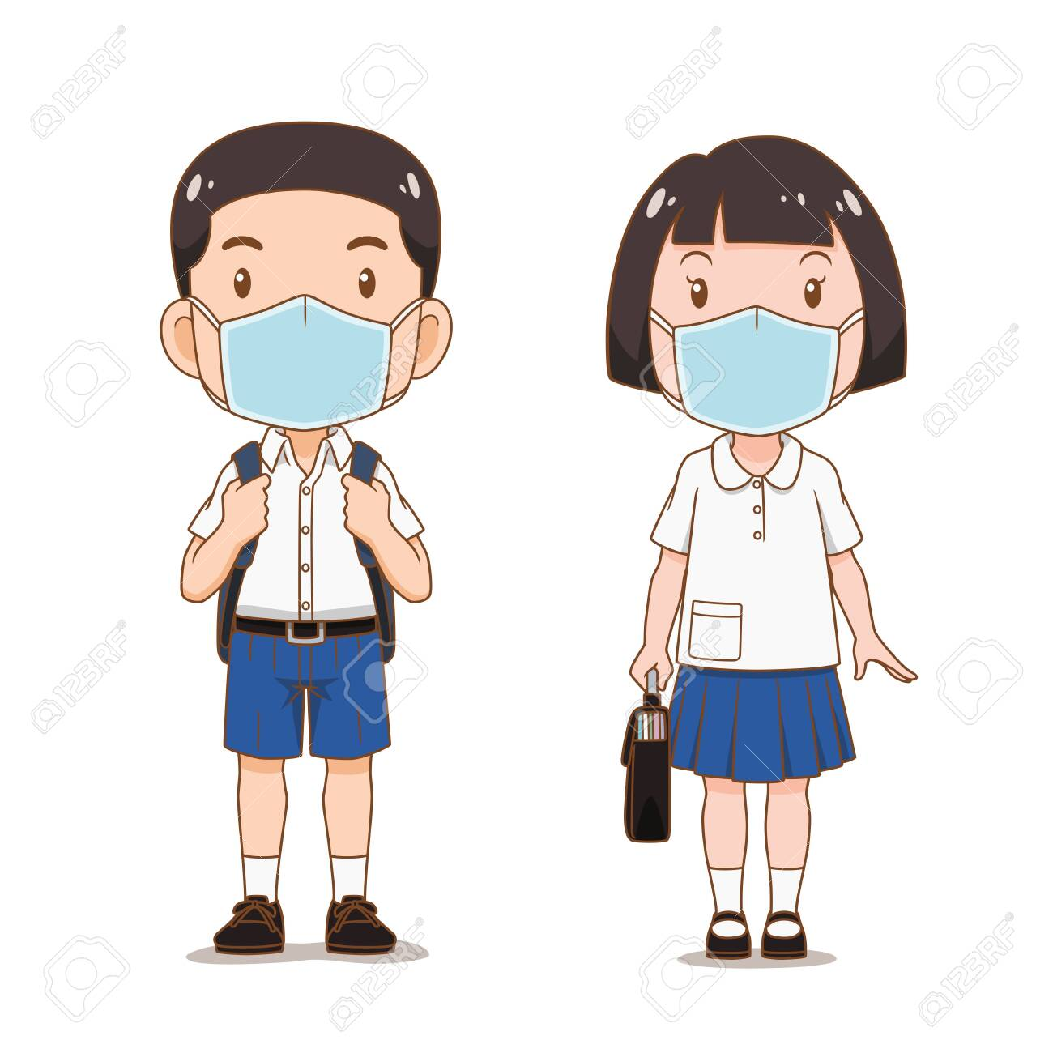


Problem & Motivation
Hello Prabhuti, How are you doing? It’s been a long time !!
Prabhuti
Hi Arkesh, I’m doing ok, just dragging along
Arkesh
Wwhhaat? You sound so dull, safe at home right? Then?
Yah, but pappa & bhayya go out for essentials. Worried about them?
They can reduce as much and wear masks while out na?
Many cases outside, we have no clue about them?
Govt is publishing the data on a daily basis, isn’t it?
Arrey, those are tested & known cases only. Many people might already have it. And they are roaming outside irresponsibly in groups, without masks. Risking others lives.
Hmmm, that’s a problem. Better to avoid or reduce going out.
Wish, it was possible. In our town no online delivery. Won’t know which shops are open, if they have masks, grocereies available. Lot of crowds, garbage thrown out in many places.
Arrey haan, itnaa dhyaan hi nahi diya. Ab mujhe bhi darr lag raha hai.

Slide 3


Fikar not… Here is the SOLUTION
Saavdhaan
Smart SaMoSa hi…
…samasya ka Samaadhaan!!!

Slide 4
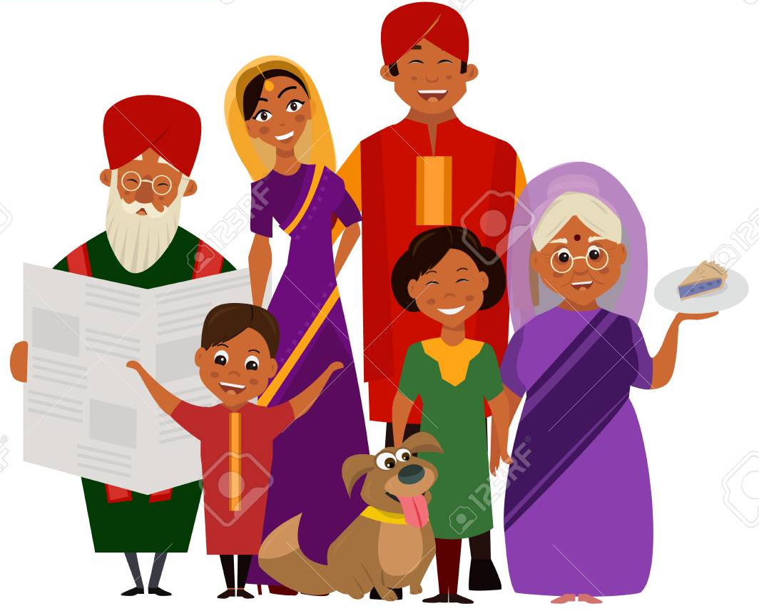


Who is it for? What does it do?
Collect accurate data of lockdown violations, crowds, garbage in real-time
Map with high-risk areas
Hear peoples’ needs, concerns & sentiments in real-time
Get actionable suggestions
Use resources wisely
Get map-based updates on crowds & risky areas in real-time
Able to report violations, sanity issues accurately in real-time
Get supplies availability and navigation help
Enable online transactions with street-vendors
Able to convey needs & concerns
Get timely advice on precautions
Citizens
Shopkeepers
Government
Update status of stocks, shop open/close status
Online transactions with people around (UPI enabled)
Get to know about peoples’ needs in real-time

Slide 5
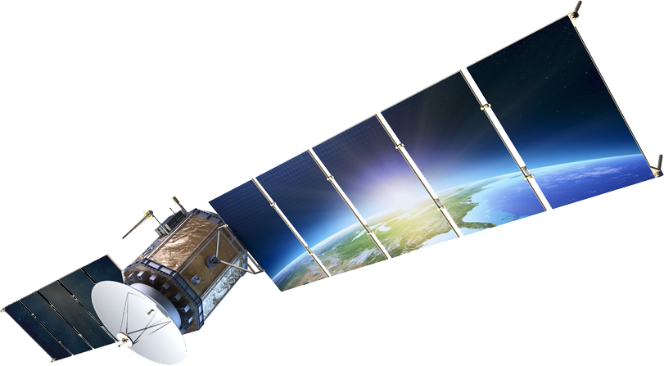
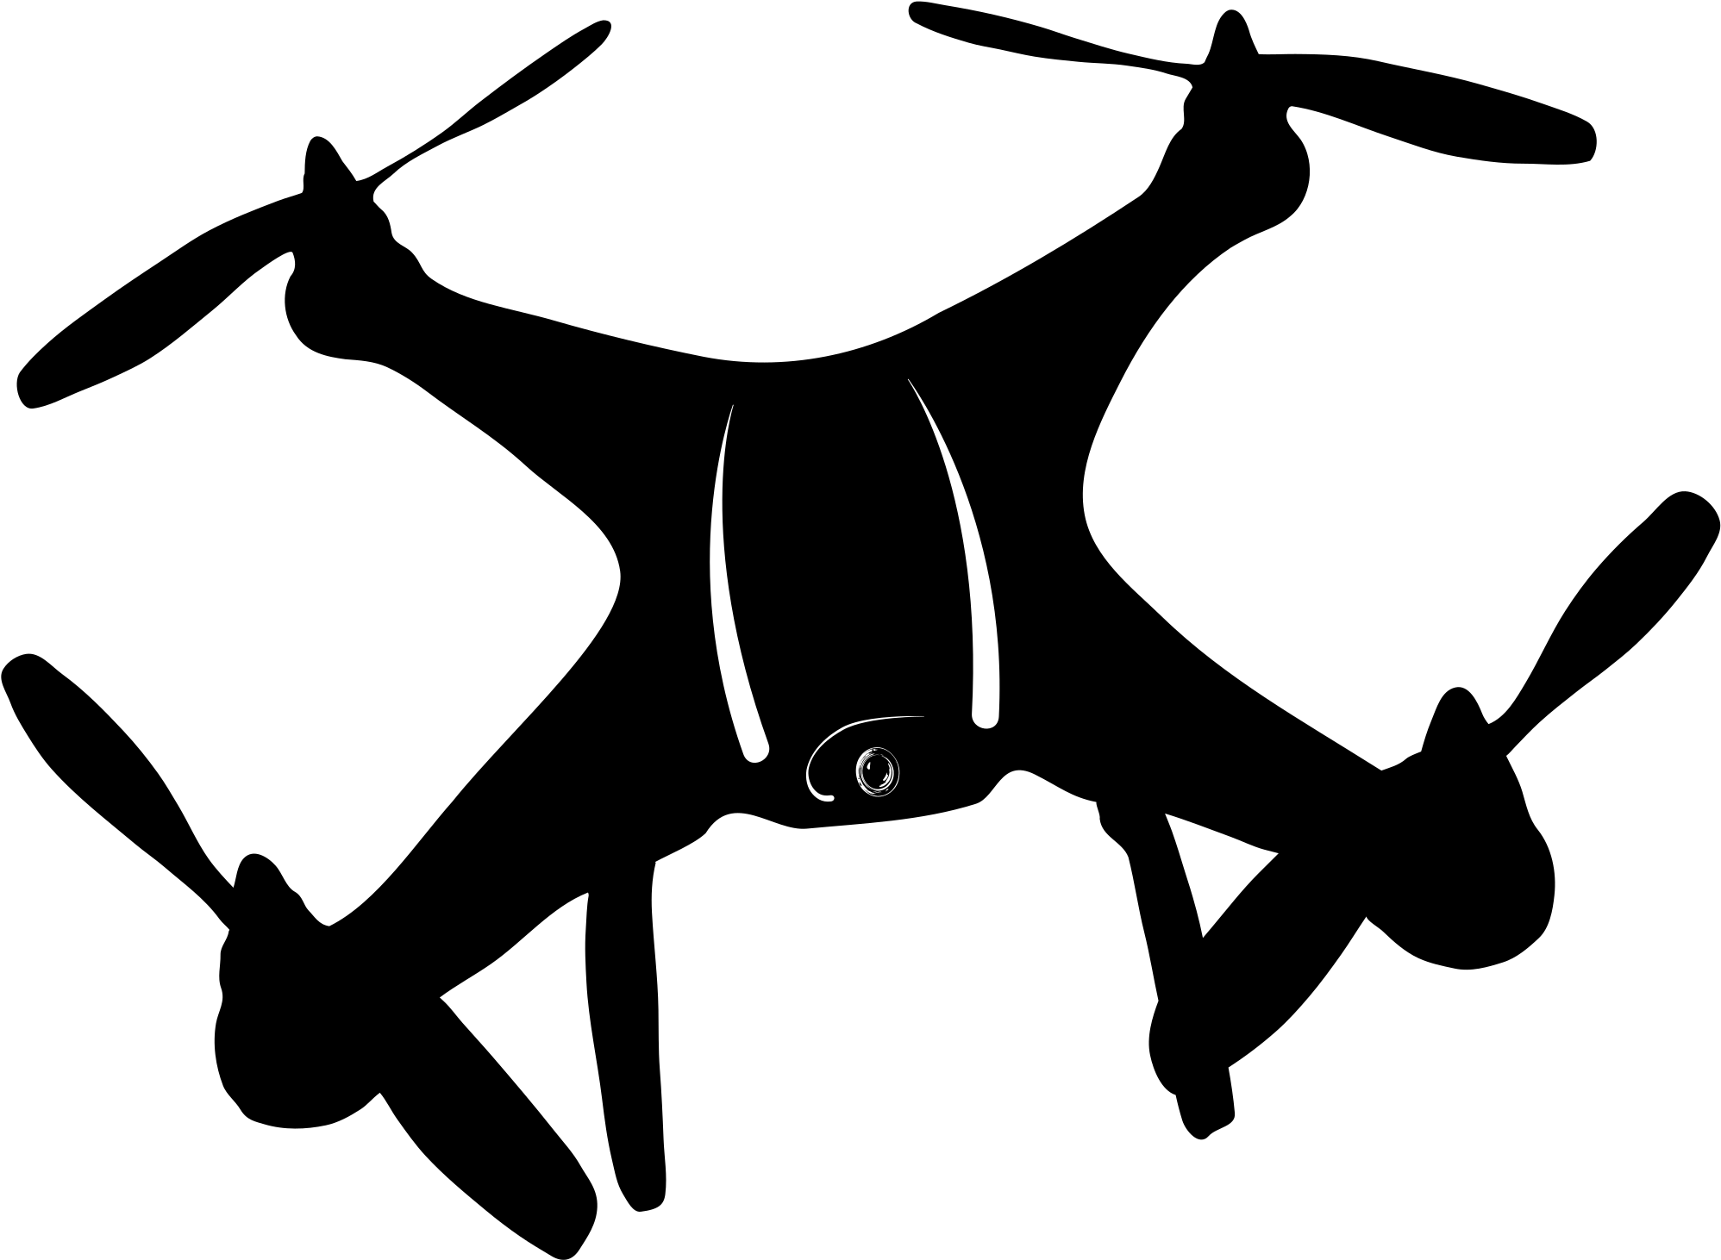
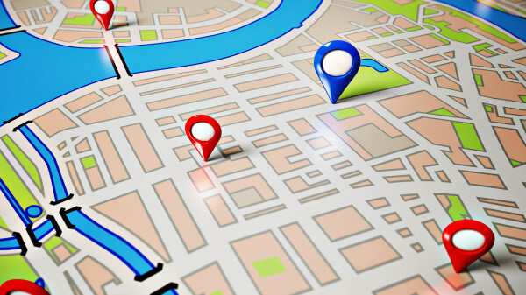


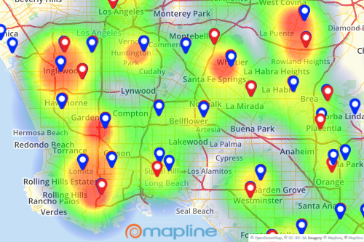


How it works?
Massive BigData Collection
Real-time Analytics
AI enabled recommender system
(for Government)
Real-time Map (GPS) based alerting system
(for Citizens)
eMohalla
Real-time image tracking from multiple sources to detect & report problematic areas
UPI based peer-to-peer
e-transactions
AI based chatbot for helping
(for Citizens)

Slide 6




Architecture & Technologies
IBM Cloud
IBM Watson Assistant Service
IBM COS
Node.js
App
Image Capture
Browser
Mobile
App
IBM Cloudant
IBM Visual Recognition Service
User
App

Slide 7
The Samosa Sena

