Slide 1

DESIGN THINKING AND INNOVATION PRESENTED BY: G.PAVANI-23KD1A0238 k.SANDHYA DEVI-23KD1A0250 b.VYSHNAVI-23KD1A0216 b.RAJESH-23KD1A0217

Slide 2
SMART DUSTBIN USING IOT
UNDER THE GUIDENCE OF:
Mr.B.Ram Vara Prasad,(Ph.D)
Assistant Professor,
Department of EEE,
LIET(A)

Slide 3
CONTENTS
INTRODUCTION TO DESIGN THINKING
PROBLEM STATEMENT
EMPATHY
DEFINE
COMPONENTS
IDEATE
PROTOTYPE
CONCLUSION

Slide 4
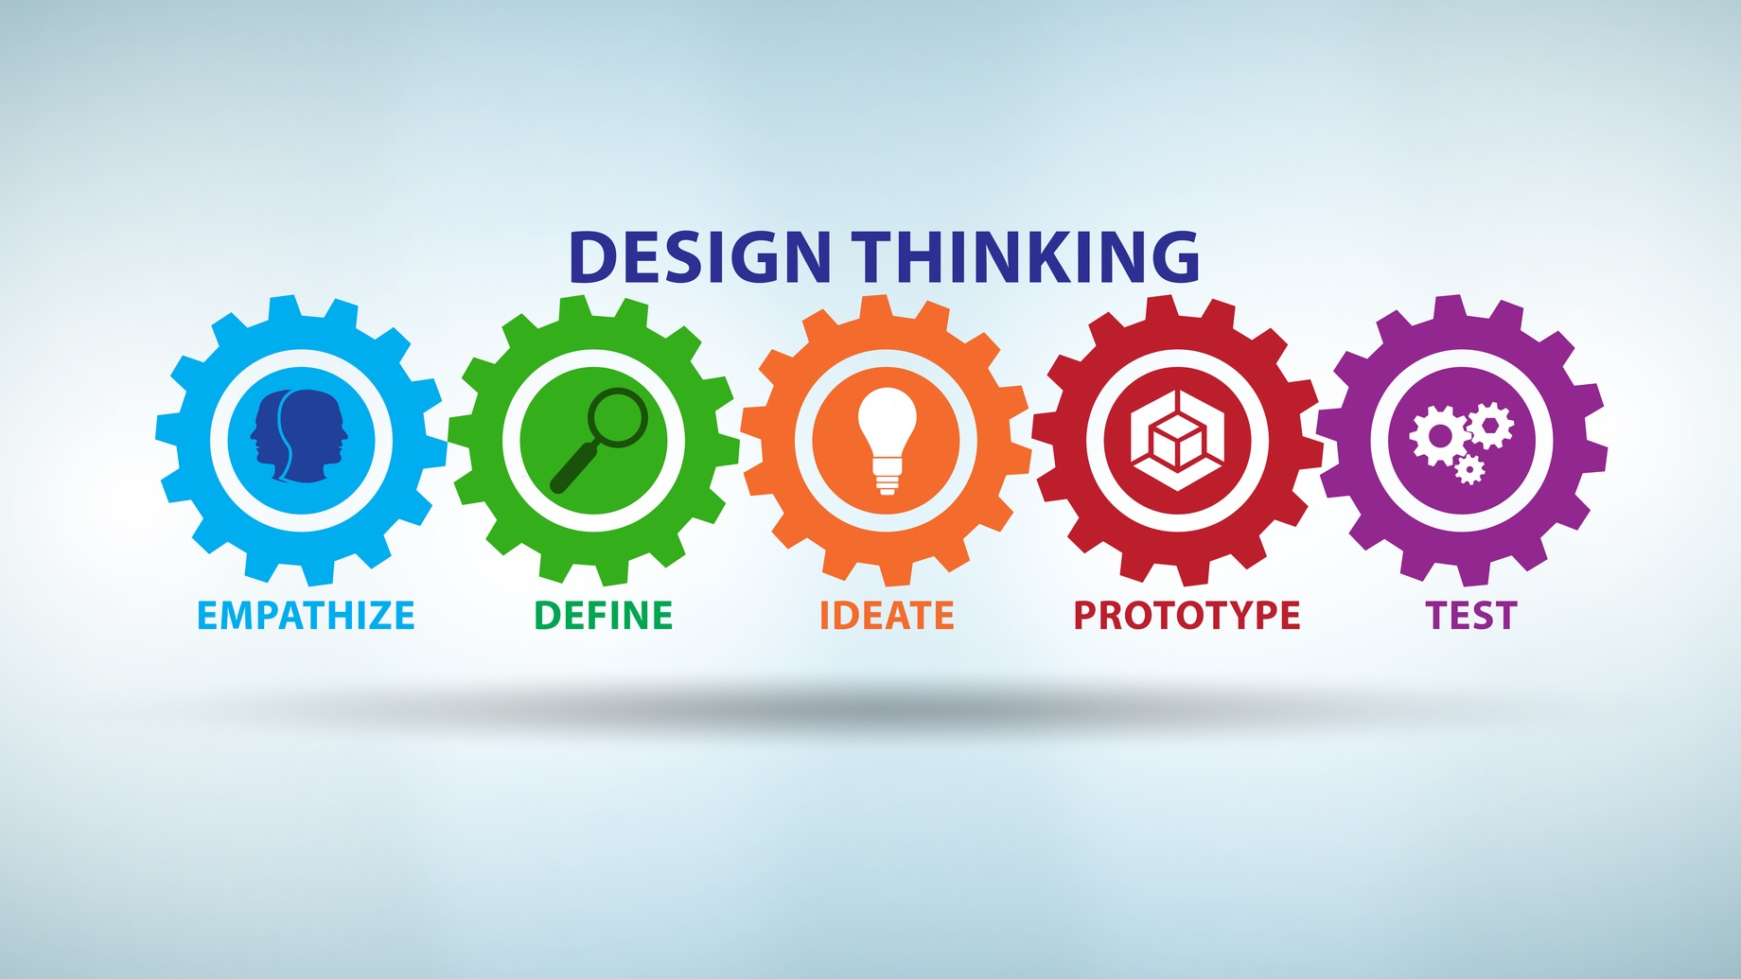
What is meant by design thinking and innovation ? .
Design Thinking is a problem-solving approach that focuses on understanding the needs of users and finding creative, practical solutions.Innovation means creating something new or improving an existing idea, product, or process to make it better, more efficient, or more useful.

Slide 5

Problem statement
In places like offices, schools, and hospitals,
people often find it difficult to walk to the
dustbin, and touching the lid can be unhygienic.
Fixed dustbins can't move and may not always
be nearby when needed.

Slide 6

Present scenario

Slide 7
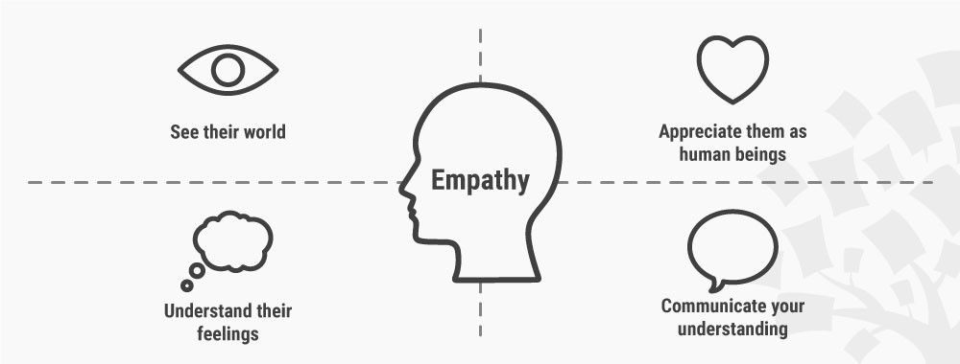
Empathy
This project is about a smart dustbin that moves on a line and opens its lid by itself. When a person comes close, the dustbin stops and opens the lid, so the person can throw trash easily. This makes people feel good and helps them keep the place clean. It is good for schools, hospitals, and offices where we need to stay clean and be kind.

Slide 8
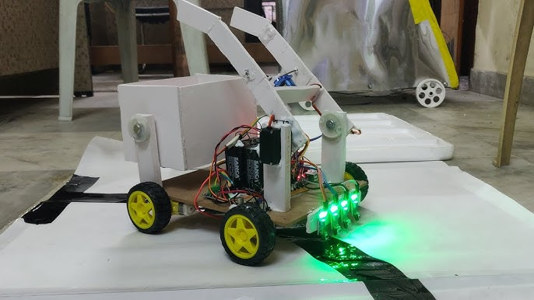
define
The Smart Dustbin with Line Following and Automatic Lid Opening is an intelligent waste bin system designed to improve cleanliness and hygiene in public and indoor spaces. The project uses sensors and motors to create a dustbin.

Slide 9
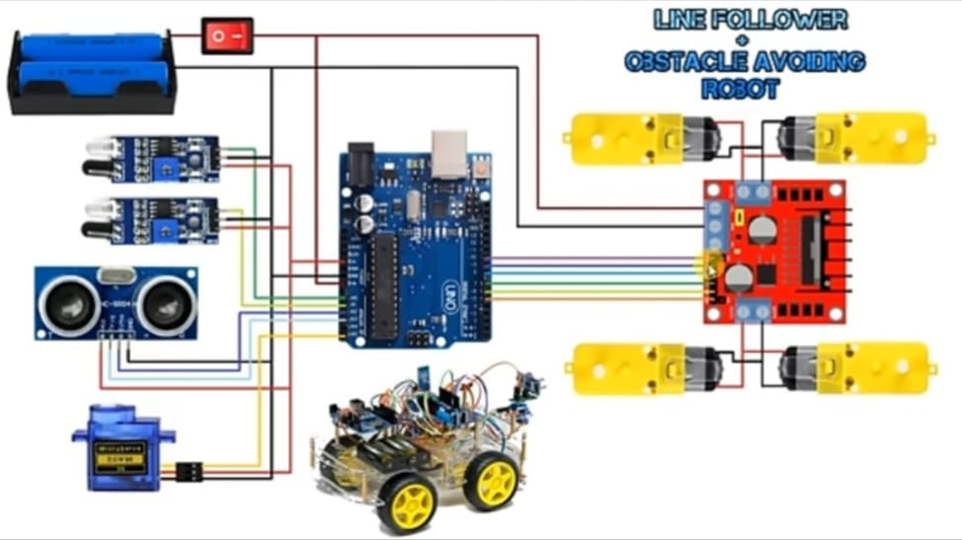
CIRCUIT DIAGRAM

Slide 10
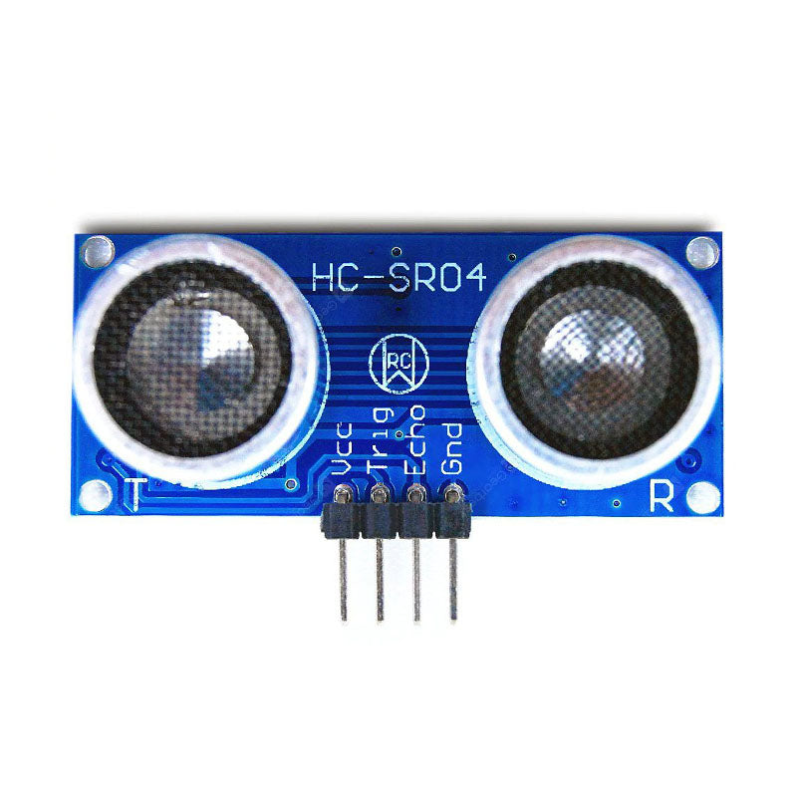
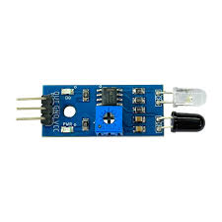
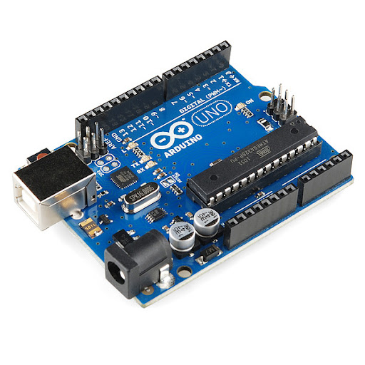
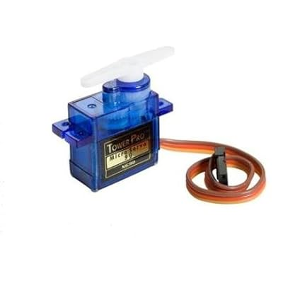
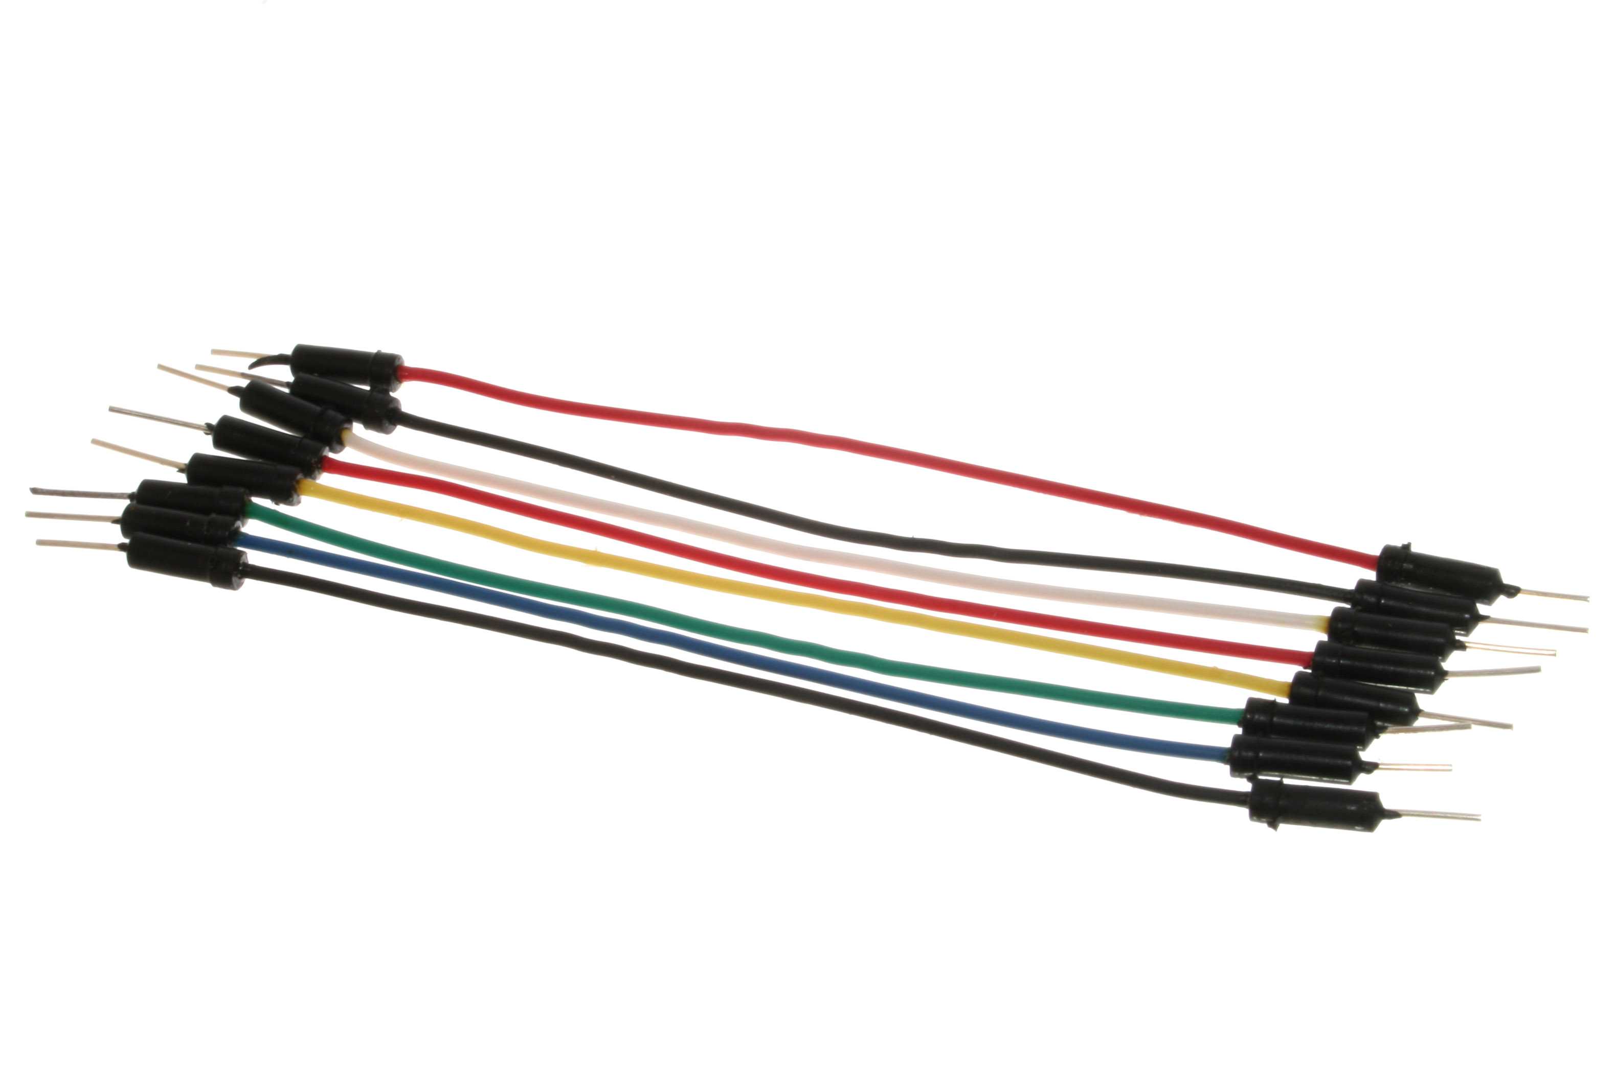
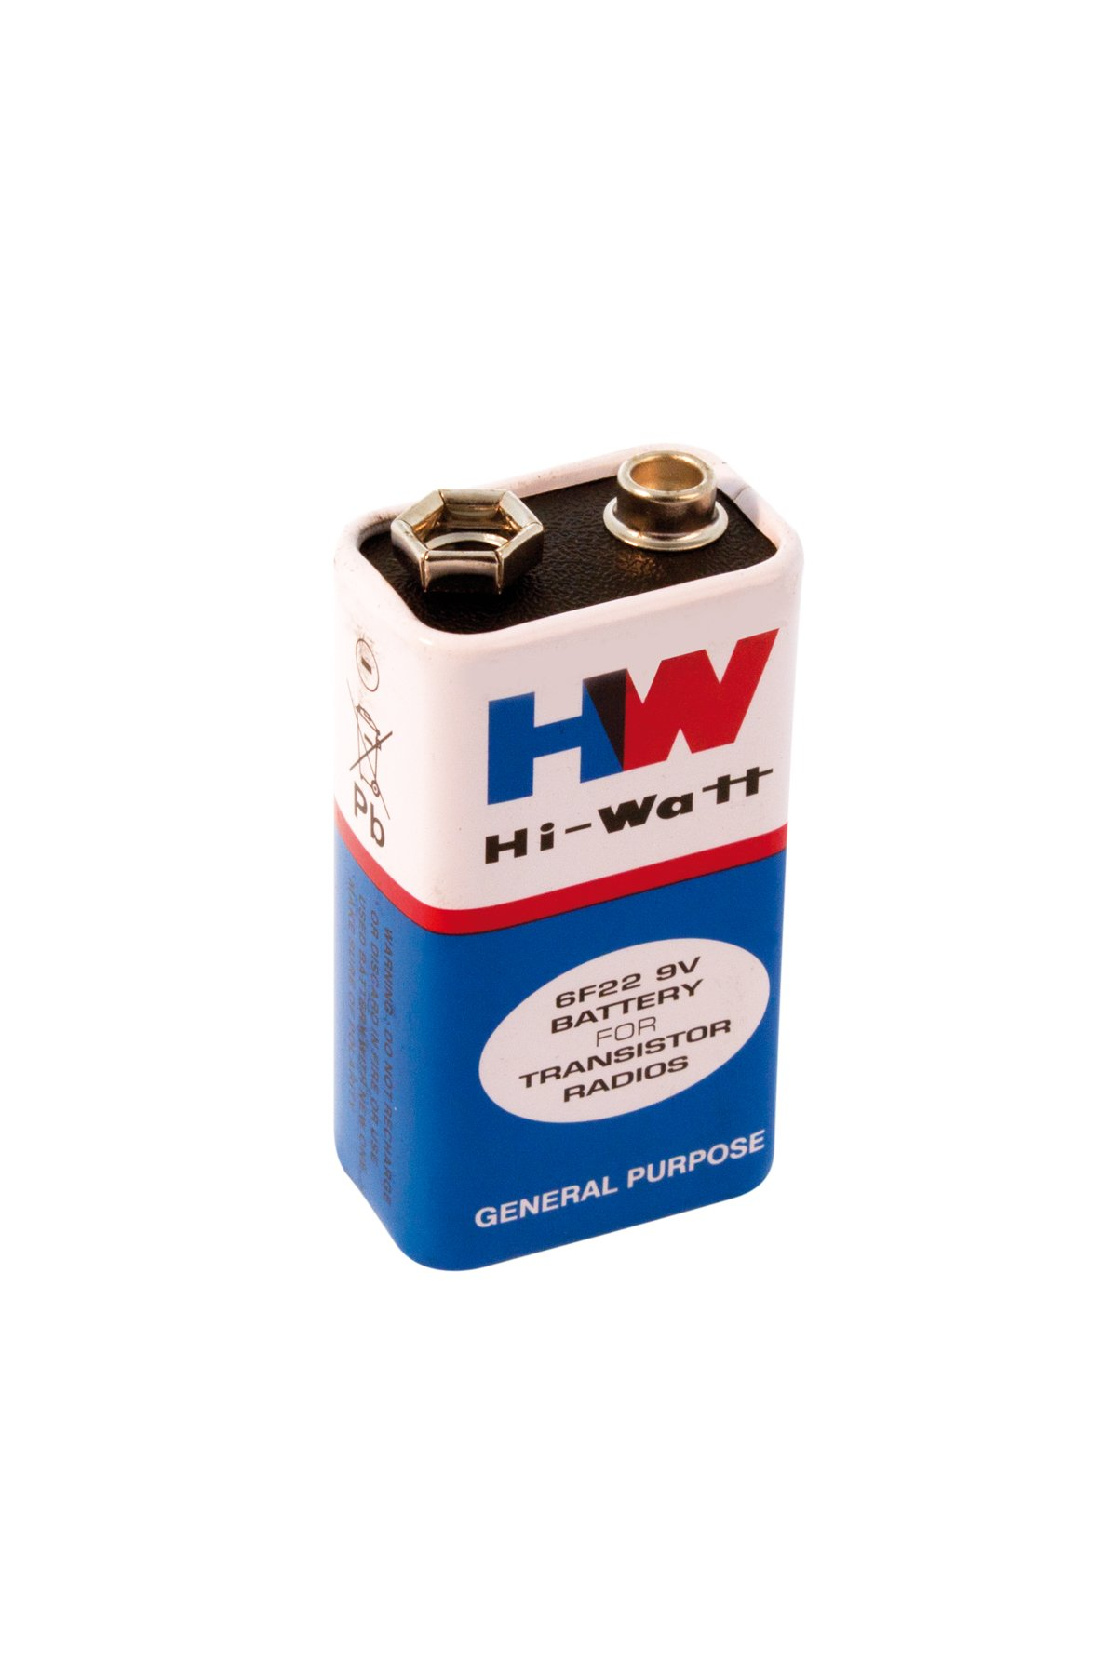
COMPONENTS
Ultrasonic sensor
IR sensor
Arduino uno
Servo motor
Jumper wires
Battery

Slide 11
Applications
Hospitals: The dustbin can move by itself to collect dirty stuff, so nurses don't have to carry it around and risk getting sick.
Big Apartments: It can go to different spots to pick up trash from people's homes, making it easier for everyone.
Factories: It can carry waste from where things are made to a central place without people having to do it.
Schools: It can go around classrooms and collect trash, keeping the school cleaner.
Shops: It can move around and collect waste in busy shopping areas

Slide 12
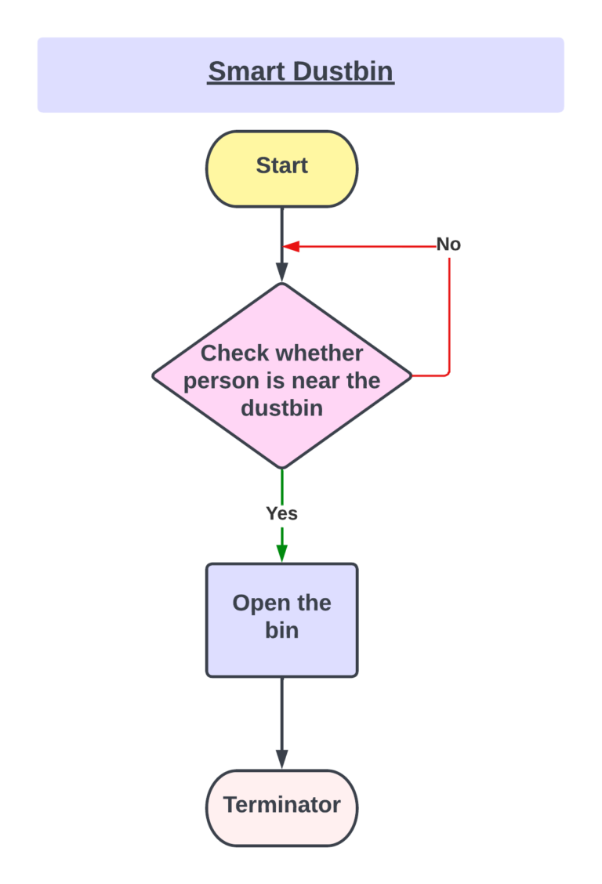
How it works?

Slide 13
INTERVIEW QUESTIONS
Do you feel comfortable touching a dustbin in public places?
Have you ever avoided throwing trash because the dustbin was too far?
Would you prefer a dustbin that opens automatically?
Do you think a dustbin that moves on its own would be helpful?
Where do you think a smart dustbin would be most useful (school, hospital, etc.)?
What problems do you face with dustbins in your daily life?
7. Would a touchless dustbin make you feel safer or cleaner?

Slide 14

CONCLUSION
The smart dustbin project was made to help people throw waste easily and safely. It can move by itself by following a line and opens the lid automatically when someone comes near. This makes it touch-free, clean, and convenient to use in places like schools, hospitals, and offices. The project helps keep the environment tidy and supports better hygiene. It is a smart step toward using technology to solve small everyday problems in a smart way.

Slide 15


