Slide 1

DESIGN THINKING AND INNOVATION
Presented by: TEAM-17
1.M.Adhi Laxmi-23KD1A0264
2.L.Neeharika-23KD1A0259
3.CH.Ravi teja-23KD1A0225
4.B.Harshavardhan-24KD5A0204

Slide 2
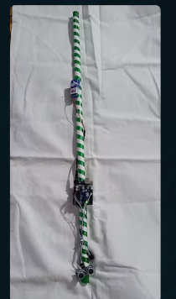
Smart Bind Stick
UNDER THE GUIDENCE OF:
Mr. B. Ram Vara Prasad, (Ph.D) Assistant professor, Department of EEE, LIET (A).

Slide 3
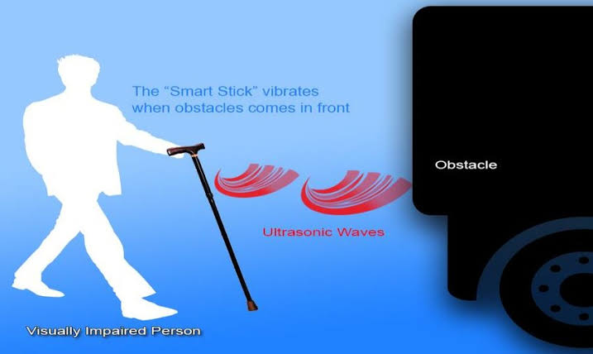
Empathize
Understand user needs and challenges.
Define
Clearly articulate the problem to solve.
Ideate
Generate creative ideas for solutions.
Prototype
Build models to test ideas quickly.
Test
Gather feedback to improve solutions.
Innovation
Implement new and better ways to meet needs.

Slide 4
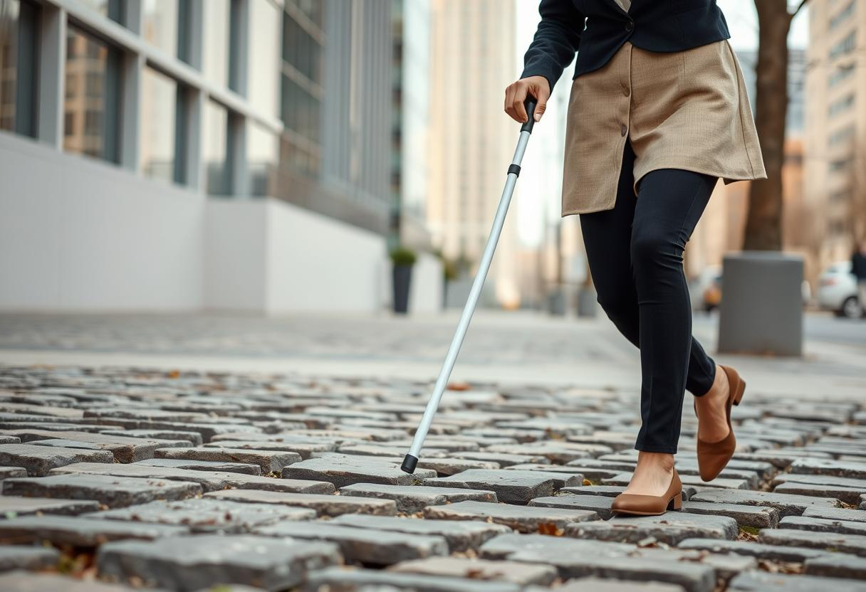
Problem Statement:
Visually impaired individuals face significant challenges in navigating their surroundings safely and independently. Traditional white canes, while useful, have limitations in detecting obstacles beyond ground level and at a distance, making users vulnerable to collisions with objects such as hanging branches, signboards, or vehicles.

Slide 5
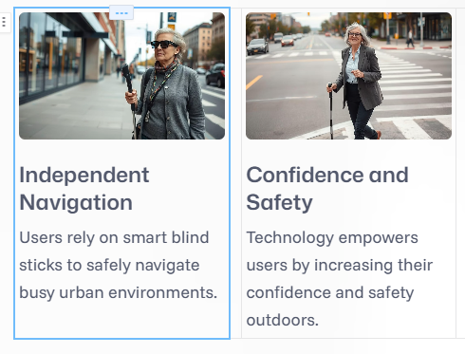
Empathy with Smart Blind Stick Users

Slide 6
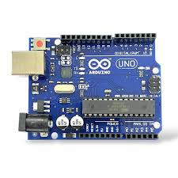
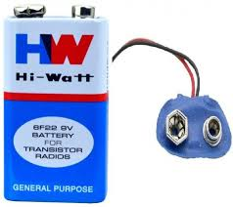
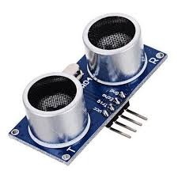
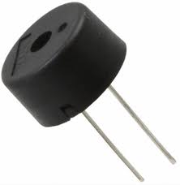
Defining the Smart Blind Stick
Ultrasonic Sensors
Detect obstacles in the path
Microcontroller
Processes sensor data and controls feedback
GPS Module
Navigation assistance
Battery
Power supply for the device
Ergonomic Handle
User-friendly design and controls

Slide 7

Ideation for Smart Blind Stick
Sensor Integration
Combine multiple sensors for precise environment mapping.
Haptic Feedback
Develop vibration patterns for distinct alerts.
Mobile Connectivity
Sync with smartphones for GPS and voice assistance.
Customizable Modes
Adjust settings based on user preferences and environments.

Slide 8
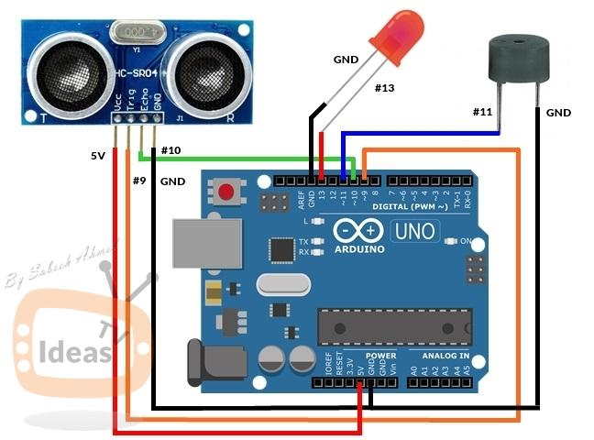
Working Prototype and Circuit Diagram
Prototype Feature
Obstacle sensors active and
response.
Real-time haptic vibration alerts.
Basic GPS navigation via connected
app.

Slide 9




Future Developments
AI Predictive Navigation
Anticipate obstacles before reaching them for smoother routes.
Smart Home Integration
Connect with home devices for seamless user control.
Wireless Charging
Extended battery life with convenient charging options.
Enhanced Haptic Feedback
Texture recognition to provide more environmental context.

Slide 10
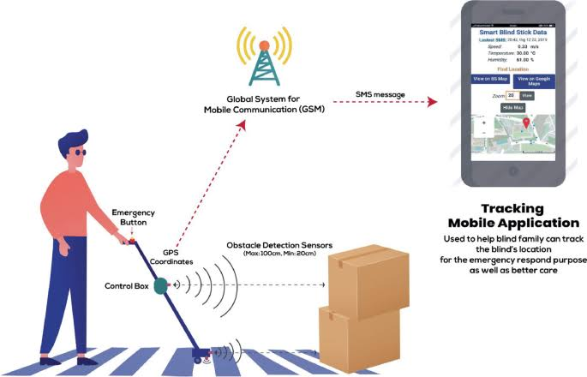
Conclusion: Empowering Independence
Inclusive Mobility
Smart stick enables safe, independent navigation.
Tech Meets Compassion
Innovative design supports users' dignity and needs.
Confidence in Movement
Empowering users to explore the world
With assura.

Slide 11
THANKYOU

