Slide 1

DESIGN THINKING AND INNOVATION
Presented By
CH .Sohitha Sai(23KD1A0219)
L . Venkata Lakshmi(23KD1A0260)
B . Ramu (23KD1A0212)
I . Vamsi (23KD1A0245)

Slide 2
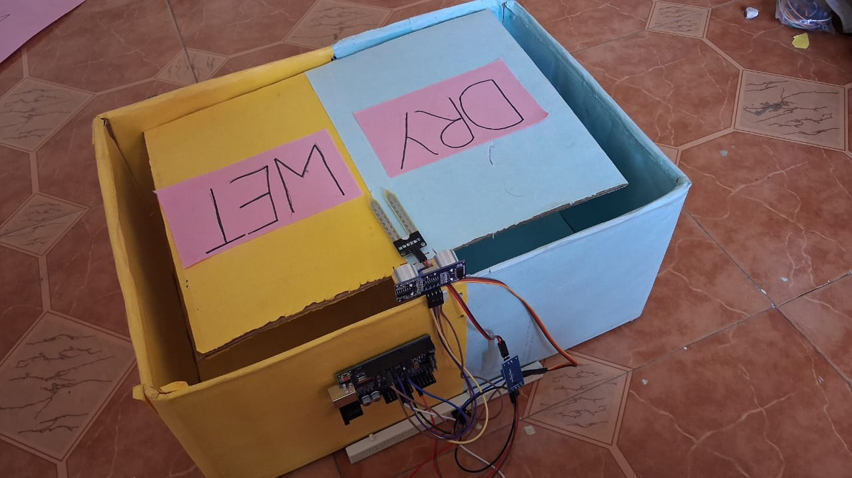
WET AND DRY WASTE SEGREGATION
UNDER THE GUIDENCE OF
Mr.B.RAM VARA PRASAD,
(Ph.D)Assistant professor, Department of EEE, LIET(A).

Slide 3
INTRODUCTION TO DESIGN THINKING
PROBLEM STATEMENT
CONTENTS
EMPATHY
DEFINE
IDEATE
PROTOTYPE EXPLANATION
CONCLUSION

Slide 4
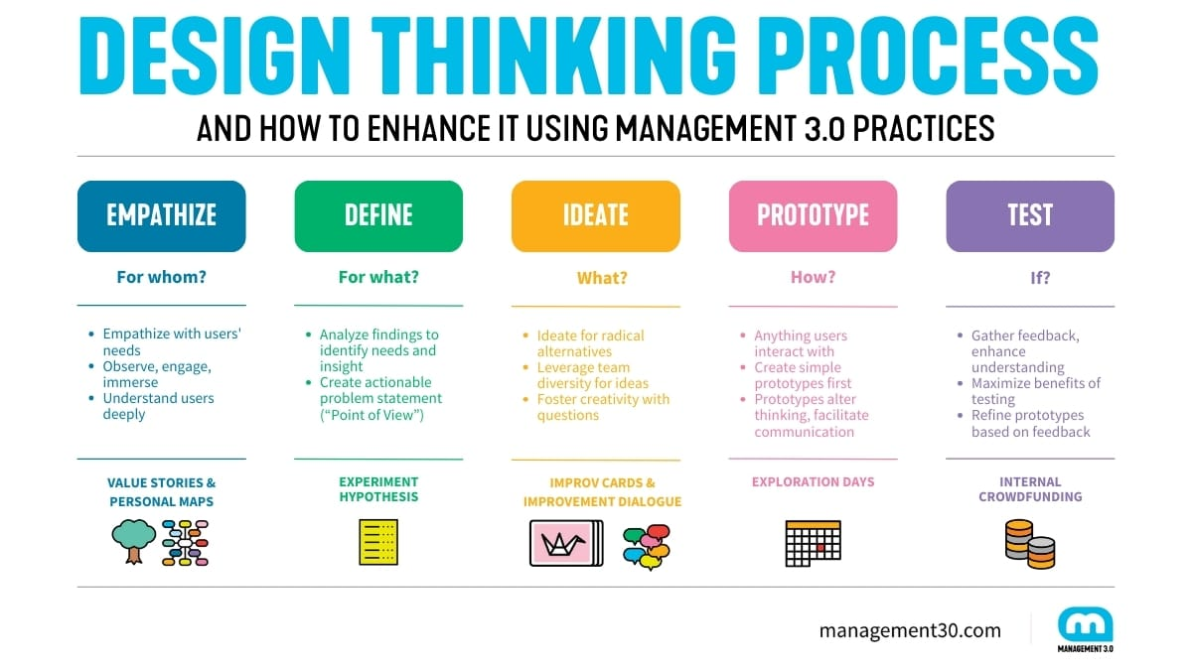
Design thinking and innovation are interconnected processes focused on creating value by understanding user needs and exploring creative solutions.

Slide 5
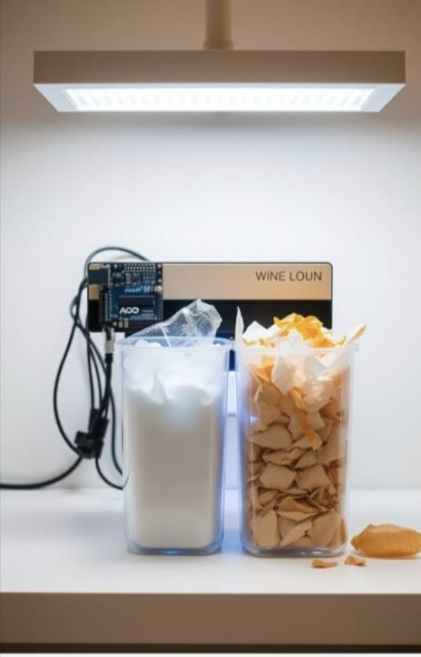
Problem Statement
✅ Poor Segregation
🕒 Time-Consuming
🧤 Unhygienic
💸 High Cost
🌍 Eco Solution

Slide 6
🧤 "Sanitation heroes deserve safety" – Manual waste handlers face serious health risks every day.
🕒 "Why waste time, when tech can help?" – Segregation shouldn’t be a chore in our busy lives.
🧠 "Awareness isn’t enough" – People may care, but forgetfulness or confusion still leads to mixed waste.
💸 "Smart doesn't have to be pricey" – Every home deserves smart solutions, not just the rich.
Empathy

Slide 7
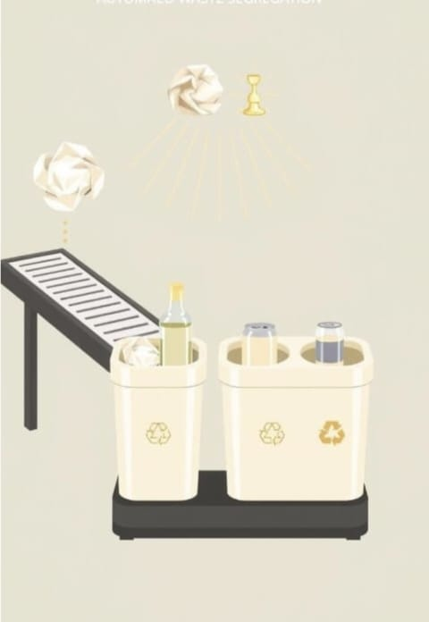
🎯 DEFINE
Despite the growing emphasis on sustainability, waste segregation at the source remains a major challenge due to:
✅ Lack of awareness and consistency in households
🕒 Time-consuming and inconvenient manual segregation
🧤 Health risks to sanitation workers
💸 High cost of existing smart segregation systems

Slide 8
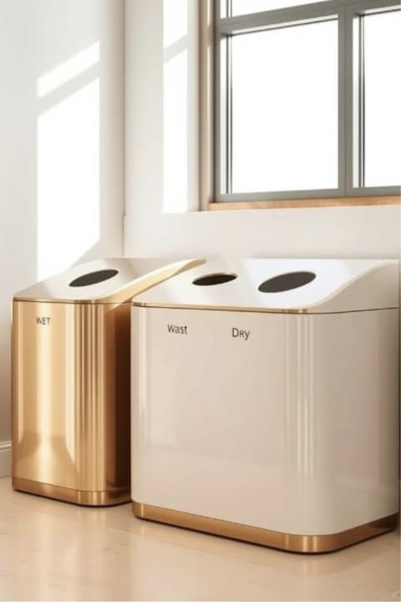
💡 IDEATE
🔍 Sensor-Based Detection – Use moisture or optical sensors to automatically identify wet vs. dry waste.
⚙️ Rotating Bin System – A smart bin that rotates compartments based on detected waste type.
📱 Mobile App Integration – App alerts and tracking to guide users and promote segregation habits.
🧩 Modular Design – Compact, detachable bin units suitable for households and small communities.

Slide 9
🛠️ PROTOTYPE – Building the Automated Waste Segregation Model
In the prototype stage, we designed and built a working model of our automated wet and dry waste segregation system using sensors and microcontroller logic. This prototype helps us test how well our concept functions in a real-world setting and gives us insights for future improvement.
🧪 Working Principle:
Waste is placed into the input tray
Sensor detects moisture level
Based on detection:
Wet waste → Bin A
Dry waste → Bin B
System notifies with LED/Buzzer
Real-time segregation with minimal user involvement

Slide 10
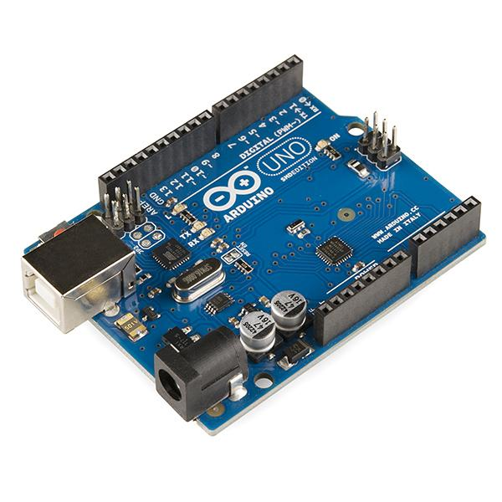
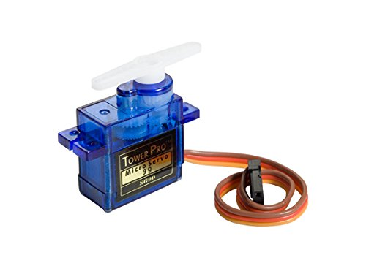
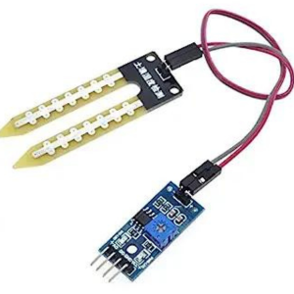
🔩 Key Components in the Prototype
Arduino Uno SMD
Acts as the system’s central controller.
Receives input from sensors and controls the servo based on logic.
Servo 9g Motor
Physically shifts the flap to direct waste into the correct bin.
Quick and precise motion based on Arduino’s signal.
Soil Moisture Sensor
Measures how wet the waste is.
Sends moisture data to Arduino to determine waste type

Slide 11
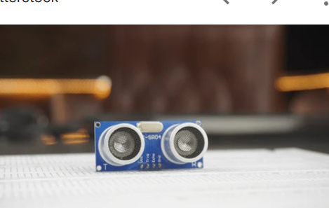
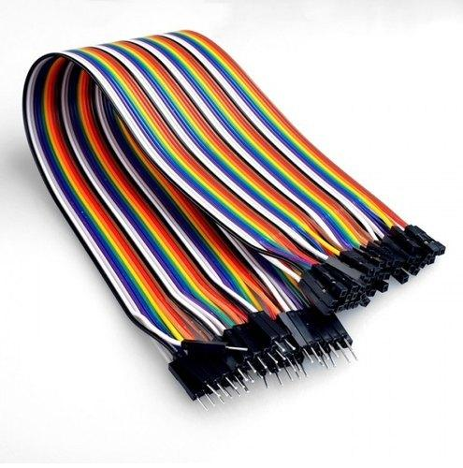
Ultrasonic Sensor 📏
Senses when waste is placed within range
Ensures system activates only when waste is detected.
USB Cable 🔌
Used for programming the Arduino and providing power during testing.
Nuts and Bolts (3x20mm & 3x12mm) 🔧
Used to build the frame of the waste segregation device.
Provides structural stability.
F-F and M-F Jumper Wires 🔗
Connect components to the Arduino.
Ensures smooth communication between sensors, motor, and microcontroller.

Slide 12
✅ Conclusion
The automated wet and dry waste segregation system we developed provides a smart, efficient, and eco-friendly solution to one of the most common problems in daily waste management. By integrating sensors and automation using Arduino Uno, the system can accurately detect and categorize waste based on its moisture content — reducing human effort and error.
This project not only promotes cleaner and more sustainable waste disposal habits but also shows how technology and innovation can contribute to solving environmental challenges. With further development, this prototype can be scaled for use in homes, schools, offices, and public spaces, encouraging widespread adoption of smart waste segregation and leading toward a greener future.

Slide 13

THANK
YOU

