Slide 1
DESIGN THINKING AND INNOVATION
PRESENTED BY:
ADAPA DIVYASRI 23KD1A0201 ANUMANTHU RAHUL 23KD1A0204 ALLURI HARISHINI 23KD1A0202
BANDA VEERENDRA HANSHITH 24KD5A0203 CHANDAKA SIDDU 23KD1A0223

Slide 2
Harness the sun: solar power bank
UNDER THE GUIDENCE OF:
Mr.B.Ram Vara Prasad,(Ph.D)
Assistant professor, Department
of EEE, LIET (A).
CONTENTS
INTRODUCTION TO DESIGN THINKING
PROBLEM STATEMENT
EMPATHY
DEFINE
IDEATE
PROTOTYPE

Slide 3
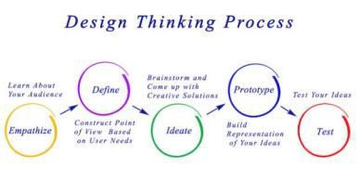
CONCLUSION
Design thinking and innovation:Design Thinking and
Innovation is a creative process that focuses on understanding people’s needs, generating new ideas, and building useful solutions. It helps in creating new products, services, or ways of doing things that solve real problems and improve lives.
"People can't charge their phones when

Slide 4
there's no electricity, especially while traveling or during power cuts."
"Normal power banks run out of charge and need electricity to recharge, which is not always available."
"People want an affordable and eco- friendly way to charge their devices without depending on electricity."
USER INTERVIEW QUESTIONS
OBSERVATION (SHADOWING)
USER INTERVIEW QUESTIONS
1. What charging challenges have you faced when you're away from power outlets?

Slide 5
Have you ever considered using a solar power bank for mobile charging?
How often do you find yourself needing to charge your phone while away from a wall outlet?
DEFINE
Using a solar power bank :
How might we able to help the smartphone users to charge their mobile while away from power outlets
How might we able to reduce stress on power grid
How might we able to increase the usage of solar power than traditional power

Slide 6
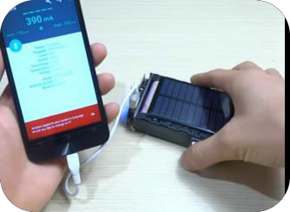
PROTOTYPE

Slide 7
CONCLUSION
In conclusion, the solar power bank represents a practical and sustainable solution for mobile device charging, especially in situations where access to traditional power sources is limited or unreliable. By harnessing renewable solar energy, it offers users an eco-friendly and portable option for staying connected while reducing dependence on electricity grids.
Throughout this project, we explored the design, functionality, and user needs surrounding solar power banks. Key insights include the importance of balancing solar panel efficiency with portability, enhancing charging speed, and increasing user awareness about realistic performance expectations.
As mobile usage continues to rise globally, particularly in outdoor and off-grid environments, solar power banks have the potential to become a more integral part of everyday life. Future development should focus on smarter energy management, rugged and user-centric design, and educational efforts to promote responsible usage.
ANY QUESTIONS?...

