Slide 1

DESIGN THINKING AND INNOVATION PRESENTED BY: G.PAVANI-23KD1A0238 K.SANDHYA DEVI-23KD1A0250 B.VYSHNAVI-23KD1A0216 B.RAJESH-23KD1A0217

Slide 2
SMART DUSTBIN USING IOT
UNDER THE GUIDENCE OF:
Mr.B.Ram Vara Prasad,(Ph.D)
Assistant Professor,
Department of EEE,
LIET(A)

Slide 3
CONTENTS
INTRODUCTION TO DESIGN THINKING
PROBLEM STATEMENT
EMPATHY
DEFINE
COMPONENTS
IDEATE
PROTOTYPE
CONCLUSION

Slide 4
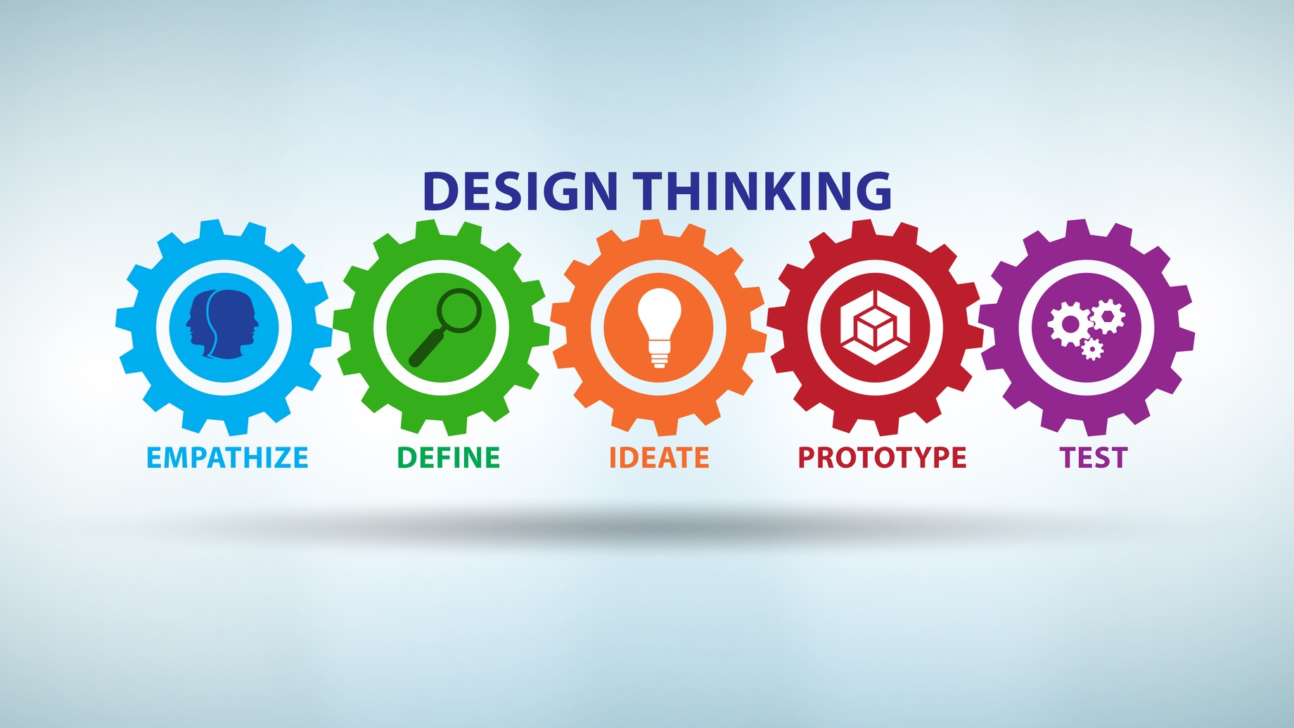
What is meant by design thinking and innovation ? .
Design Thinking is a problem-solving approach that focuses on understanding the needs of users and finding creative, practical solutions.Innovation means creating something new or improving an existing idea, product, or process to make it better, more efficient, or more useful.

Slide 5
Problem statement
Traditional waste disposal systems face challenges such as irregular waste collection, overflowing dustbins, unhygienic conditions, and inefficient use of resources. These issues lead to environmental pollution, spread of diseases, and increased operational costs. There is a need for an intelligent waste management system that can monitor the fill levels of dustbins in real-time and optimize waste collection processes."

Slide 6
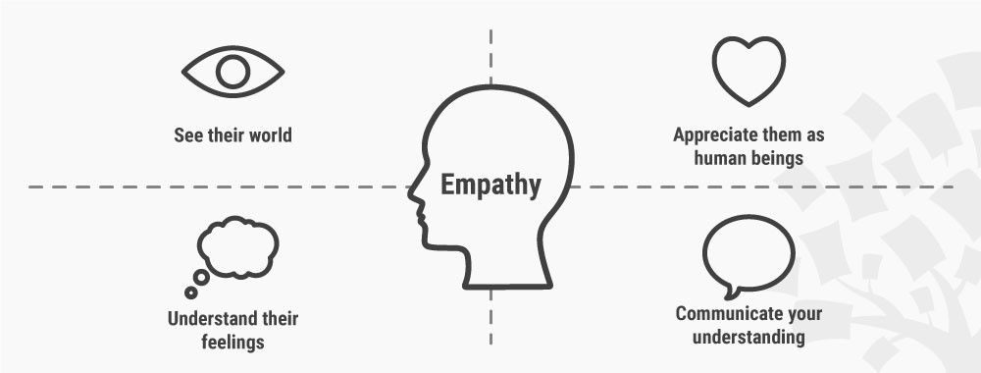
Empathy
Dirty and full dustbins can make places smell bad and look messy. People can get sick because of it. The workers who clean the dustbins have a hard job. They have to check many bins every day.A smart dustbin can help. It tells when the bin is full. This helps workers and keeps places clean. Making this shows that we care about environment and others and want to make life better and easier."

Slide 7
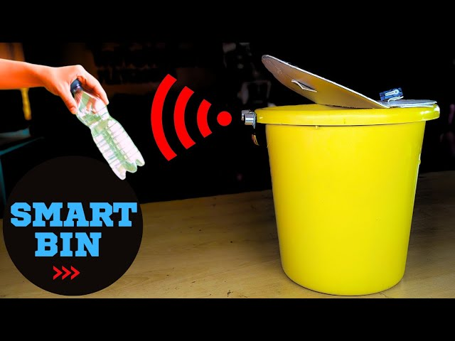
define
A Smart Dustbin is an intelligent waste container that uses sensors and IoT (Internet of Things) technology to detect the level of waste, open the lid automatically. It helps improve hygiene, reduce manual checking, and support smart waste management systems.

Slide 8

Ideate
BRAINSTORMING-EXPLORING INNOVATIVE POSSIBILITIES
1. Motion-Sensor LidTouchless access for improved hygiene.
2. Bin Fill-Level Notification System Alert users or municipal services when bin is full.
3. Solar Charging Integration Sustainable energy solution for outdoor bins
4. Smart Segregation Auto-sorting waste to promote recycling
5. Voice Command Operation Hands-free control for improved accessibility.
6. GPS and Mobile App Tracking Locate nearest smart bins and monitor status in real-time.

Slide 9
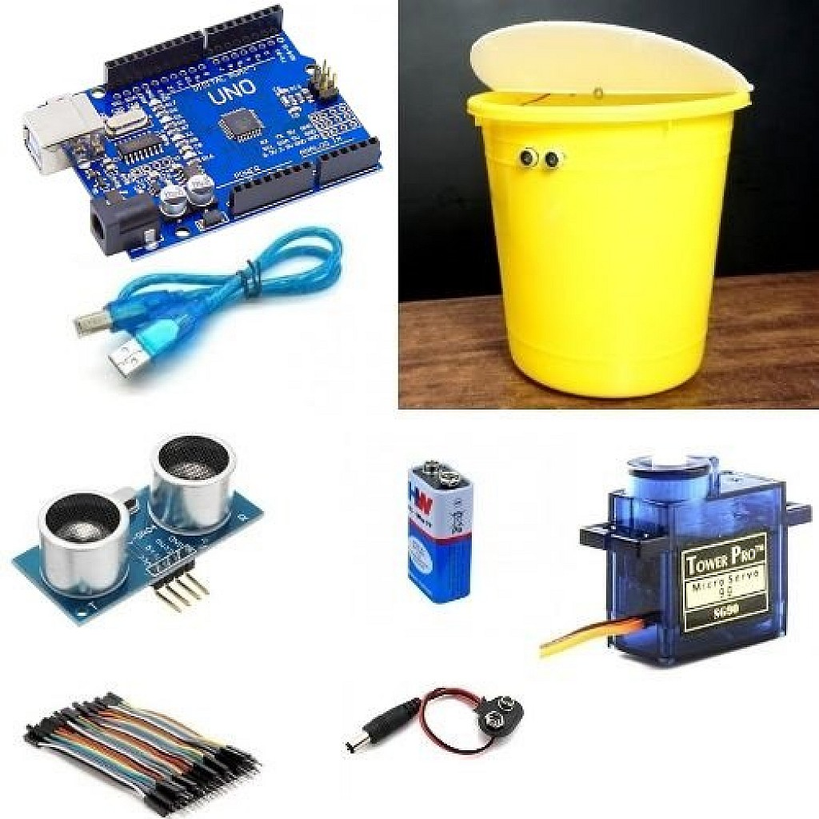
components
1. Arduino UNO – Acts as the brain of the project, controlling all components.
2. Jumper Wires & Breadboard-For making circuit connections.
3. Ultrasonic Sensor – Detects nearby objects or people to trigger lid opening
4. Servo Motor – Opens and closes the dustbin lid automatically.
5. HW Batteries (2) – Supply power to the entire circuit.
6. Battery Connector with Jack – Connects batteries to the Arduino safely.
7. Bluetooth Module – Allows remote lid control via a mobile phone
8. Dustbin (Plastic or Metal)-The physical structure where waste is collected..

Slide 10
ADVANTAGES
Clean Environment – Helps avoid overflowing and bad smell.
Saves Time – Workers know exactly when to empty the bin.
Automatic Lid – Touchless system is more hygienic.
Smart Monitoring – Tracks and records waste levels.
Less Effort – Makes work easier for cleaning staff.
Supports Smart Cities – Uses technology to improve public health.
DISADVANTAGES
Costly – More expensive than a normal dustbin.
Needs Power – Requires battery or electricity to work.
Internet Required – Needs Wi-Fi for real-time alerts.
Maintenance – Sensors and circuits may need repair.
Not Weatherproof – Needs protection for outdoor use.

Slide 11
INTERVIEW QUESTIONS
1.Do you often see full or overflowing dustbins in your area?
2. How do you feel when you see a dirty or smelly dustbin?
3. Would you like a dustbin that opens automatically when you go near it?
4. Do you think a dustbin that tells when it’s full is useful?
5. Do you believe smart dustbins can help keep public places cleaner?
6. Do you think smart dustbins can help reduce the work of cleaning staff?
7. Would you like to see smart dustbins in places like parks, schools, or markets?
8. What one feature would you like in a dustbin to make it better?

Slide 12

CONCLUSION
The Smart Dustbin using IoT is a step toward building smarter, cleaner, and more sustainable environments. By integrating sensors, automation, and internet connectivity, it reduces human contact with waste, enhances hygiene, and streamlines the waste management process. This project demonstrates how innovative thinking and empathy can work together to solve real-world problems. It not only benefits users and sanitation workers but also contributes to the development of smart cities and environmental care.

Slide 13


