Slide 1

DESIGN THINKING AND INNOVATION
Presented by:
J.Gayatri_23KD1A0246
Ch.Prasanna_23KD1A0218
G.Hareesh_24KD5A0207
B.Ramu_23KD1A0215

Slide 2
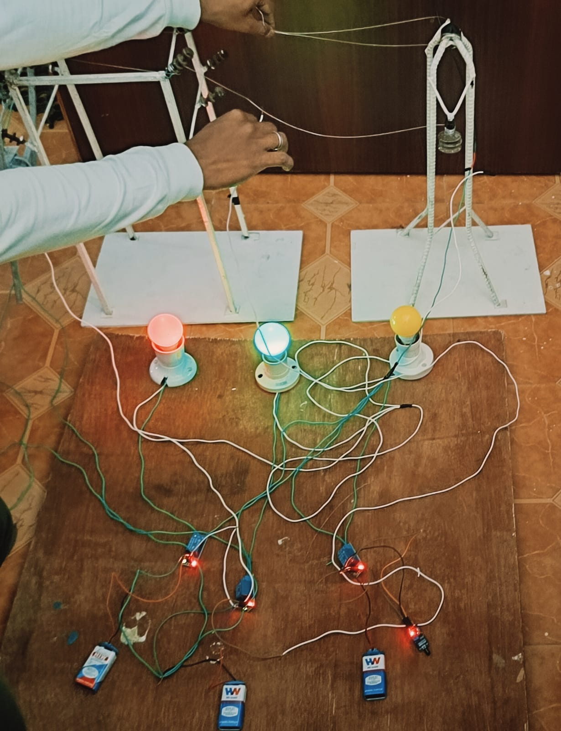
TRANSMISSION LINE FAULT DETECTION
UNDER THE GUIDENCE OF:
Mr. B. Rama vara prasad( ph. Assistatant professor, Department of EEE,LIET)

Slide 3

CONTENTS
INTRODUCTION TO DESIGN THINKING
PROBLEM STATEMENT
EMPTHY
DEFINE
IDEATE
PROTOTYPE
WORKING OF PROTOTYPE
CONCLUSION

Slide 4
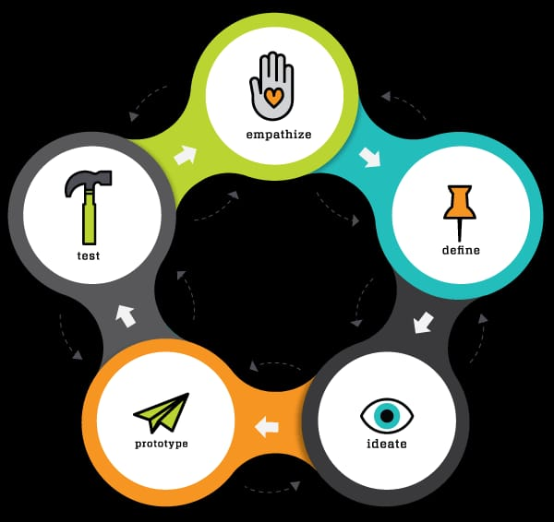
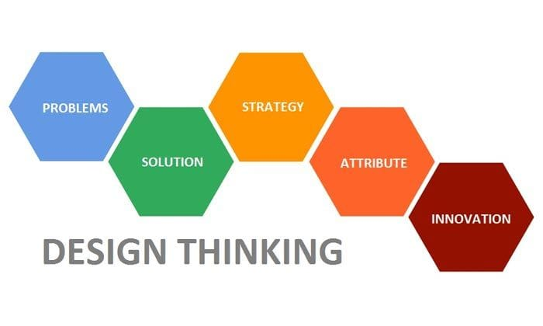
What is meant by design thinking and innovation
Design thinking is a human-centered approach to problem-solving that involves understanding users' needs, empathizing with them, and developing solutions that meet those needs. It's a iterative process that focuses on creating innovative solutions by putting the user at the forefront. By doing so, design thinking encourages creativity, collaboration, and experimentation.

Slide 5

PROBLEM STATEMENT
:
Transmission line faults lead to power outages
And system instability.Current detection methods
Are often slow and inaccurate, resulting in prolonged downtime and increased maintenance costs.

Slide 6

EMPATHY
The implementation of the Transmission Line Fault Detection project using Relay Module, Thermistor Sensor, and Transformer can have significant benefits for society. Some of the key benefits include:
1.Improved reliability of the power system: By detecting faults on the transmission lines in a timely manner, the project can help to prevent power outages and ensure a more reliable power supply to homes and businesses.
2.Reduced energy losses: By detecting and addressing faults on the transmission lines, the project can help to reduce energy losses and improve the efficiency of the power system.
3.Increased safety: By detecting faults on the transmission lines, the project can help to prevent electrical fires and other safety hazards, improving the safety of communities.
4.Improved sustainability: By reducing energy losses and improving the efficiency of the power system, the project can help to reduce greenhouse gas emissions and contribute to a more sustainable future.
5.Cost savings: By detecting and addressing faults on the transmission lines, the project can help to reduce maintenance costs.

Slide 7

DEFINE:
The Transmission Line Fault Detection project is a significant advancement in the field of power systems. The project utilizes a combination of relay modules, thermistor sensors, and transformers to detect faults ontransmission lines and improve the reliability of the power system. The use of these technologies allows for a timely and accurate detection of faults, preventing power outages and ensuring a safe and sustainable power system.The project also brings numerous benefits to society, including reduced energy losses, improved reliability, increased safety, and cost savings. The integration of the project with other systems, and continued advancements in technology, will lead to even greater benefits for society in the future.

Slide 8
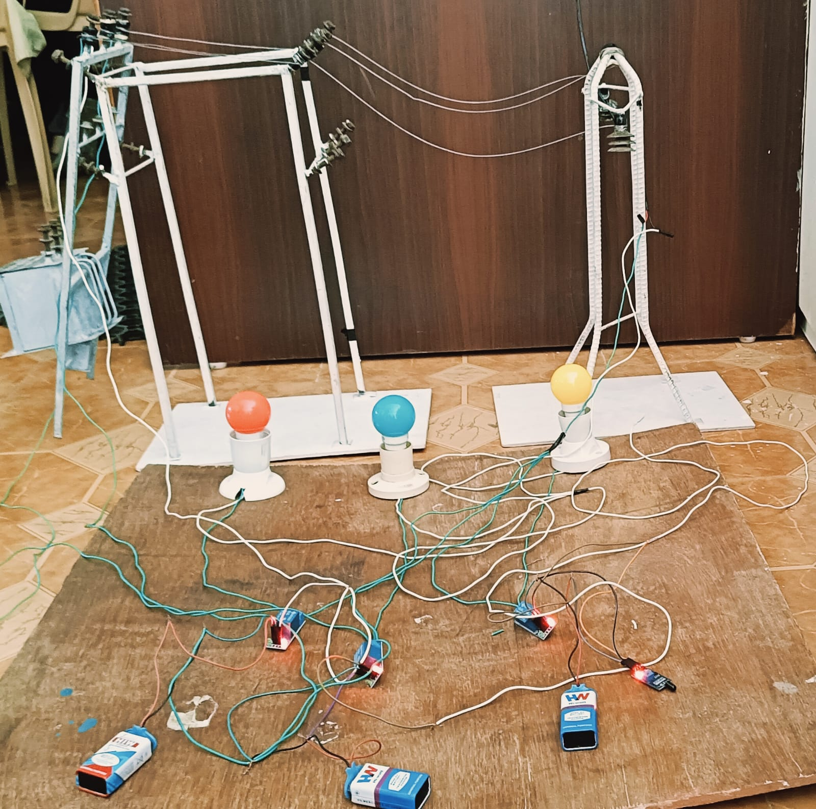
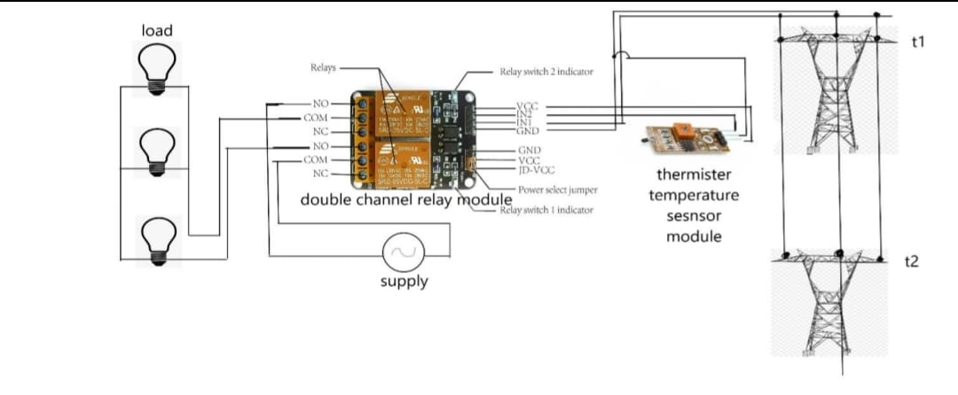
:PROTOTYPE:
:CIRCUIT DIAGRAM:

Slide 9
Equipment List:
Double channel relay module - The relay module is the primary component of the fault detection system. It is used to switch the power supply to the thermistor temperature sensor, based on the fault conditions.
Jumper wire female to female - The jumper wire is used to connect the various components of the system, such as the relay module, the thermistor sensor, and the transformer.
Thermistor temperature sensor module - The thermistor sensor is used to detect the rise in temperature due to the fault in the transmission line. The relay module switches the power supply to the thermistor sensor when a fault occurs, and the thermistor senses the rise in temperature.
Transformer - The transformer is used to step-down the voltage from the transmission line to a level that can be safely handled by the thermistor sensor.
Copper wire - The copper wire is used to make connections between the components of the system and to carry electrical signals.
Steel towers - The steel towers support the transmission line and help to keep it in place.
Three bulb - The three bulb is used to represent the load on the transmission line.
Hard card board - The hard card board is used as a base for mounting the components of the system.

Slide 10
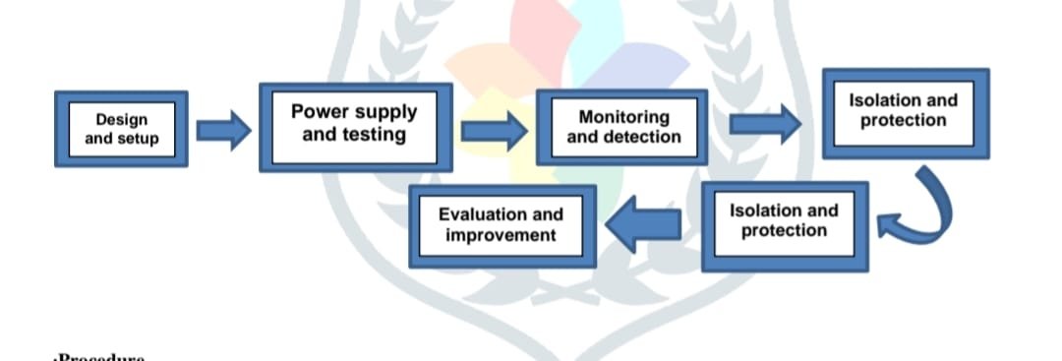
WORKING OF PROTOTYPE:
Normal Operation - When the transmission line is functioning correctly, the relay module does not switch the power supply to the thermistor sensor.
Fault Detection - When a fault occurs in the transmission line, the relay module switches the power supply to the thermistor sensor, and the thermistor senses the rise in temperature due to the fault.
Isolation of Fault - The fault is isolated by switching off the power supply to the affected section of the transmission line.
Repair and Restoration - The repair and restoration of the fault can be carried out after the fault has been isolated.

Slide 11

ADVANTAGES:
Improved Safety
Reduced Energy Losses
Increased Asset Life
Improved Reliability
Improved Maintenance
Cost Savings
Enhanced Monitoring and Control
Improved Sustainability

Slide 12
:CONCLUSION:
In conclusion, the Transmission Line Fault Detection project is a significant advancement in the field of power systems. The project utilizes a combination of relay modules, thermistor sensors, and transformers to detect faults on transmission lines and improve the reliability of the power system. The use of these technologies allows for a timely and accurate detection of faults, preventing power outages and ensuring a safe and sustainable power system. The project also brings numerous benefits to society, including reduced energy losses, improved reliability, increased safety, and cost savings. The integration of the project with other systems, and continued advancements in technology, will lead to even greater benefits for society in the future. Overall, the Transmission Line Fault Detection project is a valuable contribution to the field of power systems, and has the potential to play a significant role in improving the reliability, safety, and sustainability of the power system for years to come. By continuing to advance and improve the technology used in this project, it is possible to create a more efficient, safe, and sustainable power system for future generations

Slide 13

THANK YOU

