Slide 1

Design thinking and innovation
Presented by
G.anjali-23kd1a0233
K.lathika-23kd1a0249
L.tripathi-23kd1a0258
B.ganesh-23kd1a0210

Slide 2
Automatic plant watering system using solar panel
UNDER THE GUIDENCE OF :
Mr. B. Ram Vara Prasad,(ph.d)
Assistant professor,
Department of EEE,
LIET(Autonomous).

Slide 3
Contents
INTRODUCTION TO DESIGN THINKING
PROBLEM STATEMENT
EMPATHY
DEFINE
IDEATE

Slide 4
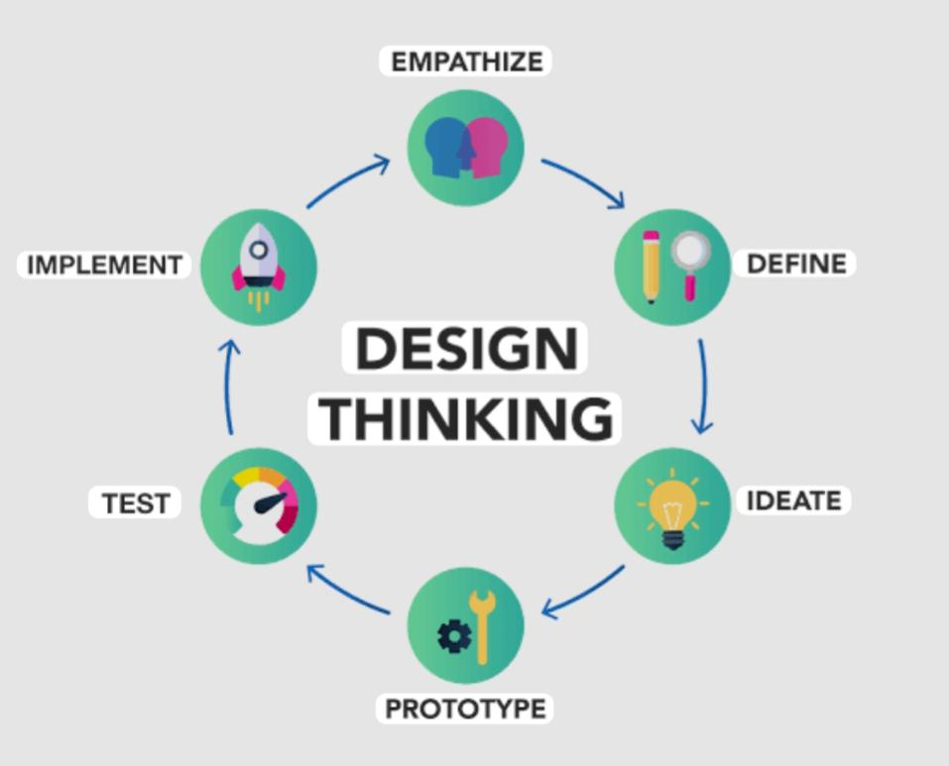
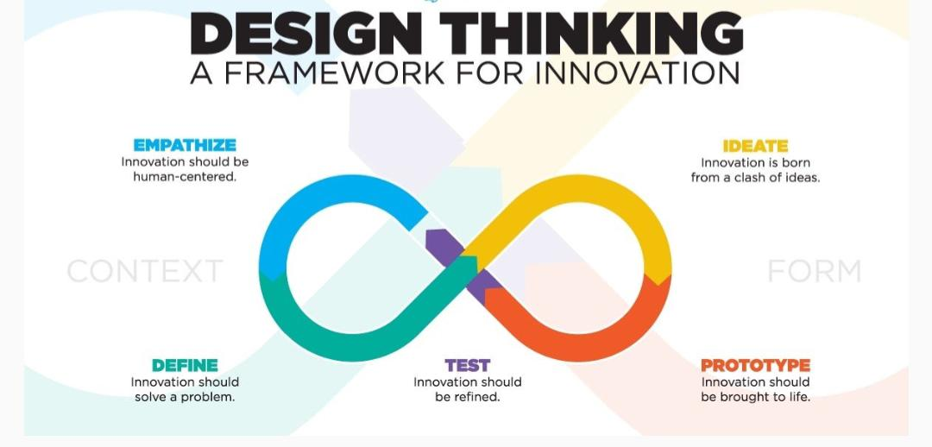
What is meant by design thinking and innovation?

Slide 5
Problem statement
During day to day activities many people often forget to water their plants and thus it becomes challenging for them to keep their plants healthy and alive.
Also it is a challenge for farmers to maintain their fields and manage watering of plants during shortage of water.
Based on the above background, we thought that it is necessary to implement the automated system which will take care of plants considering all the different aspects of home gardening system.

Slide 6
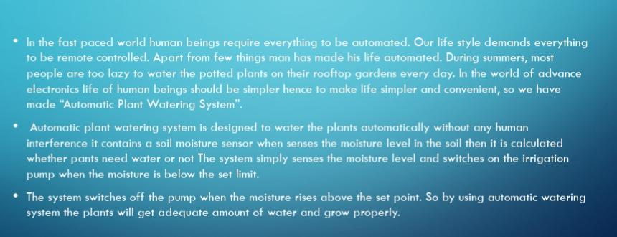
Introduction

Slide 7
Empathy
INTERVIEW QUESTIONS
PERSON’S FEEDBACK

Slide 8
Interview Questions
What type of garden do you maintain?
How often do you water your plants?
What time of the day do you usually water your plants?
How much water do you usually apply to each plant?
What method do you use for watering?
How do you decide when a plant needs water?
Have you faced any challenges with watering?

Slide 9
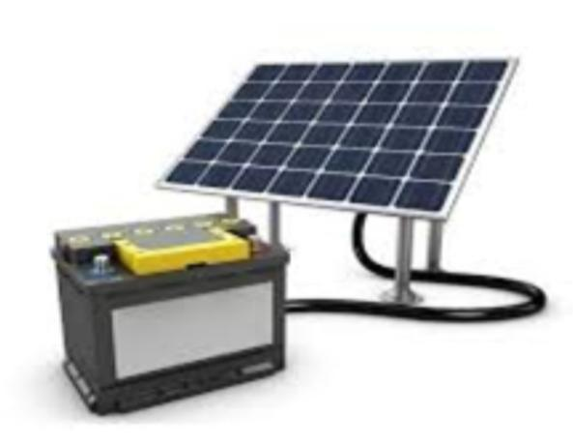
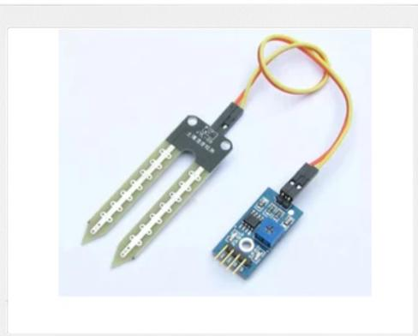
Components used

Slide 10
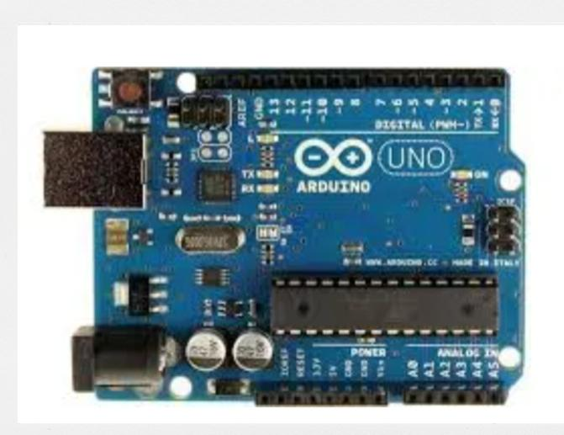
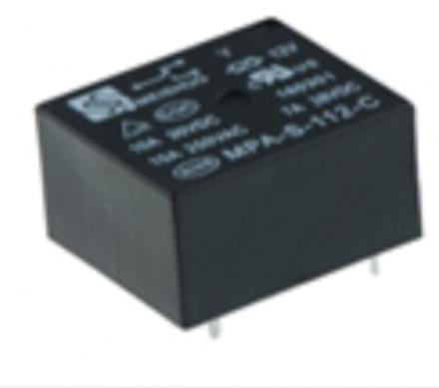
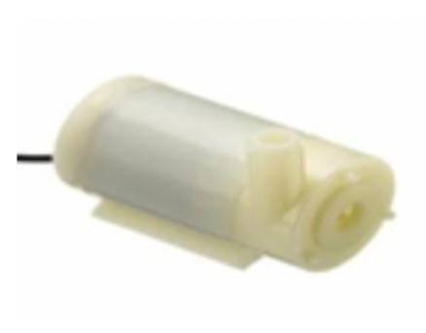
Components used

Slide 11
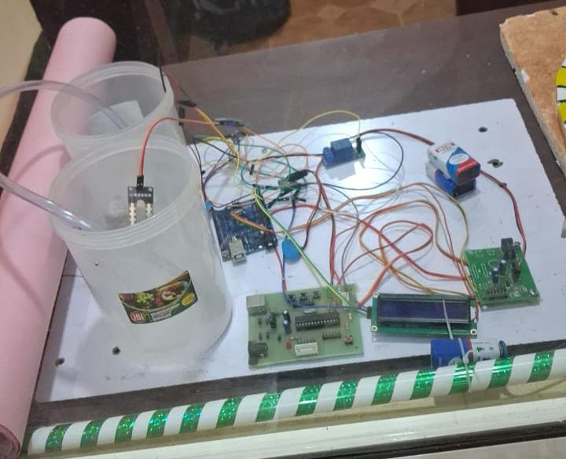
ProTotype

Slide 12
Advantages
Water Conservation
Energy Efficiency
Cost Savings
Improved Plant Health
Environmental Benefits
Reliability

Slide 13

Disadvantages
Sunlight dependency
Power storage limitations
Maintenance challenges
Weather dependency
Technical expertise

